Slide 1
What You Need to Know: iOS 10 Security
Joshua Wright

Slide 2
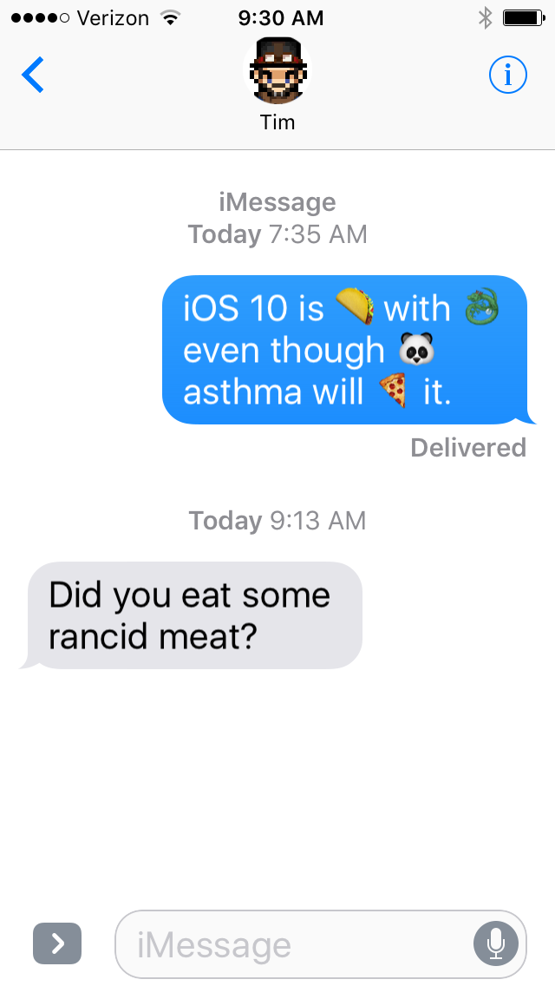
Introduction
About iOS 10
Unencrypted IPSW Access
Network Transport Security
Siri App Integration
Messages App Integration
Differential Privacy
The Missing Fixes

Slide 3
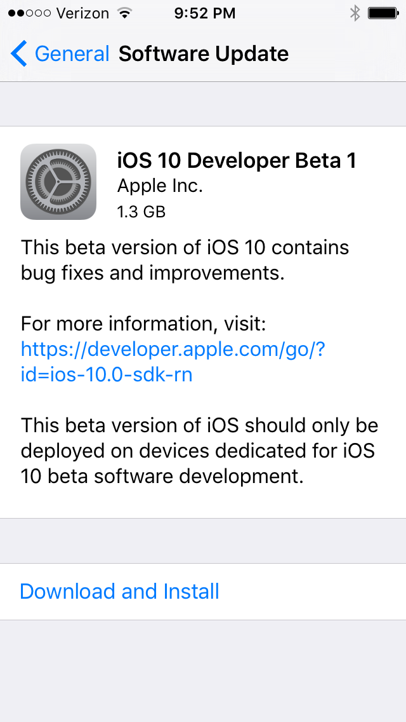
iOS 10
Announced at WWDC 6/13/2016
Currently in Beta 1 cycle for developers
Public beta expected in July
Public release in Autumn 2016
Combination of new APIs and user interface features
"This is the biggest iOS release ever for our users"
Craig Federighi, Apple Senior VP of Software Engineering

Slide 4
Unencrypted Kernelcache, File System Data
IPSW package for 64-bit iOS 10 Beta 1 does not encrypt Kernelcache, file system data
  Kernelcache is the kernel and kernel extensions (Kext) in one file
  Typically encrypted with device type-specific IV and key, required jailbreak to decrypt update files
Simplifies kernel data access for bug finders (a little, finding and exploiting kernel bugs is still hard)

Slide 5
Retrieve Unencrypted File System Data
$ wget -q http://apple.co/28R9rhS -O ios10beta1-iphone6s.zip
$ mkdir ios10beta1
$ unzip -q ios10beta1-iphone6s.zip -d ios10beta1
$ cd ios10beta1
$ # wget this file for OSX systems
$ wget http://newosxbook.com/files/OTApack.tar
$ # or wget this file for Linux systems
$ wget http://www.willhackforsushi.com/code/OTApack.tar
$ tar xf OTApack.tar
$ ./pbzx AssetData/payloadv2/payload >payload.xz 2>/dev/null
$ mkdir rootfs ; mv payload.xz rootfs/
$ cd rootfs/
$ unxz payload.xz # install unxz for Mac from http://macpkg.sourceforge.net/
$ ../otaa -e '*' ./payload
$ ls
Applications/ System/ etc private/ tmp
Library/ bin/ payload sbin/ usr/
$ ls Applications/
#images.app/ MobileSafari.app/
AACredentialRecoveryDialog.app/ MobileSlideShow.app/
Download this script or
cut-and-paste from gist.github.com/joswr1ght
Works on OS X and Linux

Slide 6
Retrieve Unencrypted Kernelcache
$ # Skip these first three steps if you've already downloaded the zipped IPSW package
$ wget http://apple.co/28R9rhS -O ios10beta1-iphone6s.zip
$ mkdir ios10beta1
$ unzip -q ios10beta1-iphone6s.zip -d ios10beta1
$ cd ios10beta1
$ wget http://nah6.com/%7Eitsme/cvs-xdadevtools/iphone/tools/lzssdec.cpp
$ g++ -o lzssdec lzssdec.cpp
$ # 439 is offset byte count to the Mach-O 64-bit header 0xFFCFFAEDFE
$ ./lzssdec -o 439 < AssetData/boot/kernelcache.release.n71 >kernelcache.decrypted
$ xxd kernelcache.decrypted | head -1
0000000: cffa edfe 0c00 0001 0000 0000 0200 0000 ................
$ file kernelcache.decrypted
kernelcache.decrypted: Mach-O 64-bit executable/
Download this script or cut-and-paste from gist.github.com/joswr1ght
Works on OS X and Linux

Slide 7
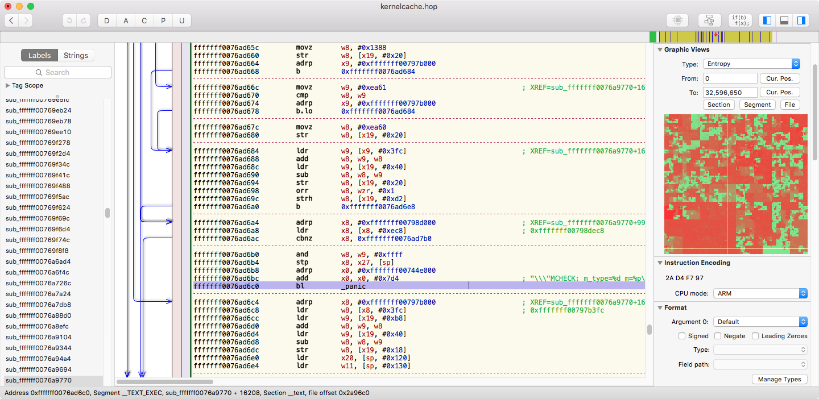
http://www.hopperapp.com, $89 for a Personal License.

Slide 8
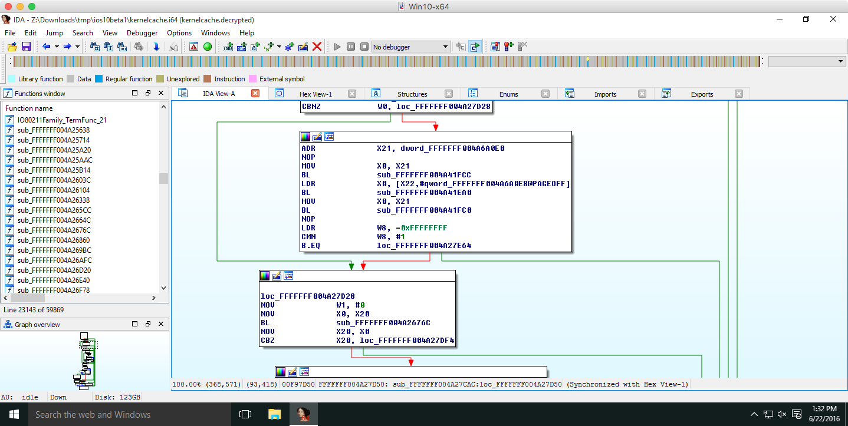
https://www.hex-rays.com/products/ida, $1129 for a Personal License (it does a lot more than Hopper)

Slide 9
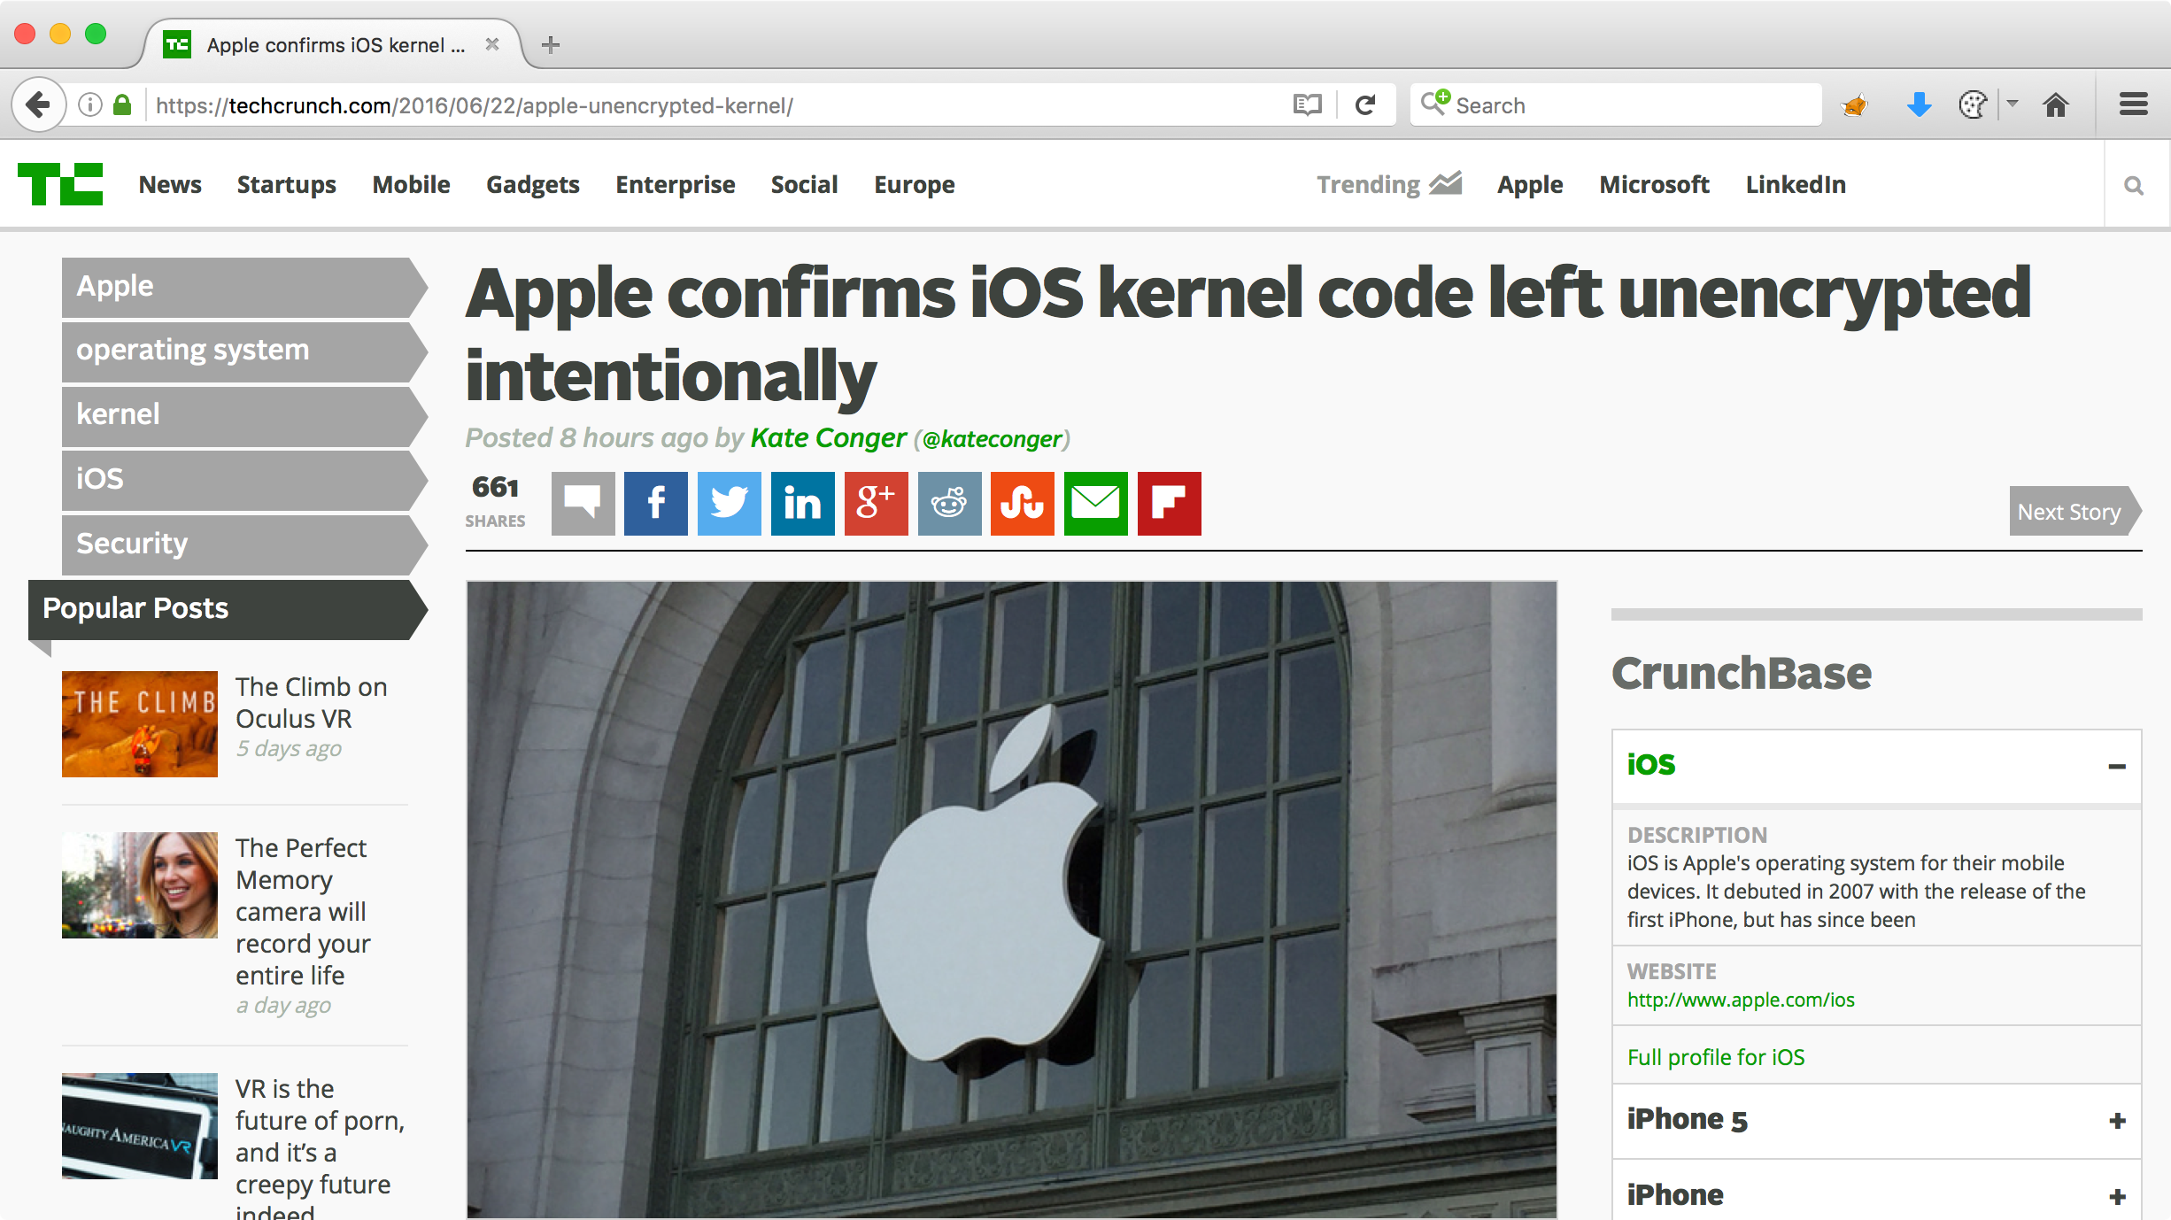

Slide 10
“The kernel cache doesn’t contain any user
info, and by unencrypting it we’re able to
optimize the operating system’s performance without compromising security,” an Apple spokesperson told TechCrunch.
https://techcrunch.com/2016/06/22/apple-unencrypted-kernel/

Slide 11

It’s completely intuitive, genuinely beautiful, and simply magical…
THAT SOMEONE IS TOTALLY GETTING FIRED OVER THIS.

Slide 12
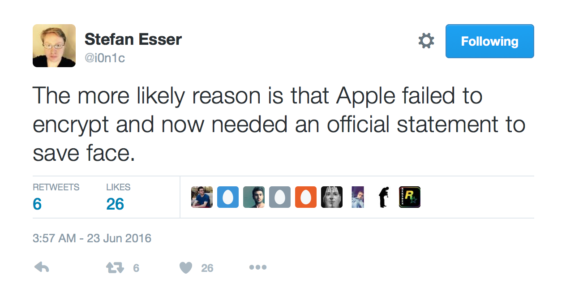
Unencrypted Kernel Notes
Apple has not released an unencrypted kernel since iOS 5
Apple retained encryption in the 32-bit release (only 64-bit kernel was unencrypted)
Probably oversight, but it's not really that big of a deal

Slide 13
App Transport Security (ATS) Enforcement
Introduced in iOS 9, required HTTPS with TLS/1.2
  Applies to NSURLSession and NSURLConnection libraries
  App developers can specify exceptions to ATS policy in Info.plist
Following 12/31/2016, all apps must use ATS
  Exceptions permitted by Apple for bulk encrypted streaming media
"At the end of 2016, Apple will make ATS mandatory for all developers who hope to submit their apps to the App Store"
Ivan Krstic, Apple Head of Security Engineering & Architecture

Slide 14
Top 20 Free iOS Apps (6/23/2016)
Snapchat
Messenger
Instagram
iTunesU
YouTube
Slither.io
Facebook
Google Maps
Netflix
Pandora
Uber
Spotify
WhatsApp
Pinterest
Gmail
Twitter
Google App
Amazon
Waze
Kik
Notes:
Top 20 apps taken from the iOS App Store "Top Charts/Free" list, presented here in no particular order.

Slide 15
Top 20 Free iOS Apps Using HTTP (6/23/2016)
Messenger
Instagram
iTunesU
Slither.io
Netflix
Pandora
Uber
Spotify
WhatsApp
Pinterest
Amazon
Waze
Kik
Notes:
65% of the top 20 free apps, 13 out of 20

Slide 16
App Transport Security Considerations
It's not clear what will happen on 1/1/2017
  Will existing apps using HTTP be removed? Will apps using HTTP crash? Will apps continue to work over HTTP until an update?
ATS applies to NSURLSession/NSURLConnection, but not CFStream (socket) connections
  Can developers use low-level libraries for HTTP to evade ATS enforcement?
Will high-profile apps be granted exceptional exceptions?
  Can Instagram, Netflix, Pandora, Spotify, Amazon, etc., transition everything to TLS/1.2 by the end of the year?
Notes:
More information on iOS 10 and App Transport Security available at https://developer.apple.com/videos/play/wwdc2016/706/.

Slide 17
Other Networking Changes
For ATS, Apple will require TLS/1.2, AES-128, SHA-2, Forward Secrecy (ECDHE)
  Automatic exception for Forward Secrecy (ECDHE) due to lack of widespread deployment
RC4, SSLv3 disabled by default for networking APIs
  3DES and SHA-1 slated for future deprecation
New support for Certificate Transparency to defeat compromised CA attacks (without having to do cert pinning)
New support for OCSP stapling (faster CRL checking, no disclosure of client data to CA)
Notes:
Lucia Ballard, Secure Transports Engineering Manager
Online Certificate Status Protocol Stapling instructions: https://www.digicert.com/enabling-ocsp-stapling.htm
https://developer.apple.com/videos/play/wwdc2016/705
https://developer.apple.com/videos/play/wwdc2016/706/

Slide 18
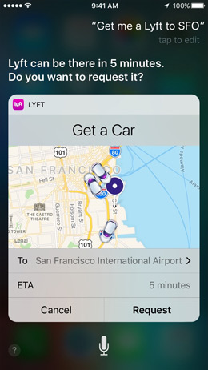
Extending Apps with SiriKit
iOS 10 introduces SiriKit, opening Siri integration into third-party apps
Apple will limit initial access to ride booking, messaging, photo searching, payments, VoIP calling and workout apps
Siri is accessible on locked devices by default
Interesting opportunity for lock screen bypass vulnerabilities in SiriKit applications
“Send $100 to John for dinner last night using MyPayApp.”
“Start my daily run workout from MyWorkoutApp.”
“Set the heater to 72 degrees.”
“Tell Skynet to go easy on me when the machines take over.”
I added this one.
Source: www.apple.com/ios/ios10-preview
Notes:
I added the last Siri example.

Slide 19
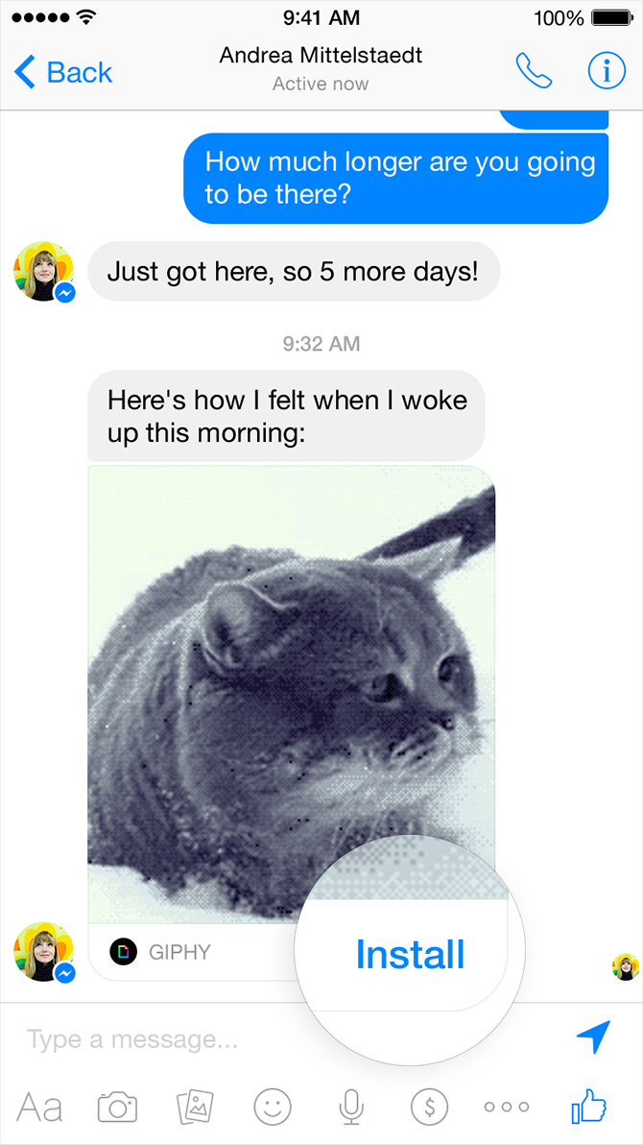
iMessage Apps
New APIs for developers to create custom apps from iMessage
Enhance messaging with animated GIFs, videos, embedded app functionality, full screen effects...
  Also payments, obtaining services, social media, etc.
Not unlike the popular WeChat app which offers WeChatPayments, City Services, Moments, etc.
  Android has long offered developers messaging APIs; potential for similar misuse on iOS
Photo credit: apple.com
Notes:
It will be interesting to see how iMessage-centric apps are received, versus the chat bot-style of messaging where you don't install Uber on your phone, but can still hail a driver by texting Uber with "Send a driver to 8 Abbott Park Place, Providence, RI".

Slide 20


Statistical Data Anonymization Fail
Companies collect data about users, building statistical databases
  Database is essential for improving products, but can reveal sensitive data
Data anonymization provides insufficient protection against external data correlation (Netflix Prize)
Customer Record
cust=121
lname="Wright"
fname="Joshua"
date=6/18
rating=4
title="Insidious"
cust=352
lname="Wright"
fname="Joshua"
date=6/18
rating=4
title="Insidious"
352, 6/18, 4, "Insidious"
"Joshua Wright", 6/18, 4, "Insidious", "Great movie!"
"Joshua Wright", 6/23, 3, "Insidious 2", "Meh"
"Joshua Wright", 6/23, 1, "Insidious 3", "What???"
352, 6/22, 3, "Insidious 2"
352, 6/23, 1, "Insidious 3"
352, 6/29, 4, "Annabelle"
352, 6/29, 5, "Sinister"

Slide 21
Differential Privacy
Differential privacy permits large dataset inference without individual record attribution
  Your data is recorded, but it can't be attributed to you
Injects "mathematical noise", hashing, subsampling, and random data to collected information
Apple will apply to QuickType, emoji suggestions, Spotlight link suggestions, and Lookup Hints in Notes
  “Differential privacy lets you gain insights from large datasets, but with a mathematical proof that no one can learn about a single individual.”
  Aaron Roth, co-author of The Algorithmic Foundations of Differential Privacy
Notes:
Starting with iOS 10, Apple is using technology called Differential Privacy to help discover the usage patterns of a large number of users without compromising individual privacy. In iOS 10, this technology will help improve QuickType and emoji suggestions, Spotlight® deep link suggestions and Lookup Hints in Notes.

Slide 22
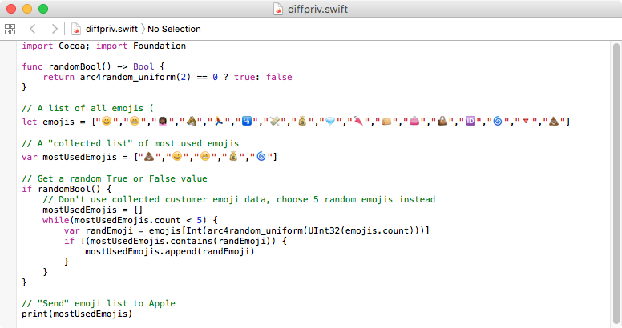
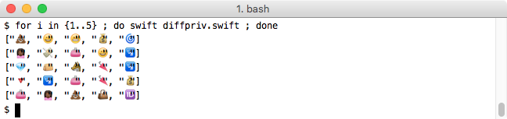
This code is not an implementation of differential privacy, it's just an illustration.

Slide 23
Uhh, Yay? Who Am I Protecting My Data From?
"Apple already has lots of my data, who cares if they can attribute my personal emoji preferences?"
If Apple gets hacked, then your personal data is exposed
If Apple is compelled to turn over your data to US LEA, ...
If Apple is compelled to turn over your data to a foreign .gov, ...

Slide 24
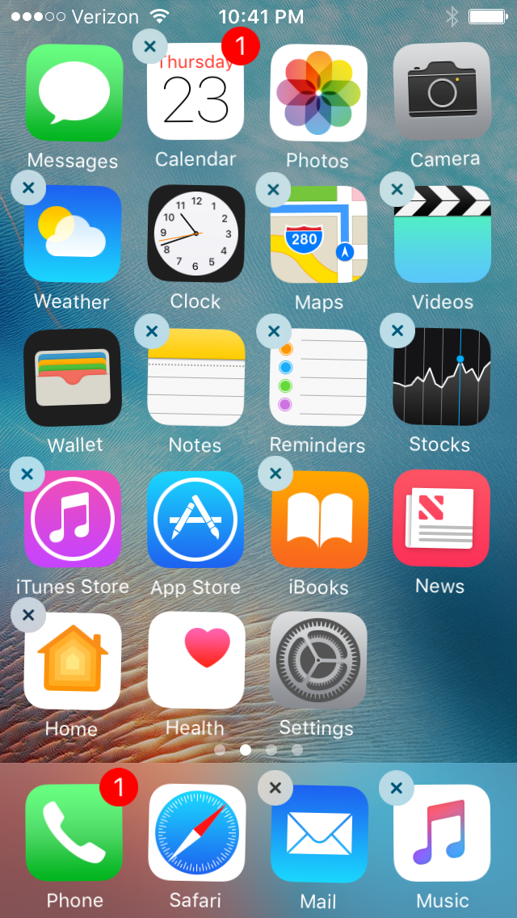
Other Security-related Items of Note
Removing built-in apps
New APFS, not scheduled for iOS 10 initial release
UIPasteBoard sharing across devices with Handoff
Deprecation of iPhone 4s, iPad 3 update support
New Home App for home automation systems
Enhanced detail and 3D Touch actions from lock screen
Phone call spam filtering API
Integrated VoIP dialer, full-screen phone support

Slide 25
Missing from iOS 10 Announcement
No support for encrypted iCloud data
  Only protected with Apple ID password; can be accessed by Apple (and LEA or attackers)
No Apple System Log security enhancements
  Any app on iOS can read and harvest content from (unlike Android's android.permission.READ_LOGS permission)
No clipboard data sensitivity controls
  Any app on iOS can read and change the contents of the clipboard
  I have no idea how to fix this; password managers worry me
Vague uneasiness about coarse permission management

Slide 26
Conclusion
iOS 10 public release in Autumn 2016
Unencrypted kernelcache and file system fun, but not a big threat
ATS will be hard for many developers, but positive for security
Improved ciphers and hashing choices, certificate transparency and OCSP stapling will improve security
SiriKit may open new attack opportunities from locked devices
iMessage enhancements and apps will require new analysis
Differential privacy a forward-thinking enhancement to data collection

Slide 27


SEC575: Mobile Device Security and Ethical Hacking
SANS | San Jose 2016
July 25th – July 30th
SEC575
GIAC – GMOB Certification
w/ Chris Crowley
SANS | Boston 2016
Aug 1st – 6th
SEC575
GIAC – GMOB Certification
w/ Joshua Wright
www.sans.org/sec575
"Directly useful training, both to pen testers & developers." - Roy Cabaniss, LGS
"New lab format is fantastic." - David Lavezzo, Capital One
"This is a great course for getting skilled at pentesting mobile applications." - Ben Brucker, Madison Gurkha

Slide 28

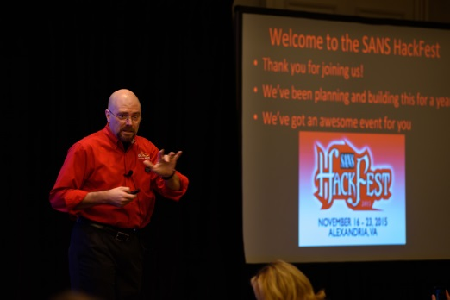

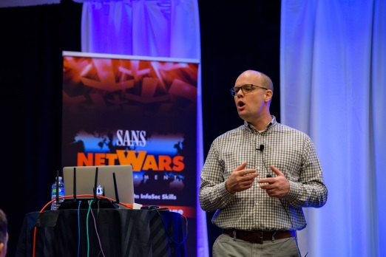
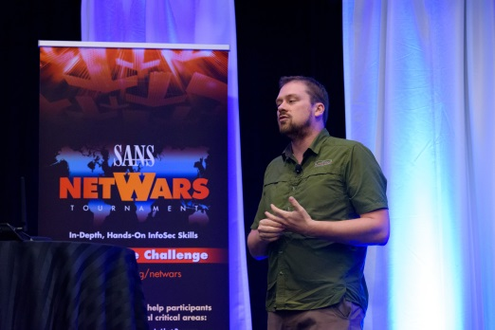

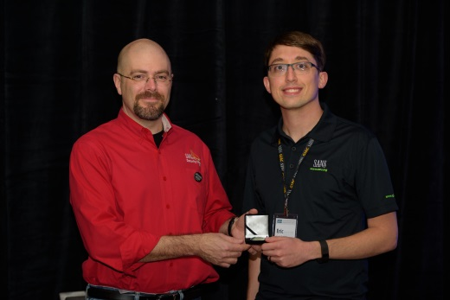

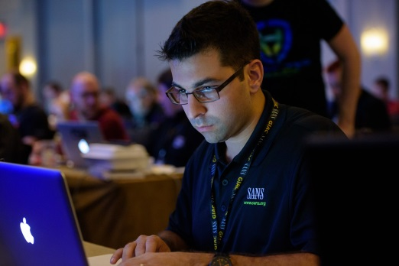




Summit Dates: November 2-3, 2016
Training Course Dates: November 4-9, 2016
Learn more at: sans.org/hackfest

Slide 29




RESOURCES AND CONTACT INFORMATION
AUTHOR CONTACT
Joshua Wright
jwright@willhackforsushi.com
Twitter: @joswr1ght
SANS INSTITUTE
8120 Woodmont Ave., Suite 310
Bethesda, MD 20814
301.654.SANS(7267)
PEN TESTING RESOURCES
pen-testing.sans.org
Twitter: @SANSPenTest
SANS EMAIL
GENERAL INQUIRIES: info@sans.org
REGISTRATION: registration@sans.org
TUITION: tuition@sans.org
PRESS/PR: press@sans.org

