Slide 1
Writing Tech: Stories from the Field
Writing Tech: Stories From the Field
Joshua Wright
jwright@willhackforsushi.com
Notes:
Writing Tech: Stories from the Field
This presentation is available at http://www.willhackforsushi.com/presentations/WritingTech.pptx. Please contact me with any questions. Thanks!

Slide 2
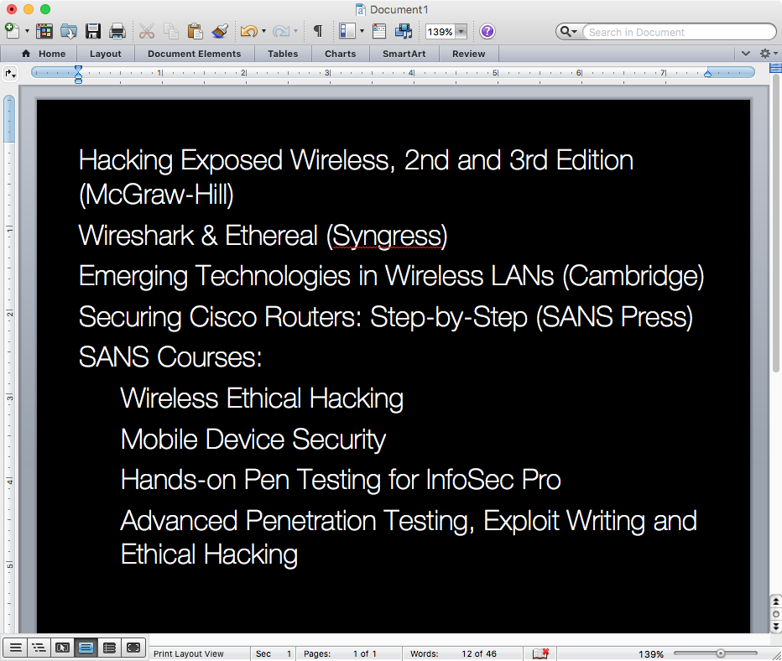
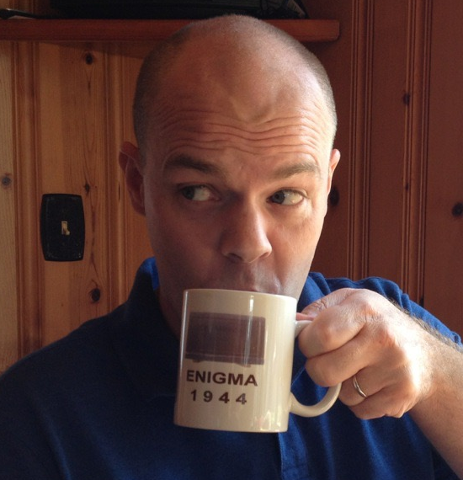
Notes:
My name is Joshua Wright. I am a hacker, and I am a writer.
I've been writing professionally since 2003 when Network World starting paying me for contributing a regular column. Since then I've written a handful of books (independently or with co-authors) and I've worked with several different publishers. I do most of my writing for the SANS Institute, where I have worked on several courses and taught those courses to thousands of students.
I know a thing or two about writing. I put together this presentation to persuade you to do something. I'll get to that in just a minute.

Slide 3
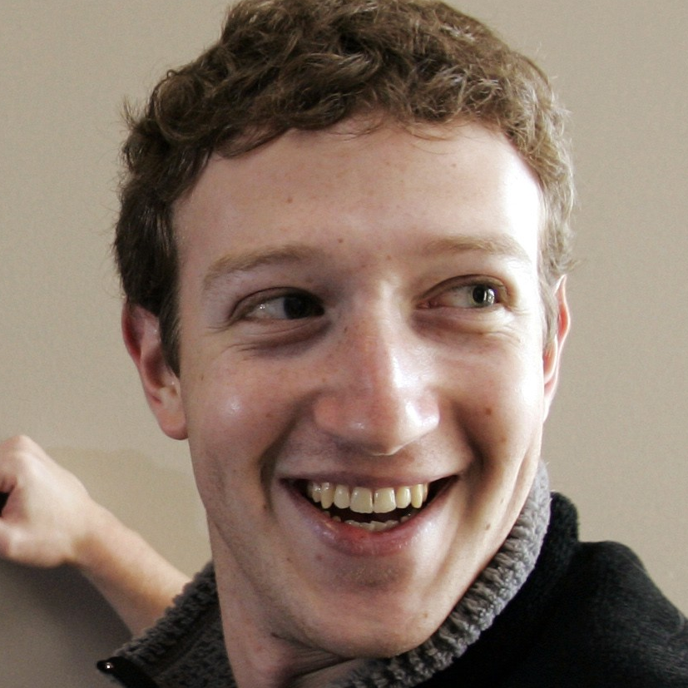


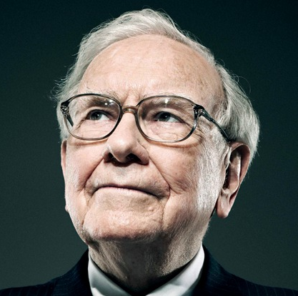
They read. A lot.
Notes:
What do Mark Zuckerberg, Bill Gates, Elon Musk, and Warren Buffet have in common? They are all billionaires. And, they all read, a lot, and have confessed that reading and the pursuit of knowledge is a large part of what makes them successful.
In fact, Warren Buffet has said that he spends 80% of his days reading (http://theweek.com/articles/460783/warren-buffett-formula-how-smarter). This article from The Week indicates that, when asked how to get smarter, Buffett once held up stacks of paper and said "read 500 pages like this every day."
I believe completely in the power of reading. I want my kids to be life-long learners, and lead by example by reading every day.
But, I think there is something even more powerful than reading. It's so powerful, that it can be used to influence all of the powerful people shown on this very page.

Slide 4
I Want You to Write.
I want you to write
Notes:
I want you to write. Writing can happen for magazines, trade journals, academic papers, or books (in this presentation, I'll focus mostly on writing books).
Why you ask? Because you are amazing. Really. Just by showing up to this talk (or reading as far as page 4 of this presentation) you've demonstrated more initiative than your colleagues.
Because we need more people who are not only smart about information security, but can also COMMUNICATE with other people.
And we desperately need great communication in our field.

Slide 5
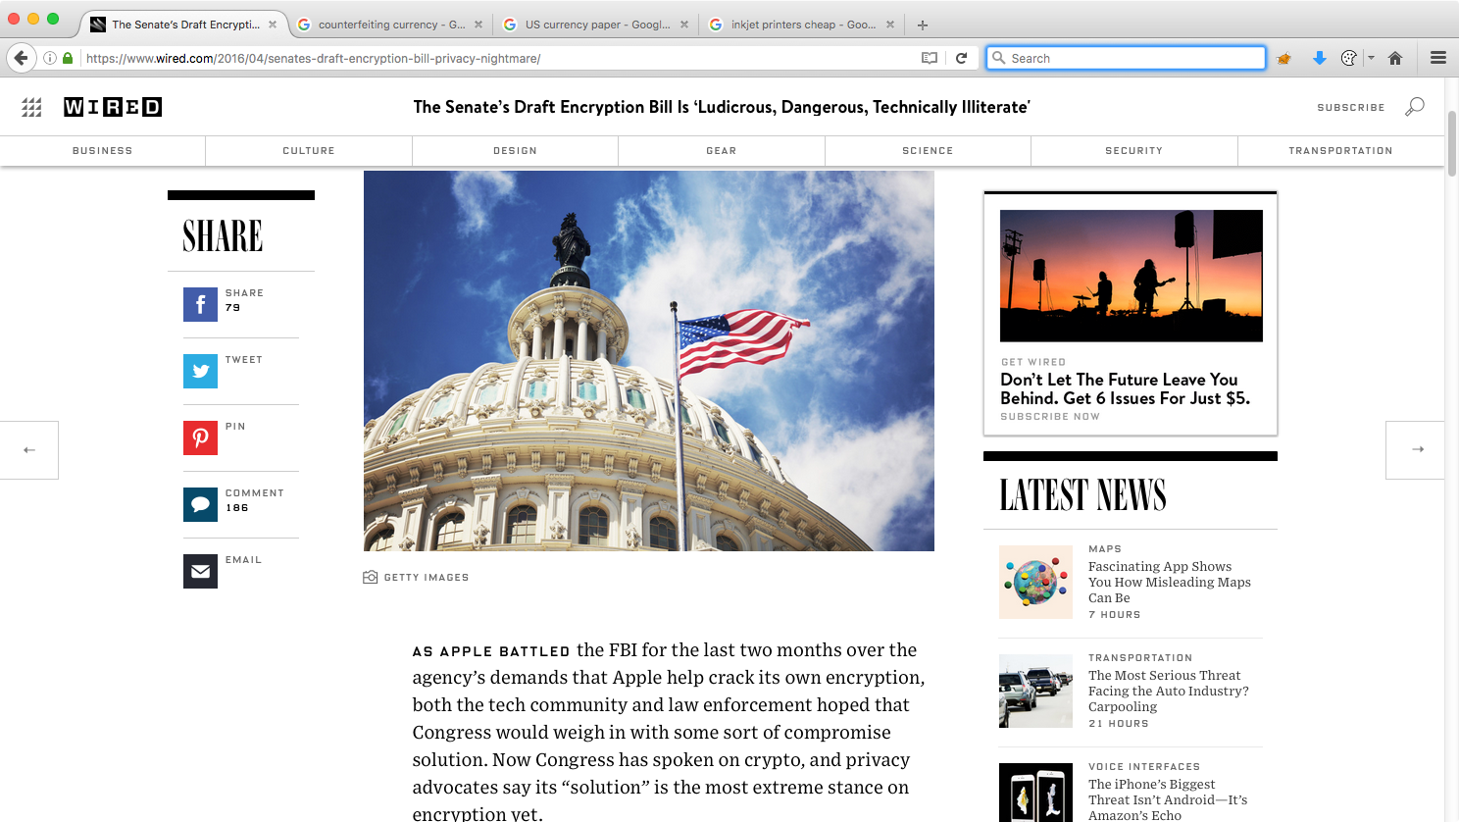
Notes:
If you've been keeping up with the SANS Newsbites newsletter (https://www.sans.org/newsletters/newsbites/) or popular media you've certainly heard about the FBI vs. Apple Corporation legal drama. Essentially, the US Department of Justice sought an injunction against Apple to unlock an iPhone 5c belonging to Syed Farook who was killed in a shootout with police after he launched an attack that killed 14 people in San Bernardino, CA. The publicity surrounding this case prompted legislators Richard Burr and Dianne Feinstein to draft the Feinstein-Burr Senate Encryption Bill (named "Compliance with Court Orders Act of 2016", available at http://www.feinstein.senate.gov/public/index.cfm?a=files.serve&File_id=5B990532-CC7F-427F-9942-559E73EB8BFB or http://tinyurl.com/j4f7r7e), requiring that "companies engineer vulnerabilities into their products" (http://www.recode.net/2016/4/13/11586108/feinstein-burr-senate-encryption-bill).

Slide 6
"In my nearly 20 years of work in tech policy this is easily the most ludicrous, dangerous, technically illiterate proposal I've ever seen"
Kevin Bankston, director of the Open Technology Institute
Notes:
The draft encryption bill was quickly lambasted by many, including this quote from Kevin Bankston. an attorney for the ACLU, EFF, and now at New America in the Open Technology Institute, as published by Wired Magazine (https://www.wired.com/2016/04/senates-draft-encryption-bill-privacy-nightmare/). When people saw that this draft bill was bad for users, they spoke up against it. In writing.

Slide 7
We need people who understand technology to share their knowledge.
* That's how we grow and mature our industry.
Notes:
We need people who understand technology to share their knowledge. The collective knowledge and skills of the people hearing or reading this presentation is incredible. Through writing, you can take that knowledge you have amassed through hard-earned experience and share it with others, influencing public policy and your contemporaries.
By sharing our collective knowledge, people can build upon the information and continue to innovate. That's how we grow and mature our industry.
You might say, "Yes, yes, this is great Josh. We're glad you want us to grow and mature our industry, but what is my motivator?"
That is an excellent question.

Slide 8
Career exploration – immersion in a topic allows you to clearly identify:
Is this field for me?
Notes:
Writing is an excellent path for career exploration. If you are interested in pursuing a career in a field, be it as a programmer, penetration tester, incident response analyst, writing on that topic will require you to immerse yourself in the field. Immersion on such a topic will allow you to clearly identify, "is this field for me?"
In college, nothing brings more complaints than the incessant term paper writing requirements. I used to think that assigning term papers was just the act of masochistic professors who like to see students flag and flail. Now I know better.
When I started my academic career as a freshman, I pursued a degree in marketing. In my first year of college, I wrote over 20 papers on topics including strategic differentiation for market analytic analysis, heterogeneous sales force compensation models, brand influence and retransmission intentions, and net present value market analysis for interdependent ideation development.
Through writing I learned an important lesson that I continue to thank my marketing professors for today: marketing is not for me. At the same time, my Computer Studies 101 course term paper, Exploitation of CGI Interface Applications over HTTP told me more than how to exploit faulty code on Linux boxes: I wanted to learn more about hacking.

Slide 9
Writing is a huge learning opportunity.
Notes:
I think a lot of people have the mistaken impression that a writer endeavors to write a book, already knowing everything that he will put into that book. In my experience, this is never the case, and the very process of writing is a huge learning opportunity. Couple the nature of having a deadline for the delivery of material as a motivator, committing to writing on a topic will force you to learn the material beyond your current understanding. This added knowledge can be very valuable beyond the development of material, supporting your work as an analyst as well.

Slide 10
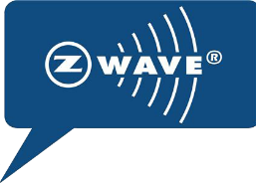
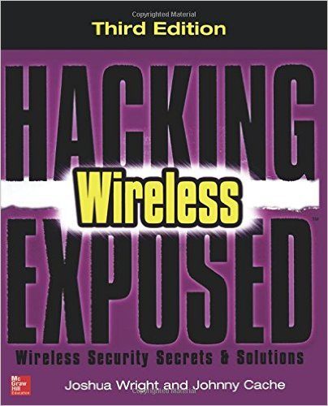

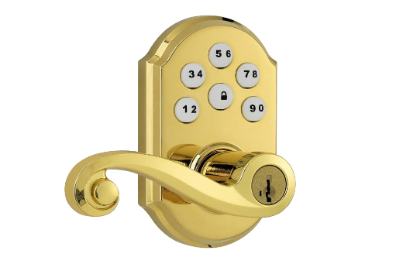
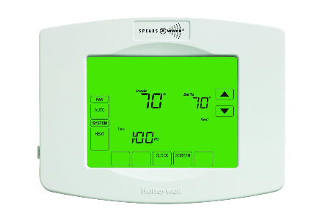
Outline: Hacking Exposed Wireless 3rd Ed.
I'll write about hacking Z-Wave
Crap, there are no tools to analyze Z-Wave!
Huh,
Z-Wave is a black box no one has analyzed
Hack, hack, hack (~3 months)
Notes:
When I was working on Hacking Exposed Wireless 3rd Edition, I had a great idea: I'll write about hacking the Z-Wave wireless protocol used in smart home systems. I didn't see any other books covering that topic, so I thought it would be a great way to differentiate the book from others and help promote it after publication. So, I put together an outline which my editor loved, including a chapter on hacking Z-Wave, something that has never been covered before.
When it came time to write that chapter, I started researching the attacks and security analysis of Z-Wave, only to make an unsettling discovery: there were no tools to analyze Z-Wave. Also, Z-Wave is a big black box that no one has analyzed or spoken about publicly (with one exception) due to the requirement of signing an NDA to get access to the Z-Wave specification.
So I emailed my editor and asked for an extension on that chapter deadline. Three months (and two deadline extensions) later I turned in my chapter, complete with documentation for the new KillerZee attack platform I developed while researching material for the chapter. During my analysis, I reverse-engineered Z-Wave devices, developed custom software and firmware to produce a wireless sniffer and packet injection device, and successfully exploited Z-Wave thermostats, door locks, and smart light bulbs.
Had it not been for the writing assignment and deadline, I probably would not have completed the research needed to really understand the operation of Z-Wave devices.

Slide 11
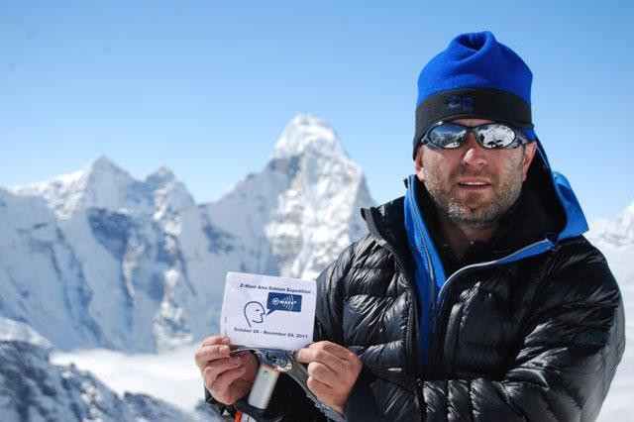
"The [Z-Wave] Alliance sponsored a Himalayan expedition where climber Mariusz Malkowski summited Cho Oyu, the sixth highest mountain in the world."
"... at the 26,906 foot peak, he [...] pulled up his Z-Wave control screen and promptly locked and unlocked the Kwikset deadbolt, raised the temperature on the Remotec thermostat and turned on the Fibaro lights."
http://www.digitaltrends.com/home/smarten-dumb-house-z-wave-automation
Notes:
Shortly thereafter, I saw a press release from the Z-Wave Alliance. While they never acknowledged the vulnerabilities I discovered in the platform, they did hire a Himalayan mountain climber to summit Cho Oyu, then promptly pull out his Z-Wave control panel and remotely lock and unlock doors, change the temperature of a location with a Z-Wave thermostat, and turn Z-Wave lights on and off.
I thought, "Wow, Malkowski climbed almost 27,000 feet and was able to control a Z-Wave smart home from the sixth highest mountain in the world."

Slide 12
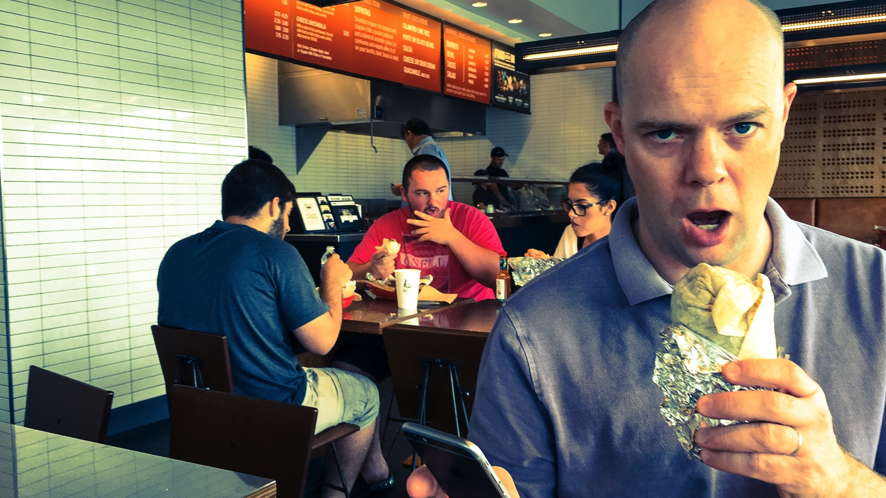
Notes:
I just hack it from Chipotle.

Slide 13
Access to new communities.
Notes:
Few things can open up doors to access resources than "I'm writing a book." (OK, money is pretty good, but being a writer isn't a bad 2nd).
When you say "I'm writing a book", people will assign you credibility, and vendors want to be part of what you're doing. Warranted or not, book authors hold a position of respect and trust, which vendors can't buy.

Slide 14
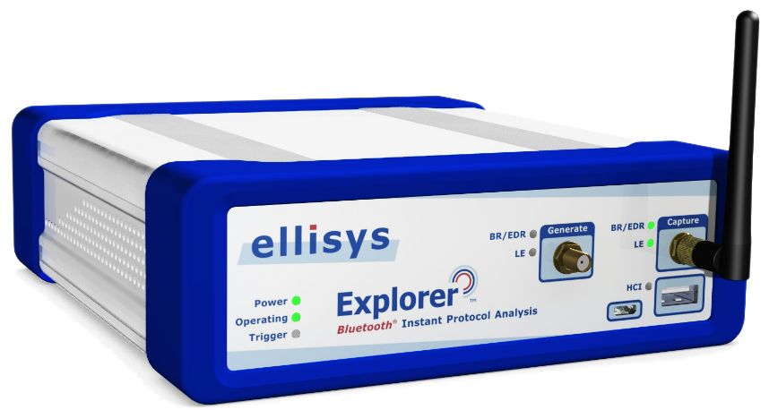
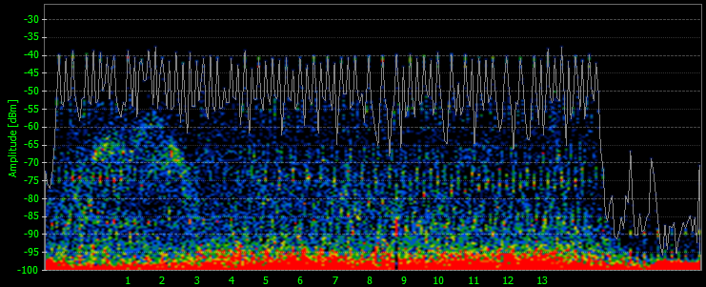
If you are a Bluetooth hacker, there is no tool better than the Ellisys Bluetooth Explorer 400.
$150,000
Notes:
If you are a Bluetooth hacker, there is no better tool you can buy than the Ellisys Bluetooth Explorer 400 (BEX400) product. Since Bluetooth uses Frequency Hopping Spread Spectrum across an 80 MHz channel, it is notoriously difficult to get a reliable packet capture. Unlike many Bluetooth sniffer products that try to channel hop along with a transmitter, the BEX400 uses several wideband radios to capture the entire channel spectrum simultaneously, process the captured data, and deliver Bluetooth packets to a PC application for easy analysis.
The BEX400 is an amazing tool. There's just one problem. It's $150,000 (MSRP). It's a little out of my budget for weekend-spending-money.
Regardless, I wanted to use it. I had analysis I wanted to complete and I needed a reliable packet capture source. Inexpensive tools such as the Ubertooth of the Texas Instruments Bluetooth Low Energy sniffer just couldn't do what I needed. So I called up Ellisys. I told them I was writing a book, and wanted to spend some time on their product. They sent me a demo unit, and let me keep it for 6 months.
Those 6 months were a lot of fun.

Slide 15
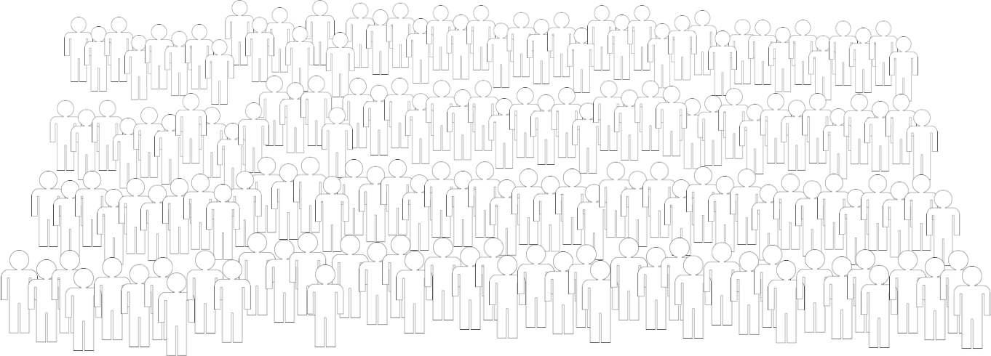

Differentiation among a sea of peers.
Notes:
Differentiating yourself from your peers is a touchy subject, yet a necessary one. We don't like to talk about differentiating the individual because we're taught to work together, and that the collective power of the team is greater than the sum of its parts. While true, we should also be motivated to promote ourselves as individuals. Selfishly, promoting yourself will help you earn promotions, more pay, and more exciting, engaging work. Self-promotion isn't just selfish though. By promoting yourself and getting recognized as a leader, or as someone demonstrating truly exceptional skill, dedication, and aptitude, you can earn a better spot on the a team that improves the overall team success as well.
There are some powerful motivators for why you should write. To be fair though, there are powerful motivators on why you should not write too.

Slide 16
NO
"I have a lot of time on my hands and want to make a meaningful contribution in the world."
* Volunteer at a food bank.
Notes:
If you want to do something really altruistic and you have a lot of time on your hands, volunteer at a food bank, or work with another charity that you find meaningful. Working on a book is a great project, but it's not a replacement for altruistic volunteering.

Slide 17
NO
"I have a lot of strong opinions about how everyone else is wrong."
* Start a blog.
Notes:
If you have a lot of strong opinions about how everyone else is wrong (except for you, naturally) and you want to share it with a wide audience, you should start a blog. You can even get an Amazon affiliate code and make money through purchases made on Amazon.com (https://affiliate-program.amazon.com/).
If you are writing a book, you will undoubtedly share your opinion, but you should also try to be impartial on controversial issues, presenting both sides of an issue where it is valuable to the reader.

Slide 18
NO
"I want to make a lot of money writing a book."
* Work at a fast food restaurant.
Really.
Notes:
If you want to make your fortune writing technical books, I hope you are prepared to write a lot. A LOT.
The truth is that technical book authors don't make a lot of money. A few authors do, but they write books for a very generalized audience that will be attractive to a large number of people (think, "Windows 10 for Dummies"), and even then they probably write several books a year.
If you're like me, you'll probably make more money working at a fast food restaurant than you will writing technical books.

Slide 19
I spent ~900 hours working on HEW 3rd Ed.*
I received $990 at project start, $990 at 50% manuscript, and $1500 at 100% manuscript.
$3.87/hour
* That's about 1.8 hours per page.
Notes:
I spent approximately 900 hours working on Hacking Exposed Wireless 3rd Edition. The book came out to about 500 pages, which means I spent 1.8 hours/page on average.
When I signed the contract with McGraw-Hill, I received a forward, payable in three parts: 33% at the start of the project, 33% at the halfway completion point, and 34% when the final manuscript was turned in. I was working with co-authors, some of whom dropped out of the project, so the numbers were recalculated at the end of the project as follows:
$990 at project start
$990 at 50% completed manuscript
$1500 at 100% completed manuscript
That comes out to $3.87/hour. It's far less than minimum wage in the state of Rhode Island. Perhaps you are a faster writer than me, maybe even twice as fast. In that case, you would make approximately $7.75/hour.

Slide 20
"But Josh, you get royalties."
Between 2.5% – 11% of net sales (publisher subtracts cost for printing, distribution, etc., then calculates royalty). Payments start after the total forward is recovered.
* Some publishers offer more; typically those focused on the tech industry.
Notes:
What I'm not calculating into these numbers are post-publication royalties. Authors do make royalties as well, and for my case with McGraw-Hill, I made 2.5% - 11% of net sales (after McGraw-Hill subtracts their costs for printing, distribution, and other overhead). Some publishers offer much higher royalties (with Pragmatic Bookshelf offering 50% royalties to the author, claiming that 74% of their authors make more than $25,000, see https://write-with-us.pragprog.com/#HowMuchDoIMake), and Amazon self-publishing allows authors to set their own price and make 75% royalties on sales.
It is nice to have checks from your publisher show up quarterly and relatively unexpectedly. However, the money I've received from these checks is not enough to retire on.

Slide 21
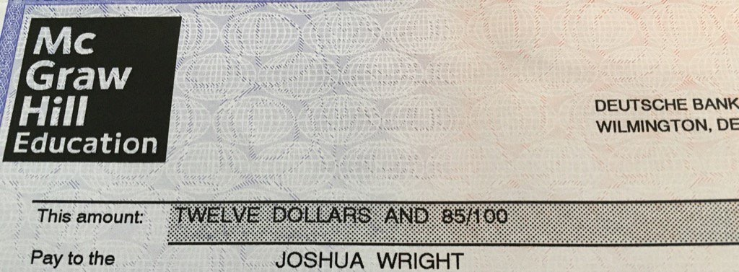
* This check arrived by FedEx, which cost $21.40 to ship.
Notes:
The publisher will only start paying you royalties after the advance has been paid off, so immediately after your book goes to print you won't see royalty checks until your percentage of net profits exceeds the advance. It's not uncommon to see checks arrive quarterly like this one: $12.85, which arrived in a FedEx package that cost $21.40 to mail to me.
If you're still with me at this point, I'm glad. You won't get rich writing technical books (at least, not in royalties or an advance from the publisher), but there are a lot of career benefits, personal growth benefits, and industry-wide benefits to sharing what we know.
Next we'll look at the process of writing. Hopefully you'll stick around.

Slide 22
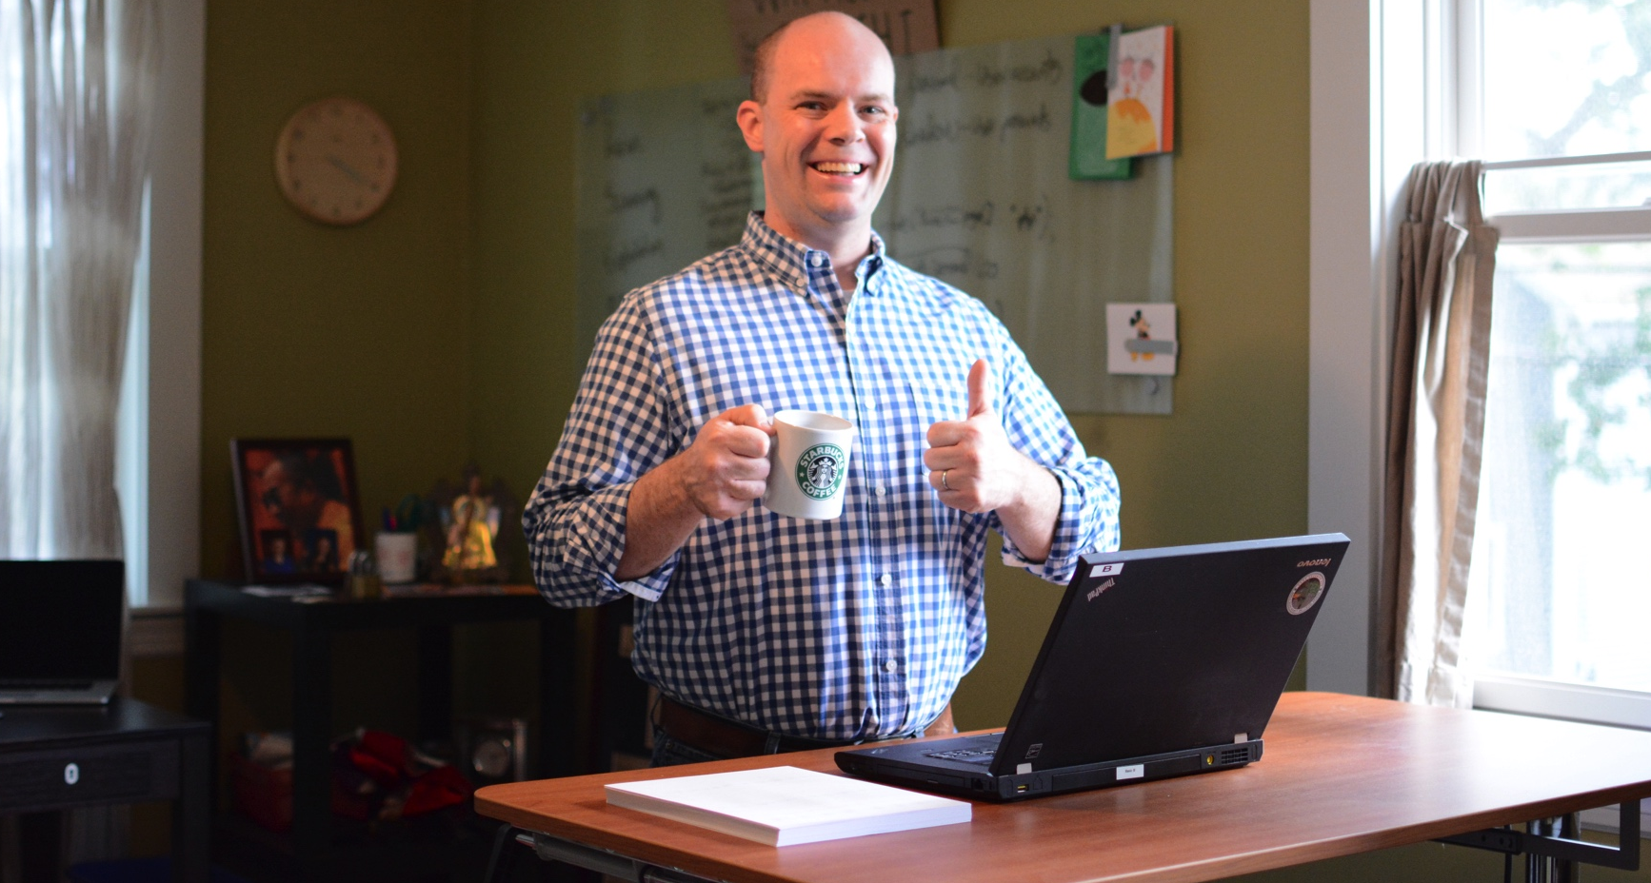
Notes:
When I talk to people, they often think that writing a book is a straightforward process. You sit down with an idea and Microsoft Word, a pot of coffee at your beck and call, and just start tapping out the words. Sure, it takes time to convert those thoughts and ideas into keystrokes, but it's just like you're talking to someone, except you're writing it down. How hard can it be?

Slide 23
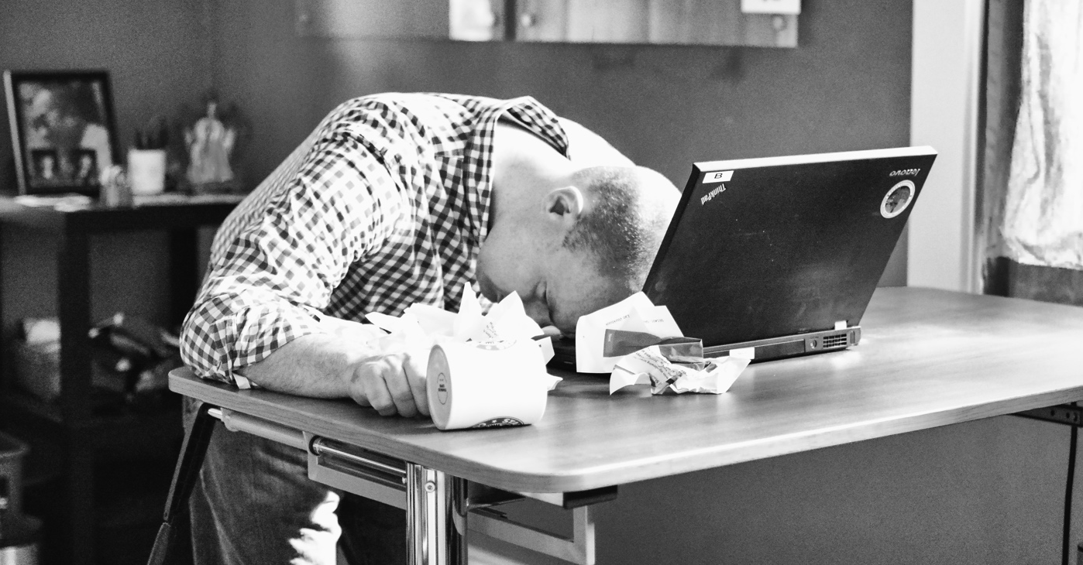
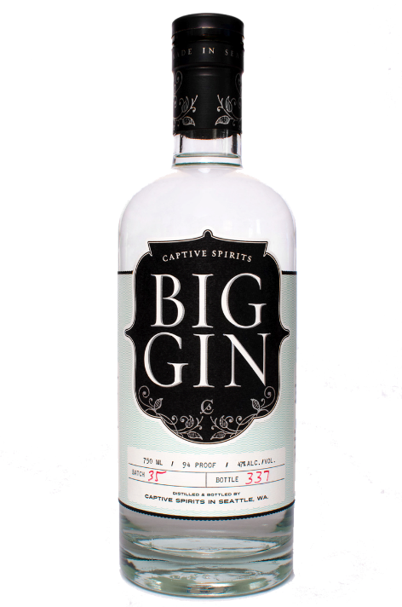
Notes:
The reality is a little different. Writing can be hard. Writing is not the same as speaking to someone, and there is always more to consider when writing than speaking. How will you make the subject approachable? How will you hold the reader's attention throughout the book? What do you do when you are writing about a topic and you discover that all the tools available totally suck?
Maybe the biggest problem in writing is this: what do you do when the words don't come out? It happens to all of us. Well, almost.

Slide 24
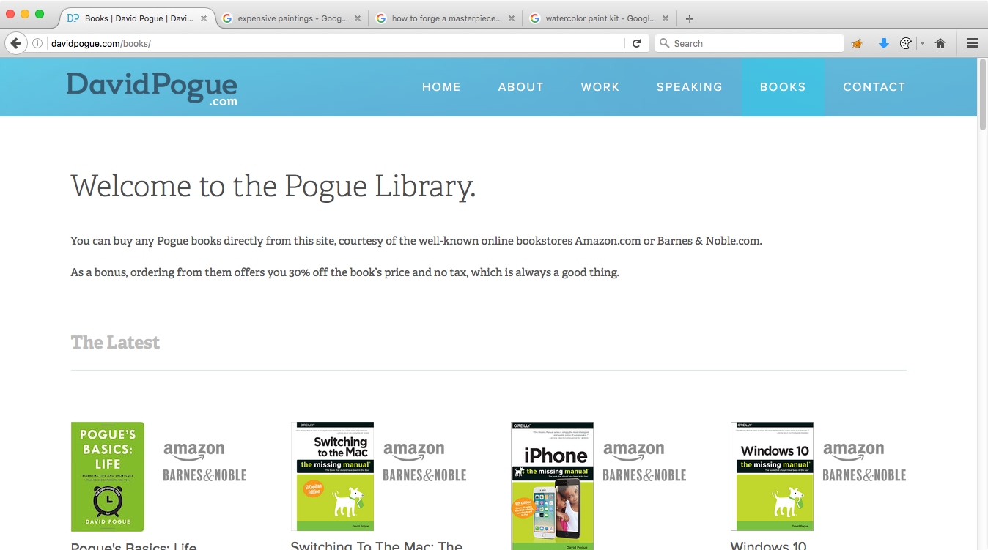
David Pogue is a prolific writer. Formerly at
the New York Times and now at Yahoo! Tech,
he has written more technology books than
anyone else. Ever.*
* May not actually be true.
Notes:
David Pogue is a prolific technical writer. His website at davidpogue.com lists his many writing accomplishments, including the many book publications, but also his career as a writer at the New York Times, and later at Yahoo! Tech.

Slide 25
"I never actually learned to write...I just write like I talk."
David Pogue
We don't like him very much.
Notes:
Eons ago, I read an interview with Mr. Pogue, where the reporter asked him about his secrets to writing. I recall the quote as indicating that he had the rare ability to just sit down and write, and how the words were always there to put down.
Unfortunately, I couldn't find that original interview. I emailed Mr. Pogue and asked him if he could confirm. He responded by saying "I think what I remember saying is that I never actually learned to write! I just write like I talk (most people say that once they meet me)!"
We don't like him very much.
Mr. Pogue is probably an awesome person, but he is a rare exception to the reality of writers: sometimes it is hard to get the right words out. It is rare indeed for a writer to sit down at the keyboard and pound out the words day after day without struggle. You won't be the first to experience this, and you won't be the last either.

Slide 26
Plan big. Think small.
Notes:
Writing can be an experience in bi-polar emotional disorder. There is the fantasy that your book will be published and received with such acclaim that strangers will marvel at your passing, tightly clutching the first edition of your "Python for Ultrix Sys Admins" masterpiece to their chests. But there is also the hypochondria known only to writers that you clearly have a brain tumor preventing you from finding the word you seek from the tip of your tongue to the page in front of you (NB: the word is "extraneous").
These episodes of hypochondria happen to me when I am overwhelmed by the amount of work I need to do. My solution for this is to plan big, but think small.

Slide 27
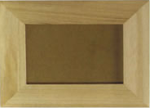
Notes:
It can be hard getting the words out on the page, especially if you are overwhelmed with the amount of writing that needs to be done. Some days you'll be HOT, and you'll pound out 20 pages, 30 pages, 40 pages in one sitting, and it will be masterful. The words will flow off the page as if by an empathetic link between you and the keyboard. Concepts will be clear, examples will be insightful, content will be a delight to read that holds the wandering attention of even the most attention deficit afflicted.
But these events don't happen often, and you should not shoot for them. Anne Lamott, the author of "Bird by Bird" offers a piece of advice that I continue to use today. Instead of sitting down intending to write 20 pages, shoot for writing down the number of words that fit in a 1" picture frame. It's a small task, and easily accomplished. Focus on getting that task done, the reasonably sized, within-your-grasp writing task. Let the 20 page groove happen naturally.

Slide 28
Develop a detailed outline.
Notes:
I can't stress this enough. At the beginning of your project, before you start one work of content, develop a detailed outline. The outline doesn't have to be static, and it can (and should) change as your book progresses, but if gives you the reference point for your work, so you know what needs to be done, and how much you've completed so far.
Stephen Northcutt, an widely respected innovator in the information security field, and my first boss and mentor in the information security industry, tells me that an outline should have at least five levels of depth. It might look something like this (taken from Stephen and Judy Novak's seminal work, Network Intrusion Detection, 3rd Edition:
Chapter 5: Stimulus and Response
1. Introduction
A. Transition from Stimulus to Response
B. Ready to diversify exposure
2. Prevalence to Alert on FP than Miss FN
Suspicious rules are often generic
i. Precision customization required to avoid FP
ii. Analyst Must Differentiate
Develop a detailed outline. It is worth the time investment, and will help your sanity as you continue the writing process .

Slide 29
Commit to a regular time to write.
Notes:
The surefire way to be a productive writer is to commit to a regular time to write. There is no "right" time, but you should commit to a regular time and meet that commitment as reliable as you are able.
For me, all of my writing projects happened while I was working full-time, teaching, traveling, and being a full-time dad and husband. Evenings usually don't work well for me, and while I could occasionally get a few afternoon or late morning hours to work on a writing project, I couldn't free up that time consistently.
So, I committed to a daily writing schedule for my more aggressive project scheduled, waking up at 4:30am, and writing for 2-3 hours. Every. Single. Day. It was amazing.
The downsides to waking up at 4:30 are plain, but the benefits are outstanding. With such an early hour, I eliminate most of the distractions of the day. I was working at my most rested point, and I was often able to draw upon my subconscious to solve problems or come up with ideas that would make my writing better.

Slide 30

Eliminate distractions.
Groupon Deals
1 new notification
Notes:
I still struggle with this one. When you are writing, and you're stuck on something, your mind will easily latch on to any distraction that brings your attention away from the hard task and gives you any satisfaction for completing a task, even of the most menial variety.
Nothing is more distracting to me than the Growl messages from my Mac. In the upper right corner of my monitor there is a periodic animation that grabs my attention. If I'm stuck staring at the blinking cursor, trying to figure out what it is I'm trying to say and a new email comes in, I'm hooked.
"OMG I absolutely must unsubscribe from the barrage of Groupon spam RIGHT NOW."

Slide 31
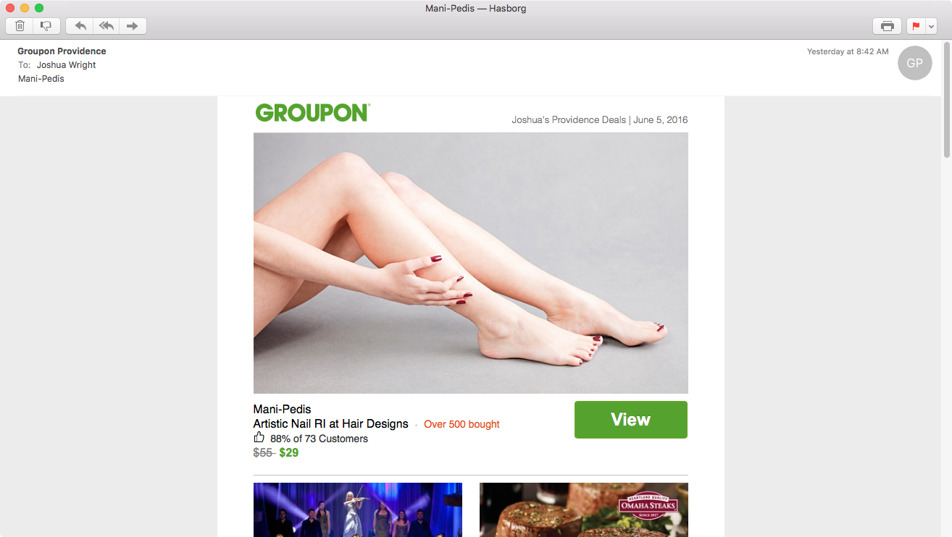
Notes:
Next, I'm opening that Groupon message, searching for the unsubscribe link and my writing commitment is temporarily forgotten. Suddenly I find myself reading the eye-catching email, and wondering about mani-pedis.
Is this something that is appropriate for a gift for my wife?
Is it too cheesy to give my wife a Groupon coupon for a mani-pedi?
Why is it called mani-pedi?
Do men get mani-pedis?
If a man gets a mani-pedi is it called a man-pedi?
Next, having forgotten the imperative need to unsubscribe from the Groupon spam, I open a new tab and start Googling mani-pedi facts.

Slide 32
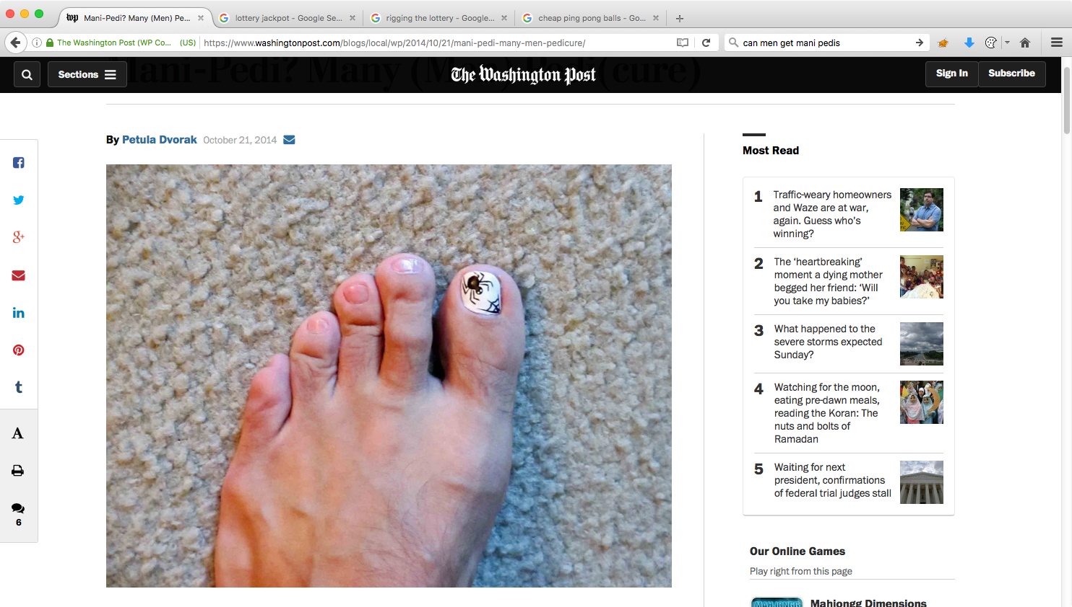
Notes:
Apparently men get mani-pedis. It's still called a mani-pedi, but you can get little spiders painted on your big toe.
I decide against it personally, but at this point I've lost my concentration, and I'm sufficiently derailed that it's unlikely today will be a productive day.

Slide 33
Use a different computer.
(One that doesn't have email, iMessage, Skype, WhatsApp, ooVoo, Twitter, Facebook, Instagram, SnapChat, Tinder, Grindr, Flickr, Tumblr, Messenger, Pinterest, LinkedIn, YouTube, Vine, Reddit, Swarm, Yik Yak, Shots, Periscope, Blab, FourSquare or Slack. DEFINITELY not Slack.)
Notes:
My advice to you when writing is this: use a different computer. One that has Microsoft Office or whatever tool you're using for writing, but is free of the millions of typical distractions we are bombarded with on a regular basis. When it's time to write, you're not checking email, or catching up on Slack. You're focusing on writing.
I have a little MacBook Air that I use just for writing. It's small enough that I travel with it and my standard MacBook Pro without too much difficulty, and it allows me to focus on writing.

Slide 34
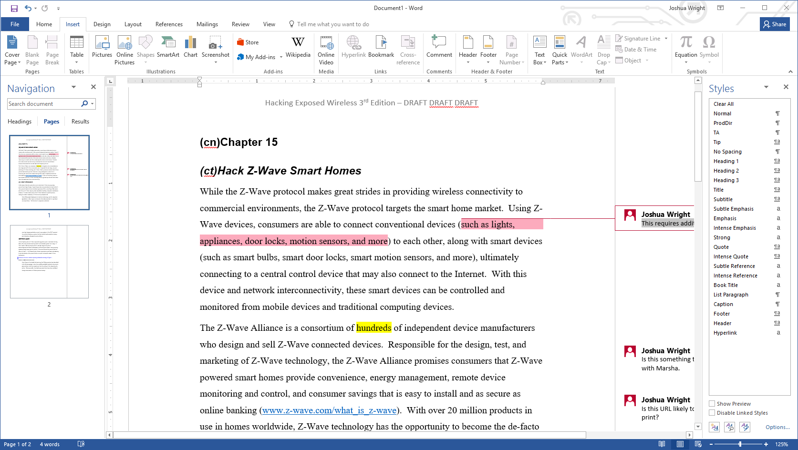
Notes:
Even if you are working on a system without the interruption of email and other messaging tools, just your editor itself can be a cacophony of visual distraction. In this Microsoft Word document, there are hundreds of clickable items, dozens of icons, and inline content distractions from notes to links to highlighted sections.
When writing, you should focus on writing. The rest of the editing, formatting, style, and other features of your editor just get in the way. Removing those distractions allows you to focus on the writing part; formatting and the like happen afterward.

Slide 35
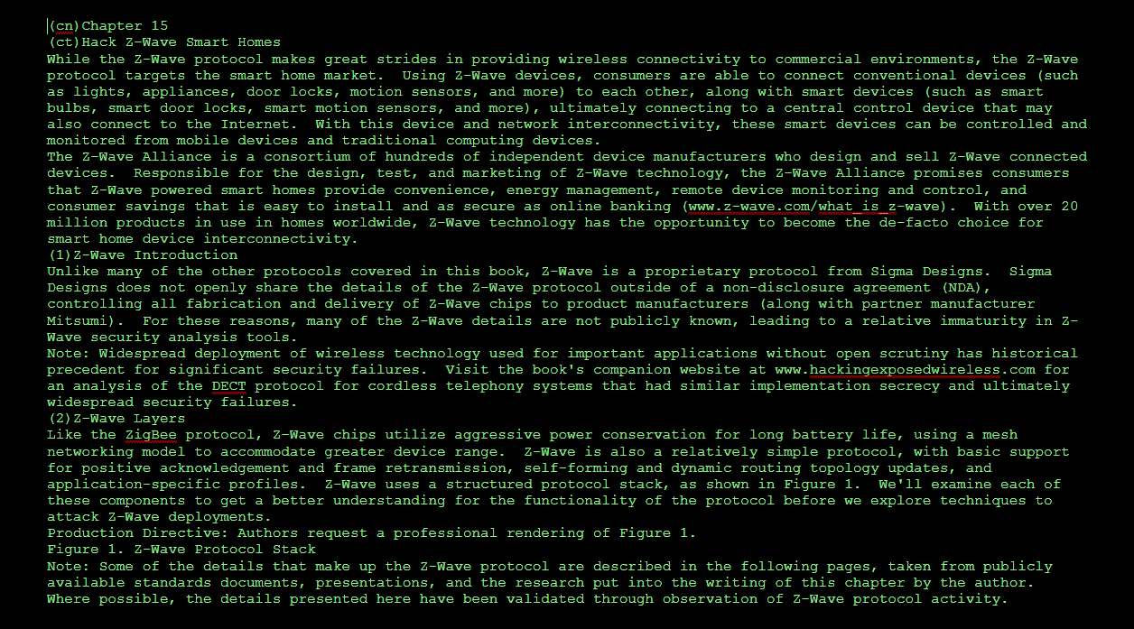
WriteSpace by Johan Danforth, writespace.codeplex.com
Notes:
WriteSpace by Jonah Danforth available at writespace.codeplex.com is a plugin for Microsoft Word to remove all the distraction of the interface and allow you to focus simply on writing. You're still working in Microsoft Word, and have access to spell check and other integrated features, but you eliminate the cluttered interface components, allowing you to focus on the important task at hand.
Other tools with comparable features, not dependent upon Microsoft Word, include WriteRoom (OS X, $10, available in the Mac App Store) and Dark Room (Windows, free, http://jjafuller.com/dark-room). Multiple other options exist as well, see http://lifehacker.com/5689579/five-best-distraction-free-writing-tools.

Slide 36
Beware of employer contractual poisoning.
Notes:
One important issue that I want to point out is that you should probably not write on your employer's time. Many employer contracts will take ownership in any work created using assets owned by the employer, or work created during the employer's work time. This can lead to an employer having the right to garner ownership of your writing product.
Unless you have an explicit agreement in writing with your employer, avoid writing on your employer's time, and avoid writing using equipment supplied by your employer.

Slide 37
Traditional or self-publish?
It's a personal decision.
Notes:
Traditional publishers know the book market. Unlike conventional fiction work, publishers are hungry for technical writers that can work independently to produce a manuscript for a hot topic that is going to engage readers. You'll get some up-front money (enough to buy that laptop you'll devote just to writing!), and you'll have an editor that emails or calls you periodically. Once you turn in your last chapter, you'll start fielding edits from your copy editor, and later from the artwork team that turns your illustrations into professional artwork. You'll have to review and approve a cover design (of which you'll have one choice, and you'll like it since it's too late and costly to put together something else), then you'll do final draft reviews in the print layout form. A few months later, a heavy box will show up with a dozen copies of your amazing accomplishment.
A lot of people work with a traditional publisher for the name brand recognition. When I told my kids' karate instructor I was working on a book, he asked me who the publisher was. I told him "McGraw-Hill", and his eyebrows made an upward motion as if he were impressed. Impressed by what, I'm not sure, but impressed. Publishers live by their brand, almost as much as Apple.
People also think the publisher is there to publicize your book, to make it sell successfully. After all, you're both in the market for the book to succeed right? Sadly, I've learned otherwise.

Slide 38
Notes:
First, you’re the primary person responsible for the marketing of your book. Second, publishers don’t use marketing to cause books to sell well—they help books that are already selling well to sell even better. You're on the hook to get that initial spark to get your book visible, then the publisher jumps in (taking all the credit, naturally) to help from there.
Another option is to self-publish. Author and entrepreneur Guy Kawasaki has published a great book on self-publishing called APE: Author, Publisher, Entrepreneur (http://apethebook.com/). Kawasaki has written an excellent how-to on self-publishing an artisanal product, one where you are the sole party responsible for the amazing product you are creating. The APE book is both motivational and tactical, with great advice including navigating through the Amazon self-publishing platform (Kawasaki's recommended self-publishing platform), developing your work in MS Word, building your audience through social media audience while you are writing, sharing with your audience for feedback throughout the writing process, hiring a copy editor and designer, and more. I cannot recommend this book enough for anyone interested in self-publishing.

Slide 39
Excuse #1: I'm not technical enough
You will speak better to your audience.
Notes:
Some of your hearing this presentation or reading these notes might be formulating excuses in your mind. Excuses that allow you to justify that this whole "writing" thing isn't for you. Excuses like, "I'm not technical enough."
I listed this excuse first because it's the one I hear all the time. People think they they aren't technical enough to write a book on a technology. What they don't realize is that they are more well-suited to writing about a technology than their most technologically advanced peers. Why? Because you can relate better to your audience.
If you are writing about a technology topic, chances are you won't be writing for the most advanced readers that represent 0.1% of your audience. You don't really want to write to that audience anyway, because that audience is notoriously hard to please. Instead, you want to write to the 99.9% of the audience, those who know a little to a lot, but need it explained in a way that is approachable and accessible.
The 0.1% can't speak to your audience the way you can. You, with your real-life struggle and experiences will present the topic in a way that is much more valuable to a greater number of people. Readers know it too, and will prefer your writing over the egg-head who thinks they have to write down to their audience.

Slide 40
Excuse #2: I don't have unique insight to offer.
You are made up of your own experiences. Share them.
Notes:
During the peer review of this presentation, I was told that a student in the SANS Technology Institute had just delivered this excuse to their advisor, moments before seeing the excuse here. People frequently feel that they don't have unique insight, but it is never true. We are all made up of our own experiences, and your experiences are very different than my own. The trick in writing is to share those experiences in such a way that it is useful for the reader.
What was the last system compromise you worked on? What did you learn from that? What tips have you picked up managing Windows or Linux systems? Is there a boring task that you've made less boring through automation? How did you successfully persuade your employer to pay for something to solve a problem on your behalf? What are the regular things you do every day to improve your ability to execute and deliver on projects?
As an exercise, write down 4 things you do each day for an entire week. Pick a few of those items that have some relationship, and put together an outline on how you could share those things in a way that would be valuable for others.

Slide 41
Excuse #3: I don't write so goodly.
Bad writers quit. Good writers persevere.
Notes:
Special thanks to Ed Skoudis for this tip, and the catch use of "goodly" in a sentence. Some people think they can't write because they struggle with writing. The problem is that if you can't write effectively, then you are constrained in your ability to communicate and demonstrate that you are a valuable, capable analyst that deserves a promotion/raise/vacation/etc. If you struggle with writing, then you need to improve if you want to succeed.
Fortunately, the act of writing is the very thing that makes you a better writer. To accelerate that process, you need to write, a lot, and you need feedback on your writing to show you where you can improve.
If you have maintained an excellent relationship with your high school English teacher, then use him as a resource to continue reviewing your writing and learning from his feedback. If you are like the rest of us, that might not be an option for you. Fortunately, we have Grammarly.

Slide 42
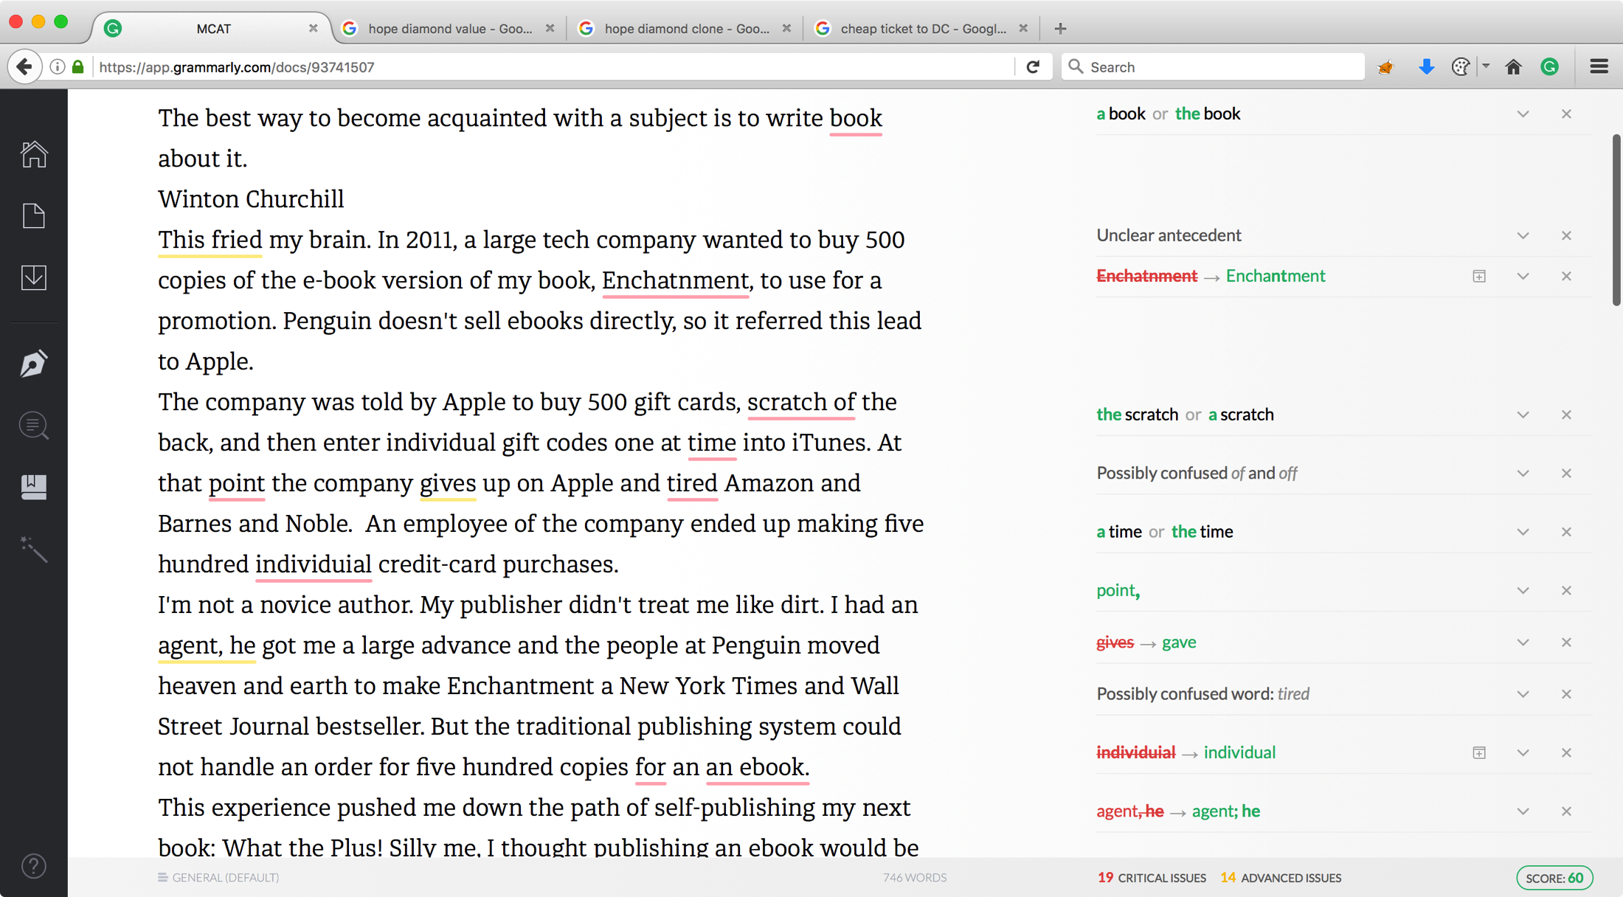
Notes:
Grammarly is an online writing enhancement service (that's what Wikipedia says – I saw it's a teaching tool to make better writers) at www.grammarly.com. Grammarly will analyze an uploaded document or pasted content for issues, providing suggestions on how to improve your writing. With a free version, and a more complex paid version, Grammarly is an excellent tool to improve your writing (exceeding the capabilities of Microsoft Word's grammar checking). The feedback you get from the tool helps you correct the content you submit for review, but continued use will also help you to improve as a writer, helping you to learn from your mistakes.
I was introduced to Grammarly by Stephen Northcutt, who leverages this tool for assistance in evaluating GIAC Gold papers. To test out the service, I used a document supplied by Guy Kawasaki, the Mandik Copyediting Aptitude Test (MCAT). It is a poorly written draft of a chapter (4 pages) designed by Kawasaki's copyeditor Rachelle Mandik. By supplying the original poorly-composed copy and her track-changes copyedited revision, Kawasaki provides us with a valuable tool to evaluate the skills of a copyeditor.
While Grammarly does well in evaluating the MCAT document, it does not replace a copyeditor. No matter how wonderful of a writer you are, you will always benefit from the skill of a copyeditor.

Slide 43
Excuse #4: I can't make the time.
Start small.
Notes:
This is the excuse that I often use. Time is a precious resource, so you have to decide: if my time investment worth it for me?
Remember that your book doesn't have to be a tome, or a canonical history of all things. You can start small. Start with a short paper, maybe coupled with a GIAC Gold certification (two wins – you publish and you differentiate yourself as GIAC Gold certified). Or, be creative about how you deliver your writing with a publisher that suits your availability for writing.

Slide 44
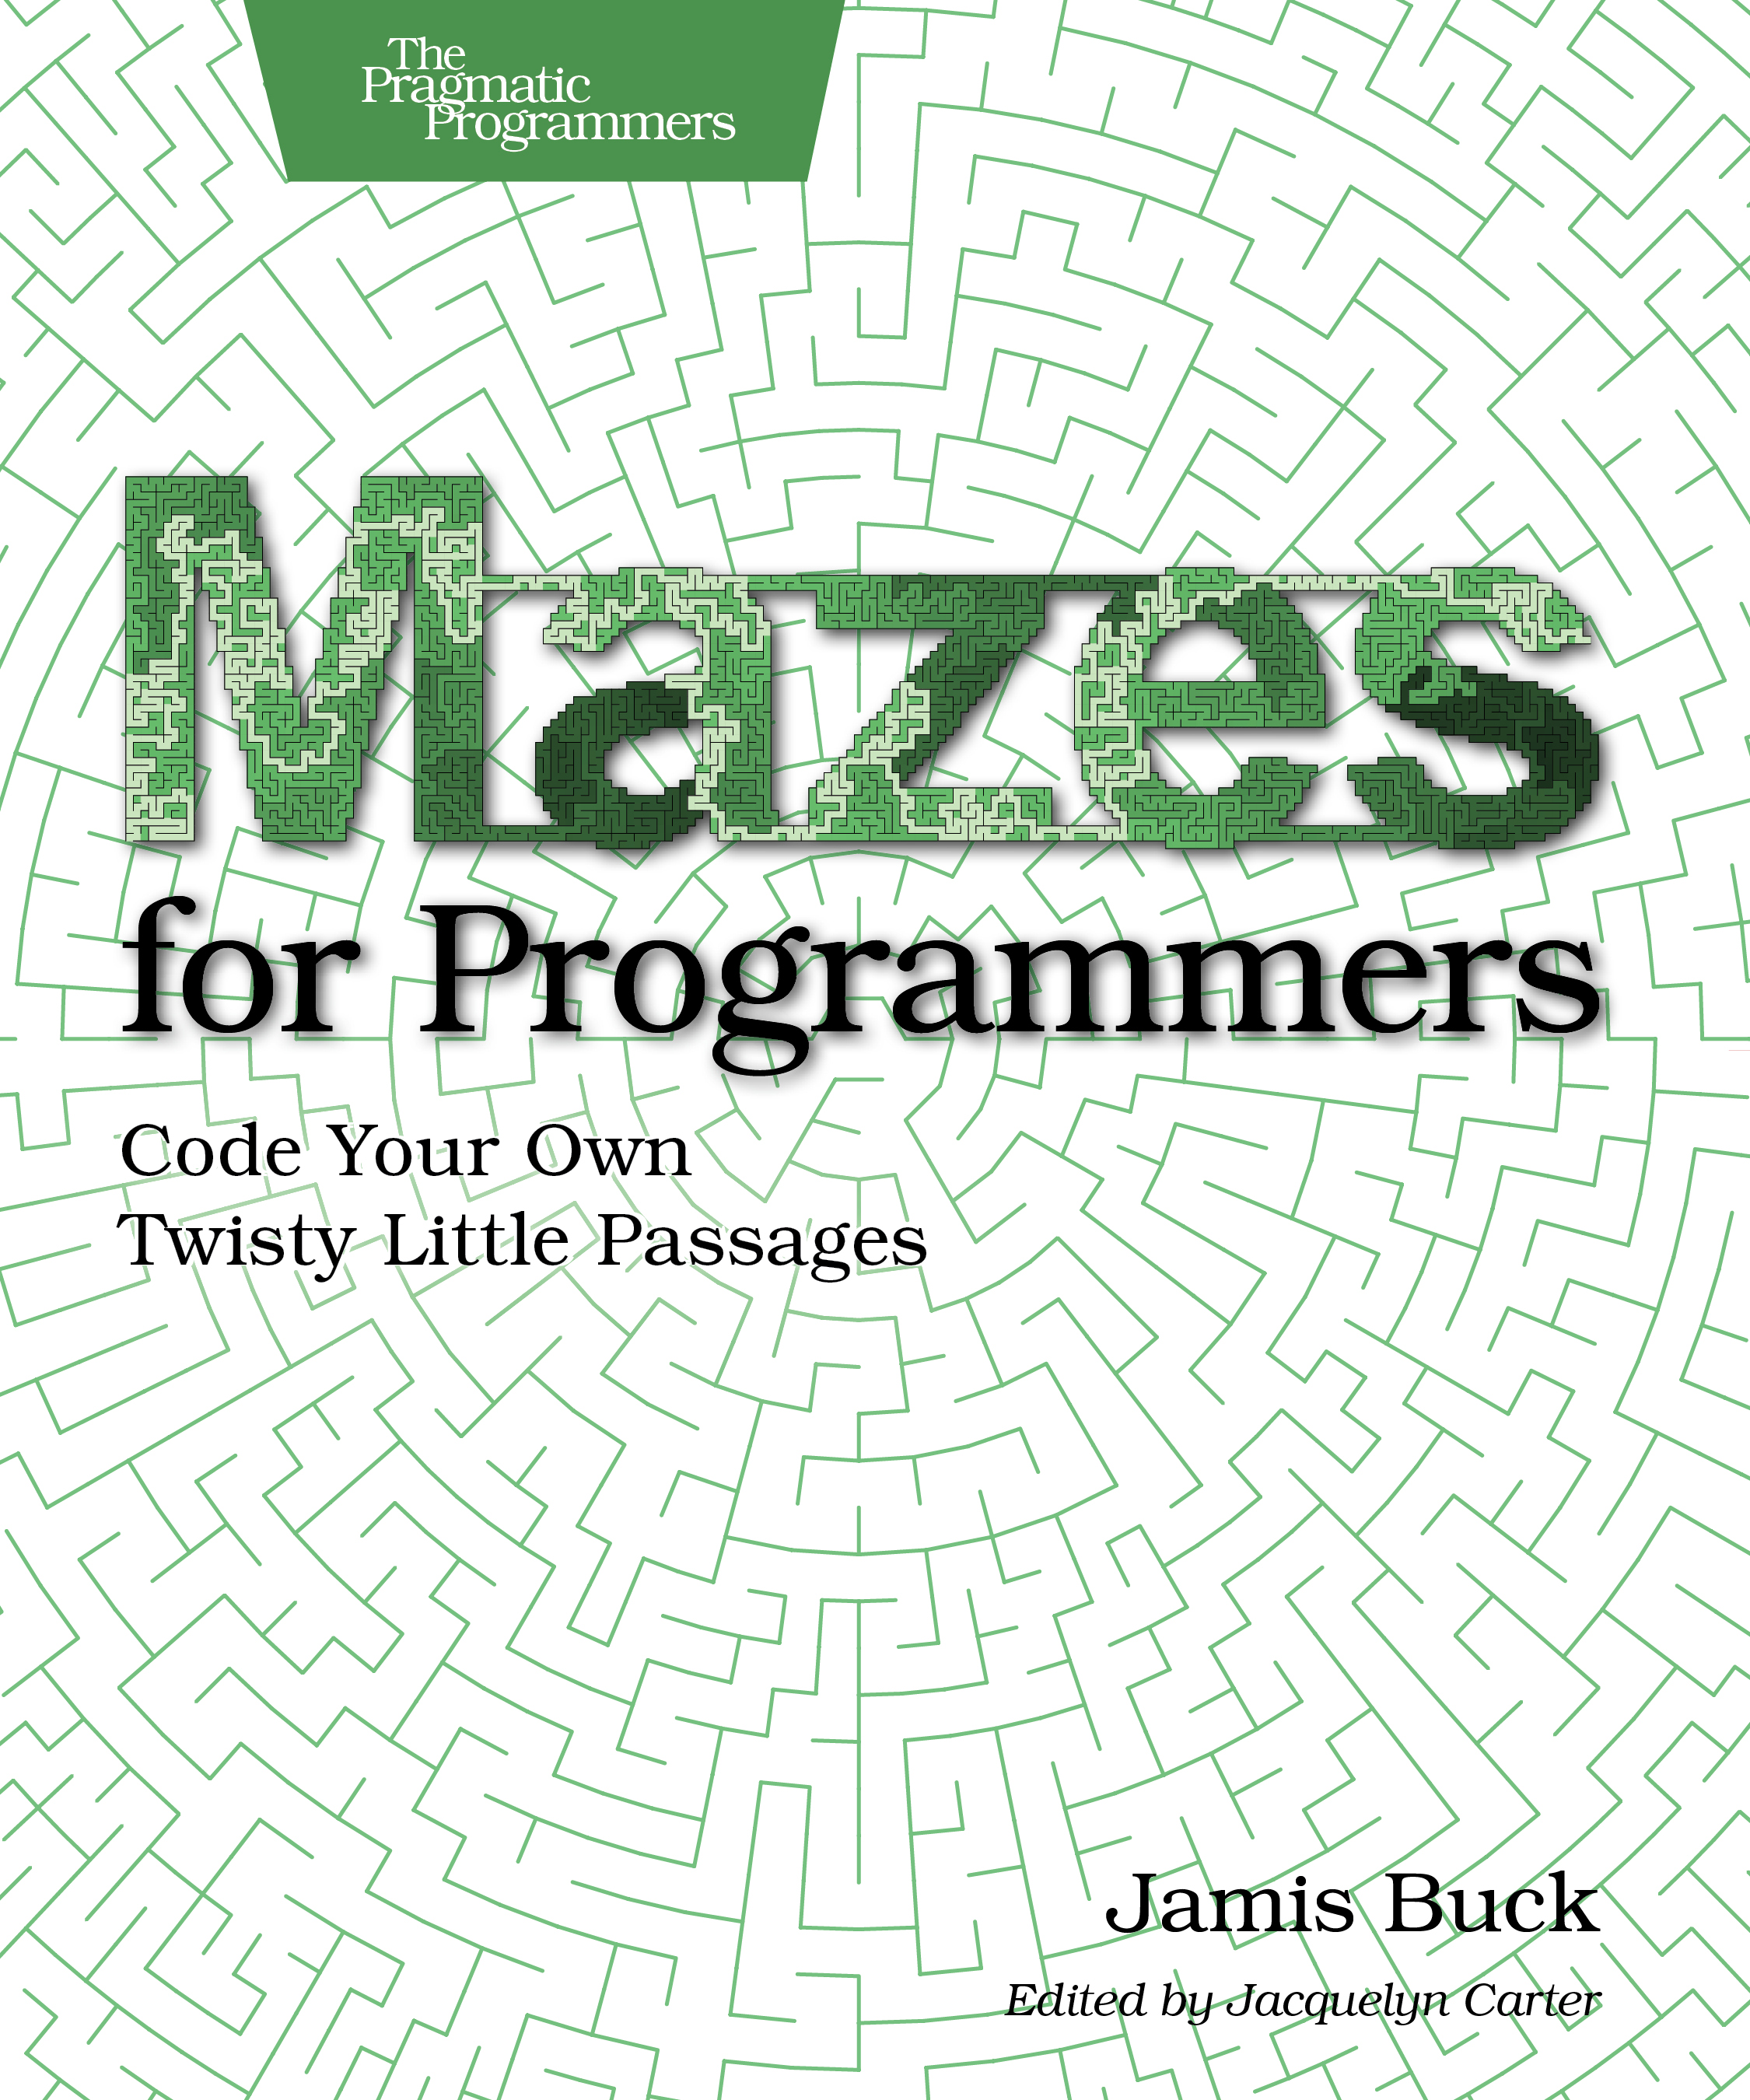
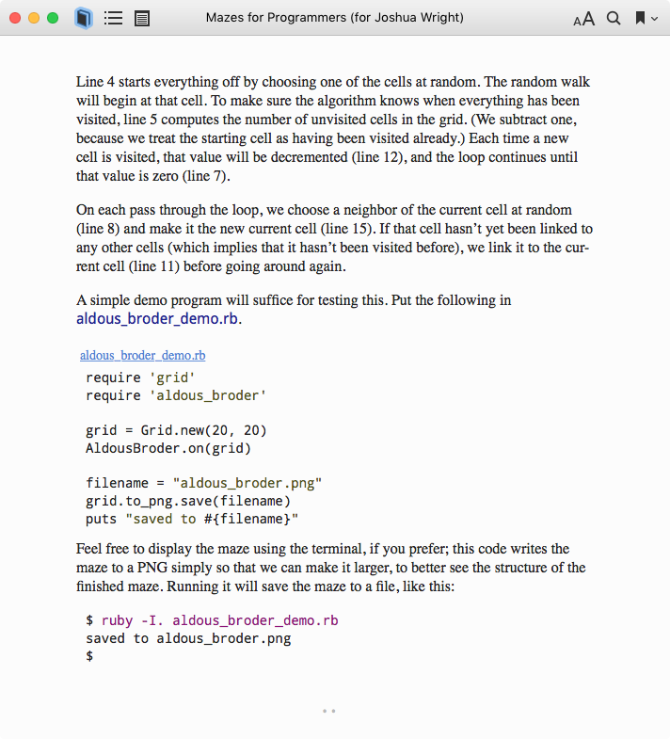
Notes:
A few years ago I pre-ordered Mazes for Programmers, and I had a blast reading and practicing with the examples for each chapter. The author Jamis Buck published 1 chapter at a time, each about 20-40 pages. The publisher, The Pragmatic Programmers, distributed electronic copies of each chapter as they became available, on approximately a bi-monthly basis. The book is 275 pages, but it took Buck a few years to finish the book.
Mazes for Programmers is narrowly focused, and you might think it has a very small audience, but it is SO MUCH FUN. I couldn't wait for the next chapter to come out each time, and I enjoyed each part. I contributed my feedback when I found errors in new chapters, and learned a lot about Ruby, algorithms, and having fun creating mazes.
The point is that you have options. You still need to set a regular schedule and commit to writing, but you can make that schedule whatever you need it to be.
If you get this book, check out chapter 14 and creating mazes on a Mobius strip. It blew my mind.

Slide 45
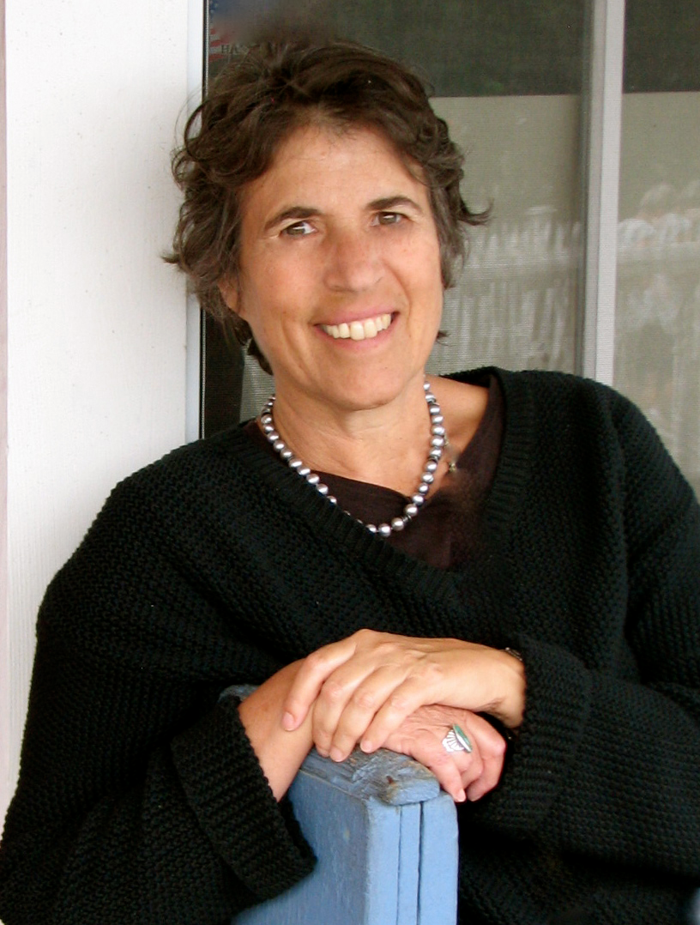
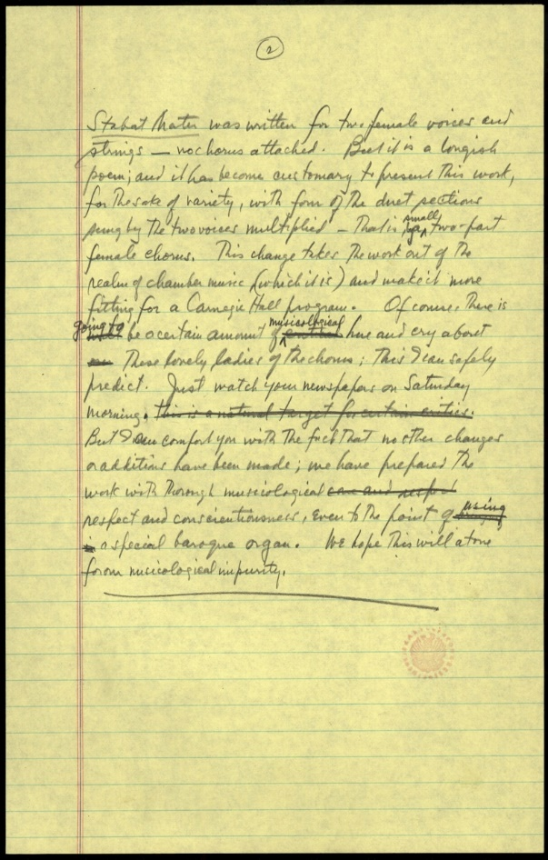
What is the best writing advice she had to offer?
Notes:
Natalie Goldberg, who wrote "Writing Down The Bones", likens writing to Zen practice. When asked for the best possible writing advice she had to offer, she held up a yellow legal pad and pantomimed writing.

Slide 46
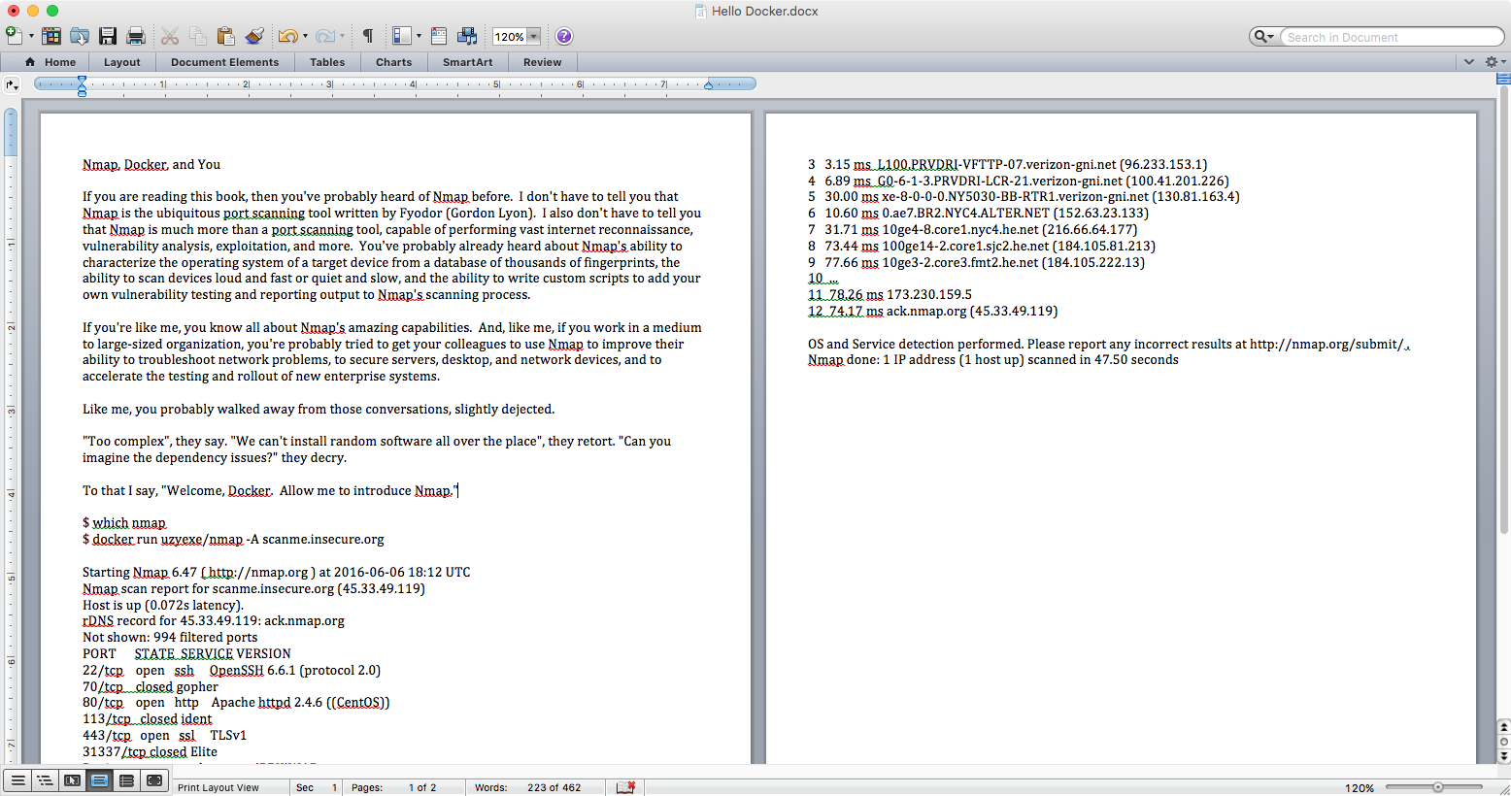
Notes:
For technical writers, I liken Goldberg's advice 2 modern tools. First, open a in Microsoft Word. Next, start writing.

Slide 47
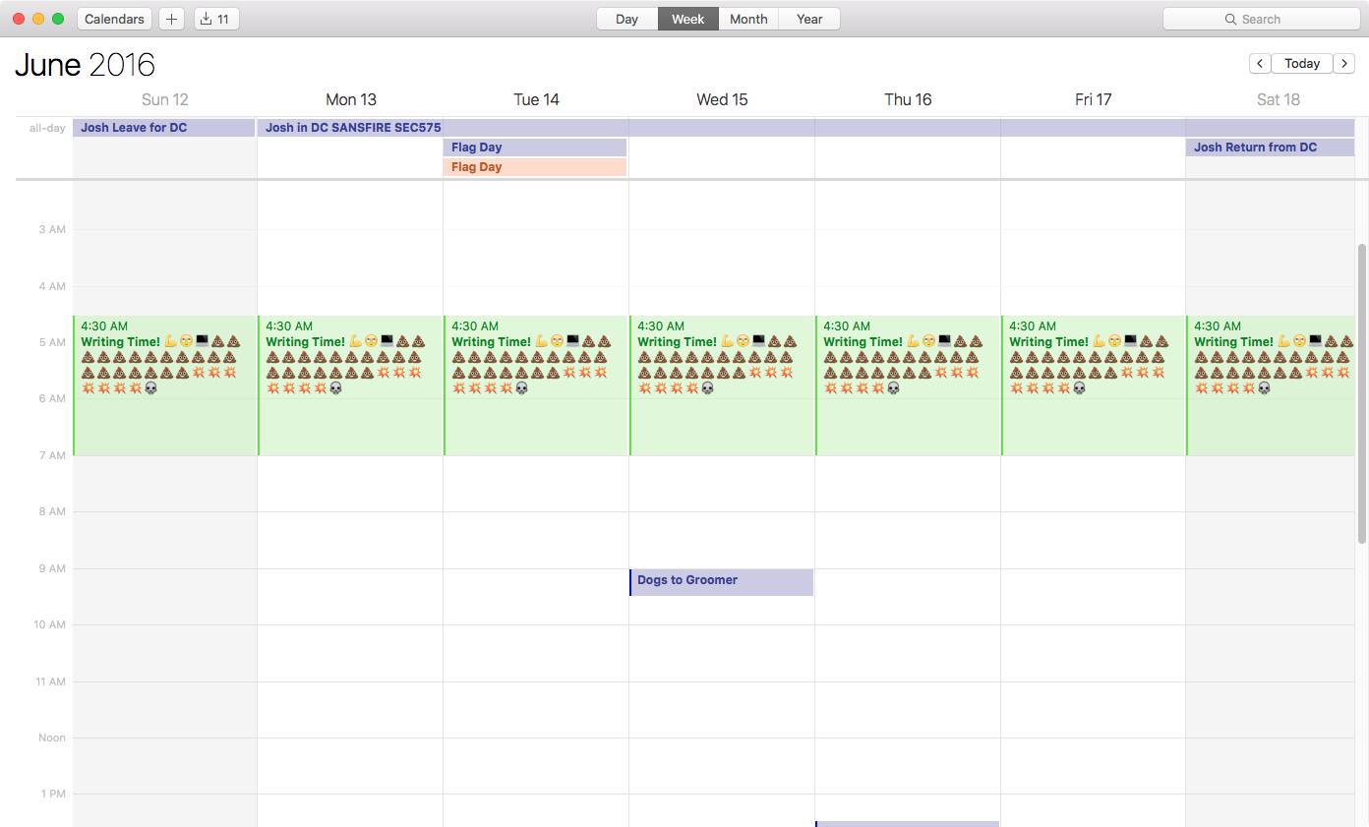
Notes:
Next, open your calendar, and book a regular time to write. Commit it to that time. Write without self-criticism. Just get the words out, read them, then improve on them.

Slide 48
Thanks Josh, but this sounds like disappointment, heartache, and ... work.
Notes:
Writing isn't easy. It will be hard work, it will be disheartening, and sometimes disappointing. It's fair to ask: is it worth it?
You can examine the quantifiable benefits of writing, or the hope-filled opportunities for promotion that can come with establishing yourself as a writer and authority on a given topic. These things are easy to point to as benefits of writing. But there are also more elusive benefits.

Slide 49
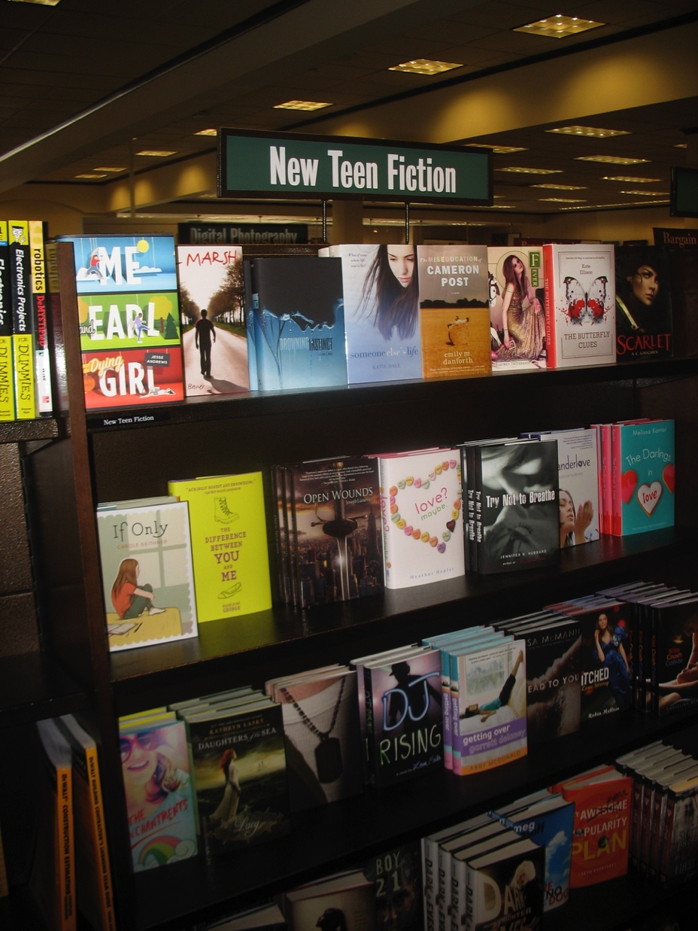
Notes:
Seeing your book on a shelf is an amazing experience. Alongside "Open Wounds", "Love Maybe?" and "Try Not to Breathe". Wait, what?

Slide 50
More like
this section!
Notes:
Maybe your book won't make it to the New Teen Fiction section, but if you work with a traditional publisher you'll likely see it on the shelves alongside technology books. You'll get an ISBN number. You'll get to write an Acknowledgements page. These are powerful events that are hard to valuate.

Slide 51
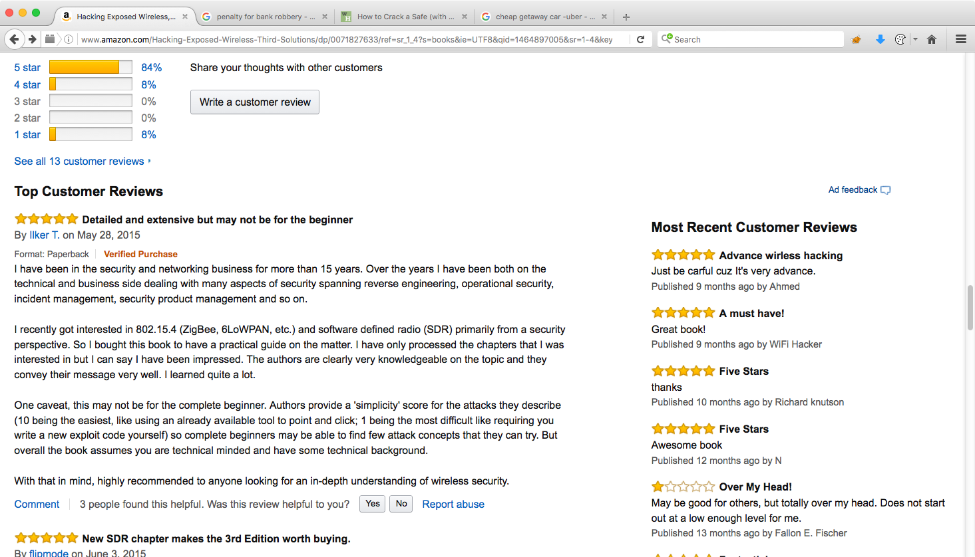
Hacking Exposed Wireless
Notes:
This is the Amazon.com page for Hacking Exposed Wireless, 3rd edition. There aren't a lot of reviews posted, but the majority of them are 5-star.
It's special. It gives you a sense of pride. You know that you have accomplished something that many talk about, but few accomplish.

Slide 52
I am in print, therefore I exist.
Notes:
It seems a little cheesy to adapt Descartes this way, but it is the best way I can describe the emotion you get from publishing. The record of having written will exist for far into the future. You can make that happen.

Slide 53
"I don't like writing. I like having written."
Dorothy Parker (for me: Ed Skoudis)
Notes:
My good friend Ed Skoudis told me once, "I don't like writing. I like having written." Later he told me that he wasn't the first to say these words, it was Dorothy Parker, but I still like to give Ed credit.
This statement reflects the incredible result of producing a written work. It says that, yes, writing is hard work, but the result is worth it. It tells me that the work I put into writing was worth it, both in terms of tangible benefits, and vague, indescribable emotional benefits.

Slide 54
How do I get started?
Come up with an idea, and shop it around to friends and colleagues.
Notes:
I'm glad you've stuck with me so far, because now we get down to the real question: how do you get started?
Come up with an idea for a writing project. Shop it around to friends and colleagues whose input your value. Would they want to read about what you want to write about?

Slide 55
What are you passionate about?
Notes:
Most importantly, ask yourself what you are passionate about? I'm passionate about wireless security, and hacking. I'm passionate about mobile app security. I want to read about those topics, I want to talk about those topics, and I want to share those topics with others. You should ask yourself this question as well.

Slide 56
Ideas
Making Your IT Job Easier with ________
  Docker, LXC, Chocolatey, OneGet, Puppet, Git, Salt, Chef, Ansible, Otter, Meteor, NuGet, ProGet, etc.
Automating Boring IT with ________
Windows Management for Linux SysAdmins
Linux Management for Windows SysAdmins
Getting What You Need: CTO Conversations
Encryption Ransomware: Defend Yourself
Writing Tech: Stories from the Field
Notes:
This busy slide has some ideas for topics. I don't even know what NuGet is, but apparently it's a hot IT technology.
Notice how many of these ideas help the reader solve a problem. Making their jobs easier, or automating the boring stuff is important – you're creating a reason for the reader to buy your book.
Focusing on job responsibilities is also a great way to make your book more appealing to an audience. Crossover in system administration is common, but admins on both sides of the Windows or Linux platform commonly despise the other. Writing a book that builds on what someone knows, and helps them grow into a new subject matter is a great way to appeal to their desire to improve their skills while building on the skills they already know.
If you aren't technical, there is still a lot of valuable information you can share. Think of the last time you had a meeting with an executive and you got something you wanted. What did you do to get that? What case studies can you present to reinforce your message? If someone writes a book on getting what you need from CTO conversations, please let me know and I'll buy 2 copies.
While the majority of this presentation is about writing books, don't forgot writing for presentation, or magazine articles, or white papers for the SANS Reading Room. It's a smaller commitment, less pressure, and still a valuable way to differentiate your skills from those of your co-workers.

Slide 57
Publishers
McGraw-Hill: Wendy Rinalidi (Wendy.Rinaldi@mheducation.com)
O'Reilly: Courtney Allen (callen@oreilly.com)
Pearson: Chris Guzikowski (chris.guzikowski@pearson.com)
Pragmatic Programmer: proposals@pragprog.com
Packt Publishing: Rahul Nair (rahuln@packtpub.com)
Wiley: "Mail us your proposal" # Seriously? NoThx.
NoStarch: editors@nostarch.com
Notes:
I contacted a bunch of publishers and asked them to share contact information for authors who want to get into writing technical books. In no particular order, I've listed several who agreed to field ideas on technical books from people who attend this presentation (or at least read this particular slide).
Each of these publishers offers a resource on the web for people to think about putting together a proposal. They offer sage advice on why you should want to write, and the format they want your proposal in to best review it effectively (which you want, too). I recommend you spend some time researching your publisher before you submit a proposal. Use the format they ask for in your proposal, and look into the kinds of books they publish to see if your idea is a fit.

Slide 58
You are amazingly resourceful.
You can differentiate yourself, and demonstrate your capabilities.
You can take pride in seeing and holding the efforts of your hard work.
You can, with passion and determination.
Notes:
Here's my motivational pitch to you.
First, you're amazing. I don't know you, but I'm sure of it. You read all the way to page 58. You're dedicated, and you care about this subject.
By writing, you can differentiate yourself. You can demonstrate your capabilities. You can show people that you really are amazing.
When you publish, you get to take pride in your hard work, seeing and holding the thing you created. It's an amazing feeling.
You can write. You can publish. You can differentiate yourself, when you work with passion and determination.

Slide 59
Please let me know if I can help.
Joshua Wright
jwright@willhackforsushi.com
@joswr1ght
+1-401-524-2911
http://www.willhackforsushi.com/writingtech.pptx
Notes:
Finally, please let me know if I can help.
Thanks for coming to this presentation or reading this material. I've listed my contact information on this page if I can ever be a resource
Sincerely,
Joshua Wright

