Slide 1
How I Ruled the Worl^Hd
Applying iOS Game Hacking Techniques
Joshua Wright
jwright@hasborg.com

Slide 2
Introduction
My adventures in game hacking
A quick look at the iOS game market
Three iOS game hacking techniques
Applying iOS game hacking to penetration testing (in the real world)

Slide 3
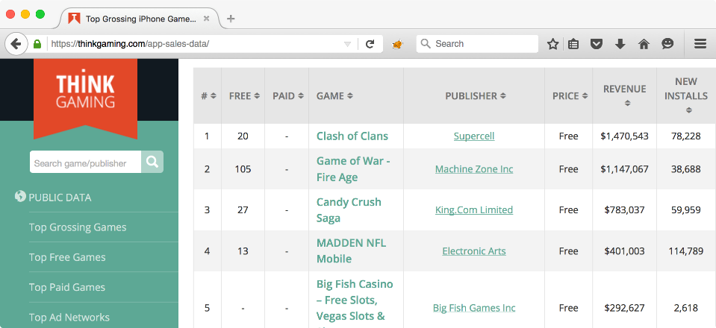
iOS Game Market
Gross revenue, per day (12/6/2015)
184 of the top 200 grossing iOS games are free.

Slide 4
Hacking Games
I am terrible at video games. I lack the patience, attention, and coordination to play well.
I don't let that stop me from winning.
I have been known to chea^H^H^H^H use other skills to my advantage to win games…at any cost.

Slide 5

My Favorite Competitor: Mike Poor
In 2007, I spent $1000 and 12 months to build a wide-band RF jammer, so I could beat Mike Poor at Wii Tennis.
I enrolled in an electrical engineering course to finish building the design so I had access to an engineering lab.
When I play, I play to win.

Slide 6
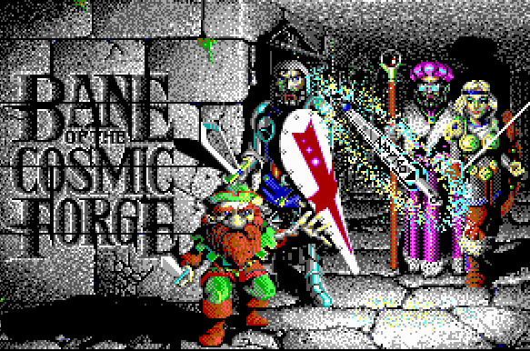
Bane of the Cosmic Forge
I spent many hours on this game
It showed me how awesome computers could be

Slide 7
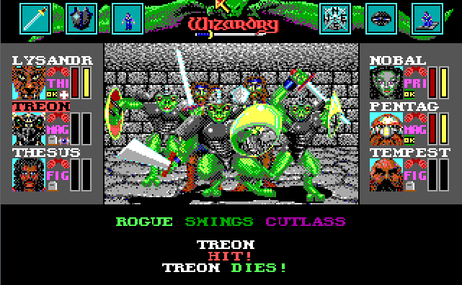
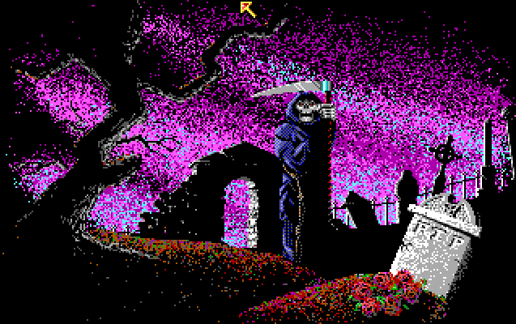
There Was a Lot of This…
Surely, there must be a better way…

Slide 8
T H E ////////// /// ///////// ///////// /////////
/// // /// /// // /// // ///
/// // /// /// // /// // ///
////////// /// //////// //////// /////////
///// /// /// // /// // //
/// // /// /// // /// // //
/// // /// /// // /// // //
/// // /// ///////// ///////// //////// L I S T
Covering BBS's in the RI calling area!
February 1992 Edition
Go USA!
O O O
O O
PHONE # LOCATION SYSTEM NAME OPERATOR(S) FEATURES (SEE KEY BELOW)
-------- ---------- -------------- --------------- ---------------------------
252-4035 Rehobth,MA Crossroads Tom/Renee Croome
254-0848 Bristol Our House William Johnson NE
254-1262 Bristol EarthWorld Heidi/Marc Agin EN,RS,Wiccan Sharing
272-4739 Providence IBM World Mike M/Marcy C ^,32,42b,RN,NE,C2,Q,V
274-5731 Providence Obsessions M Baldelli/BOD ^,HST,32,42b,CB,Q

Slide 9
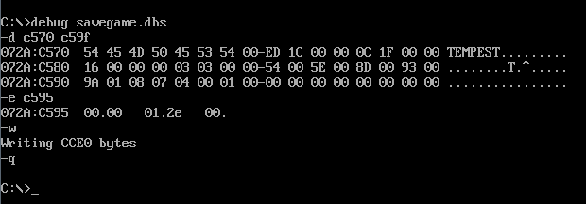
The Power of DEBUG.COM
My Bane Character
Stamina
Stamina is now 0x2e or 46!

Slide 10
Game Hack #1: Save File Editing
Fundamentally, this technique is the same as it was in the 1990's
Requires a jailbroken device
Can be time-consuming for complex applications

Slide 11
Four Steps to Save Game Editing
Close app, baseline the files used ("A" set)
Make a minimal change in the game
  Lose 1 life, use X coins, or some other measurable change
Close app, baseline the files used ("B" set)
Compare and analyze changes

Slide 12
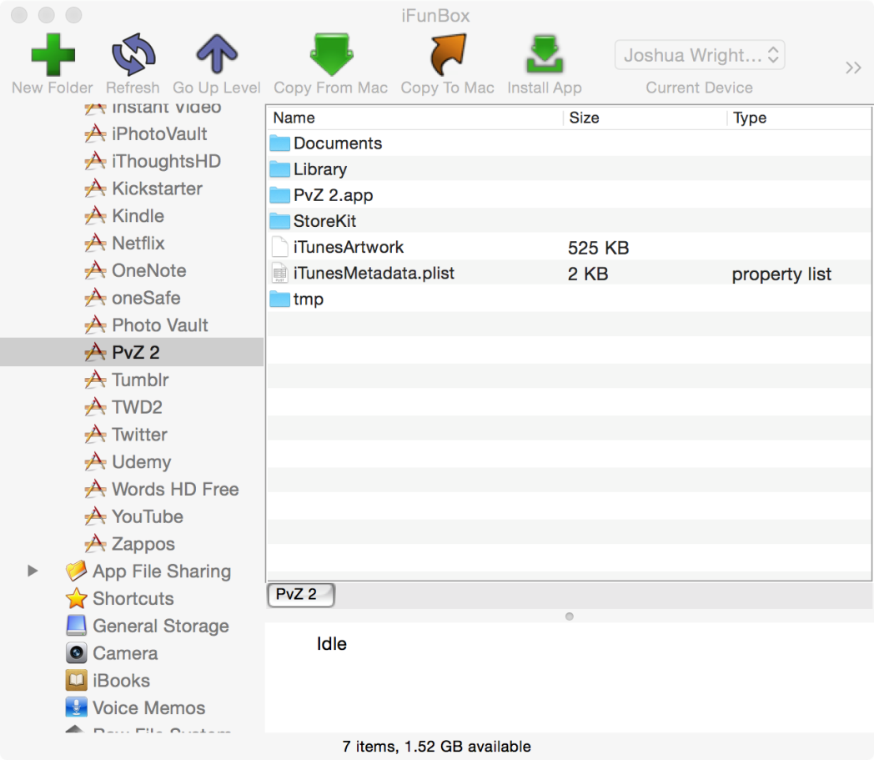
iFunBox
Easy access to iOS app sandbox directory files
Here, Documents, Library and tmp are writeable
Potential areas for saving local game resources
Apple took this access away in iOS 8.3

Slide 13
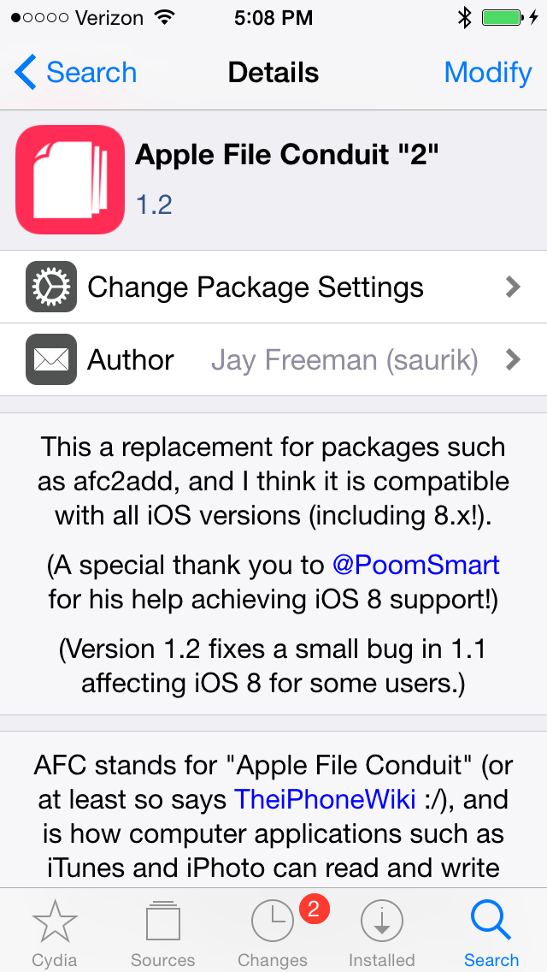
iFunBox + Apple File Conduit 2
iFunBox requires a jailbroken device to access the app sandbox
Jailbreak, then install Apple File Conduit "2" from Cydia
  Restores pre-8.3 file sharing access

Slide 14
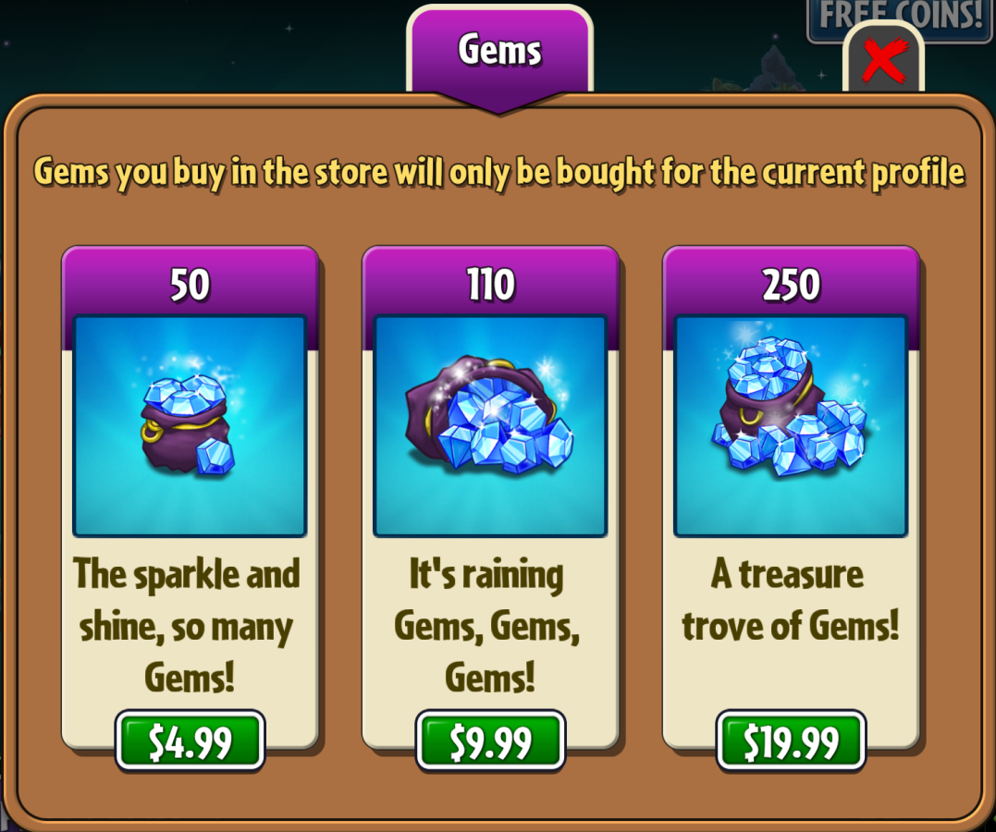
Plants Vs. Zombies 2
Free to play game developed by PopCap Games and published by Electronic Arts
#73 in iOS game revenue, $20K/day
Users can buy plants, coins, gems

Slide 15
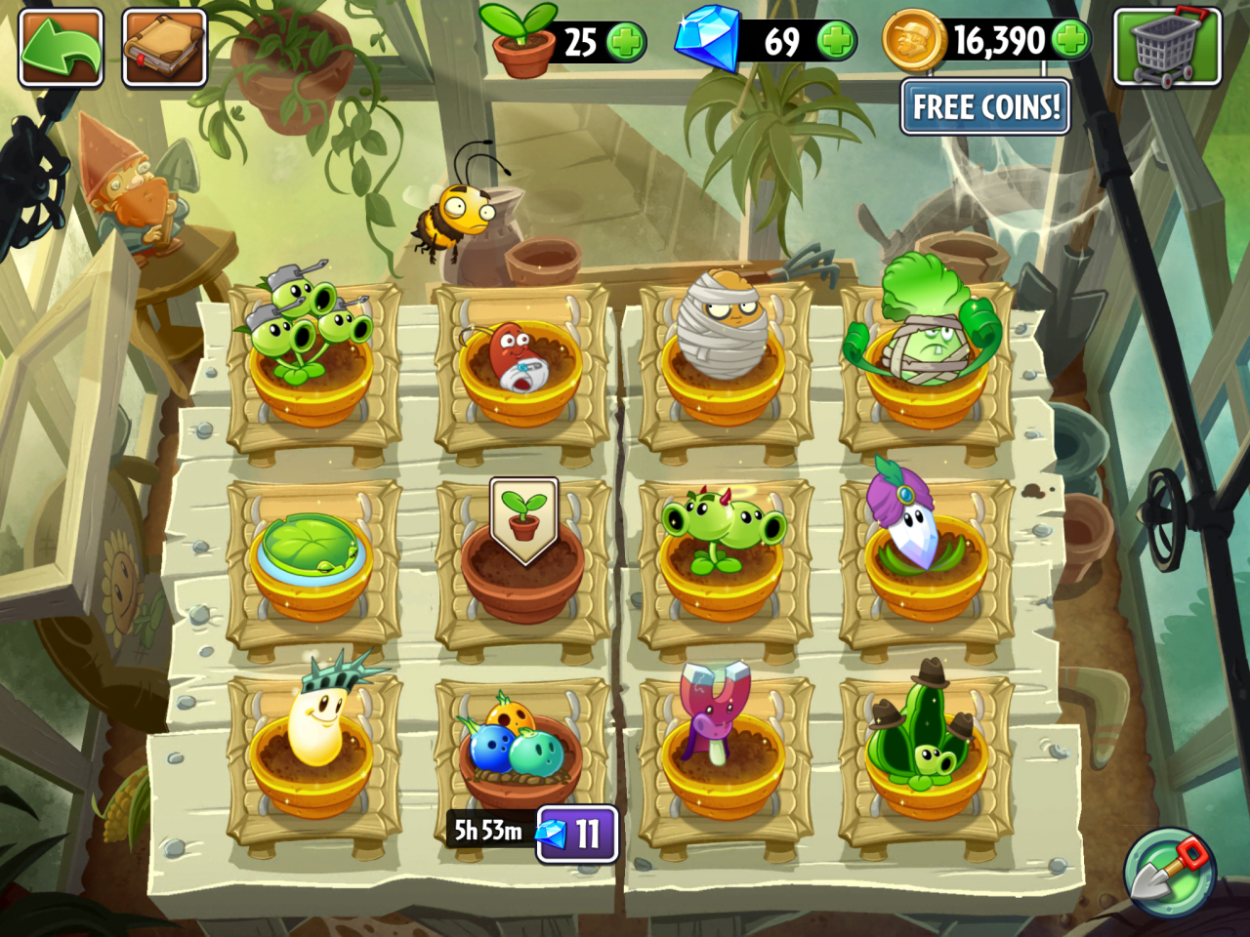
Gem Hack
I have 69 (0x45) gems
I want more gems, but I don't want to pay for them
Kill app, baseline data before change - "A" set

Slide 16
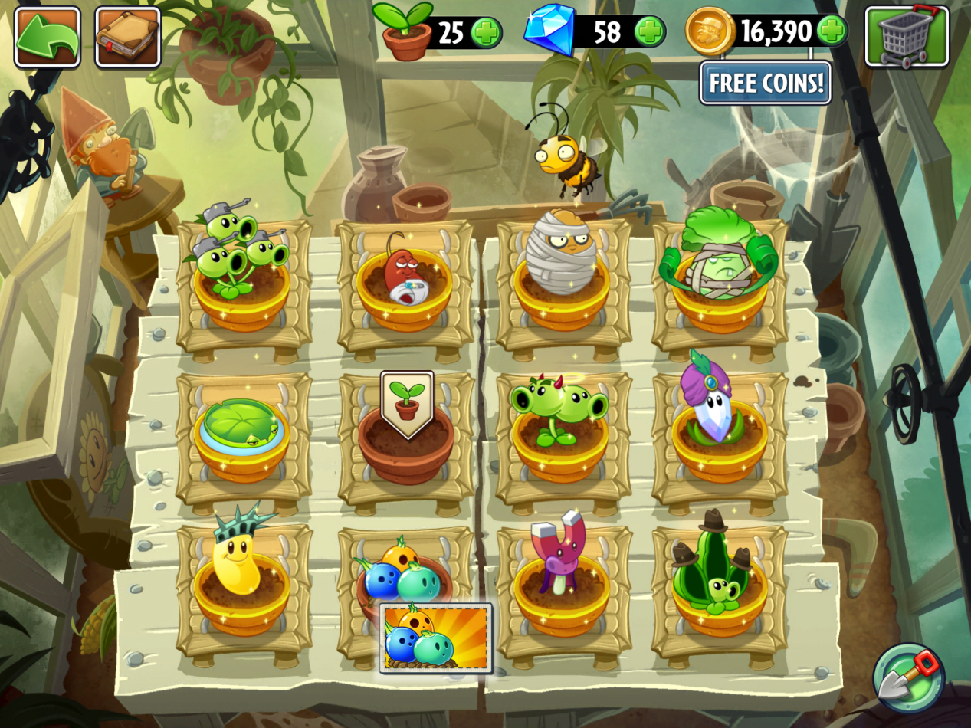
Gem Use
I used 11 gems, leaving 58 (0x3A) remaining
Kill app, baseline data after change - "B" set

Slide 17
Identify File Differences with Diff
$ diff -rq A B
Files A/Library/Application Support/No_Backup/draper_1401653778 and B/Library/Application Support/No_Backup/draper_1401653778 differ
Files A/Library/Application Support/No_Backup/pp.dat and B/Library/Application Support/No_Backup/pp.dat differ
Only in A/Library/Caches/com.crashlytics.data/com.popcap.ios.PvZ2/analytics/v1/ACTIVE: 1415282362557_545B7EBA0221-0001-48F5-393033333030
Only in B/Library/Caches/com.crashlytics.data/com.popcap.ios.PvZ2/analytics/v1/ACTIVE: 1415283507899_545B83330378-0001-4950-393033333030
Files A/Library/Caches/com.crashlytics.data/com.popcap.ios.PvZ2/session.clslog and B/Library/Caches/com.crashlytics.data/com.popcap.ios.PvZ2/session.clslog differ
Files A/Library/Preferences/com.popcap/plantsvszombies2.plist and B/Library/Preferences/com.popcap/plantsvszombies2.plist differ
Files A/Library/Preferences/com.popcap.ios.PvZ2.plist and B/Library/Preferences/com.popcap.ios.PvZ2.plist differ
Extra carriage returns added for clarity

Slide 18
Plist File Comparison
Convert plist files to ASCII format with PlistBuddy
Use diff to compare and identify differences
$ alias pcat="/usr/libexec/PlistBuddy -c Print"
$ pcat A/Library/Preferences/com.popcap.ios.PvZ2.plist >com.popcap.ios.PvZ2.plist.A
$ !!:gs/A/B/ # I'm really just showing off here
pcat B/Library/Preferences/com.popcap.ios.PvZ2.plist >com.popcap.ios.PvZ2.plist.B
$ diff -u com.popcap.ios.PvZ2.plist.[AB]
--- com.popcap.ios.PvZ2.plist.A 2014-11-06 15:46:36.000000000 -0500
+++ com.popcap.ios.PvZ2.plist.B 2014-11-06 15:47:29.000000000 -0500
@@ -85,9 +85,9 @@
WebKitOfflineWebApplicationCacheEnabled = true
mat_fixed_for_icloud = true
- com.crashlytics.insights.lastsessionidentifier = 545B7EBA0221-0001-48F5-393033333030
+ com.crashlytics.insights.lastsessionidentifier = 545B83330378-0001-4950-393033333030
google_timing_shared = Dict {
}
There isn't anything significant for our change here, but a lot of game testing is like that. You have to follow a lot of dead-ends.

Slide 19
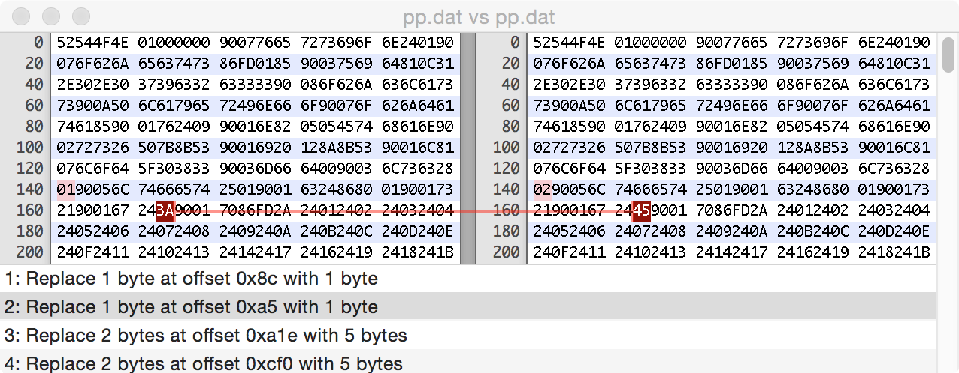
Hex Fiend File Compare
Windows users can try Beyond Compare ($30) or WinMerge ($0)

Slide 20
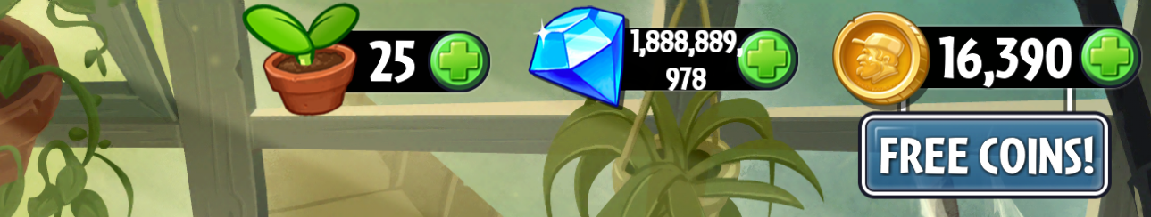
Experimentation
Start with small changes, +/- 1
  Kill app, copy file to iOS device, restart app
Keep multiple copies of working files
  Revert when you make changes you can't recover from
Experimentation can pay off…
Retail Cost
$151 million dollars

Slide 21
Game Hack #2: Network Manipulation
I am never going to make it to the high score board…legitimately.
Many games send your score to the Apple Game Center at the end of play for leaderboards.
Traffic to Game Center is protected by SSL, but not from us.

Slide 22
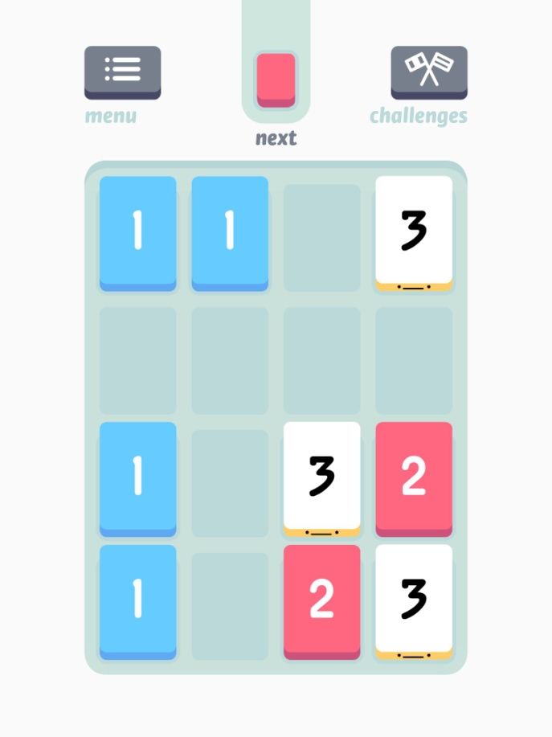
Threes
Written by Asher Vollmer, Greg Wohlwend, and Jimmy Hinson at Sirvo
Simple game of matching numbers on a 4x4 grid
Maddeningly difficult

Slide 23
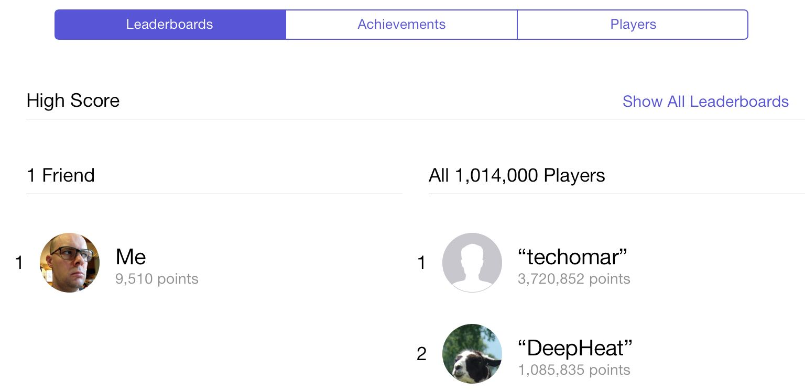
This is My "Not Pleased" Face
Ranked #244,272

Slide 24
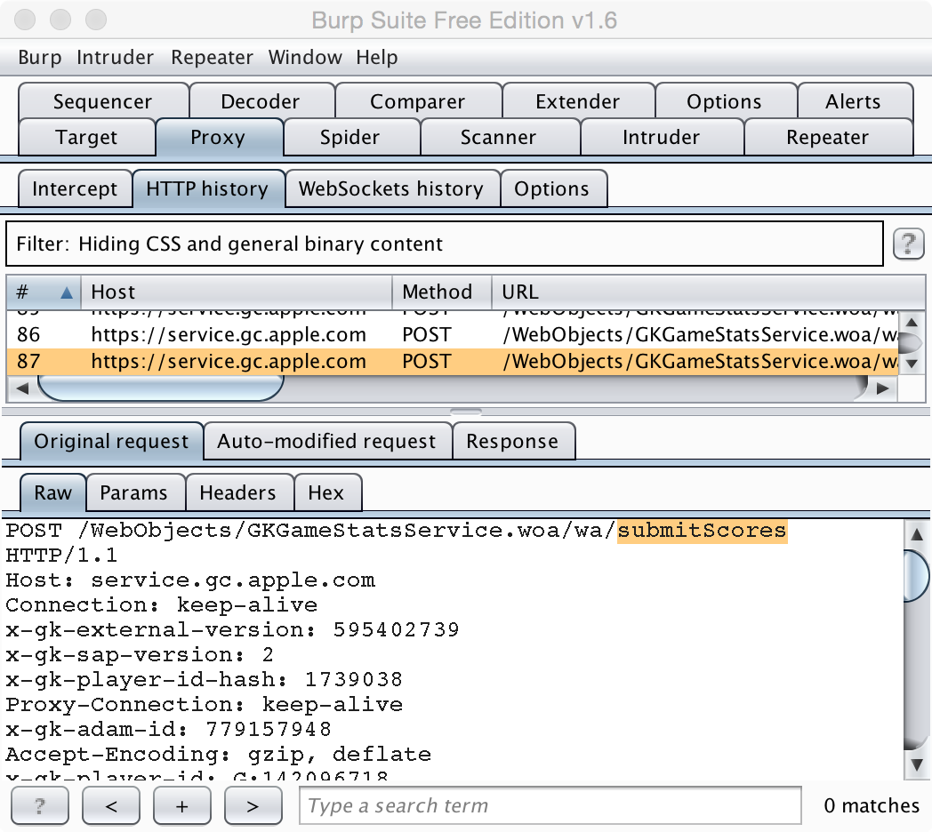
SSL MitM
Configure iOS to use a proxy server (Burp Suite)
Browse to http://burp/cert and install the Burp CA certificate
Run Threes, play game
Inspect score submission

Slide 25
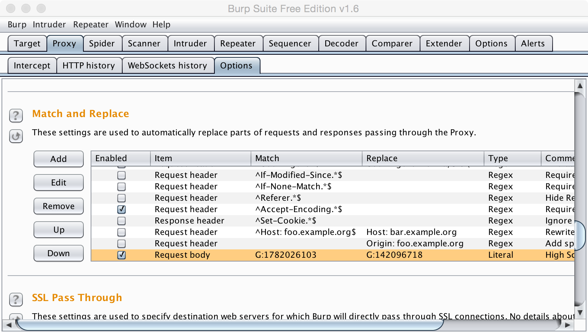
Burp Match and Replace
Automatically replace my unique Game Center ID with that of a high scoring player, recording his achievements as my own.

Slide 26
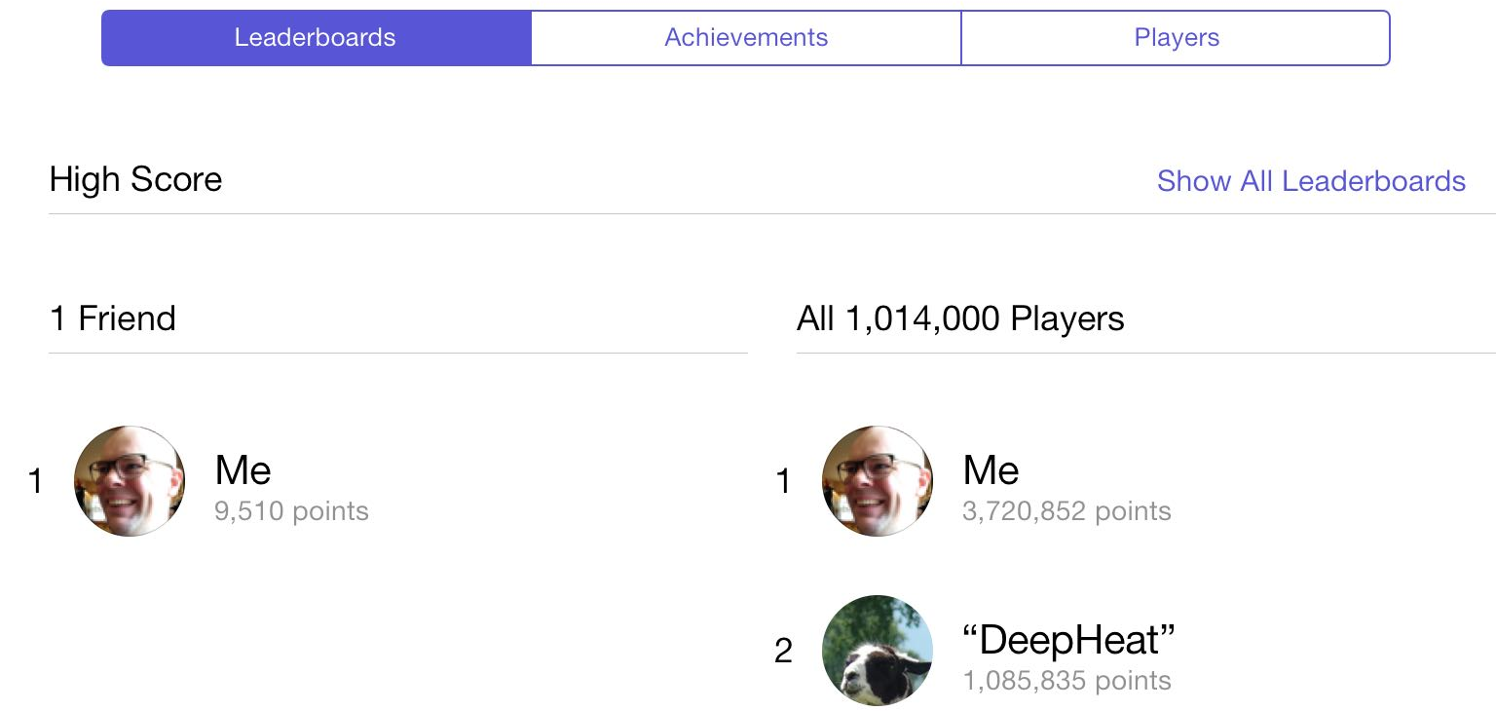
This is My "Happy" Face

Slide 27
Game Hack #3: App Manipulation
Obj-C is a reflective programming language.
We can explore app classes, methods and variable names used by the developer.
With a jailbroken device, we can manipulate how an app functions, running new code as desired.

Slide 28
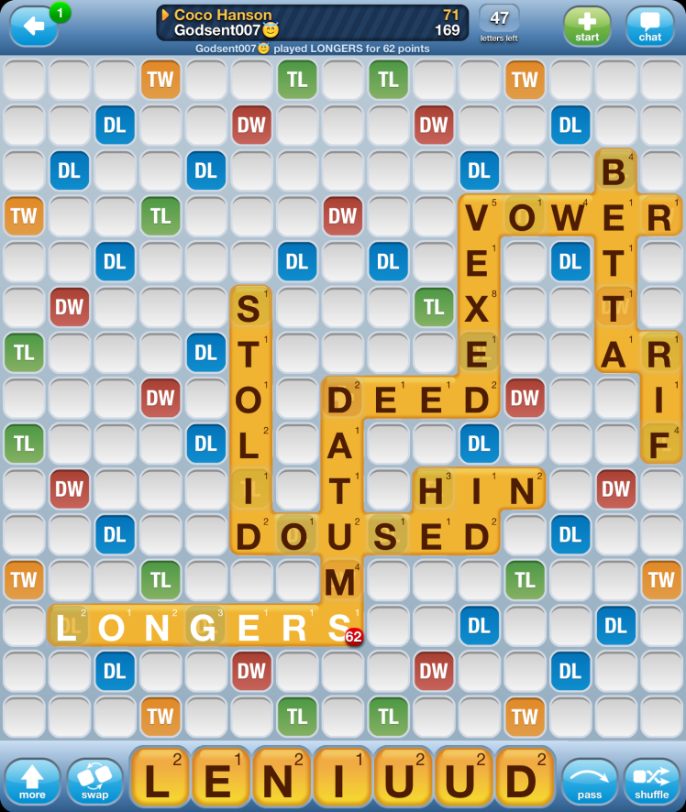
Words with Friends
Multi-player word game by Zynga
  "It's not Scrabble" © Hasbro
#155 top grossing iOS, #55 top free games
  $12K in daily revenue
Heavy social interaction, compete locally or globally

Slide 29
App Manipulation with Cycript
Explore app classes and methods
  Using Cycript and iPhoneDevWiki functions or class-dump-z
Identify the method you want to change
Attach to the game process with Cycript
Reassign functionality as desired using a mix of Obj-C and JavaScript code

Slide 30
Words with Friends: isValidWord
# cycript -p WordsWithFriendsFreeiPad
cy# [ObjectiveC.classes allKeys]
@["UINib","BurstlyCurrencyUpdateInfo","GEOTileLoader","NSSortedArray","AARegisterRequest","PLLocationController",...
cy# ObjectiveC.classes["WordGameDictionary"]
#"WordGameDictionary"
// Paste printMethods()
cy# printMethods(WordGameDictionary)
[{selector:@selector(isValidWord:),implementation:0x241f71},{selector:@selector(getDawgArray),implementation:0x241e41},...]
cy# WordGameDictionary.messages['isValidWord:'] = function() {return true;}
function () {return true;}
Submitted words are no longer checked for validity.

Slide 31
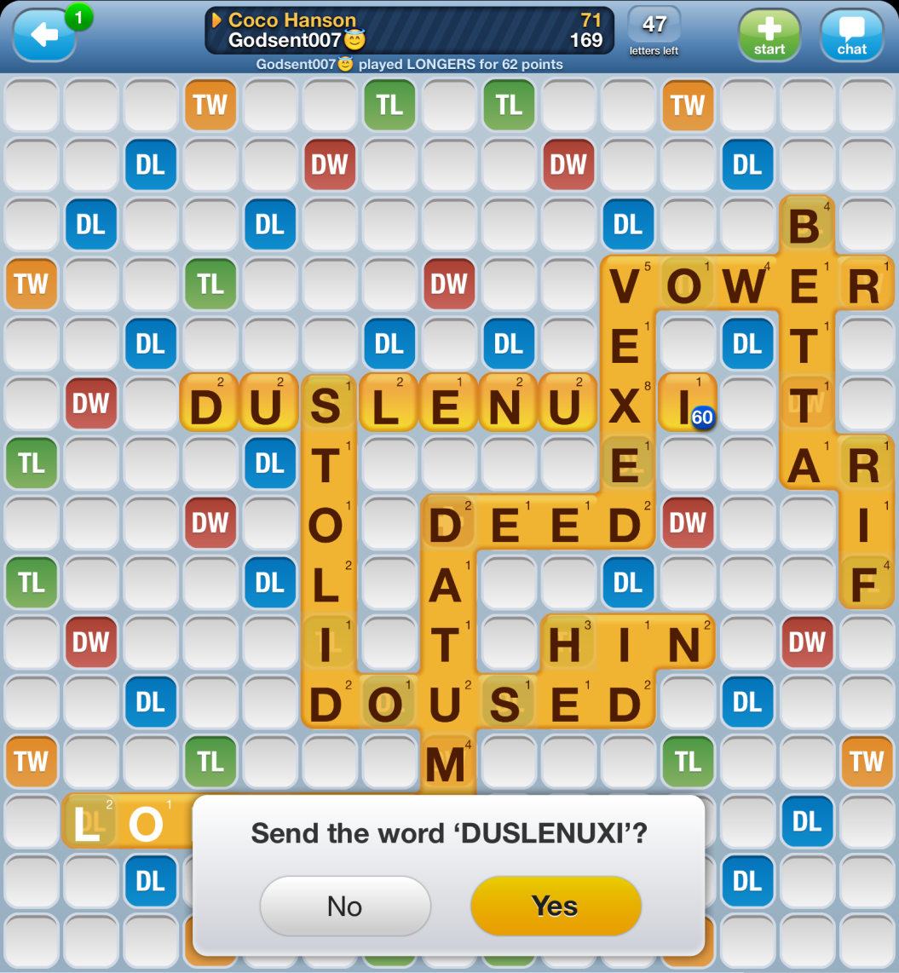
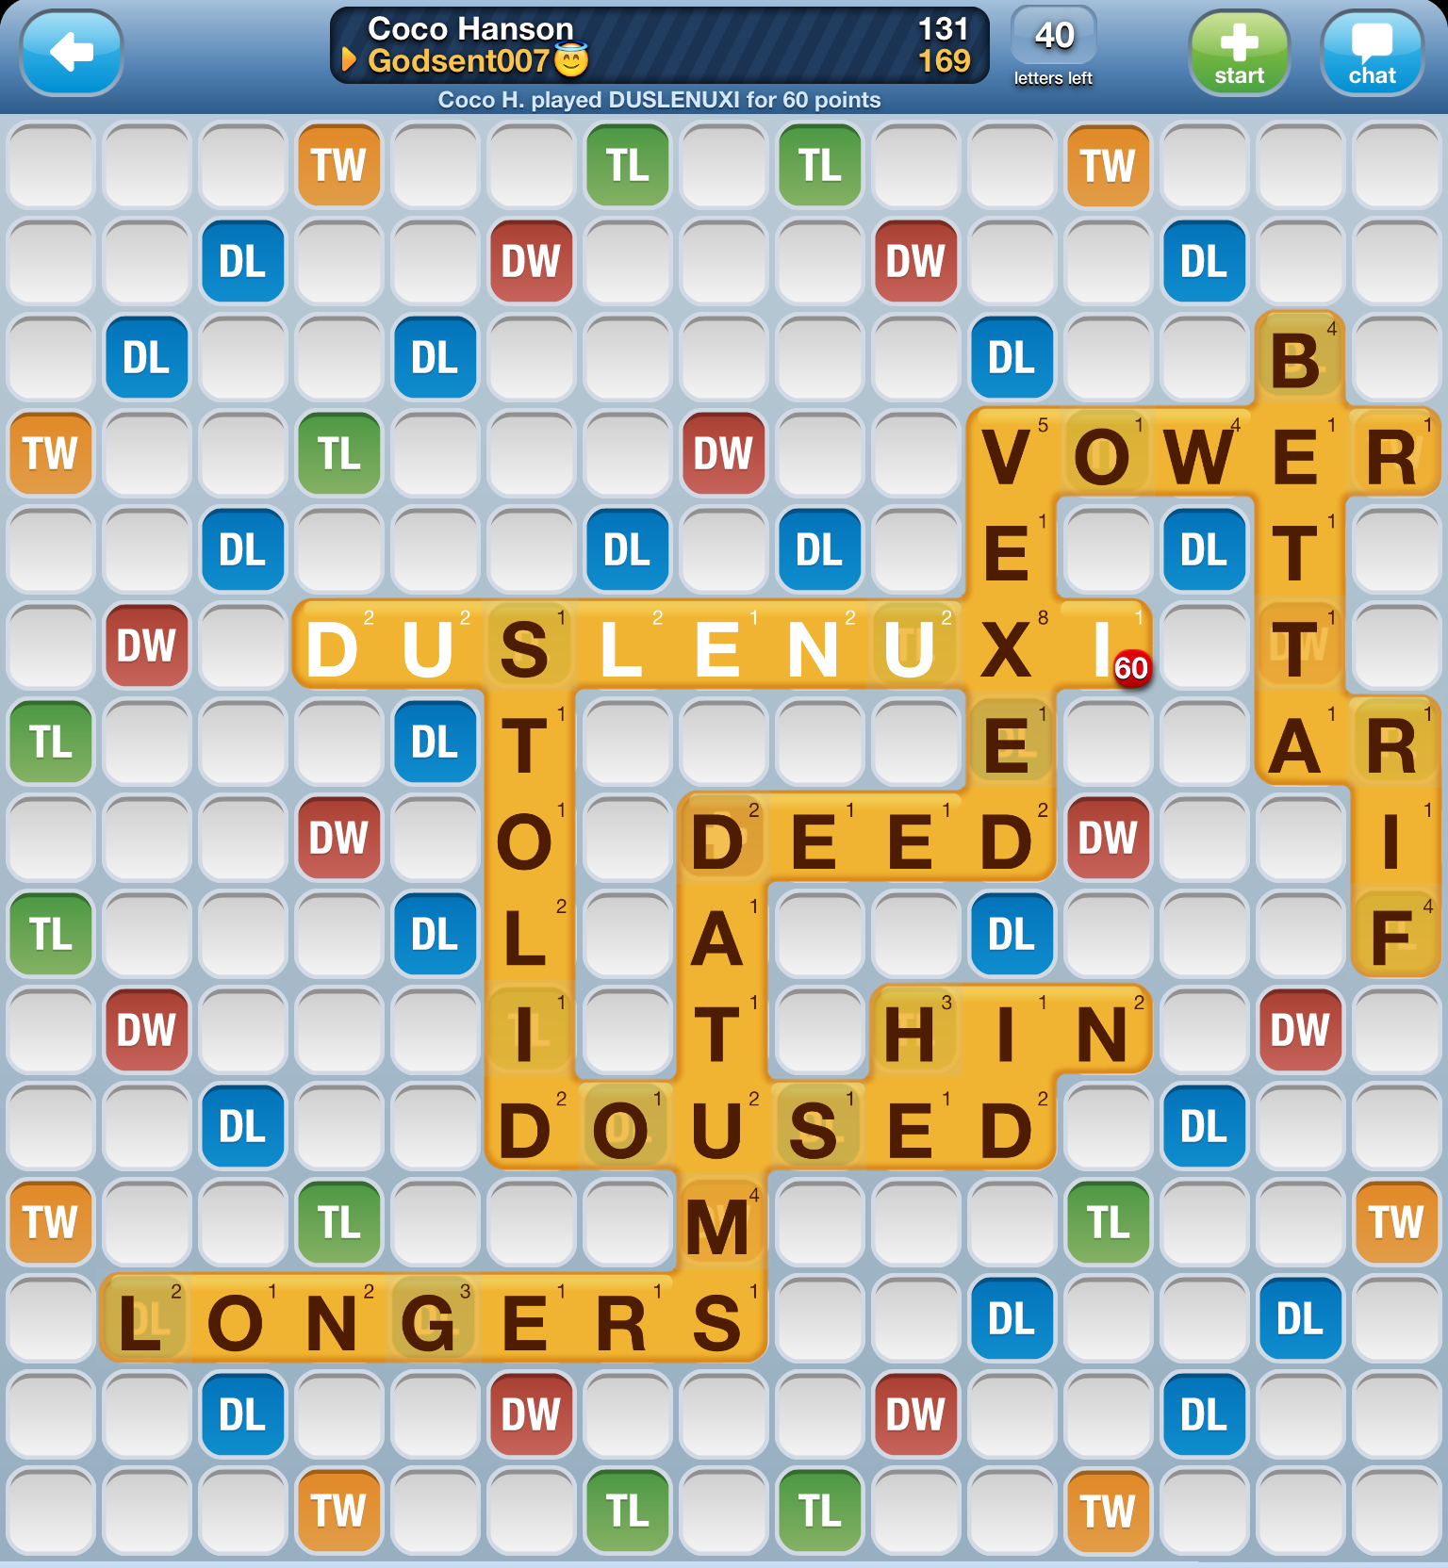
60 points for duslenuxi !
Notes:
http://iphonedevwiki.net/index.php/Cycript_Tricks

Slide 32
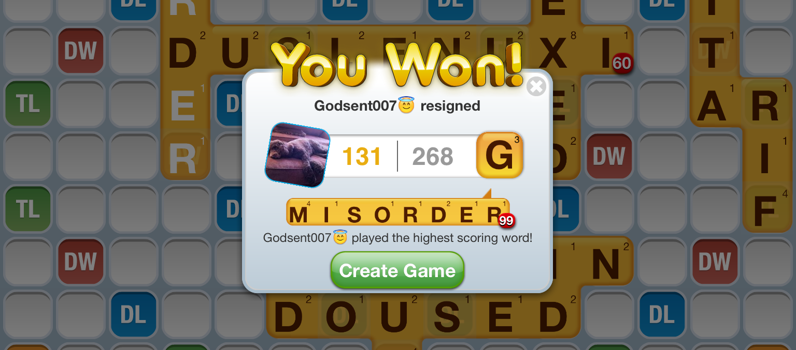
Godsent007 Resigned :(

Slide 33
Practical Application
I'm not showing you these techniques so you can steal coins or impress your friends with the use of the word "quone".
These techniques are best applied to improve the security of apps through penetration testing.
Use your skills for good, not evil.

Slide 34
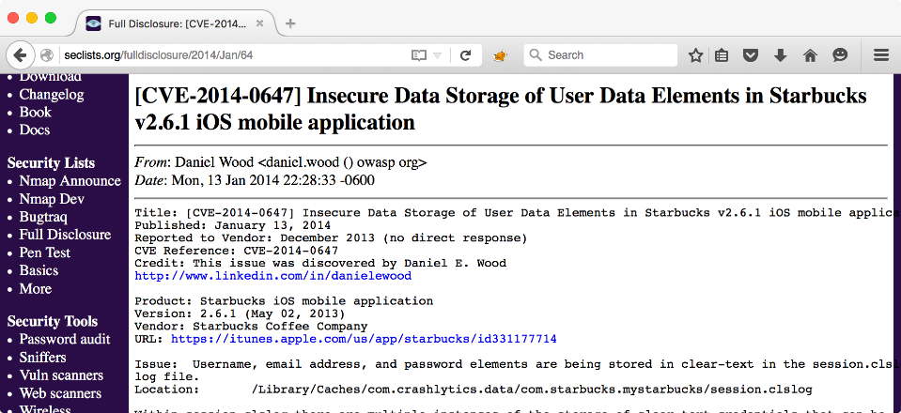
Dangerous File System Artifacts

Slide 35
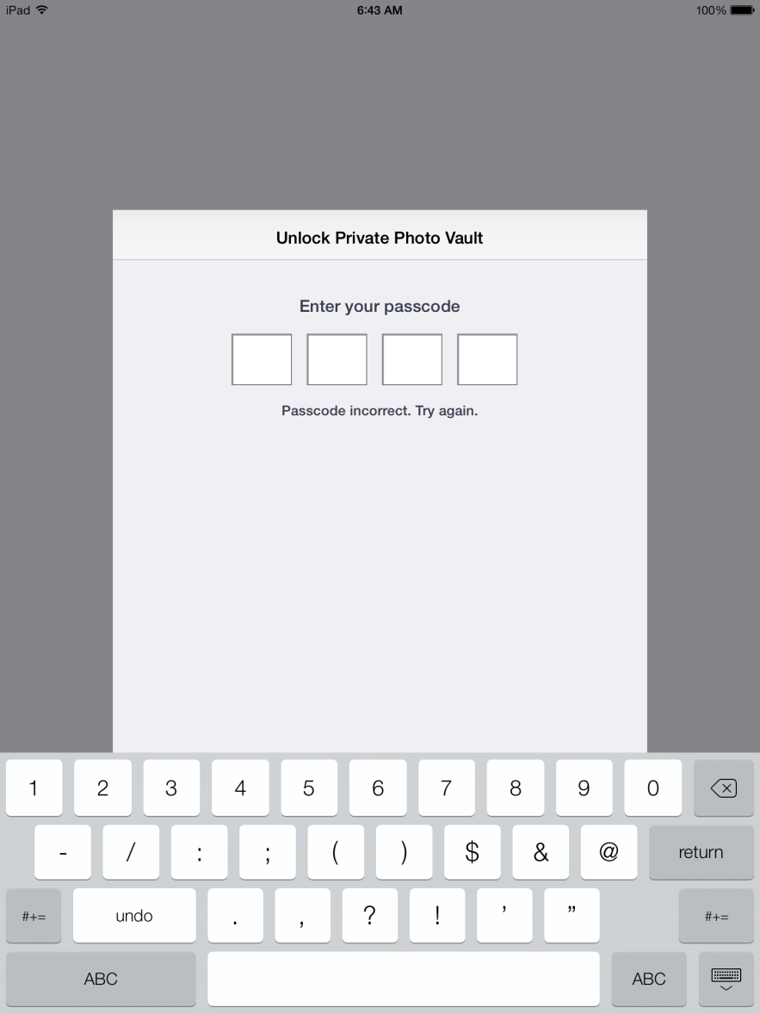
#1: Save File Storage
Question: Does the app securely store a password used to unlock an app?
Copy "A" set, change passcode, copy "B" set
Use diff to identify file changes
$ alias pcat="/usr/libexec/PlistBuddy -c Print"
$ pcat com.enchantedcloud.photovault.plist | grep PIN
PIN = 9121

Slide 36
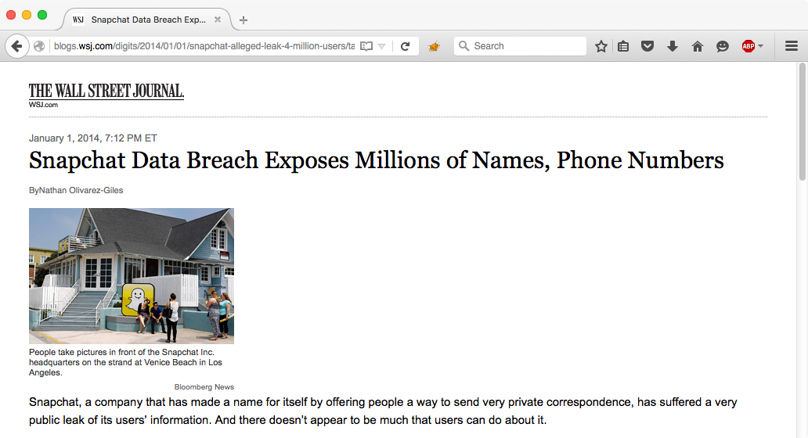
Snapchat Hack

Slide 37
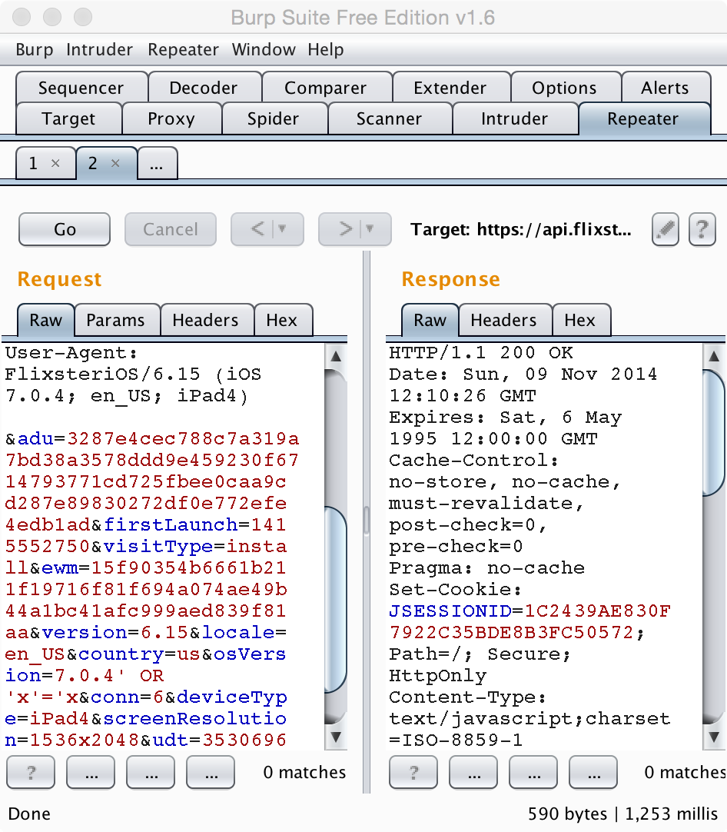
#2: Network Traffic
Question: Can we manipulate app network traffic to exploit back-end server weaknesses?
Configure iOS device to use Burp Suite as a proxy server
Intercept and manipulate traffic traffic
Identify XSS, SQLi, CSRF, LFI, RFI, RCI vulnerabilities

Slide 38

Hello Barbie Hack
"The mobile app contained a number of vulnerabilities … the app can be altered, which enables leakage of credentials used to authenticate with the ToyTalk servers as well as the disabling of security features within the app."
Bluebox Security White Paper

Slide 39
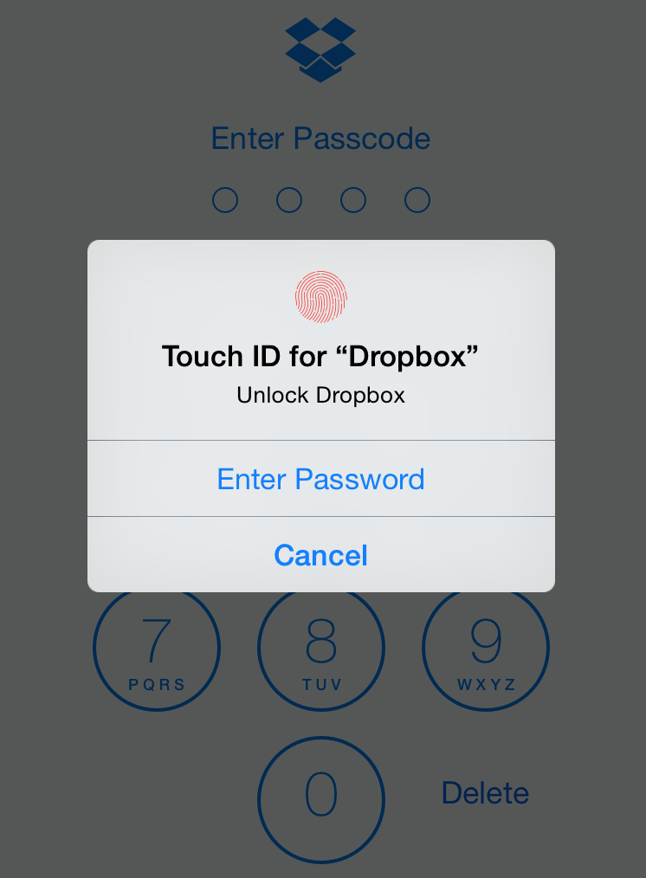
#3: App Manipulation
Question: Can we bypass app authentication controls?
Dropbox: Now with TouchID integration!
  No encryption, just a lock screen
# cycript -p Dropbox
cy# var ViewController = [UIApplication sharedApplication].keyWindow.rootViewController.presentedViewController->_passcodeController;
cy# var DBLoggedInPasscodeState = [DBStateManager sharedInstance]->_dbState;
cy# [DBLoggedInPasscodeState ViewControllerDidReceiveCorrectPasscode:ViewController];

Slide 40
Conclusion
iOS games are a big market, with a lot of money to be won and lost.
We can use file system diff and editing, network traffic manipulation, and dynamic app manipulation to win…unfairly.
More importantly, we can apply these skills to identify significant flaws in apps, and become better penetration testers.

Slide 41
Contact and Resources
Joshua Wright
jwright@willhackforsushi.com
www.willhackforsushi.com
@joswr1ght
+1-401-524-2911
I am the author of
SANS SEC575: Mobile Device Security and Ethical Hacking
www.sans.org/sec575
iFunBox - www.i-funbox.com
Diff Man Page - linux.die.net/man/1/diff
Hex Fiend - ridiculousfish.com/hexfiend
Beyond Compare - www.scootersoftware.com
WinMerge - winmerge.org
Burp Suite - portswigger.net
Cycript - www.cycript.org
iPhoneDevWiki - iphonedevwiki.net
Thank you! Questions?

