Slide 1
SANS Institute
Develop Technical Recall Skills: Spaced Repetition with Anki
Joshua Wright | Wednesday, June 10 2020*
Senior Instructor and Author
* Or something. Honestly, I lost track of days a while back.

Slide 2
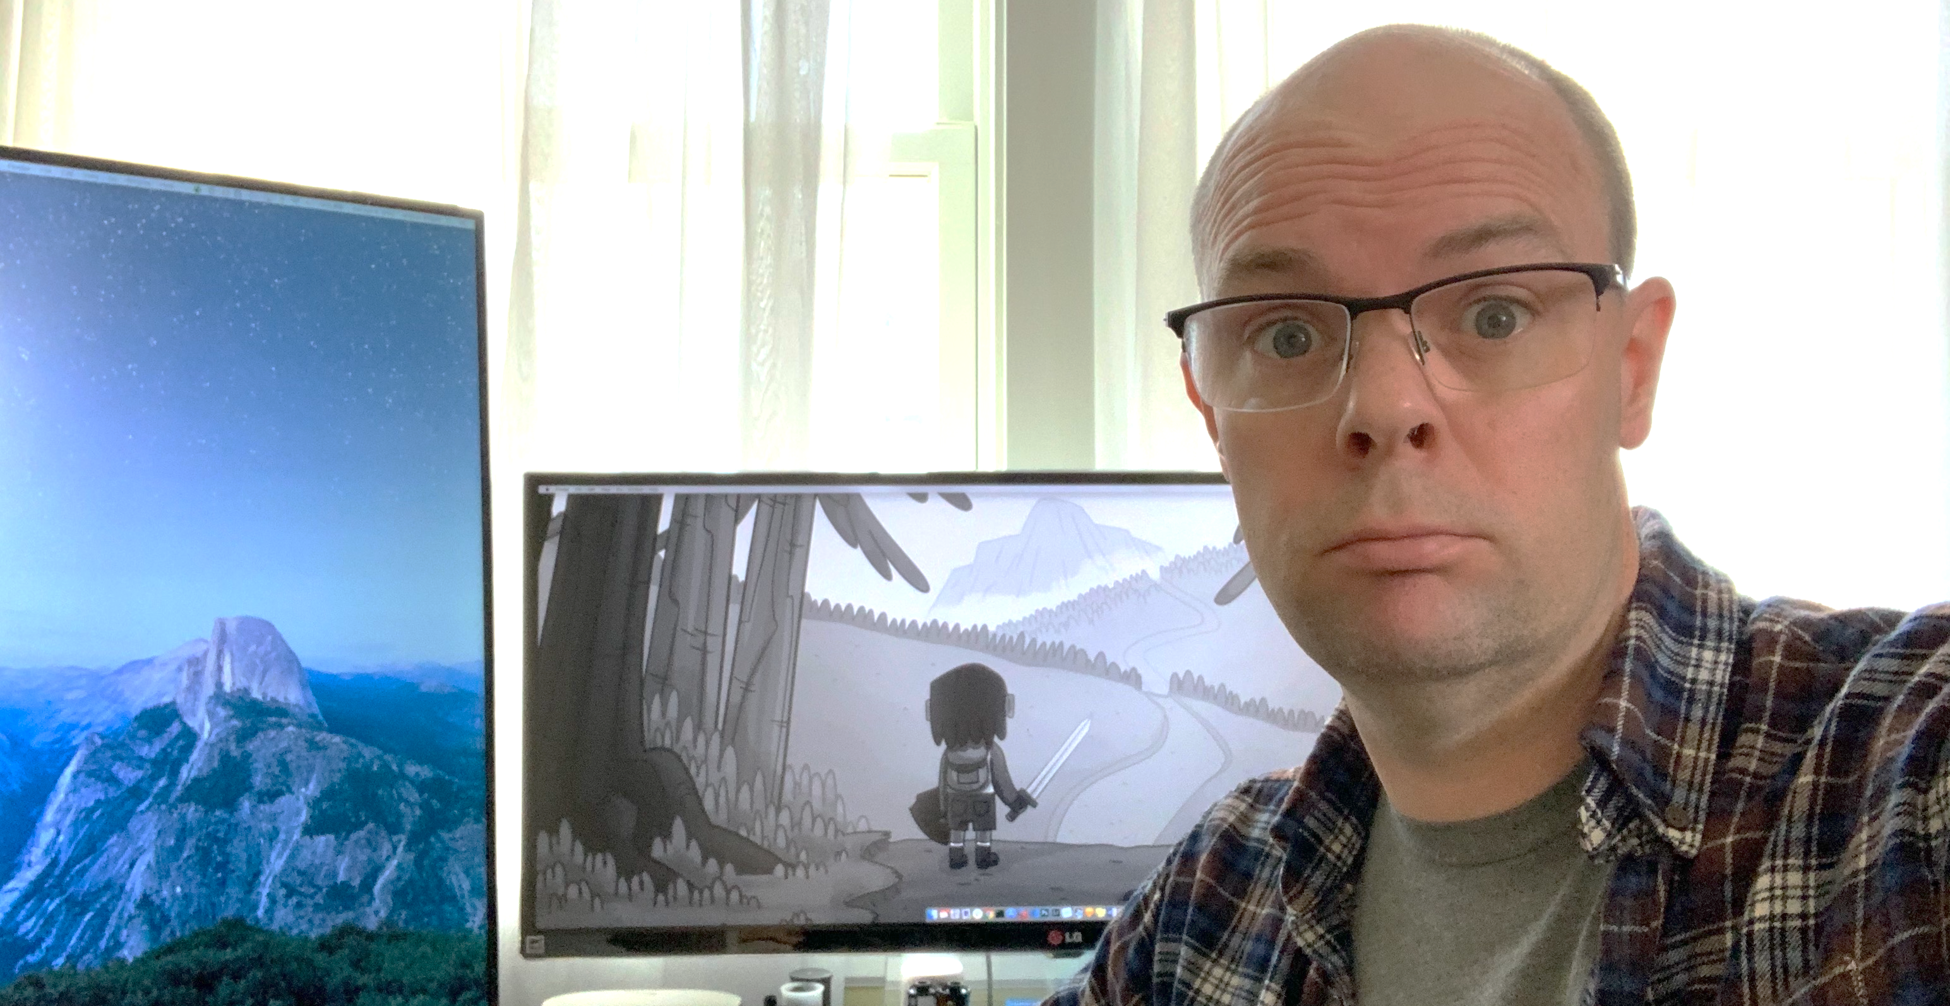
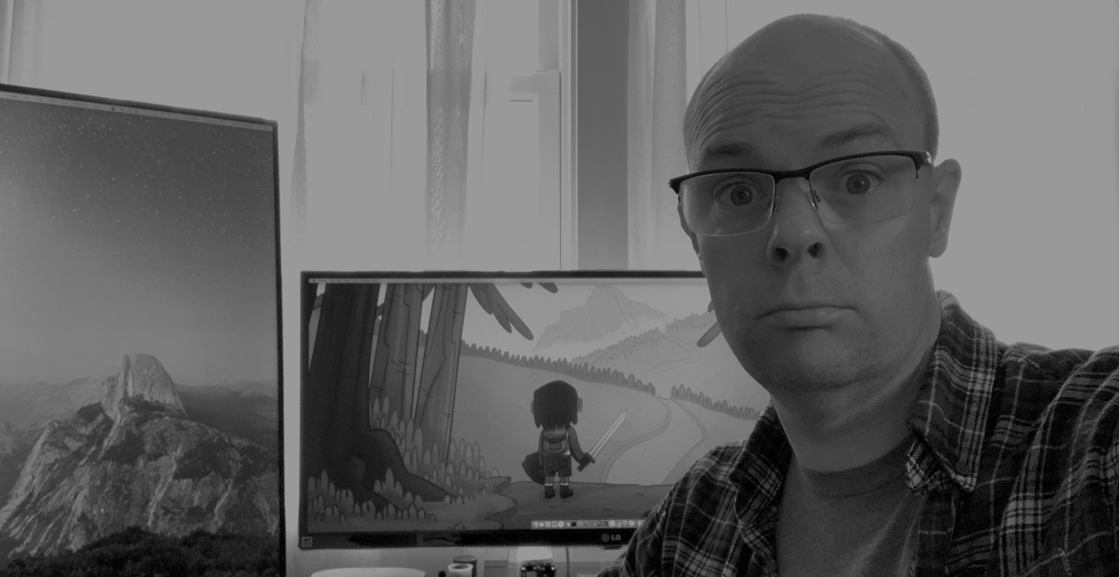
I really need to learn more about Docker Swarm.
Bookmarks an article on Portainer to read ... later.
Kubernetes? Oh, and Terraform. Oh, and Helm. And Spinnaker.
Should I memorize the arguments to kubectl? kubectl --exec ...
What does EKS stand for again? Googles for 15 minutes...
Oh crap, I messed up the GitHub repo...again.
I'll spend some time reading up on docker-compose.yaml
YAML syntax is interesting. ERROR: yaml.parser.ParserError
AKV with AKS apps built using Vagrant and Ansible. Googles...
Rust? Sure, why not? Or, maybe I should start Golang again. Or PowerShell. Oh, new Python3 features? Or ... Clojure?
This all happens before 10 AM.
It turns out, I'm not the only that struggles with this.

Slide 3
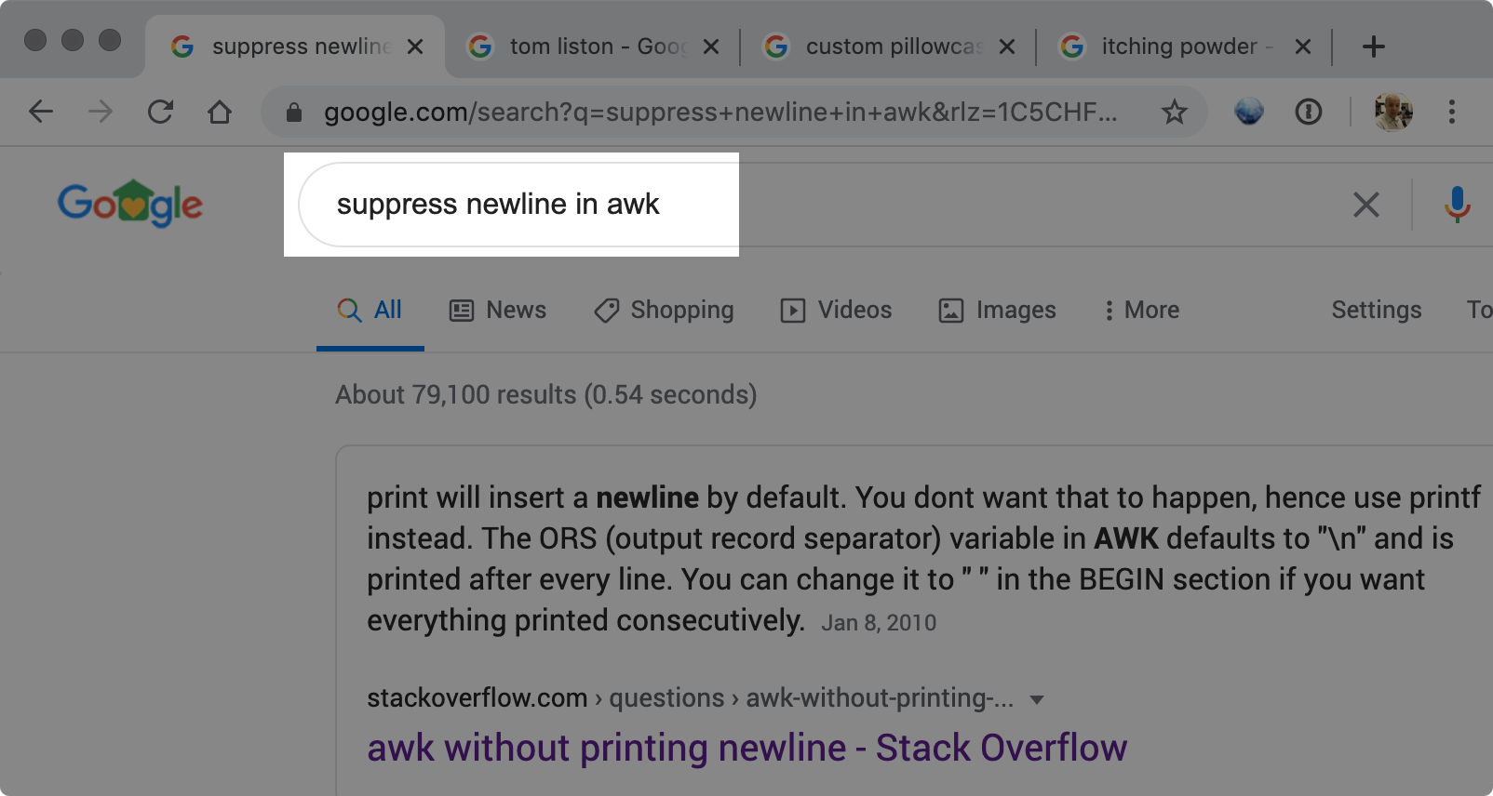
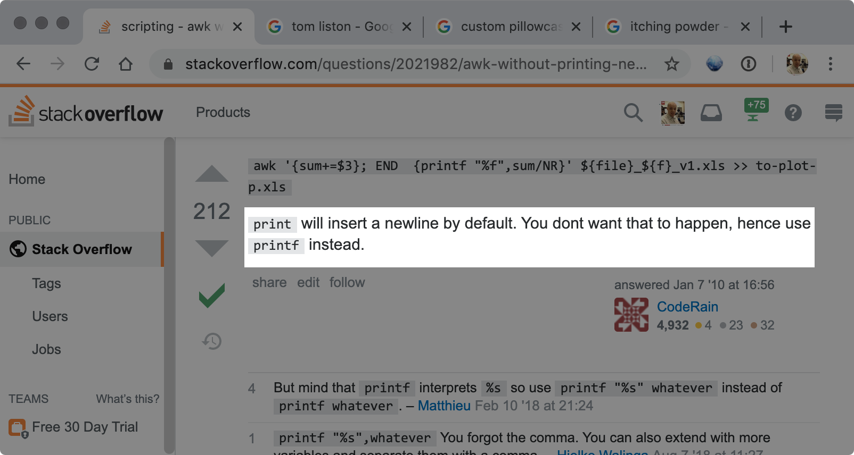
I will forget this in 15 minutes.

Slide 4
Why We Invest Time and Energy in Skill Development
What are your goals for developing technical skill?
I want to pass a certification exam
I want to build recall to draw on this knowledge when needed
I want to continue to build my skills in other advanced areas
I want to be the SME that other people turn to when they need help
I want to use what I've learned to meet my career goals
I want to run screaming from this and choose a different career
There are no wrong answers. It is up to you to decide what you want to do with the knowledge you're gaining. Let's examine some opportunities to maximize the time you have to spend on meeting your goals.

Slide 5
The Problem of Focused Technical Training
Focused technical training (such as SANS classes) gives you access to expertise that requires many years to develop
  Delivered in a short period of time
SANS authors develop the content to suit different learning styles
This exposure gives you an accelerated jump start to mastery of the subject area
These are the good points about short-term focused training. The hard part is building retention after the class is over.

Slide 6
The Forgetting Curve
Herman Ebbinghaus, 1885: 50-80% of what you learned 24 hours prior is forgotten (by day 30, only 2-3% is retained)
This is the Forgetting Curve, and it's kind of depressing
100%
Understanding
0%
Day 1
Day 2
Day 7
Day 30

Slide 7
Spaced Repetition
Within 24 hours, review the material again for 30 minutes
  This resets your retention curve to 100% again
48 hours later, review again for 25 minutes (back to 100%)
  Each subsequent review requires less time than the prior review, and builds retention
30 minute
review
15 minute
review
5-10 minute
review
100%
Understanding
0%
Day 1
Day 2
Day 7
Day 30

Slide 8
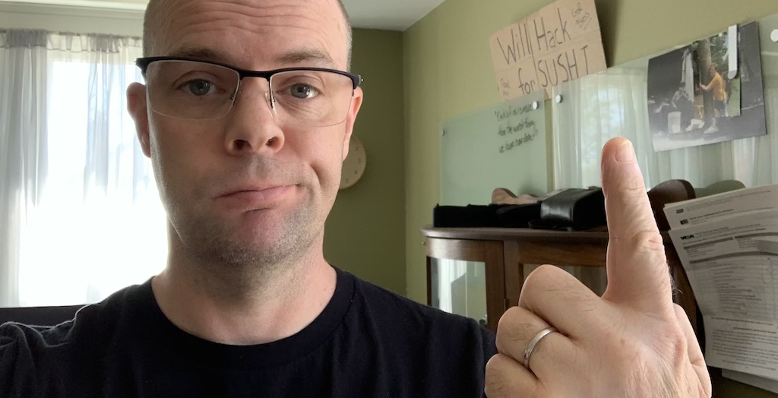
"Good morning class. Today we're going to review Chapter 4 and our study on early Republican Rome. Then we'll continue to examine Imperial Rome with the introduction of the first Roman Emperor: Augustus."
This style of teaching should be familiar to you. It's what is employed in schools worldwide when there is a long period of study available.

Slide 9
Optimizing Review Intervals
Optimal interval for review is based on two non-intuitive ideas
1. Longer review intervals lead to stronger recall skills
I asked friends who work in fields where they have to memorize a lot of facts what they do
  Medical students, polyglots, applied math graduates
2. Review intervals need to be short enough to recall concepts with minimal review time
The best way to optimize study time is Anki.

Slide 10
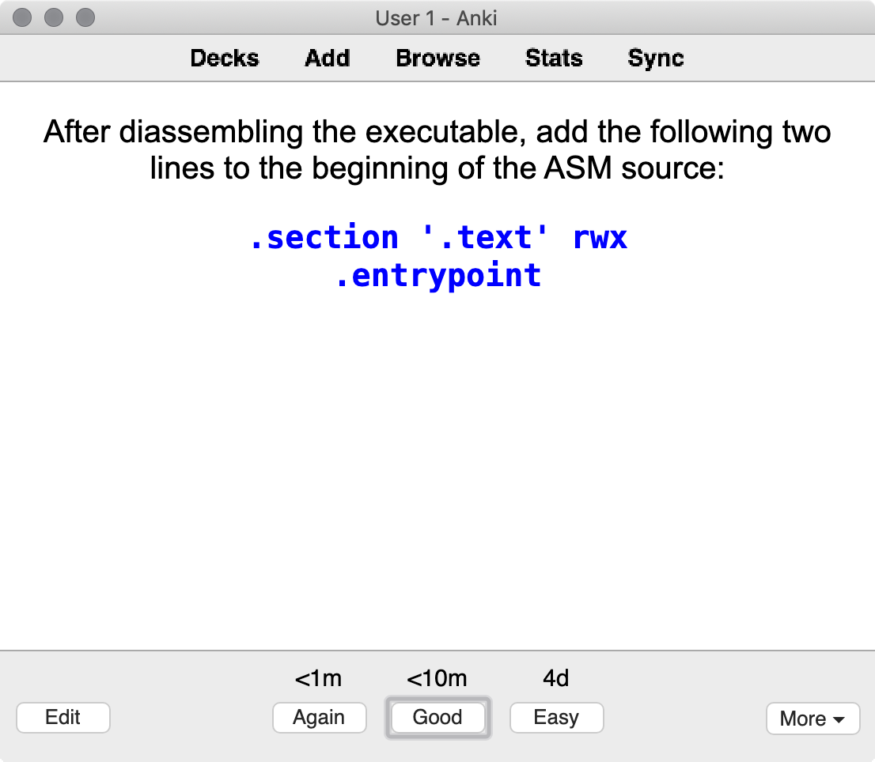
Anki
Anki is a free flash card app that integrates spaced repetition training
Anki uses your input of Again, Good, or Easy after answering a question to reschedule the card for retraining
  If you indicate Easy, Anki increases time before showing this card again
  If you indicate Again, Anki decreases time before showing this card again
After answering, select your comfort level with recall for this question.
https://apps.ankiweb.net

Slide 11
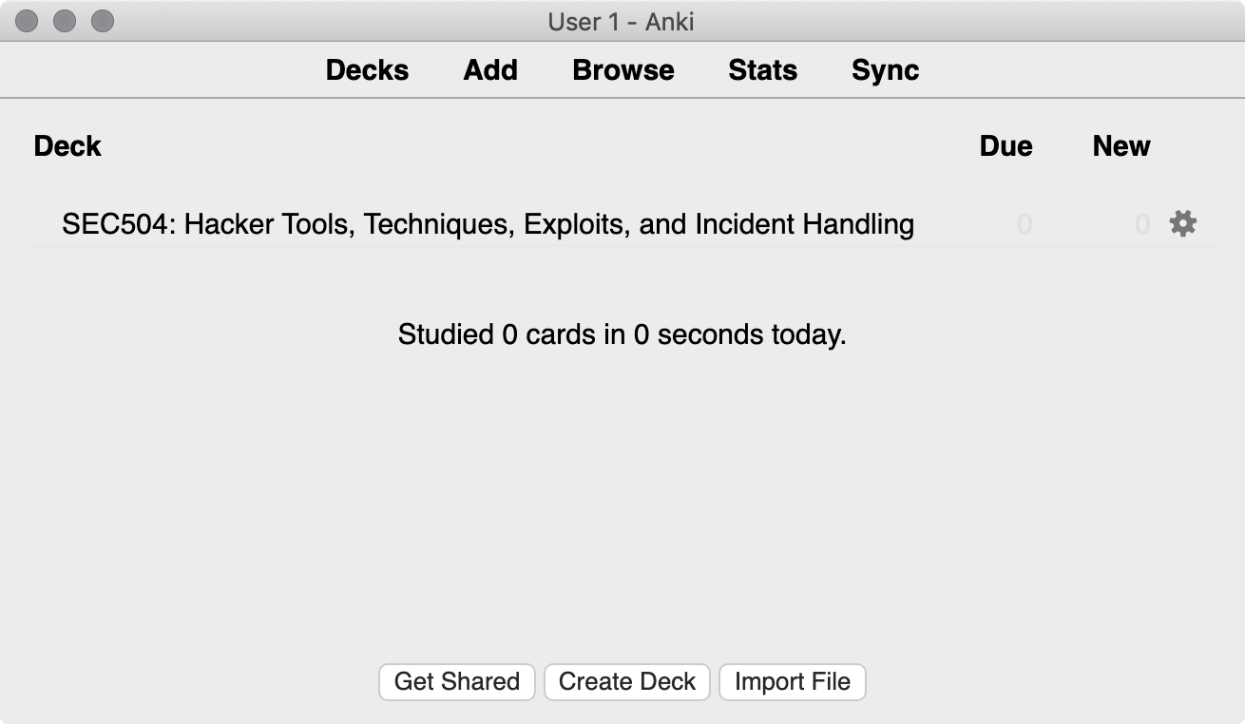
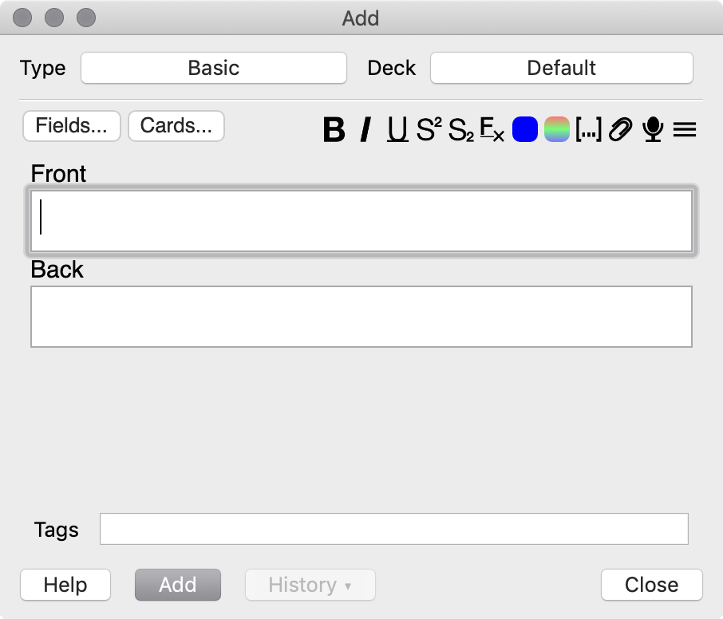
Start Anki, and create a deck of study cards. Add your first card. Change the card type from Basic to Cloze.

Slide 12
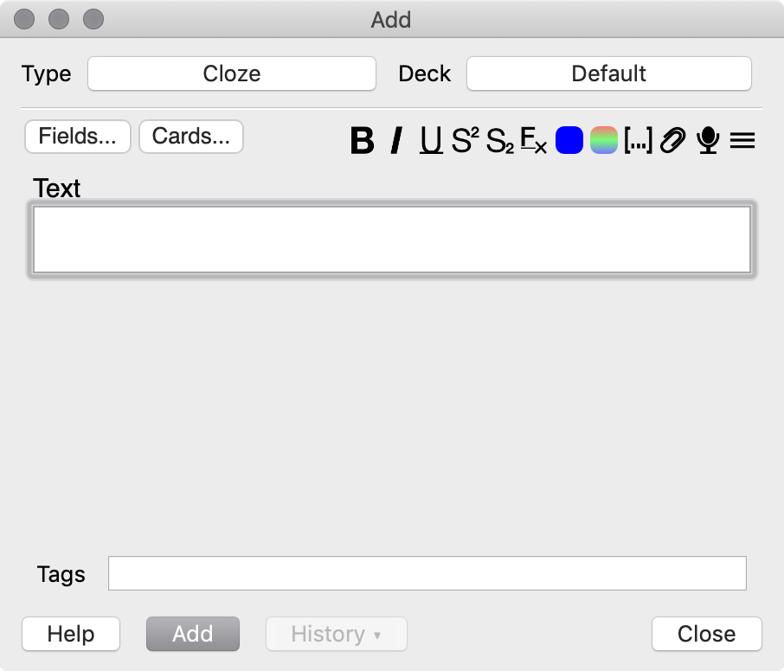
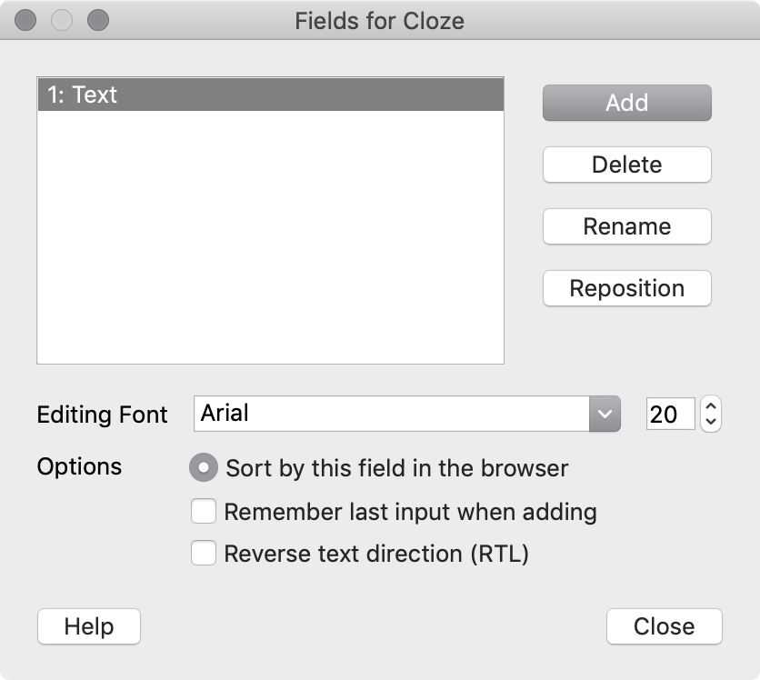
I like to customize the Cloze type to include a graphic element. You only have to do this once. Click Fields, then click Add.

Slide 13
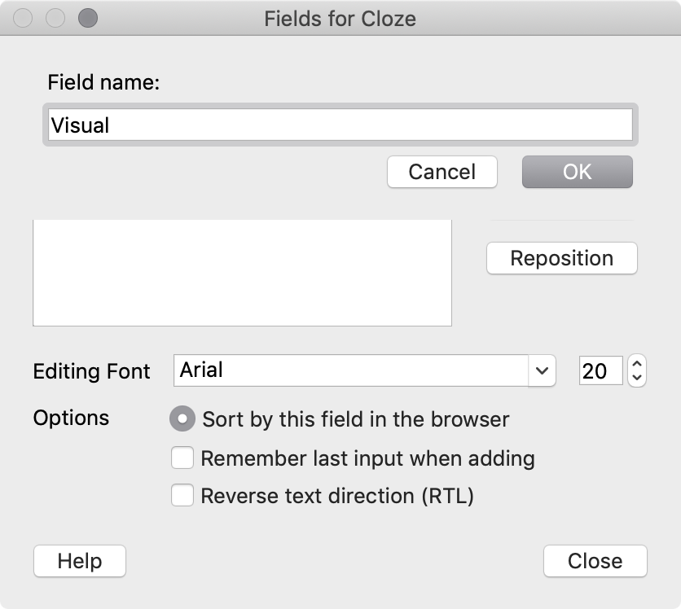
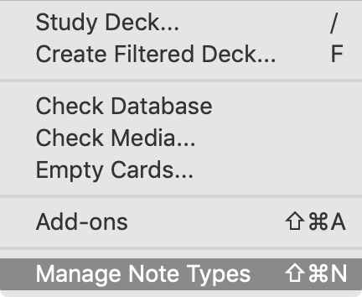
Next, click Tools | Manage Note Types.
Create a new field called Visual (or Graphic, or Screenshot, or whatever). Click OK.

Slide 14
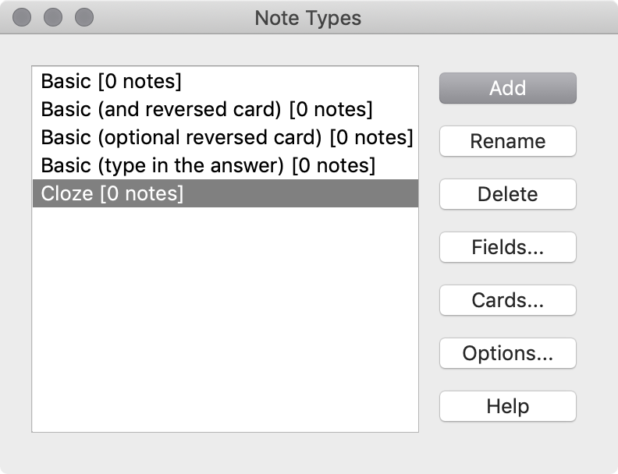
Click Cards to customize the Cloze card type.

Slide 15
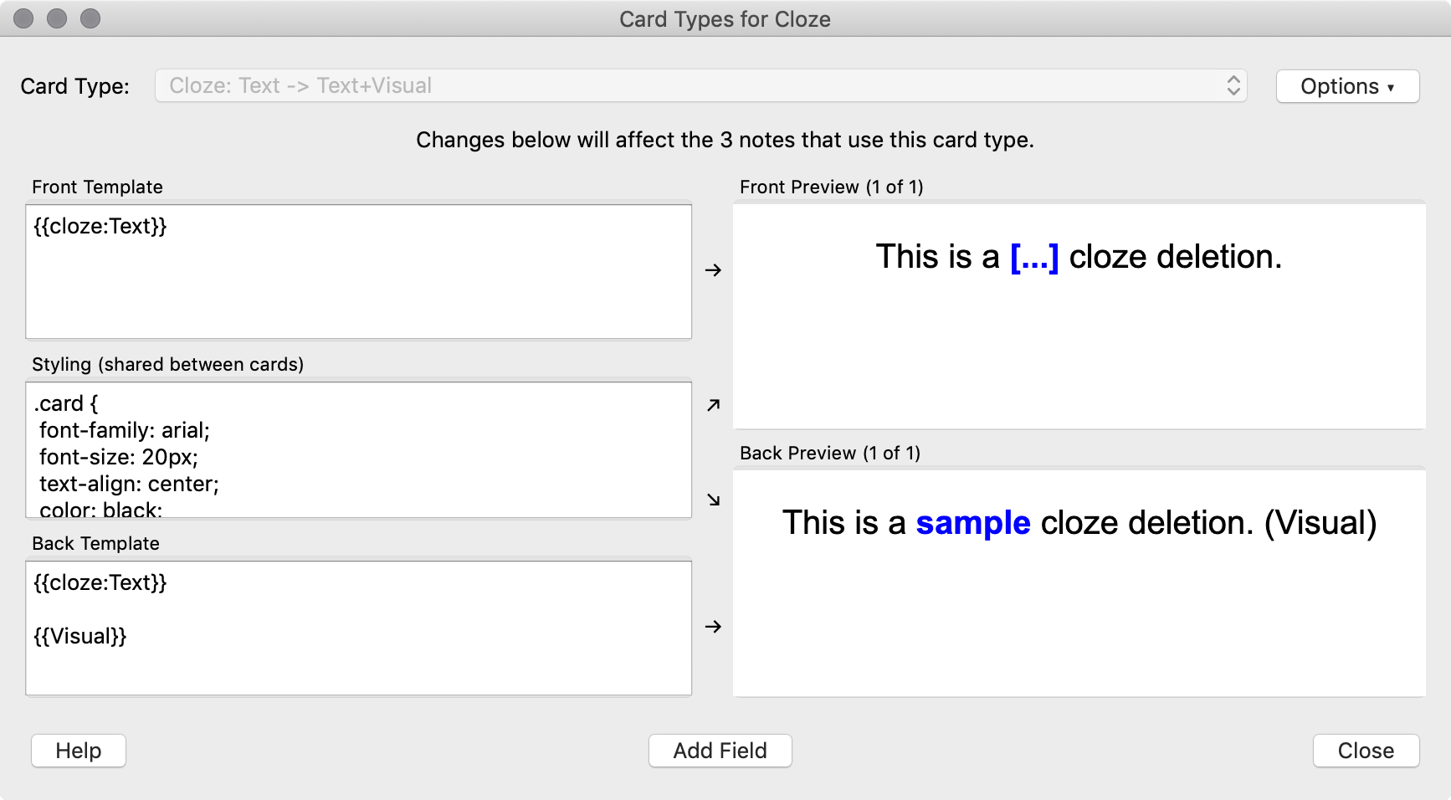
In the Back Template section, underneath {{cloze:Text}} add {{Visual}} (with the curly brackets). Then click Close.

Slide 16
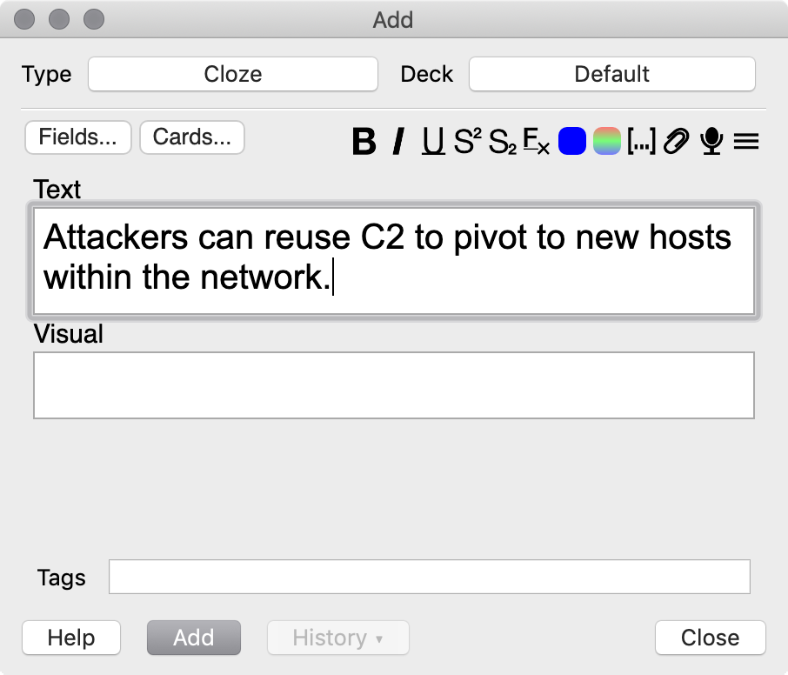
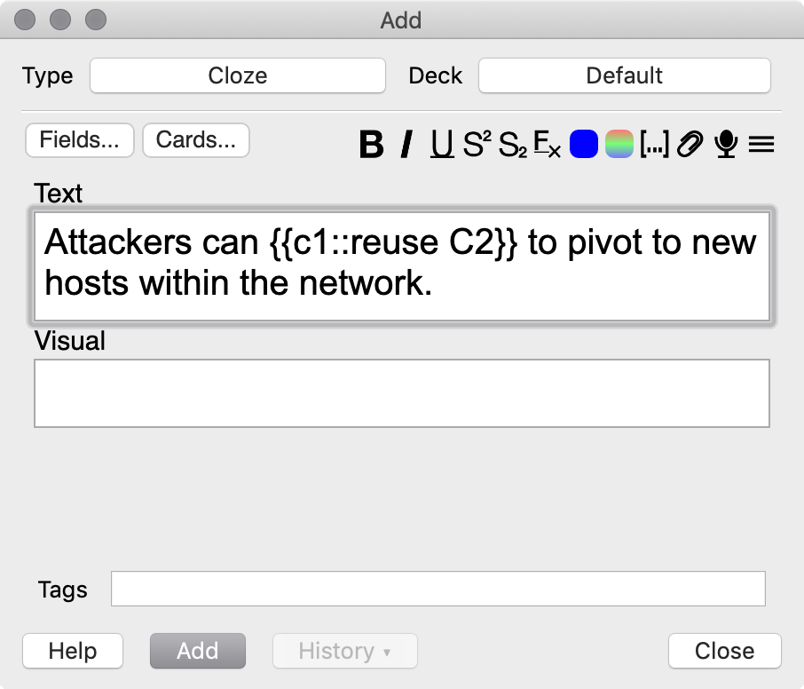
Add a statement that you want to commit to long-term memory.
Highlight the part of the statement and press CTRL+Shift+C to create a Cloze block.

Slide 17
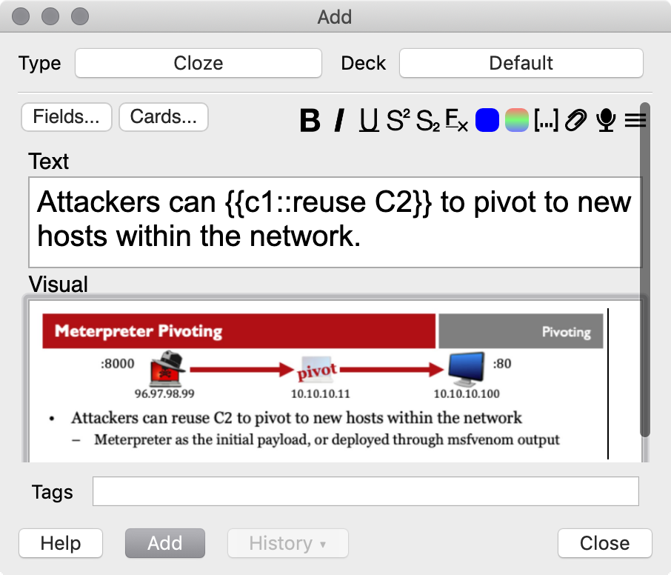
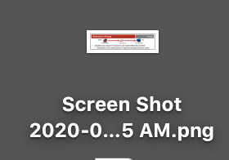
Drag and drop a screenshot in the Visual block, then click Add.

Slide 18
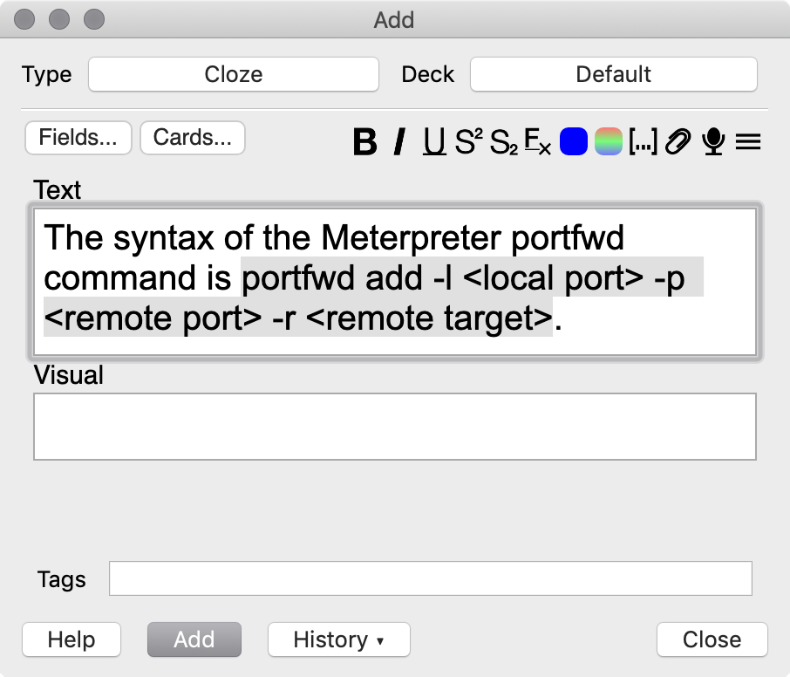
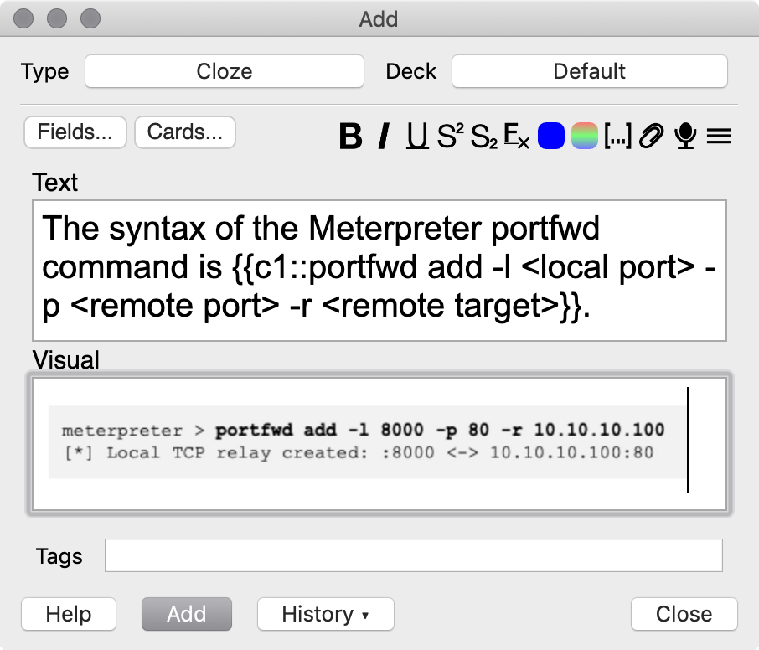
Another example, highlighting the command syntax as the Cloze block.

Slide 19
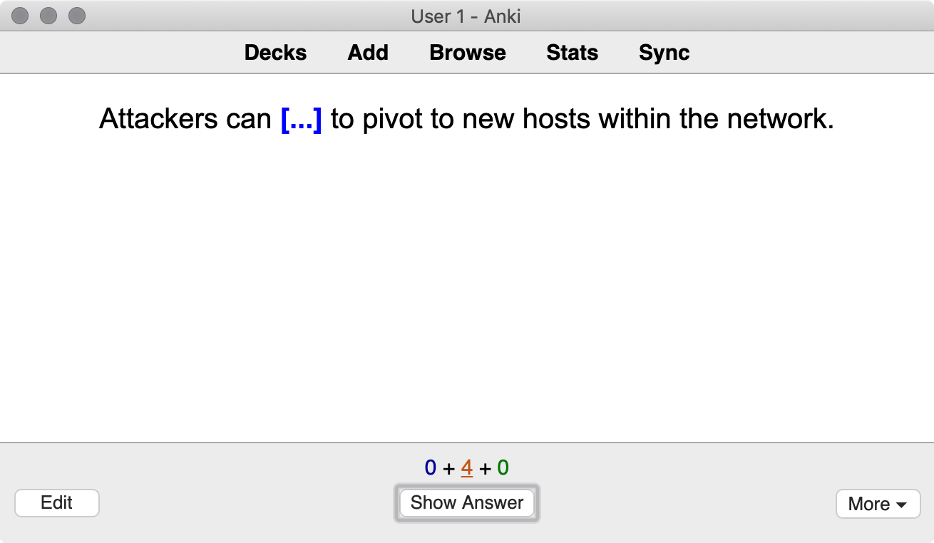
When you study, Anki will ask you to answer the Cloze block in [....]. Try to remember the answer, then click Show Answer.

Slide 20
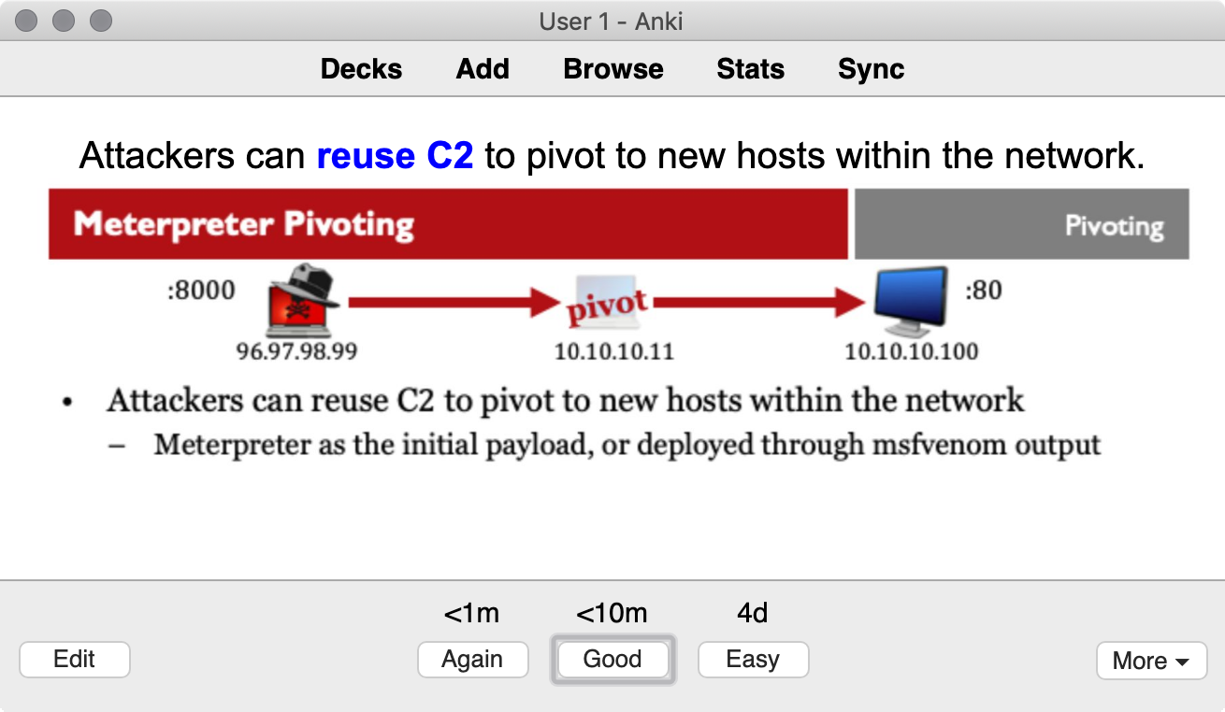
How hard or easy was the question?
Click Again (it was HARD), Good (I sort of knew the answer) or Easy (I knew the answer).

Slide 21
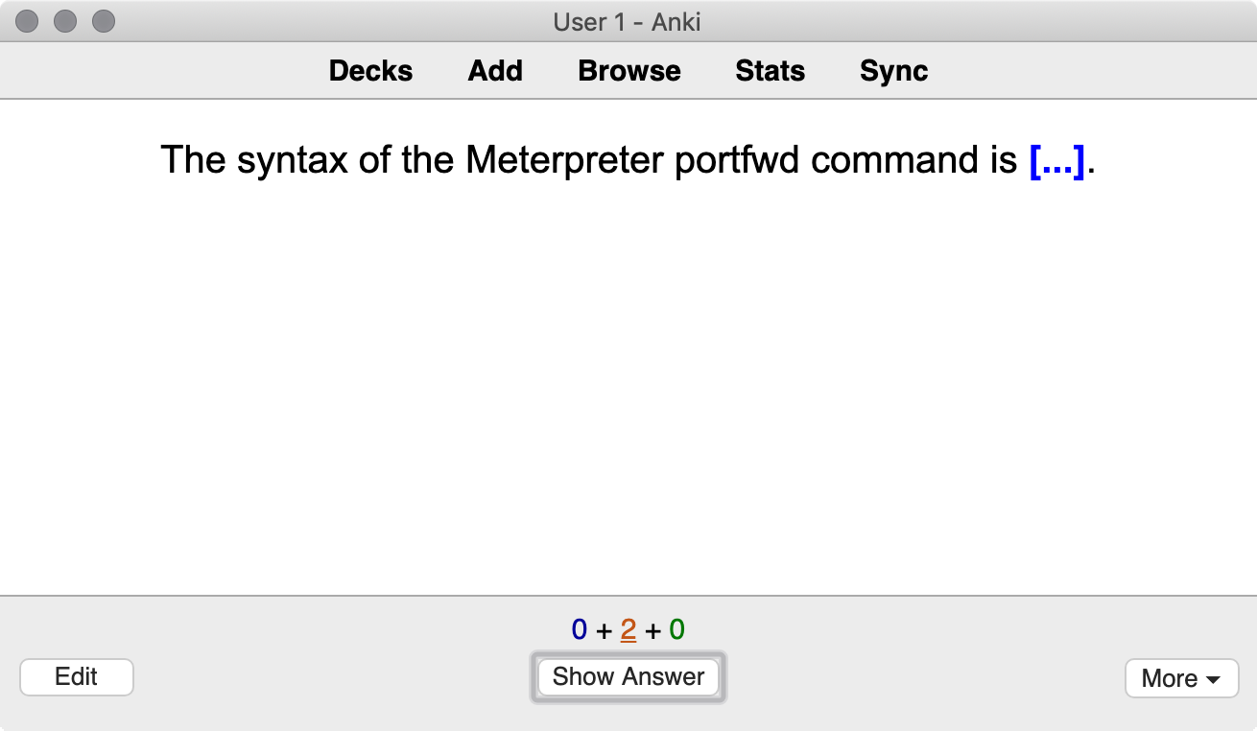

Slide 22
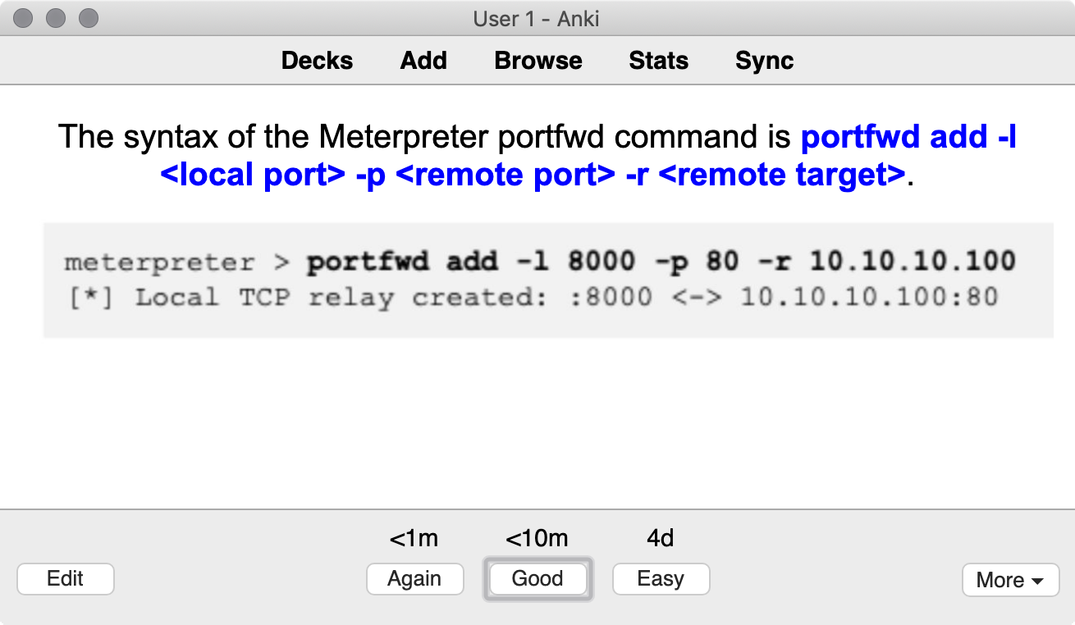
Choosing Again/Good/Easy sets up Anki for spaced repetition practice, optimizing your study time to maximize retention.

Slide 23
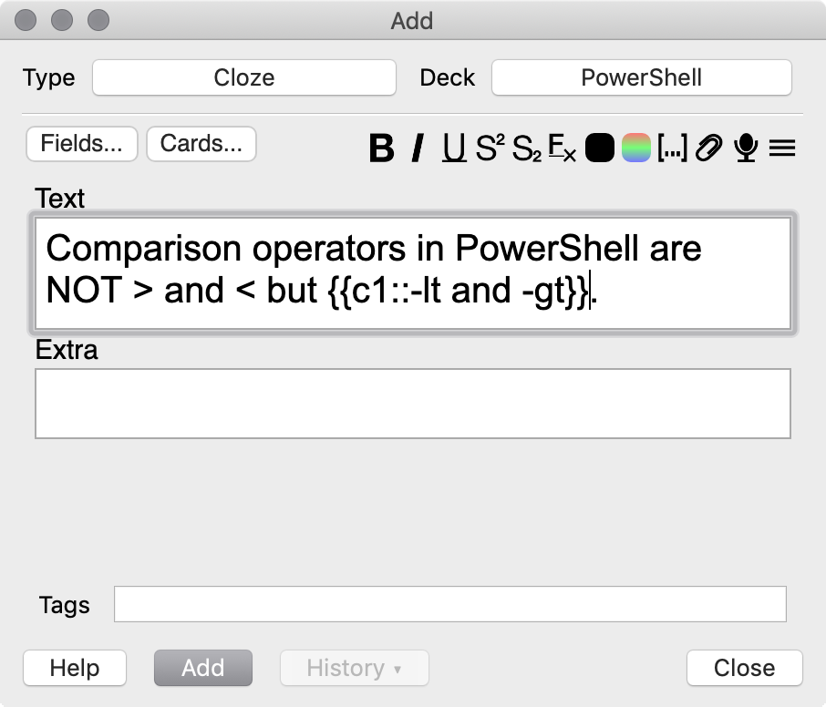
Putting Anki in Practice
After you take a focused-study class, review and create Anki cards for self-study and retention development
While you are reading a technical book or taking a self-paced class, create Anki cards
Keep Anki open throughout the day; add the tidbits you Google (read: SO answers) to an Anki deck
Review your Anki cards every day for 15-30 minutes

Slide 24
There are two significant problems that Anki does not solve for you.

Slide 25
The Problem of Motivation
Retaining knowledge requires persistence, and persistence is self-motivated
Enjoyment: Finding enjoyment in your topic will help with motivation, and sustain you for long-term study.
Methods: A method (spaced repetition, Anki) gives you a task, and a clear completion target.
System: Habit development is necessary to continue a task through the long haul.
Patience: Frustration is a normal and valuable part of learning. Embrace it instead of being dissuaded by it.

Slide 26
The Problem of Time
Time is a precious commodity and we all have competing factors for our time
Studying Anki every day may seem burdensome on your time
  But 20-30 minutes/day decreasing to 10 minutes/day is much better than cramming for a week with little retention benefit
Revisit your goals – are they worth the time you need to invest?
What changes can you make in your life?
  Waking up a little earlier, studying over breakfast, watching one fewer 30-minute TV show/YouTube video, multi-tasking while exercising, ...
How important is retention to your employer?
  Can you dedicate time at work to study? Negotiate for time at your next compensation review?

Slide 27
Why Do We Care?
Your job matters. It really, really does.
Consider the alternatives:
  Important digital assets are lost
  Organized crime wins
  People lose their savings, retirement
  Cities go dark. Lives are threatened.
We're all in this together. Please support each other.
"Do the best you can until you know better. Then when you know better, do better." Maya Angelou

Slide 28
Free Anki Lab Exercise
https://sansurl.com/504-lab-ankicards
SEC504: Hacker Tools, Techniques, Exploits, and Incident Handling has gone through a major update:
  New emphasis on hands-on and practical incident response techniques
  New look at modern attack TTPs
  Integration with MITRE ATT&CK
  Double the number of hands-on exercises
  All new CTF
  Coming soon!
https://www.sans.org/sec504
Please reach out with your success stories, and your struggles. Thank you!
josh@willhackforsushi.com | @joswr1ght

