Slide 1

Hackventures with Josh: Using AI for Zero-Day Vulnerability Discovery
Joshua Wright | SANSFIRE 2026 | 2026-07-14

Slide 2
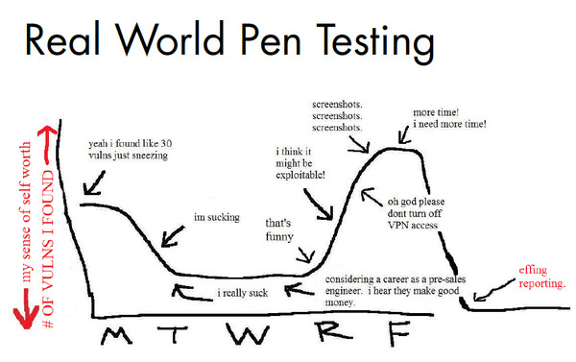
Credit: Vinnie Liu, like 30 years ago.

Slide 3
I forgot that this was fun.
(So, let's have some fun.)
Notes:
Somewhere along the way, I realized that I wasn't having fun anymore. I used to have fun on every test, but I forgot to make that a priority, and the work just became a grind.
I want to change that, and I came up with the idea of doing a series of presentations titled Hackventures with Josh. Each presentation would take on a different topic of something we do in penetration tests but make it fun. To remind me why I love this work, and to use it as motivation to keep doing this work and finding new problems and using this opportunity as a way to make the world a slightly better place.

Slide 4
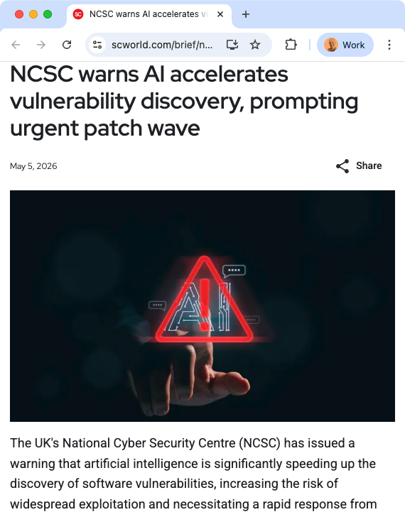
Using AI for Vulnerability Discovery
AI models find new vulnerabilities using source code
Reading source to find vulnerabilities is not new, but:
  We get tired and bored
  We need specialized training for bug hunting
  We need to understand the code language
  We need to understand the human language
AI models excel at:
  Following code and logic trails
  Identifying patterns that reveal possible vulnerabilities
  Developing one-off testing scripts and harnesses
  Running multiple tests in parallel
  Running tirelessly until completion is achieved
  Understanding comments in other languages

Slide 5
Key Lesson: AI-assisted vulnerability discovery is broadly accessible, but we need to orchestrate AI for the best results.

Slide 6
Zero-Day Vulnerability Discovery: Your Prep, AI Analysis
Map out the target source code elements
  What language? How many lines?
  How large is the project?
  What is the potential attack surface?
Establish a target environment for finding validation
Build a project configuration file (/init)
  Review and edit for applicability
Direct the model to find vulnerabilities
  Manage the context window using slices of the app
  Set verification procedures with a target environment
  Define the desired reporting output
Assess validated findings for impact
1
Build your understanding of the target application.
2
Build a target environment for validating findings.
3
Build the scaffolding and scoping to describe the source code.
4
Direct the model to find, validate, assess, and document.
5
Apply your understanding of the organization to assess impact.

Slide 7
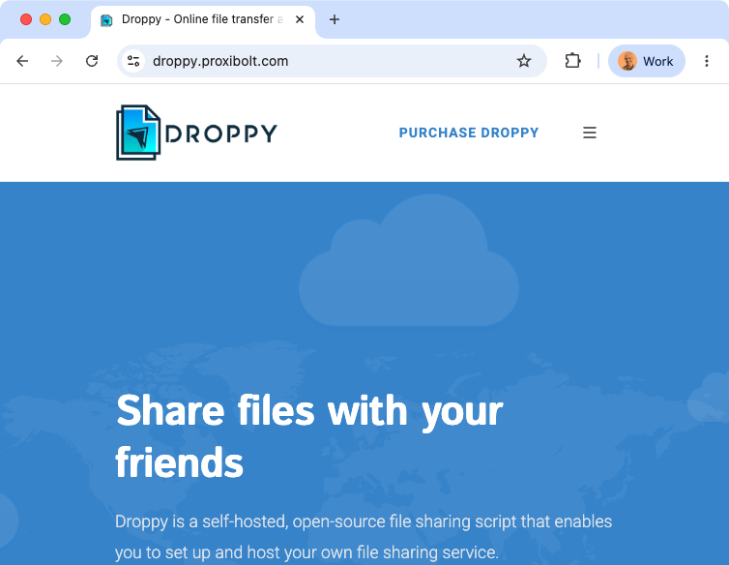
Proxibolt Droppy
On a customer engagement a year ago, we saw a Droppy deployment.
Droppy is a "secure file sharing" web app.
Web app assessment exceeded the scope of the engagement, so we noted it and moved on.

Slide 8
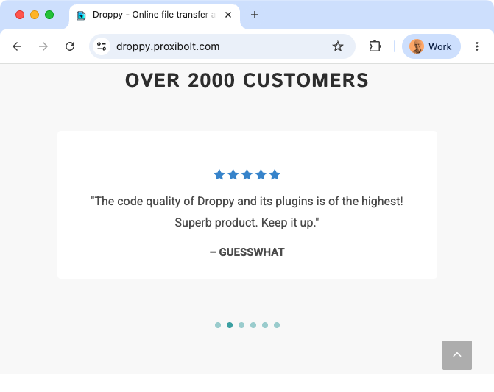
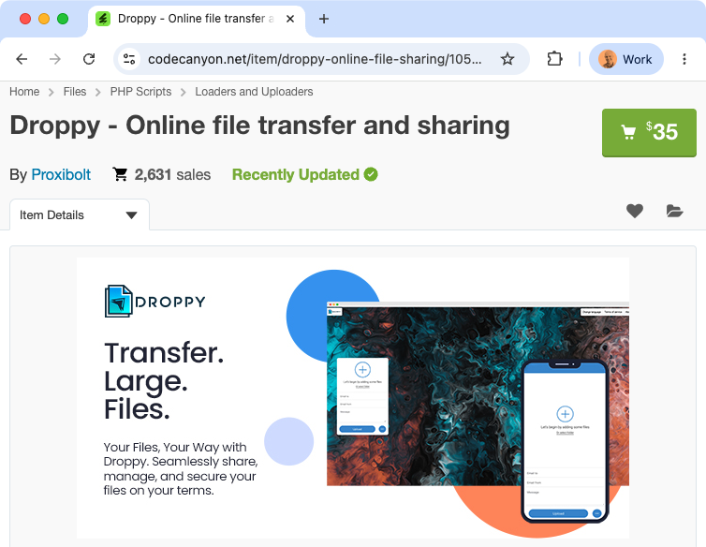
Envato CodeCanyon: An Ecosystem of Crappy PHP Code for Sale
Share files using email or link
File encryption
User accounts
Drag & Drop files
Password protected downloads
Automatic file destruction
S3 storage support (add-on)
FTP/SFTP storage support (add-on)
User subscriptions (add-on)
Active Directory integration (add-on)
🧐

Slide 9
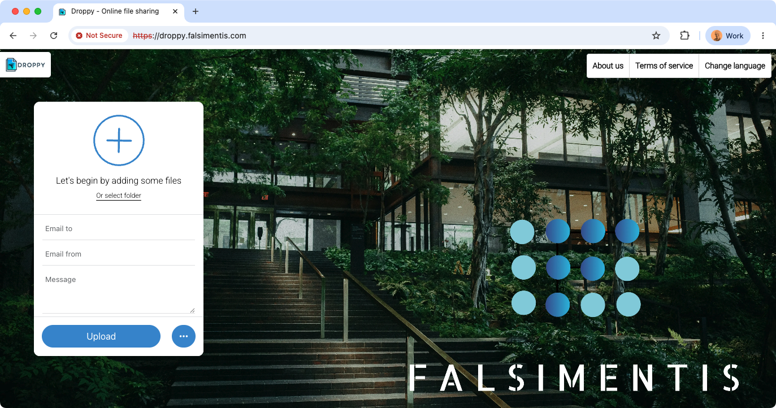
Our Target Deployment: droppy.falsimentis.com

Slide 10
Preparation: Scoping and Scaffolding
$ unzip droppy.zip && cd droppy
Analysis for you
Analysis for the model
$ ls -a
...
$ cloc .
Language files code
----------------------
CSS 22 47547
PHP 301 45832
JavaScript 64 18072
SVG 390 8714
HTML 5 1355
SCSS 2 995
...
$ tree -L 3 --dirsfirst .
$ cp ~/repomix.config.json .
$ repomix
📦 Repomix v1.16.0
✔ Packing completed successfully!
📈 Top 10 Files by Token Count:
───────────────────────────────
1. Files/application/libraries/ inc/pclzip.lib.php (48,209 tokens, 203,007 chars, 1476.1%)
2. Files/application/librari ...

Slide 11
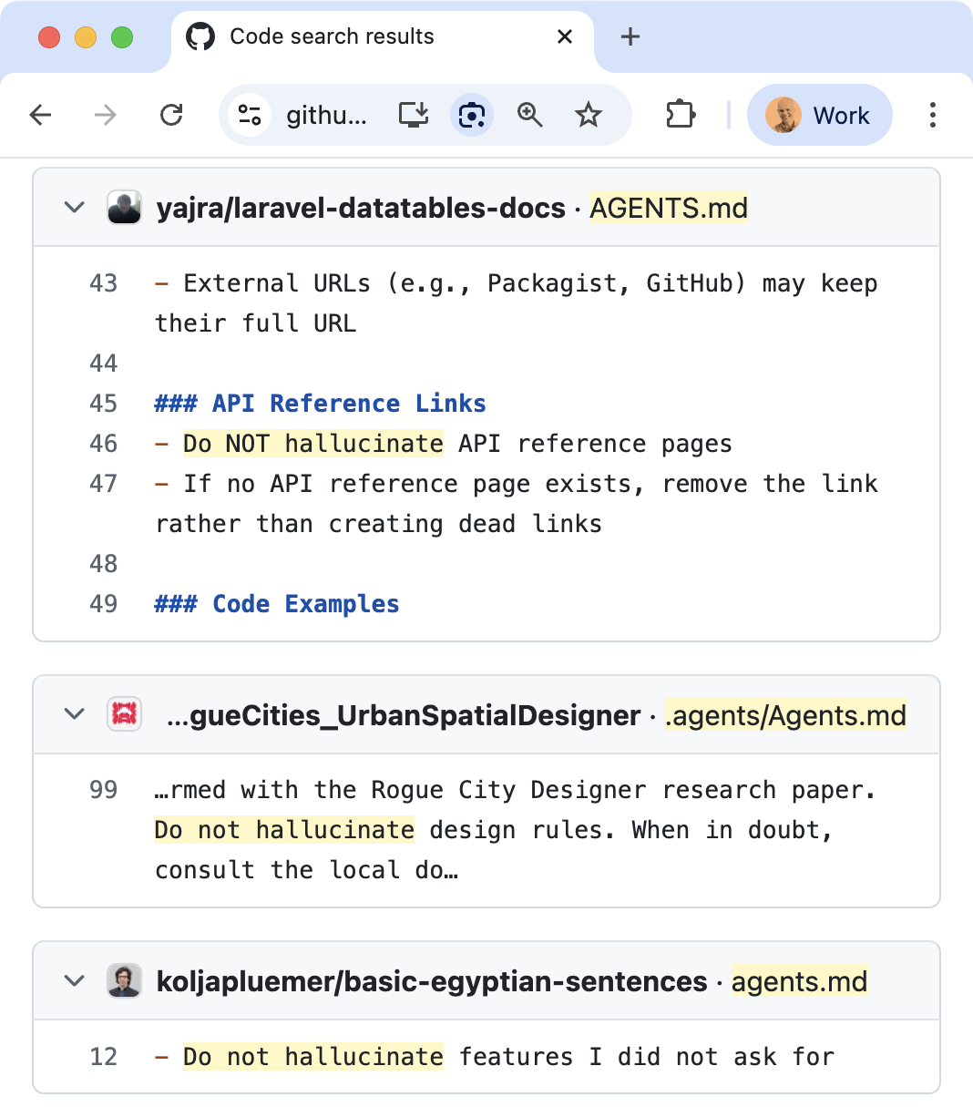
Constraint: Hallucinations
Models will hallucinate, more so when the context window fills up
Solution: design and automate validation techniques
  Accommodate testing using agentic AI
  Require independently verifiable scripts
For vulnerability discovery, make an instance of the target server available
  Let the model start and restart as needed
Telling the model do not hallucinate does not help (but is very entertaining to watch).

Slide 12
Preparation: Docker
Docker allows us to run UNIX software in a container
  Minimal resources required
  Easy to start and reset
  Accessible on the local system for validating findings
Docker build directions are often defined in a Dockerfile
Many projects ship with their own Dockerfile
  Let the agentic AI interface create the Dockerfile and a launch script as needed
FROM php:8.1-apache
RUN apt-get update
RUN apt-get install -y \
mariadb-server \
mariadb-client
COPY Files/ /var/www/html/
RUN chown -R www-data:www-data \
/var/www/html
# Sample files staged for the app
COPY samplefiles/ /opt/samples/
EXPOSE 80
COPY run.sh /usr/local/bin/run.sh
ENTRYPOINT ["/usr/local/bin/run.sh"]

Slide 13
Constraint: The Context Window
Lots of source == lots of tokens
Filling the context window too aggressively produces:
  More hallucinations
  Fewer valuable results
  Silent truncation
  More cost
Software | SLOC | Tokens
Firefox | 5.7M (CPP) | 20M
WordPress | 800K (JS+PHP) | 10M
OpenSSL | 616K (C) | 8.4M
Tomcat | 372K (Java) | 4.7M
Redis | 200K (C) | 2.7M
$ find ./wordpress -name \*.php -o -name \*.js -print0 | xargs -0 counttokens.py
Total token count: 10130153
Analysts need to manage the model's context window when identifying vulnerabilities.

Slide 14
Managing the Context Window
Performance and capabilities degrade well before the limit (~30%–50% used). Monitoring controls change depending on the agentic platform (often in the status bar for CLI tools).
Strategy | Technique | Considerations
Scoping and scaffolding | Front-load project details; scope goals by identifying app slices. | Cuts overhead tokens, but source files still dominate cost.
Compact and continue | Pause the model periodically to continue or compact context. | Simple to monitor manually; frequent HITL required.
Hierarchical decomposition | Orchestrator agent delegates to subagents with separate context windows. | Faster, but higher compute/token cost; subagent usage is hard to track.
Proactive hygiene | Manually split work across sessions, one source slice each. | Manual effort; slice sizing is guesswork.

Slide 15

Vulnerability Discovery Prompt Excerpt
## Operating Rules
- **DO NOT** suggest fixes, patches, or remediation
- **DO NOT** modify the application source code
- **DO NOT** report style issues or general best-practice deviations unless they have a concrete security impact
- **DO** include file paths and line numbers for every finding
- **DO** include the vulnerable code snippet as evidence
- **DO** describe a realistic attack scenario and the impact
- **DO** prioritize findings by severity and exploitability
- **DO** validate findings against the live target described in the user's `CLAUDE.md`/`AGENTS.md` or project context (typically a local Docker container, dev server, or staging URL). If no target is described, ask the user where to send requests before sending any. Never scan or send payloads to a host you have not been told is in scope.
- **DO** include the validation command or short Python script in each finding so it can be re-run
- **DO** label each finding with severity using the rubric below:
This prompt is 350 lines and ~5000 tokens. Instead of copy/paste as a prompt, we can apply it as a skill.

Slide 16
Skill Files are Prompts with YAML Front Matter
Skill files use a specific file name in a given directory. Using YAML parameters, we indicate that the skill does so the model can invoke it as needed.
~ % cd .claude/commands
commands % head pentest-webapp.md
---
name: pentest-webapp
description: Crystal-box web application security audit. Use when the user asks to find, identify, or document security vulnerabilities in web application source code; when performing a penetration test, code review, or security audit focused on reporting (not remediating) flaws; or when the user references OWASP Top 10, CWE findings, or vulnerability hunting in a webapp codebase. Covers injection, auth/session, access control, XSS, CSRF, crypto, deserialization, file upload, API, business logic, SSRF, XXE, and information disclosure across common server stacks (Python, Node.js, Java, Go, PHP, Ruby, .NET).
---

Slide 17
Demo

Slide 18
Droppy Auth Bypass
public function step4() { if ($_SESSION["\151\156\163\x74\141\x6c\x6c"] != 1) { header("\x4c\157\143\141\164\151\x6f\x6e\72\40" . $_SESSION["\142\141\163\x65\137\165\162\x6c"] . "\x2f\151\x6e\163\164\x61\x6c\154\57\x73\164\145\160\x32\77\141\x75\x74\x68\75\156\157"); } $data = array("\163\x65\x74\x74\151\x6e\147\163" => $this->config->config, "\x73\x74\145\160" => 4); $post = $this->input- >post(NULL, TRUE); if ($post) { $this->load->model("\141\x63\x63\x6f\165\156\164\163"); $data = array("\145\155\141\151\154" => $post["\145\155\x61\151\x6c"], "\x70\x61\x73\163\167\157\162\144" => password_hash($post["\x70\x61\x73\163\167\x6f\162\144"], PASSWORD_DEFAULT), "\x69\160" => ''); if ($this->accounts- >add($data)) { header("\114\x6f\x63\x61\x74\151\x6f\x6e\x3a\40" . $_SESSION["\142\141\x73\145\137\165\x72\154"] . "\57\151\x6e\163\164\141\154\x6c\x2f\x73\x74\145\160\x35"); } } $this->load- >view("\x69\x6e\x73\x74\x61\x6c\154\x2f\137\145\154\145\x6d\57\x68\145\x61\144\x65\162", $data); $this->load- >view("\x69\x6e\x73\164\141\154\154\x2f\163\164\145\160\x34", $data); $this->load->view("\151\x6e\x73\x74\x61\x6c\x6c\x2f \137\x65\x6c\x65\x6d\x2f\x66\157\x6f\x74\145\x72", $data); }
This step4() function uses obfuscated code to check for a legitimate Droppy license. It also allows an attacker to send an unauthenticated POST to create new admin credentials.
Analyzing this obfuscated code for a human would be time consuming and annoying. AI doesn't care.
Notes:
This step4() function in Droppy uses ob

Slide 19
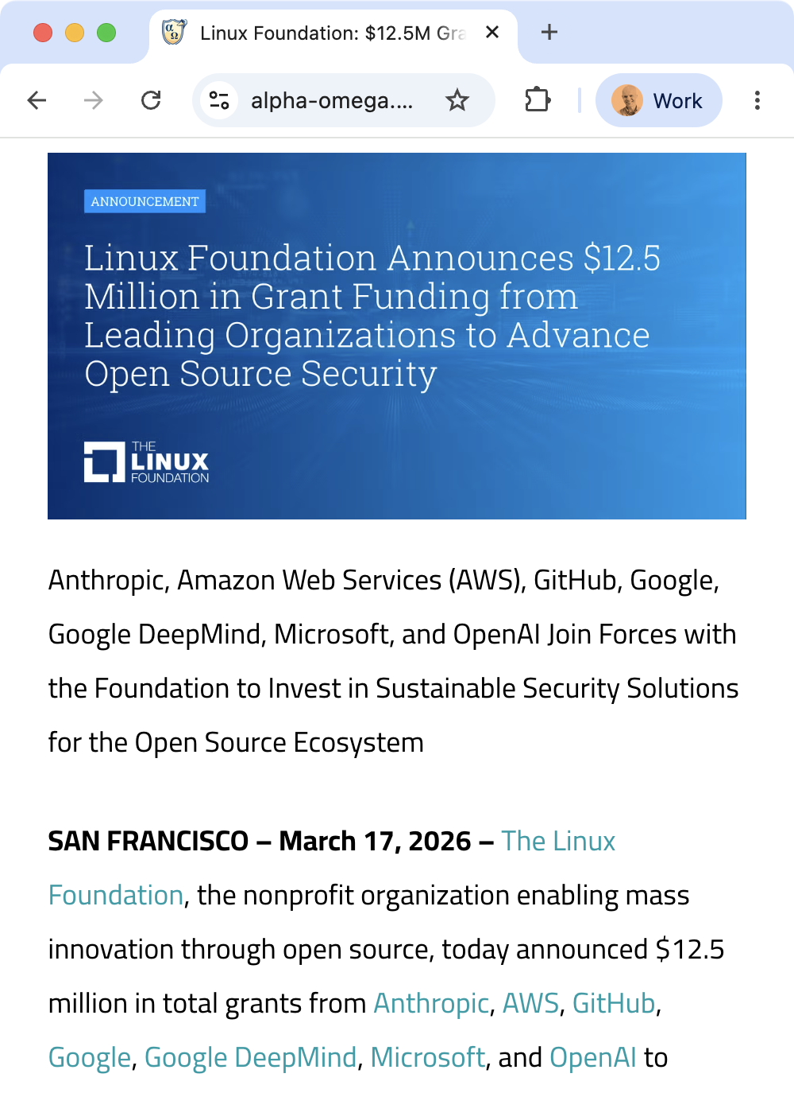
Key Takeaway: The Very, VERY Long Tail of Software Packages
Popularity
Linux, Firefox, VLC, ...
Libraries you've never heard of
7-zip
Droppy and millions of other vulnerable packages
Number of Software Packages
Frontier model investments in OSS is great, but we have a long way to go before we sufficiently secure all the weird things (like Droppy).
Notes:
Frontier model investments in tokens, support from GTIG and other teams to help OSS authors of key elements is great. We have a long way to go before we sufficiently secure all the weird things (like Droppy).

Slide 20

Orchestration for Maximizing Results, Reducing Cost
Image by 윤재 손 from Pixabay
Notes:
In the Droppy example, the source tree is small enough where we didn't have to worry (much) about the context window. A single monolithic skill prompt gave Claude enough insight to complete the analysis. However, this is not always ideal, such as for larger source code projects, or when a powerful frontier model is not an option for reading sensitive data (including company source code).
In these cases, orchestration is a better option, leveraging a less-capable local model to handle small, limited-scope analysis tasks, while the frontier model (Claude, GPT, etc.) handles orchestration. This task deconstruction and orchestration approach can exceed the capabilities of frontier models, while reducing cost and keeping information local to the analyst system (provided the analyst can run a sufficiently powerful local model,

Slide 21
AI is faster, doesn't tire, and doesn't get bored. But it's still not valuable without you.

Slide 22
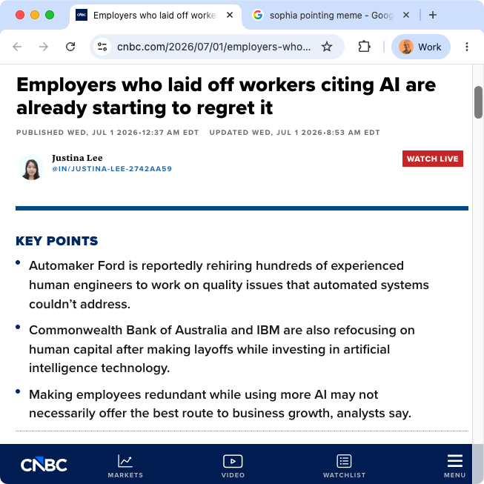
Your Role
None of the vulnerability discovery scenarios are accessible without human work.
Planning, orchestrating, reviewing, and understanding risk are what you bring to an assessment.
The opportunity to use AI to significantly increase your productivity is valuable to an employer.
You > AI
Notes:
“If we don’t continue to invest in entry-level hires, what happens in three-five years?,” IBM’s chief human resources officer, Nickle LaMoreaux, said at a Charter AI Summit in New York. “There’s no pipeline; the well simply dries up,” LaMoreaux added.

Slide 23
Summary
Cybersecurity burnout is real. We need to remember to have fun.
SEC504: Hacker Tools, Techniques, and Incident Handling
1
Your investment in decomposing tasks and orchestrating AI is what gets you the best results.
www.sans.org/sec504
2
SEC543: AI-Assisted Source Code Analysis and Exploitation
Your investment in understanding risk and threats to your organization is what makes it useful.
3
www.sans.org/sec543
None of this happens without you. Now is the time to experiment, to fail, to learn, and to grow as analysts.
4

