Slide 1
Propelling Your InfoSec Career into the Next Decade
Joshua Wright
josh@counterhack.com
@joswr1ght

Slide 2
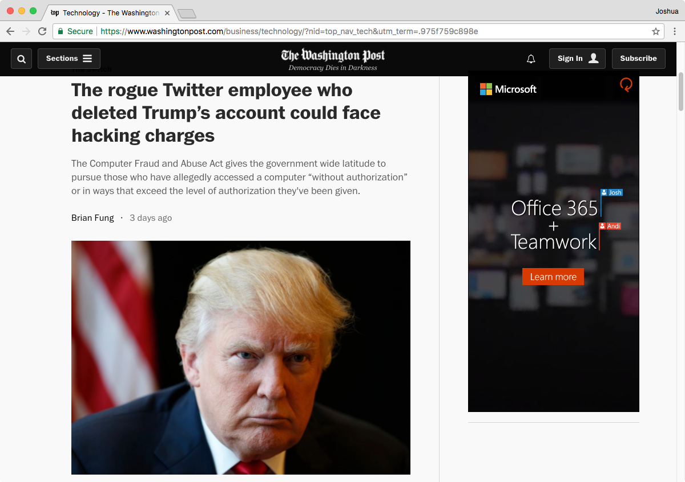
Notes:
* "I read the Infosec headlines every day"
* "And most days are pretty glum"

Slide 3



Slide 4
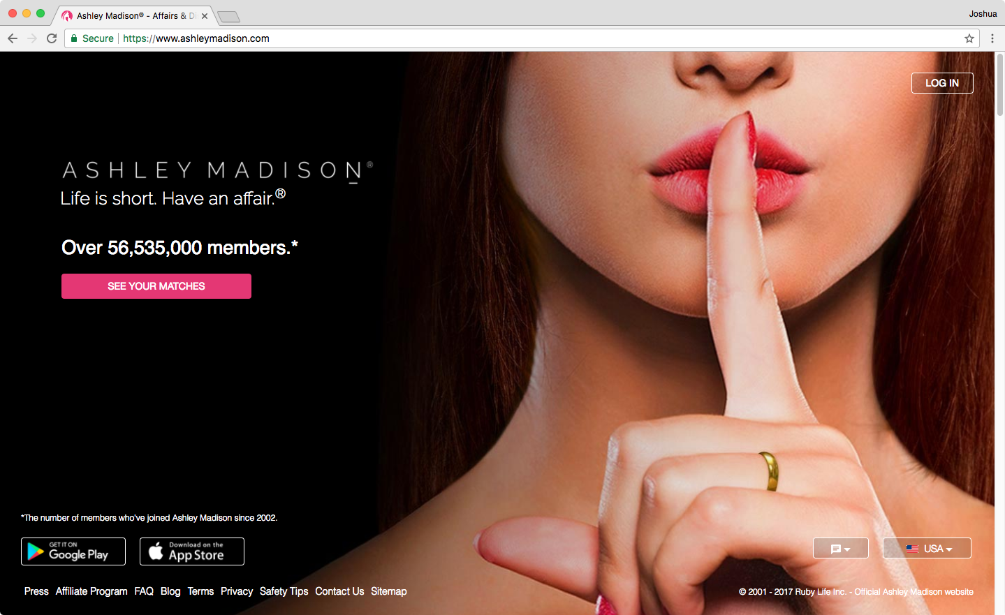

Slide 5

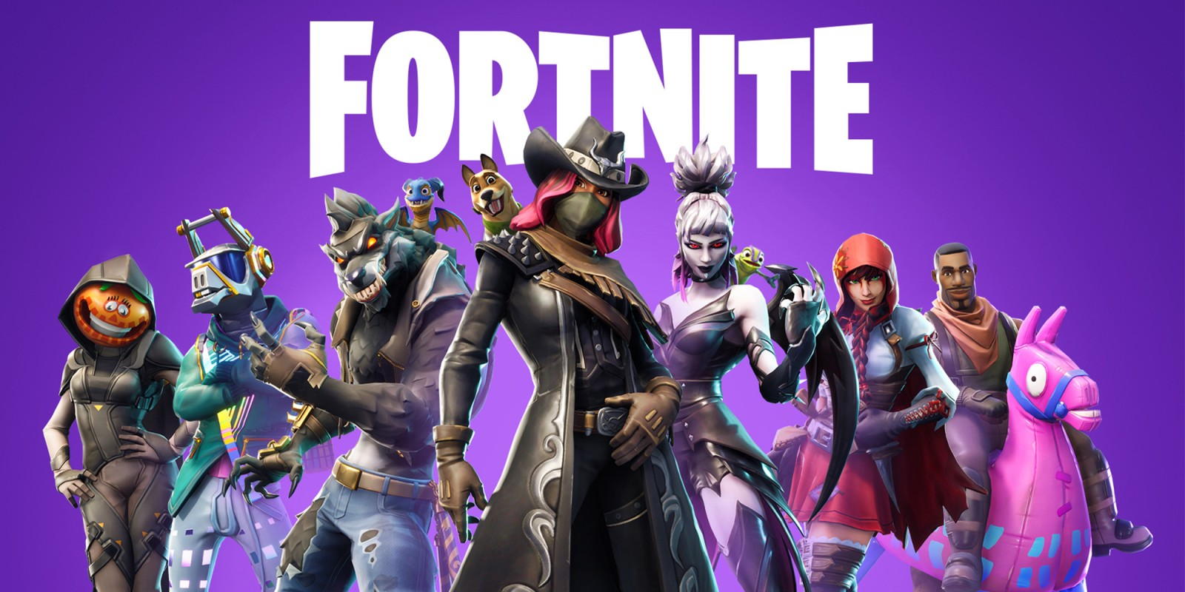
"... take over the account of any game player, view their personal account information, purchase V-bucks (in-game currency), and eavesdrop on game chatter."
Notes:
https://research.checkpoint.com/hacking-fortnite/

Slide 6
WE LIVE IN THE GOLDEN AGE OF INFOSEC EMPLOYMENT OPPORTUNITIES.*
* Also known as the Golden Age of Hacking, the Golden Age of Surveillance, the Golden Age of Ransomware, the Golden Age of Compromises, and The Golden Age of Exploiting Anything That Can Make Hackers a Buck.

Slide 7
Significant career growth is within your reach.
*
* If you want it, and are willing to work for it.

Slide 8
$182,000
$150,000
$98,000
$77,000
$48,200
Average US salary
Information Security Analyst (US)
Senior Information Security Analyst (US)
Notes:
* Opportunities
* Glassdoor.com reports that average US salary for Infosec Security Analyst is between $77k and $150k (average $130k). Senior analysts report between $98k and $182k.
* Many high-tech firms offer unique benefits: maternity and paternity paid leave, above average vacation allocations, premium health and dental benefits, college scholarship programs for children of employees, nap rooms (Zappos), community service sponsorship, healthy living programs, retirement programs, etc.
* Lacking amazing financial incentives or hipster benefit programs, other employers offer more work flexibility, personal development opportunities, and training and skill development budgets to attract top talent.
US salary https://www.thebalance.com/average-salary-information-for-us-workers-2060808 $48,200

Slide 9
Extended maternity and paternity paid leave
Retirement benefits
Compensated sabbatical programs
Professional development opportunities
Above average vacation allocations
Child care programs
On-site car wash, haircuts, and other conveniences
Premium health and dental benefits
Technical training budgets
College scholarships for children of employees
Vertical-related independent project support
Family planning, fertility services
NAP ROOMS
On-site acupuncture, improv classes
Telecommuting and work from home benefits
Personal development opportunities
Discounted dining options
LGBTQ rights and diversity support
Community service sponsorship programs
Pet healthcare programs
Healthy living programs

Slide 10
How do you get there?

Slide 11
The restrictive thinking of innovation.

Slide 12
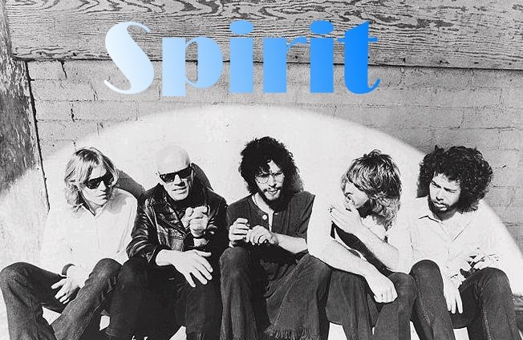

Notes:
Taurus by Spirit or Stairway to Heaven by Led Zeppelin.

Slide 13
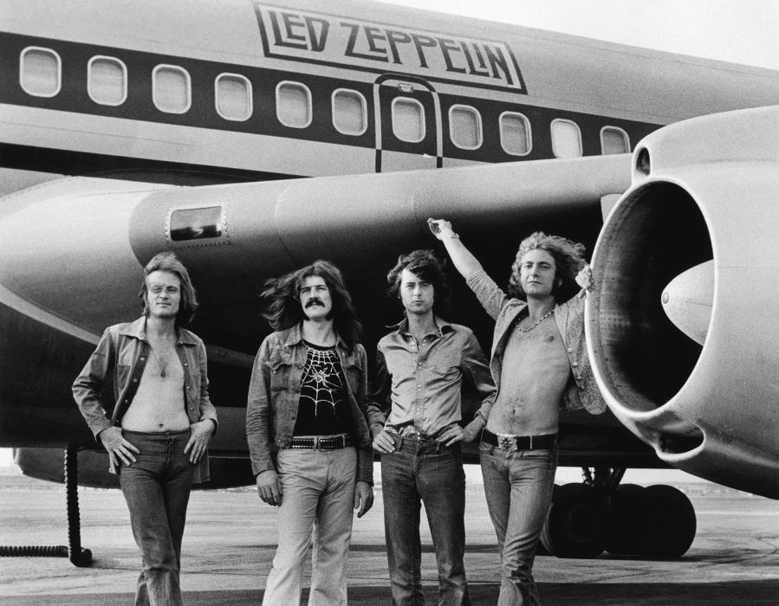
"widely considered one of the most successful, innovative, and influential rock groups in history."
Notes:
* In the 1970's, Led Zeppelin was the biggest touring rock group in America.
* Record sales between 200 and 300 million, considered one of the best recording selling artists of all time
* Each of their 9 studio albums placed in the Billboard top 10 (6 reached number 1)
* Wikipedia cites Led Zeppelin as "widely considered one of the most successful, innovative, and influential rock groups in history."
* Yet, much of Led Zeppelin's work is uncredited derivatives of other recording artists

Slide 14
The Lead Zeppelin
Bring it on Home (Willie Dixon)
Bring it on Home (Led Zeppelin)
Killing Floor (Howlin' Wolf)
The Lemon Song (Led Zeppelin)
Blackwaterside (Bert Jansch)
Black Mountain Side (Led Zeppelin)
Dazed and Confused (Jake Holmes)
Dazed and Confused (Led Zeppelin)
Notes:
Much of Led Zeppelin's work is uncredited derivatives of other recording artists.

Slide 15
Everything is derivative.
*
* This is a good thing.

Slide 16
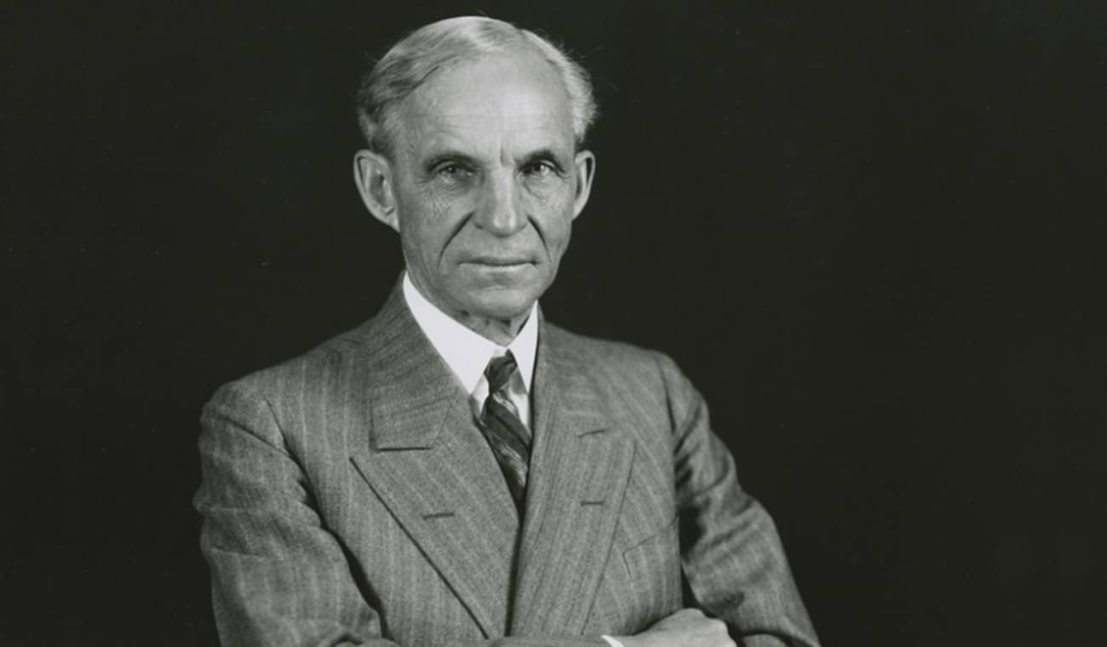
Notes:
* Ford didn't invent the assembly line, interchangeable parts, or the automobile. Rather, he combined them together to produce the first mass market car in 1908, the Model T.
https://www.thehenryford.org/images/default-source/explore/henry-ford.jpg/?Status=Master&sfvrsn=2

Slide 17
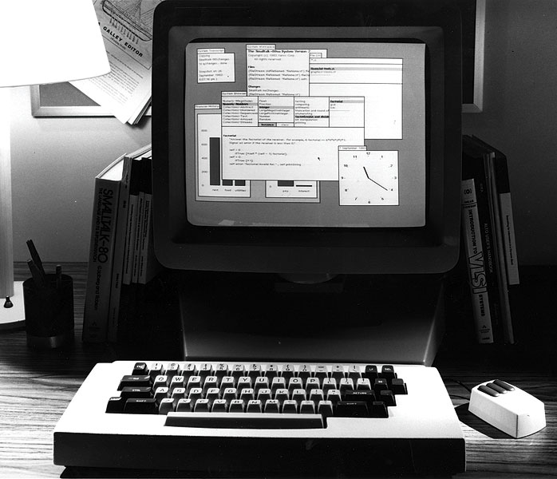
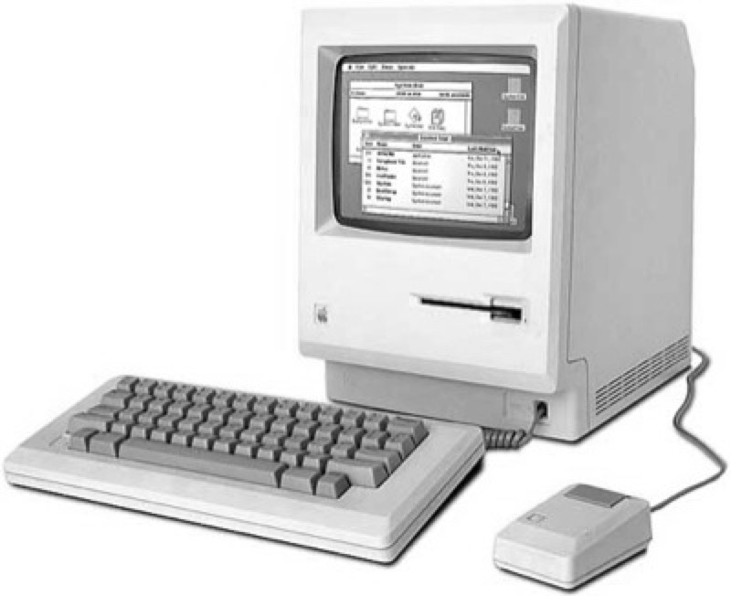
The Alto
The Macintosh
Notes:
Xerox
* Invented the PC in the early 70's: The Alto
* The Alto was released as Star 8010 in 1981. Who here remembers the Star 8010 OS?
* Apple released The Lisa in 1983, and the Macintosh in 1984. Who here remembers the Macintosh? (presumably, way more hands)
* Many will claim Steve Jobs stole the mouse from Xerox PARC. He did not. He took the idea from Xerox and innovated. He made the mouse 1 button. He required that the mouse cost $15 to manufacture (compared to the $300 Xerox mouse). He required that it could be used "on Formica and my bluejeans." (https://zurb.com/blog/steve-jobs-and-xerox-the-truth-about-inno).
* Xerox can't claim that Jobs stole the idea of the mouse from them, because they didn't even invent that. Douglas Engelbart a Stanford Research Institute researcher came up with the idea of "of moving the cursor around the screen with a stand-alone mechanical "animal" back in the mid- nineteen-sixties." (https://zurb.com/blog/steve-jobs-and-xerox-the-truth-about-inno)

Slide 18
The basic elements of creativity:
Copy
Transform
Combine

Slide 19


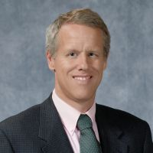
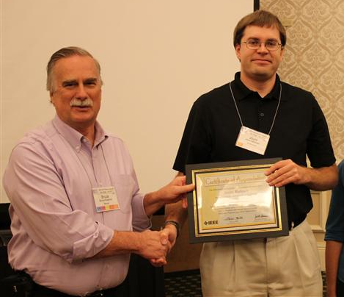

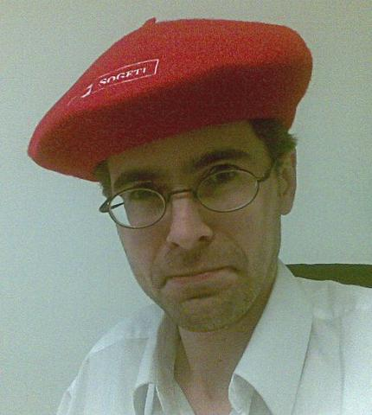
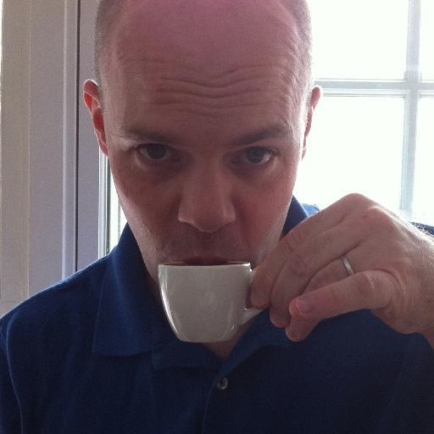
wpa-psk-bf
coWPAtty
Notes:
Ted Krovetz

Slide 20
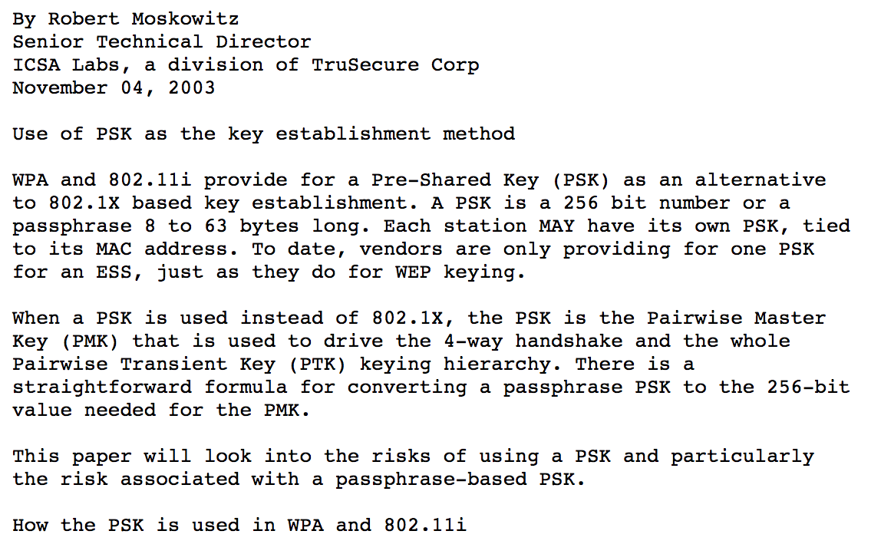
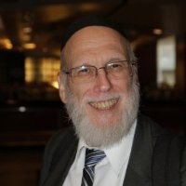

Slide 21
Copy
Transform
Combine

Slide 22
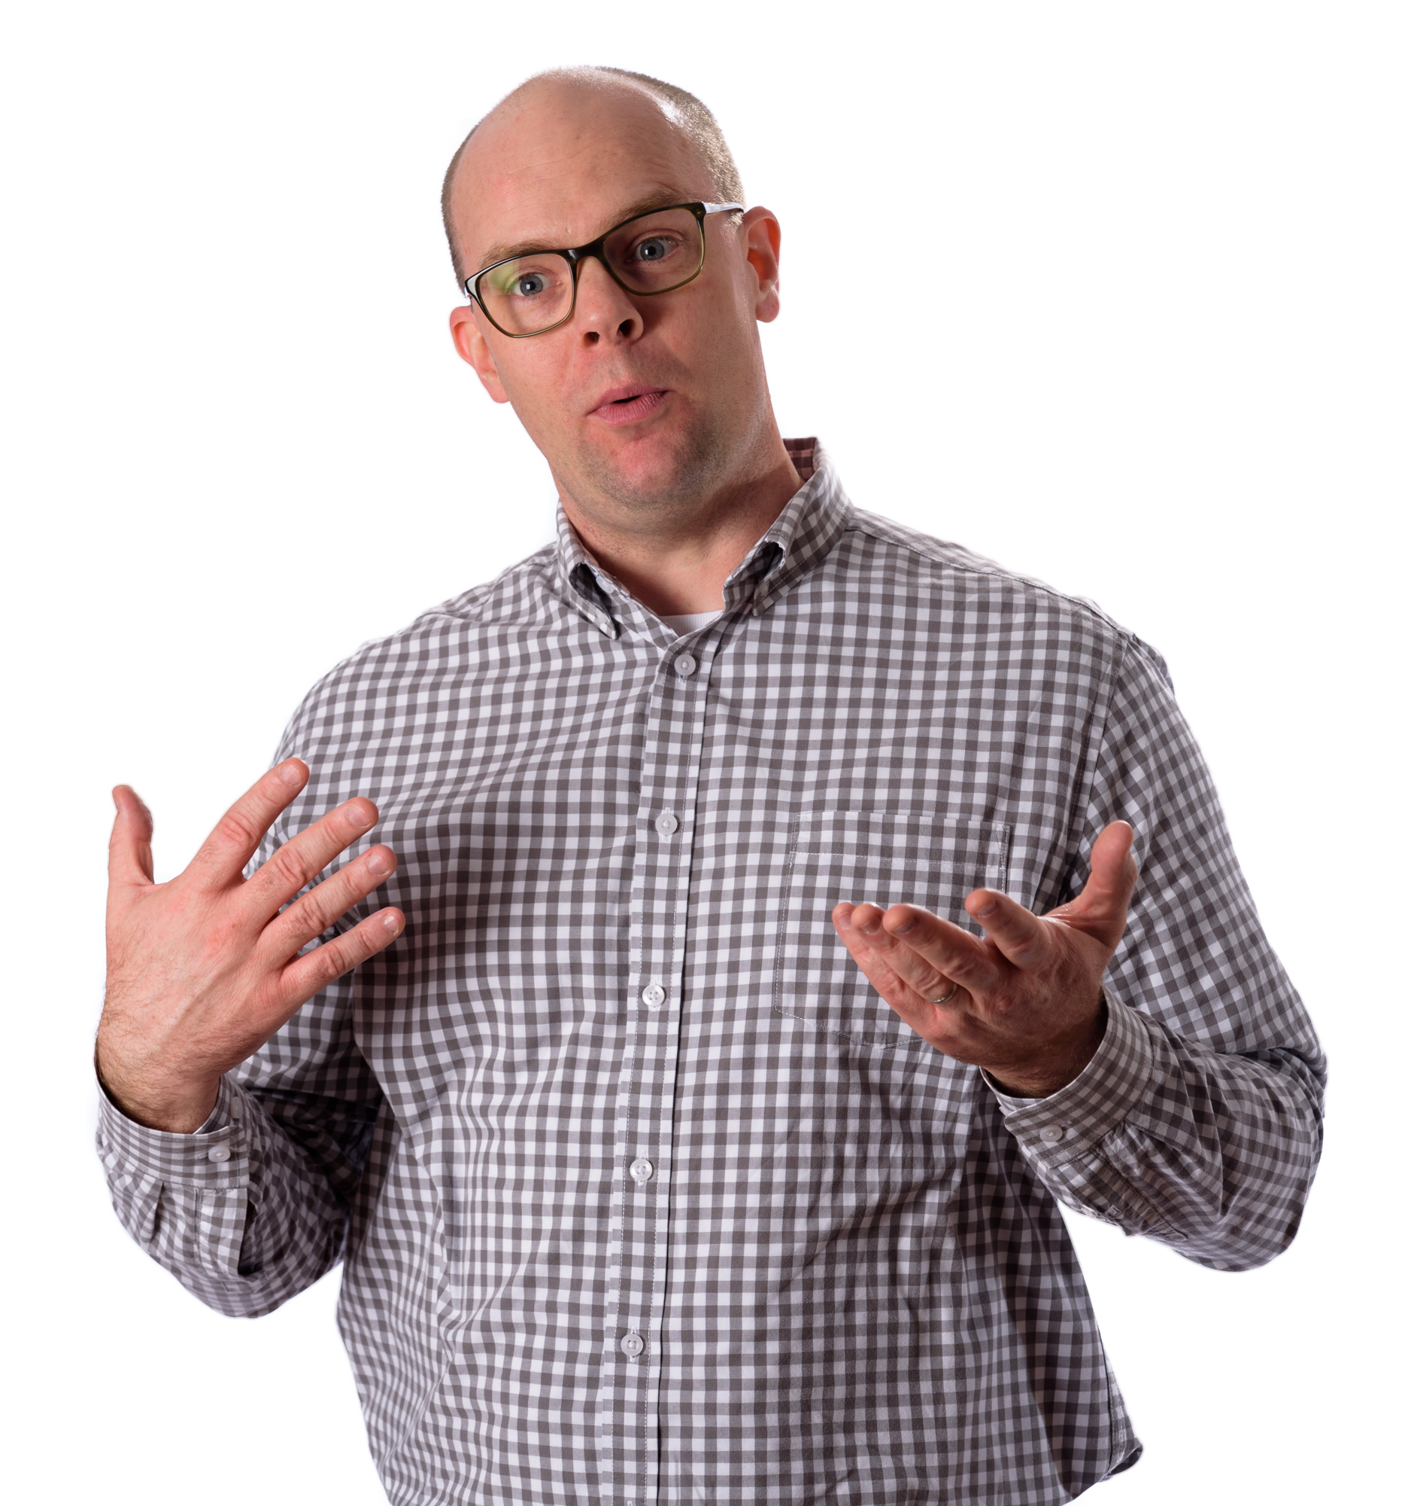
Jeff McJunkin
Jorge Ochilles
John Strand
Larry Pesce
Kevin Finisterre
Carrie Roberts
Lesley Carhart
Moses Hernandez
Paul Asadoorian
Thomas d'Otreppe

Slide 23
1. Constant learning
*
Develop new skills to increase your employee value proposition.
* You're here, and that's a great start.

Slide 24
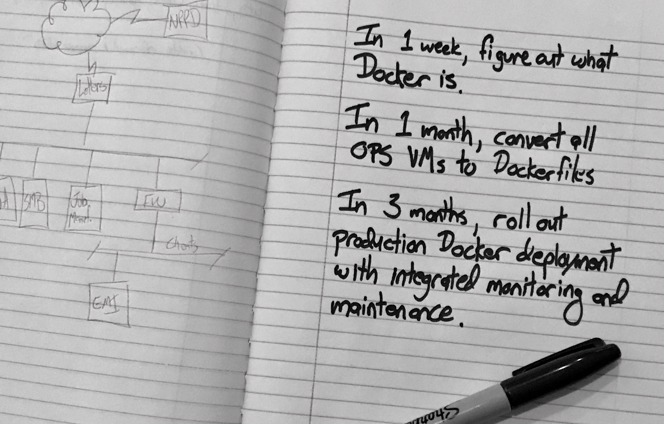
Notes:
Set goals for yourself, and work to meet those goals.

Slide 25

@SecurityWeeklyTV
@TWiTSecurityNow
@Hak5Darren
Kali Linux Penetration Testing
Kali Root
SSTec Tutorials
SANS Pen Test Training
@JackkTutorials
@DEFCONConference
@InfoSecInstitute
@irongeek
Pentester Academy TV
@BlackHatOfficialYT
Crazy Danish Hacker

Slide 26
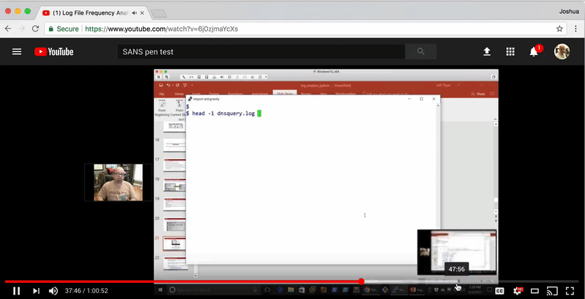
Notes:
Joff Thyer

Slide 27
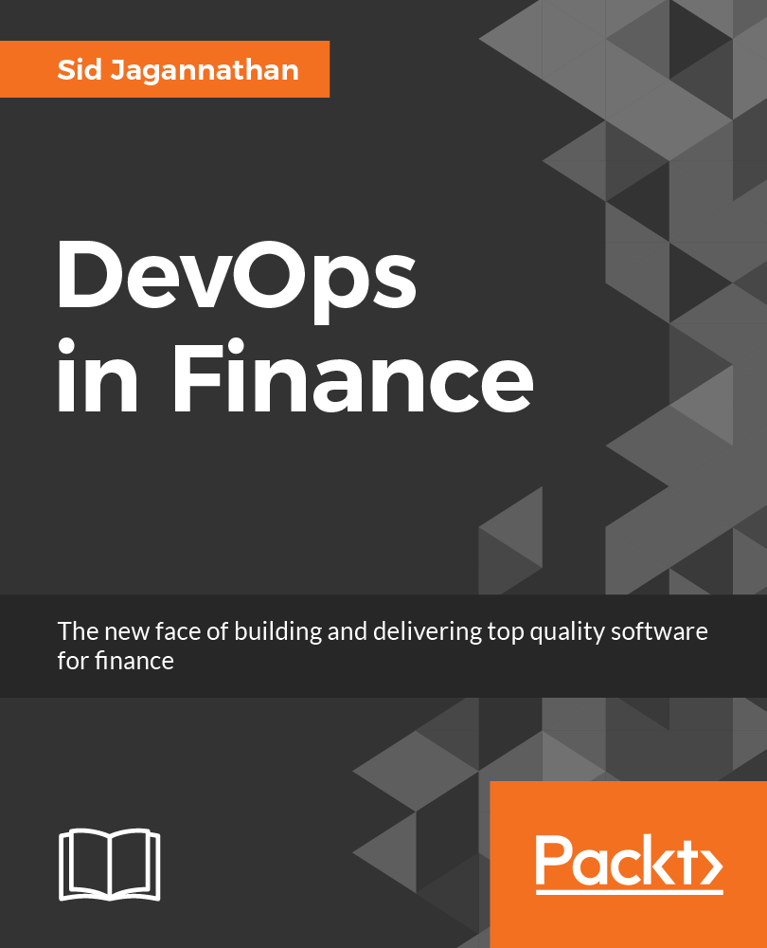
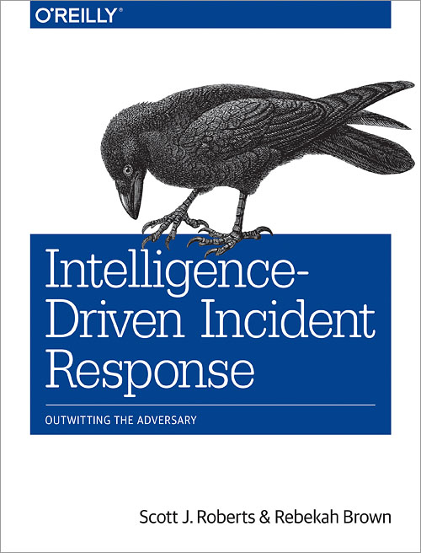

Breaking Technology
In-depth Reference
Coding Guides

Slide 28
https://www.packtpub.com/packt/offers/free-learning
http://www.oreilly.com/free
https://www.humblebundle.com

Slide 29
Use an RSS reader.

Slide 30






I'm going to let you in on a little secret. Remember AOL ? I know, they cancelled A , and people are all broken up about it. But did you know they have a free R service? Go to reader.aol.com. You can login with your old AI account. Oh, and there's no . I'm pretty sure someone is going to figure it out and . Until then, hop on over there and manage all your reading from one place.

Slide 31
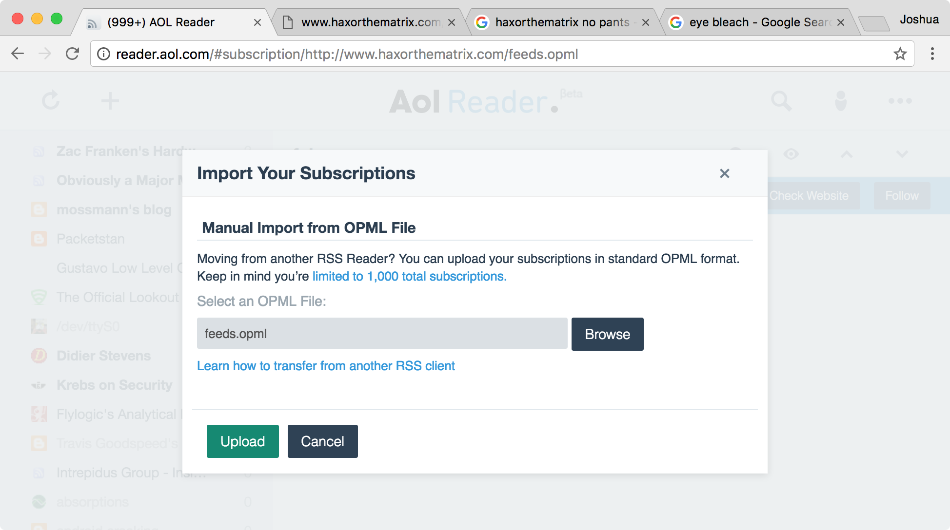
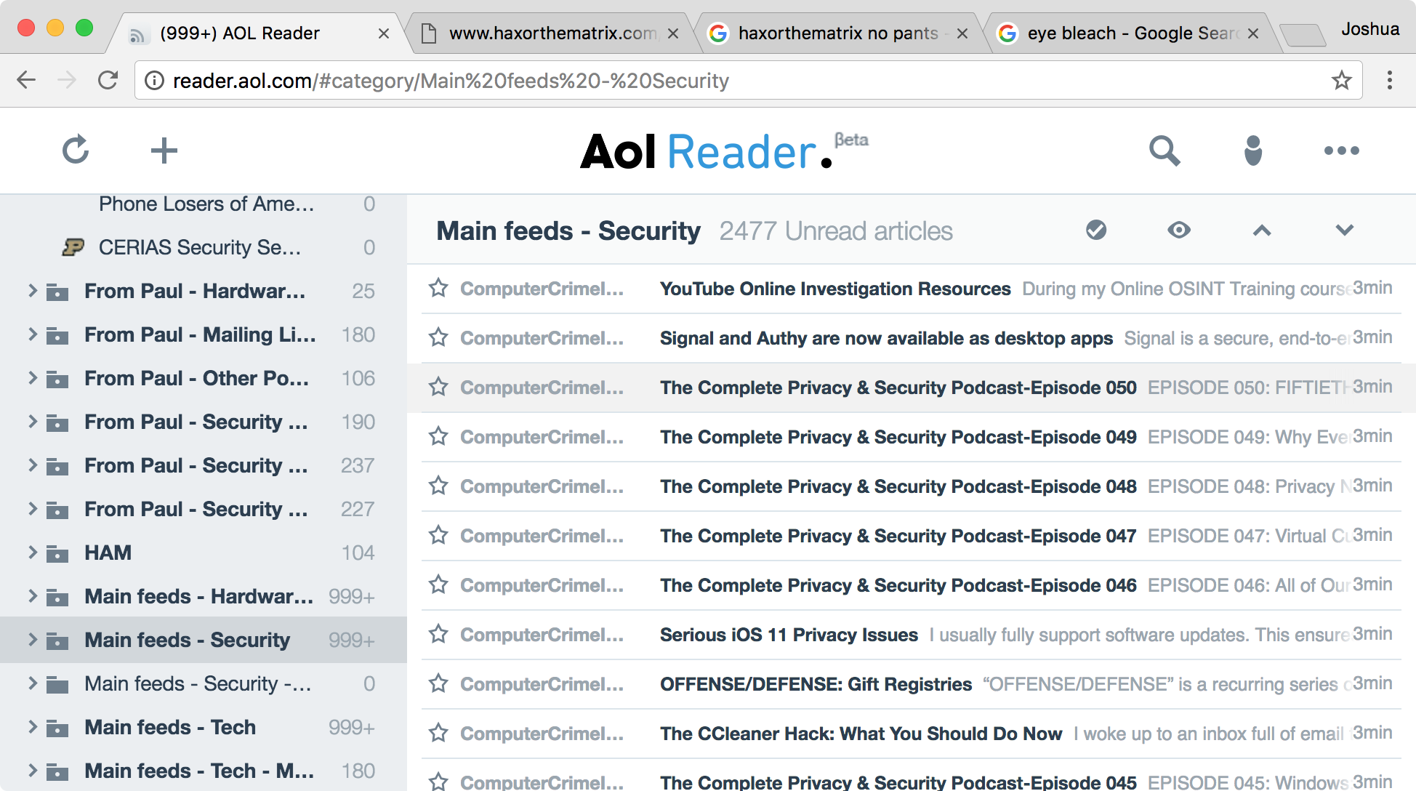
Download Larry Pesce's RSS OPML file at http://www.haxorthematrix.com/feeds.opml.
Login to reader.aol.com, click ••• | Import. Select the OPML file, then click Upload.

Slide 32
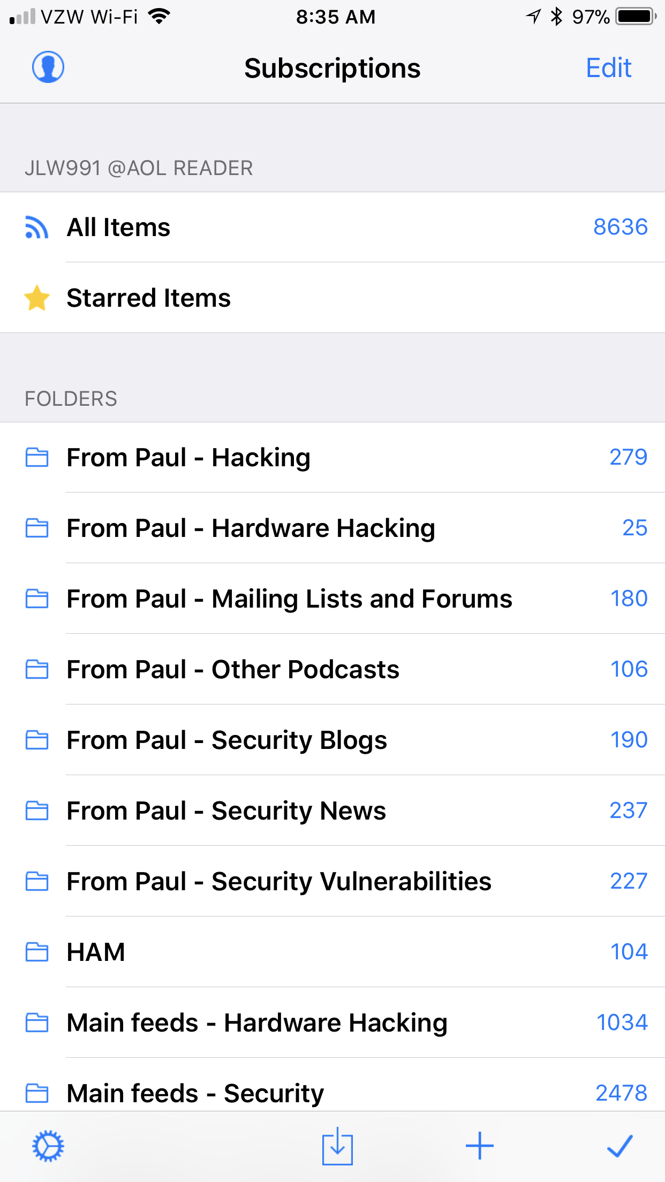
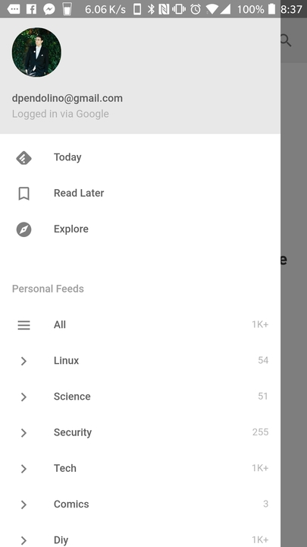
FeeddlerPro for iOS
Feedly for Android

Slide 33
2. Create. Write. Code.
Apply the skills you develop at work to solve problems and get noticed.

Slide 34
Differentiate through creation.

Slide 35

Start writing.
Commit to a regular writing schedule.
Work on communicating complex topics in plain language.
Work on communicating what is important to your audience.
An editor that doesn't suck.

Slide 36
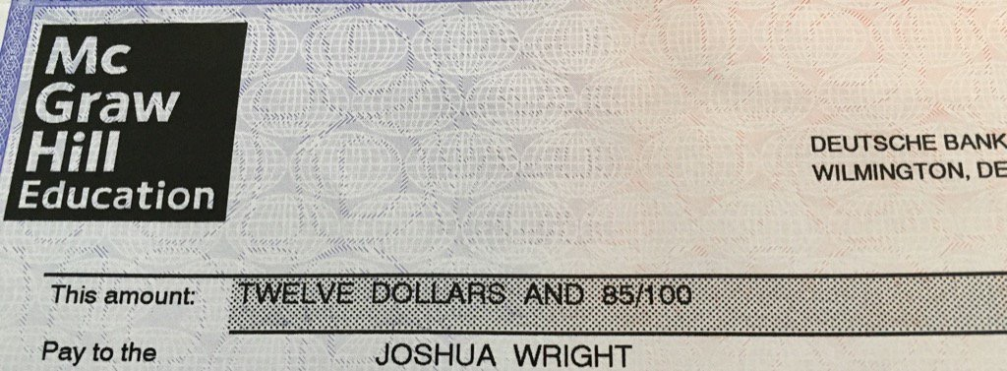
* This check arrived by FedEx, which cost $21.40 to ship.
Notes:
The publisher will only start paying you royalties after the advance has been paid off, so immediately after your book goes to print you won't see royalty checks until your percentage of net profits exceeds the advance. It's not uncommon to see checks arrive quarterly like this one: $12.85, which arrived in a FedEx package that cost $21.40 to mail to me.
If you're still with me at this point, I'm glad. You won't get rich writing technical books (at least, not in royalties or an advance from the publisher), but there are a lot of career benefits, personal growth benefits, and industry-wide benefits to sharing what we know.
Next we'll look at the process of writing. Hopefully you'll stick around.

Slide 37
https://www.willhackforsushi.com/presentations/WritingTech.pptx

Slide 38

If you don't code, it's time to start.

Slide 39
Learning to code isn't hard.
Staying motivated until you can be productive with your code is.
Solution: Build something that motivates you.

Slide 40
Use Python to automate a mundane task on Unix boxes.
Use PowerShell to do the same on Windows boxes.
Use Swift to write a simple app for iOS.
Use Kotlin for the same on Android.
Use JavaScript to write a simple web app to help people choose passwords.

Slide 41
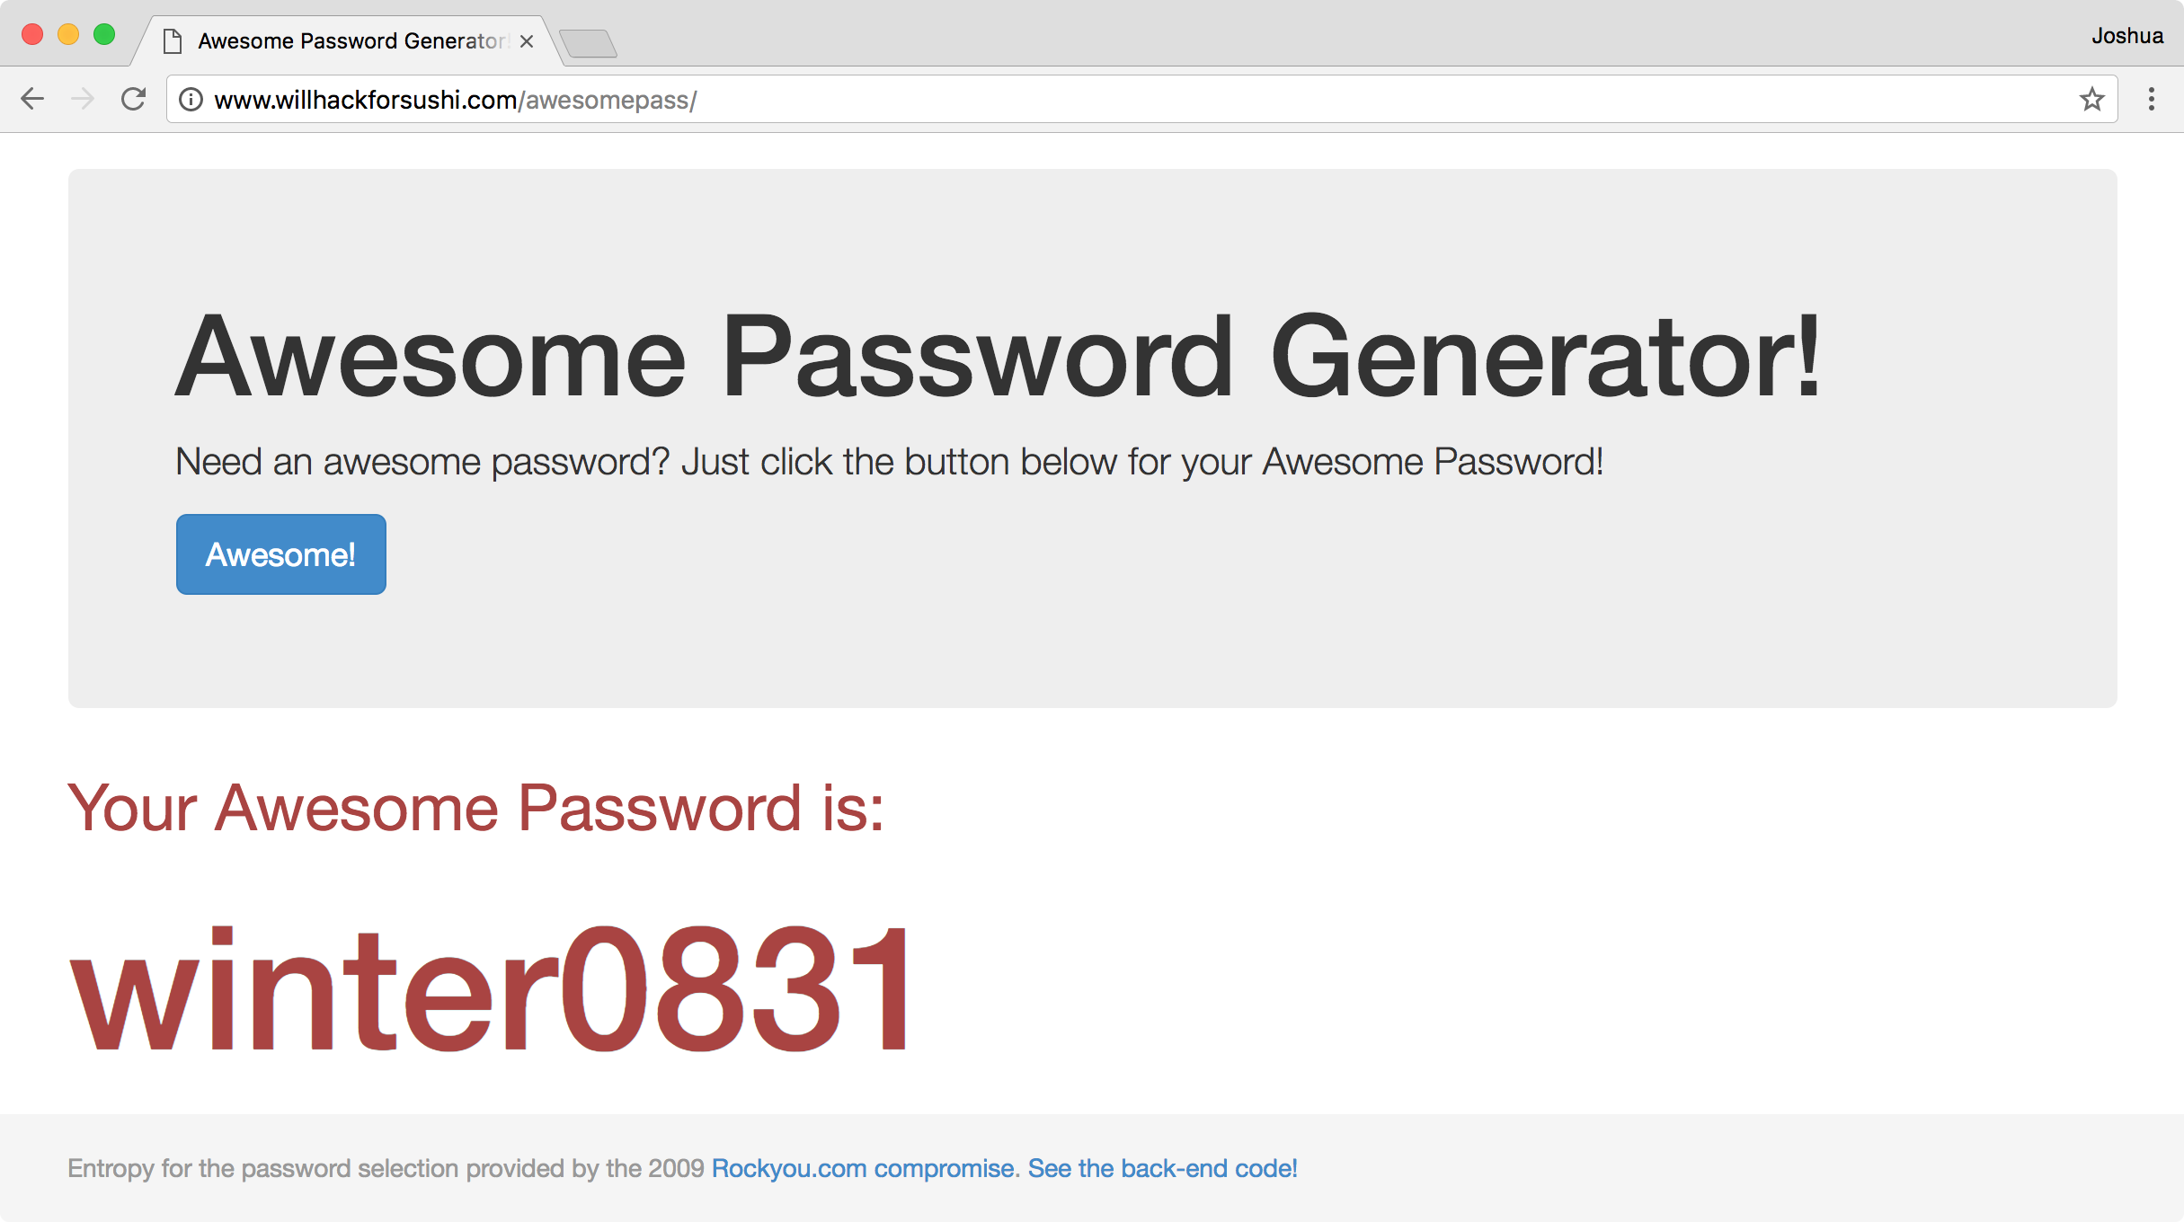

Slide 43
<?php
$fp = fopen('rockyou.txt', 'r');
// 139751900 is a little less than the total file size
fseek($fp, rand(0, 139751900));
fgets($fp); // Skip this possibly incomplete line
print fgets($fp);
?>

Slide 44
3. Give back.
Everyone I spoke to said their career success is tied to the contributions they have made in the infosec community.

Slide 45
"What are three things you've done that you feel are pivotal to your career success?"
"Information sharing has been critical for networking. ... Open collaboration to support other people and gain their support."
Kevin Finisterre
"Knowledge itself is not enough. I work on giving back to the community through blogging, webcasts, and speaking at conferences whenever I can."
Carrie Roberts
"I've participated in the infosec community - blogging and volunteering. Not only does that push me, but it makes our community of practice better as a whole."
Leslie Carhart
"Networking wherever possible and being involved with the community. I started as a volunteer for my local ISSA chapter, then joined the board, then VP, then president. While doing that, I contributed to OWASP, and I wrote a book."
Jorge Orchilles

Slide 46
The infosec profession, in particular, is a close-knit community that values those who excel, but reveres those who give back.

Slide 47
Blog. Submit patches. Vlog. Publish. Volunteer at cons. Speak. Mentor. Join a board. Start a DC group. Facilitate. Teach. Code. Report bugs. Participate on mailing lists. Reply to Stack Overflow questions. Tweet. Webcast. Start a con. Run a B-Sides. Socialize. Submit pull requests. Share.

Slide 48
4. Choose your employer carefully.
Your employer will help you succeed, or they will hold you back.

Slide 49
Important Questions:
Does your employer support your professional growth?
Does your employer allow you to speak publicly and share outside of work?
Is your employer more interested in making you more employable or retaining you (and holding you back)?

Slide 50
Leaving an employer is always scary, but an employer that doesn't support you or help you to succeed will significantly limit your chances for success.

Slide 51

"If people give you advice out of selfishness, then you should avoid that advice. Seek out an employer that encourages you to promote yourself and give back to the community."
John Strand, Founder
Black Hills Information Security

Slide 52
Actionable Steps for Moving Forward

Slide 53


"So Josh, tell me about your five year goals."
You should figure out your five year goals.

Slide 54
Write down your five year goals.
Identify how you plan to accomplish each.
Read and update the list often.

Slide 55
Identify your personal brand.

Slide 56
My personal brand:
Technical excellence with attention to detail for high-quality, on-time delivery.
Identify what works for your brand, and take on projects that will support it.

Slide 57
Regular time for tech.

Slide 58
Copy
Identify the practices of successful people in infosec that you want to match and exceed. Copy those ideas for your own use.
Transform
Identify what works for you, and how you can change those practices to improve your own career. Be daring, but not reckless.
Combine
Combine the practices identified in this presentation, and those your build for your own career to achieve wild success.

Slide 59
"Check that heavy metal
Underneath your hood
Baby, I can work all night
Believe I got the perfect tools"
Led Zeppelin
Robert Johnson (1936)
(you get the idea)

Slide 60
Thank you.
Joshua Wright
josh@counterhack.com
401-524-2911 (mobile)
@joswr1ght

