Slide 1
If you can see this, you aren't viewing this presentation the right way.
To help illustrate some of the concepts in this presentation, I've used PowerPoint animations. View this presentation in Slide Show mode (press F5 to start). Watch for embedded video and audio content, too!
Thanks!
-Josh
BUILDING ANALYSIS SKILLS THROUGH ANDROID APP REVERSE ENGINEERING
Joshua Wright, @joswr1ght

Slide 2
INTRODUCTION
HACKFEST | Ghost in the Droid
Motivation
The Plan
Android Package Analysis ─ Ghost Hunter, Joe's Ghost Box
Android Static Analysis ─ Ghost Hunter
Obfuscated Static Analysis ─ Ghost Radar
Cross-Platform Dev Analysis ─ Ouija: Real Spirit Board
Applying Android Reverse Engineering Skills

Slide 3
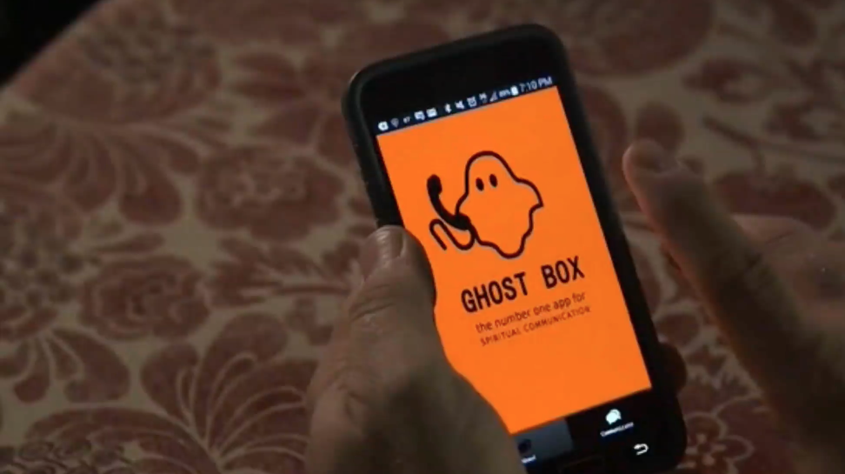
A Haunting

Slide 4
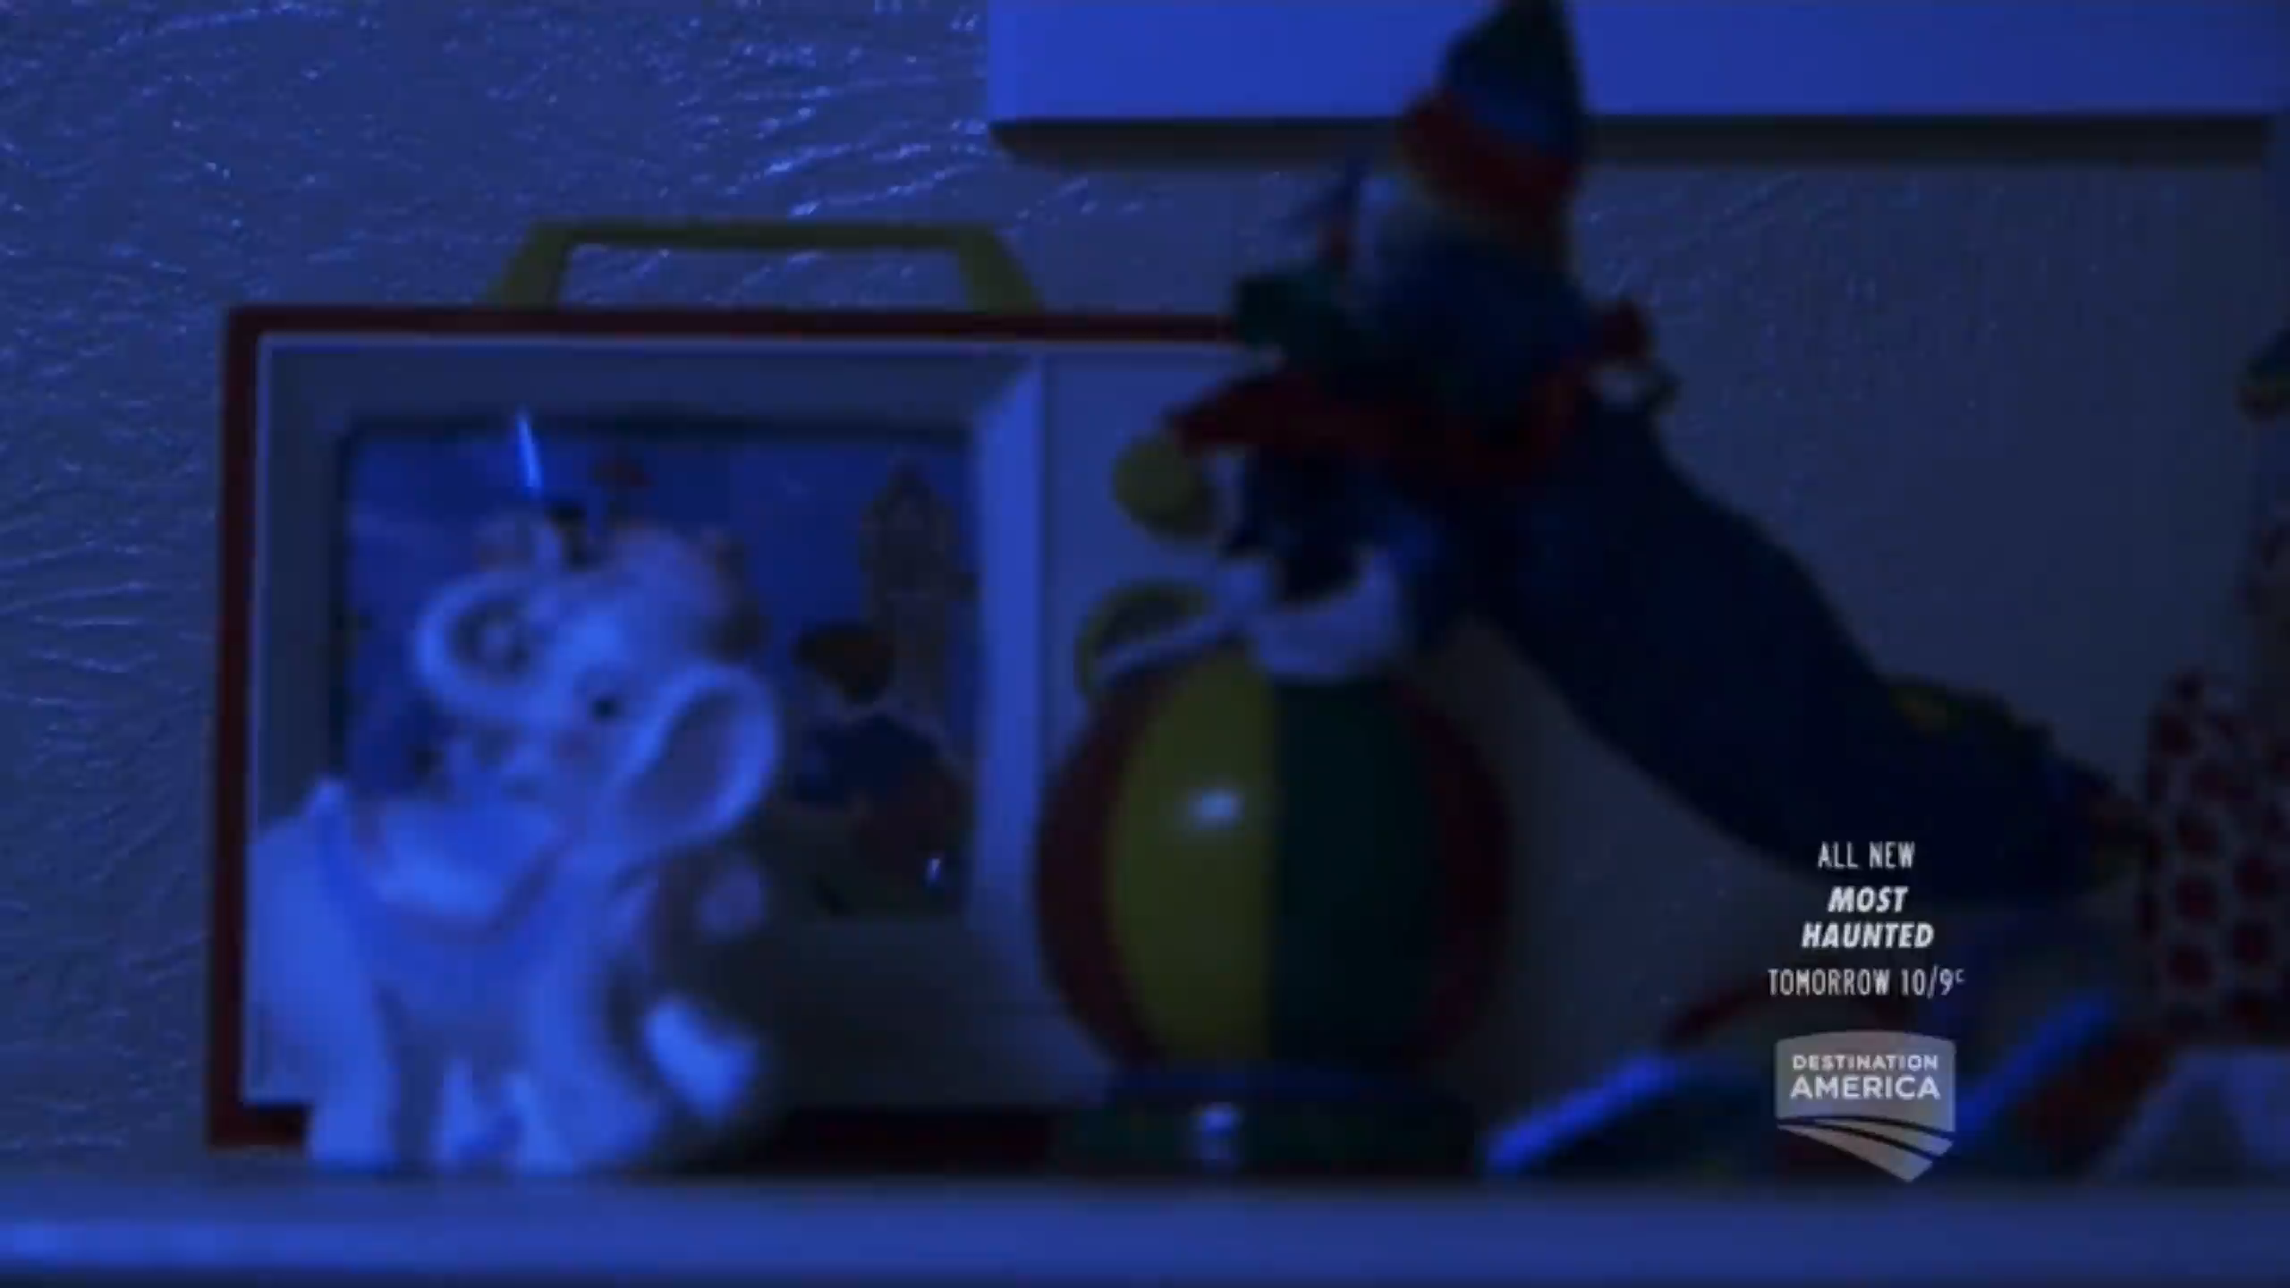

Slide 5
THE PLAN
Spend $200 on Android ghost detection apps from four categories
  Electromagnetic Frequency Measurement (EMF) tools
  Electronic Voice Phenomenon (EVP) measurement (ghost audio)
  Ghost radar and visual identification apps
  Ghost communication tools
Use apps in a variety of locations as intended (cemeteries, woods at night)
Reverse engineer apps to evaluate how they function
  Using open-source/free tools, and a cheap, rooted Android device
Use this project to build my Android reverse-engineering skills

Slide 6
CHOOSING APPS
Limited to pay-for applications ($0.99 to $29.99)
Focus on "pro" apps that claim to meet or exceed commercial tools
Focused on apps that perform "genuine" ghost detection
Exclude apps marked as intended for entertainment
Joe's
Ghost
Box
P-SB7 Ghost Box
My Own
Ouija Board
Ghost
Hunter
Ghost
Speaker

Slide 7

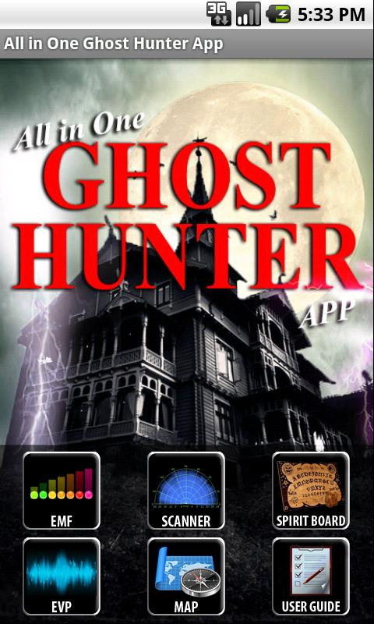
GHOST HUNTER App
Published by IntelliTech Entertainment, $0.99
3.6 stars, 498 ratings, 10K-50K downloads
EMF scanner, EVP recording, visual decoding, and a spirit board
"I use a lot of the "ghost hunting" apps. [...] I have tested my phone against equipment used by pros & it has worked.
I can tell a fake app when I see one."
Julie Hafford, 4-star Rating

Slide 8
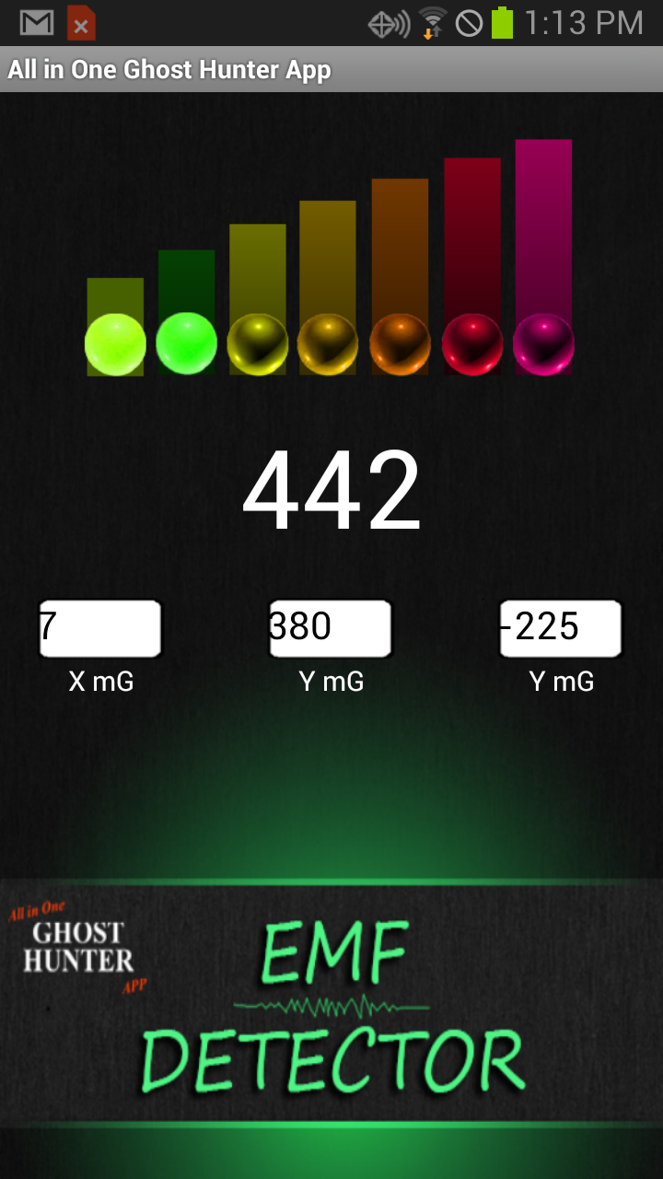
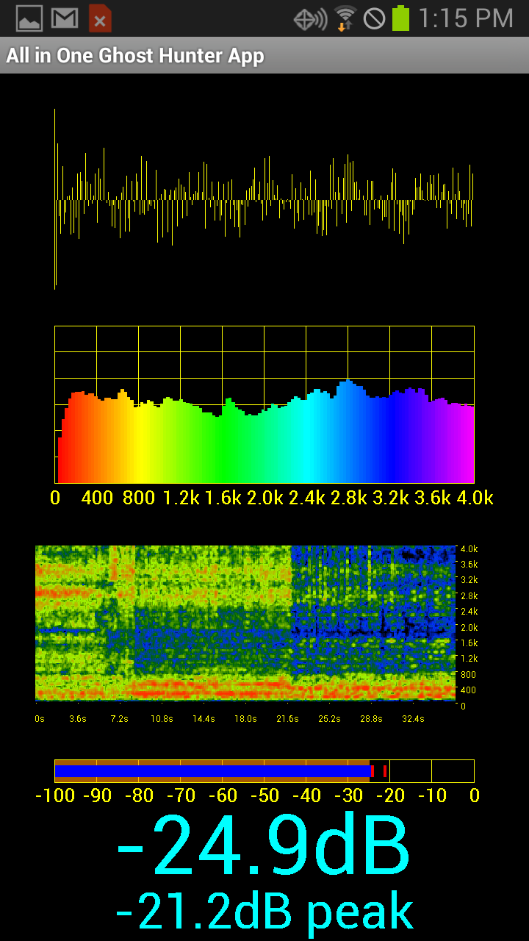
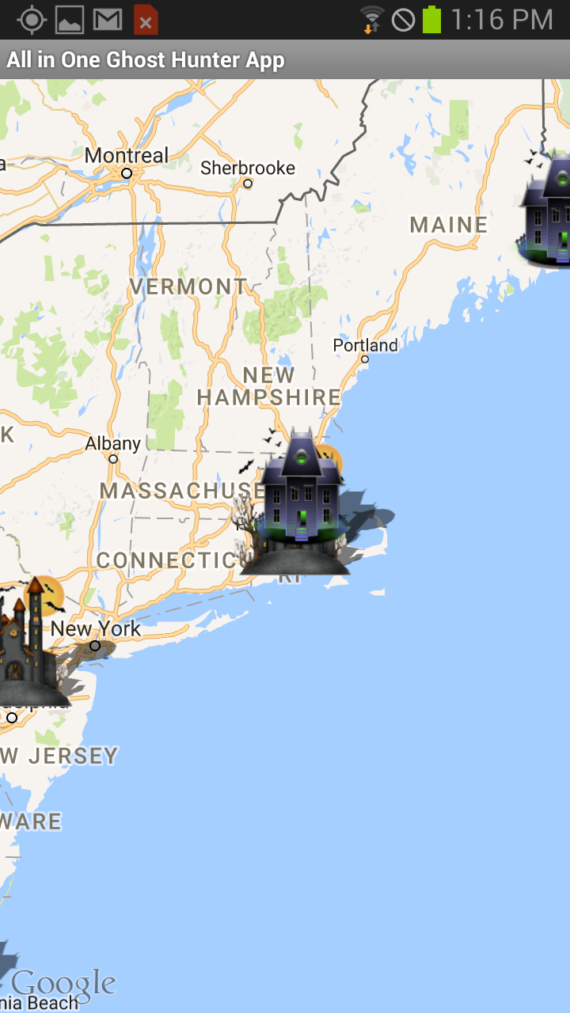

Slide 9
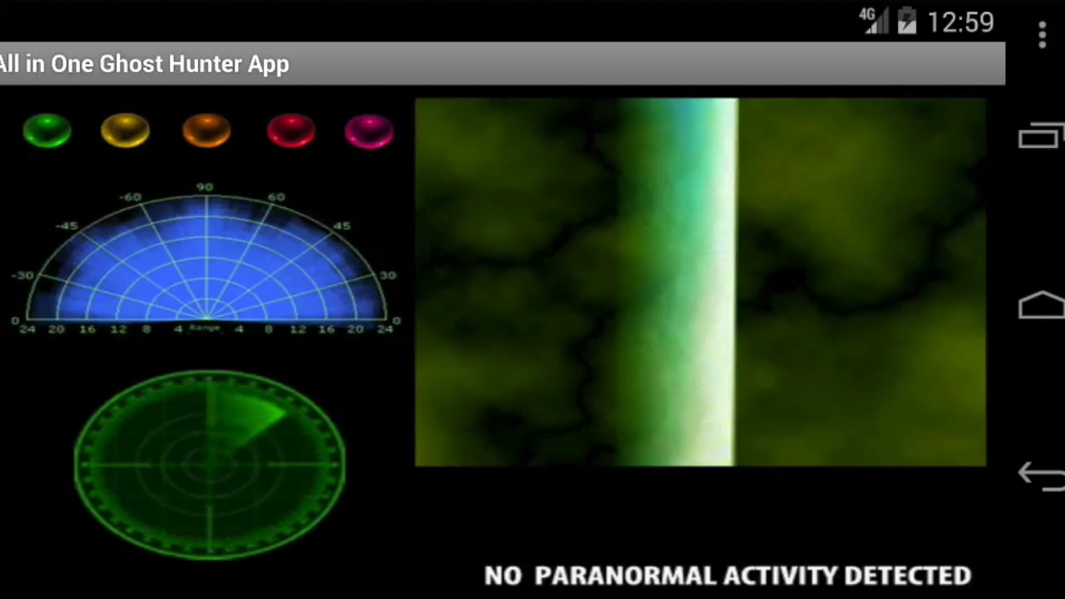
Paranormal

Slide 10
RETRIEVING THE APK FILE
HACKFEST | Ghost in the Droid
$ adb shell pm list packages | grep -Ev "com\.android|com\.google"
package:com.gregorypothier.AIOGhostHunter
package:android
package:com.example.android.softkeyboard
package:com.svox.pico
package:jp.co.omronsoft.openwnn
$ adb shell ls /data/app/com.greg*
/data/app/com.gregorypothier.AIOGhostHunter-1.apk
$ adb pull /data/app/com.gregorypothier.AIOGhostHunter-1.apk
[100%] /data/app/com.gregorypothier.AIOGhostHunter-1.apk

Slide 11
EXTRACTING THE APK FILE
HACKFEST | Ghost in the Droid
$ mkdir aioghosthunter
$ unzip -d aioghosthunter/ com.gregorypothier.AIOGhostHunter-1.apk
Archive: com.gregorypothier.AIOGhostHunter-1.apk
inflating: aioghosthunter/res/layout/audiomain.xml
inflating: aioghosthunter/res/layout/audiorecorderlayout.xml
inflating: aioghosthunter/res/layout/audiotrack.xml
inflating: aioghosthunter/res/layout/draw.xml
inflating: aioghosthunter/res/layout/emf.xml
...
extracting: aioghosthunter/res/drawable-hdpi/redscan1.jpg
extracting: aioghosthunter/res/drawable-hdpi/redscan10.jpg
extracting: aioghosthunter/res/drawable-hdpi/redscan2.jpg
extracting: aioghosthunter/res/drawable-hdpi/redscan21.jpg
...
extracting: aioghosthunter/res/drawable-mdpi/icon.png
inflating: aioghosthunter/classes.dex
inflating: aioghosthunter/META-INF/MANIFEST.MF
inflating: aioghosthunter/META-INF/CERT.SF
inflating: aioghosthunter/META-INF/CERT.RSA

Slide 12
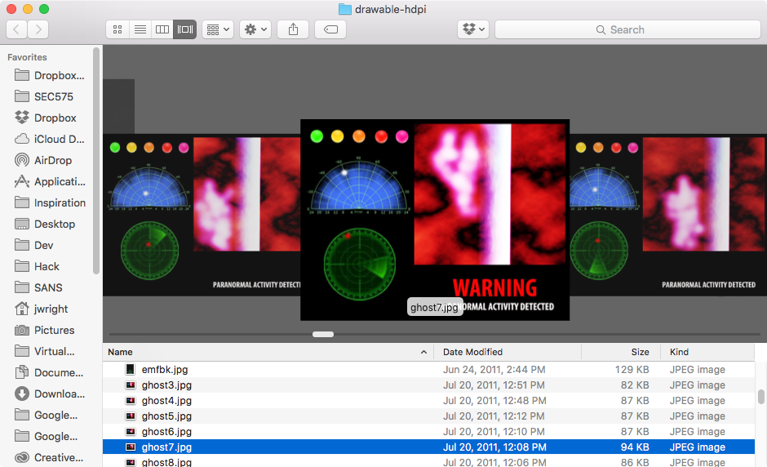
GHOSTLY IMAGES
8 static images with "ghosts" on radar view

Slide 13
DISPLAY GHOSTLY IMAGES, RANDOMLY
HACKFEST | Ghost in the Droid
// 70% of the time, display the animated green scanning images
if (PreviewActivity.this.randInt0to100 < 70) {
randInt0to10 = new Random().nextInt(10);
if (randInt0to10 < 4) {
((ImageView) ... setImageResource(R.drawable.greenscan1);
// ...
}
// 30% of the time, display the Paranormal Activity Detected red images
if (PreviewActivity.this.randInt0to100 >= 70) {
if (randInt0to10 < 4) {
((ImageView) ... setImageResource(R.drawable.redscan1);
// ... about 7% of the time, display a ghostly image
} else if (PreviewActivity.this.mySecondsPassed == 1) {
if (randInt0to10 < 4) {
((ImageView) ... setImageResource(R.drawable.redscan3);
} else if (randInt0to10 > 4 && randInt0to10 < 8) {
((ImageView) ... setImageResource(R.drawable.redscan23);
} else if (randInt0to10 > 8) {
((ImageView) ... setImageResource(R.drawable.ghost3); // scary

Slide 14
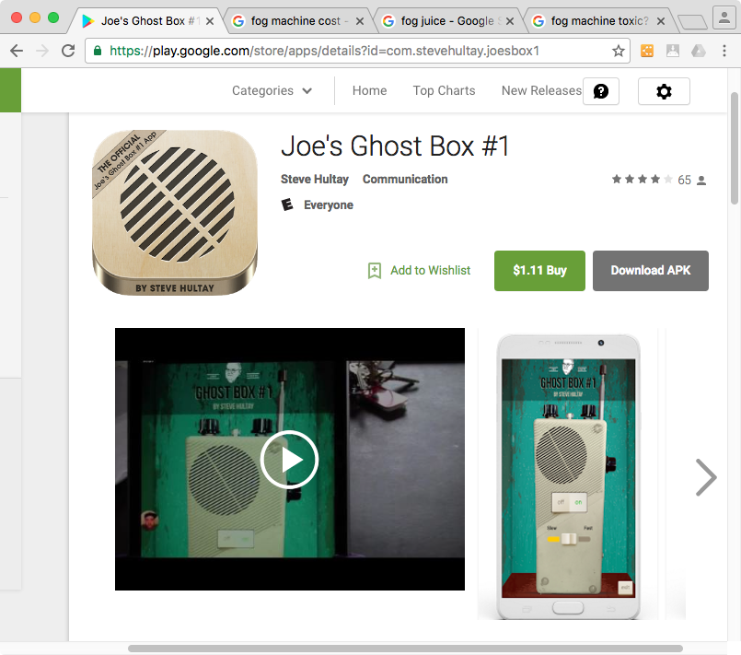
JOE’S GHOST BOX App
Published by Steve Hultay, $1.11
3.9 stars, 65 ratings, 5000 downloads
EVP app, decoding captured audio segments
"I was just looking at my dad's picture in my head telling him I missed him. Then on my third try using the app I hear I love you to in Spanish which is the language he spoke..."
I. Flores, 5-star Rating
Notes:
https://play.google.com/store/apps/details?id=com.stevehultay.joesbox1&reviewId=Z3A6QU9xcFRPRTJMdTczYlZNTHBISDZoam1mZkFJMWdfcHZVZXFCSmFzRWZjMGFkbjBWWEg4VGxOS3R6a0szMkFfTzVkczJ0Um9zZHE3Q1FiLWgwYXFnX2ZF

Slide 15
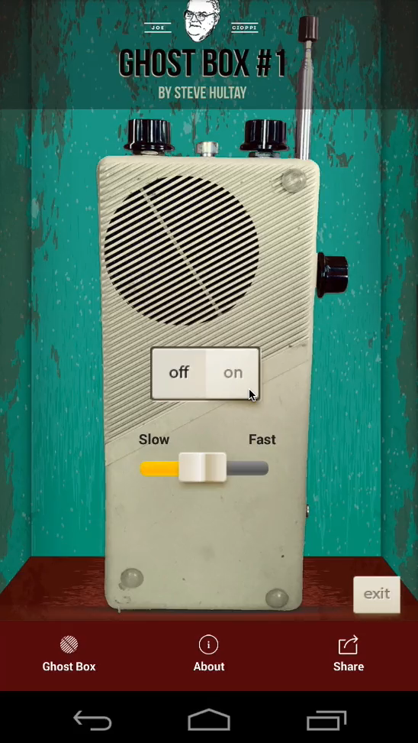
JOE’S
GHOST BOX
Functionality
Extracts and plays EVP audio content
Simple controls, turn the virtual replica of the actual Joe’s Ghost Box on
You ask questions and listen for answers

Slide 16
JOE'S GHOST BOX FILE SYSTEM DATA
$ mkdir joesghostbox
$ unzip -d joesghostbox/ com.stevehultay.joesbox1-1.apk
Archive: com.stevehultay.joesbox1-1.apk
inflating: joesghostbox/AndroidManifest.xml
inflating: joesghostbox/assets/Fonts/font_one.ttf
inflating: joesghostbox/res/anim/abc_fade_in.xml
inflating: joesghostbox/res/anim/abc_fade_out.xml
extracting: joesghostbox/res/raw/a000001.mp3
extracting: joesghostbox/res/raw/a0000010.mp3
extracting: joesghostbox/res/raw/a00000100.mp3
extracting: joesghostbox/res/raw/a00000101.mp3
extracting: joesghostbox/res/raw/a00000102.mp3
extracting: joesghostbox/res/raw/a00000103.mp3
extracting: joesghostbox/res/raw/a00000104.mp3
extracting: joesghostbox/res/raw/a00000105.mp3
extracting: joesghostbox/res/raw/a00000106.mp3
extracting: joesghostbox/res/raw/a00000107.mp3
extracting: joesghostbox/res/raw/a00000108.mp3
extracting: joesghostbox/res/raw/a00000109.mp3
Ghostly MP3 File Count: 13,986

Slide 17
JOE'S GHOST BOX FILE SYSTEM DATA
public void initializeViews() {
try {
// Choose a random "song" from the songNames list as a mediaPlayer object
this.value = new Random().nextInt(this.songNames.size());
this.nameIntRandom = Integer.parseInt(this.songNames.get(this.value));
this.mediaPlayer = MediaPlayer.create(getActivity(), this.nameIntRandom);
}
if (this.countInitialaze > 0 && toggleCount > 0) {
if (this.finalTime < 2000.0d) { // finalTime is a const - future feature?
play(); // Play the selected "song"
}
}
this.countInitialaze++;
}
Question: Can ghosts influence the RNG on Android devices?

Slide 18
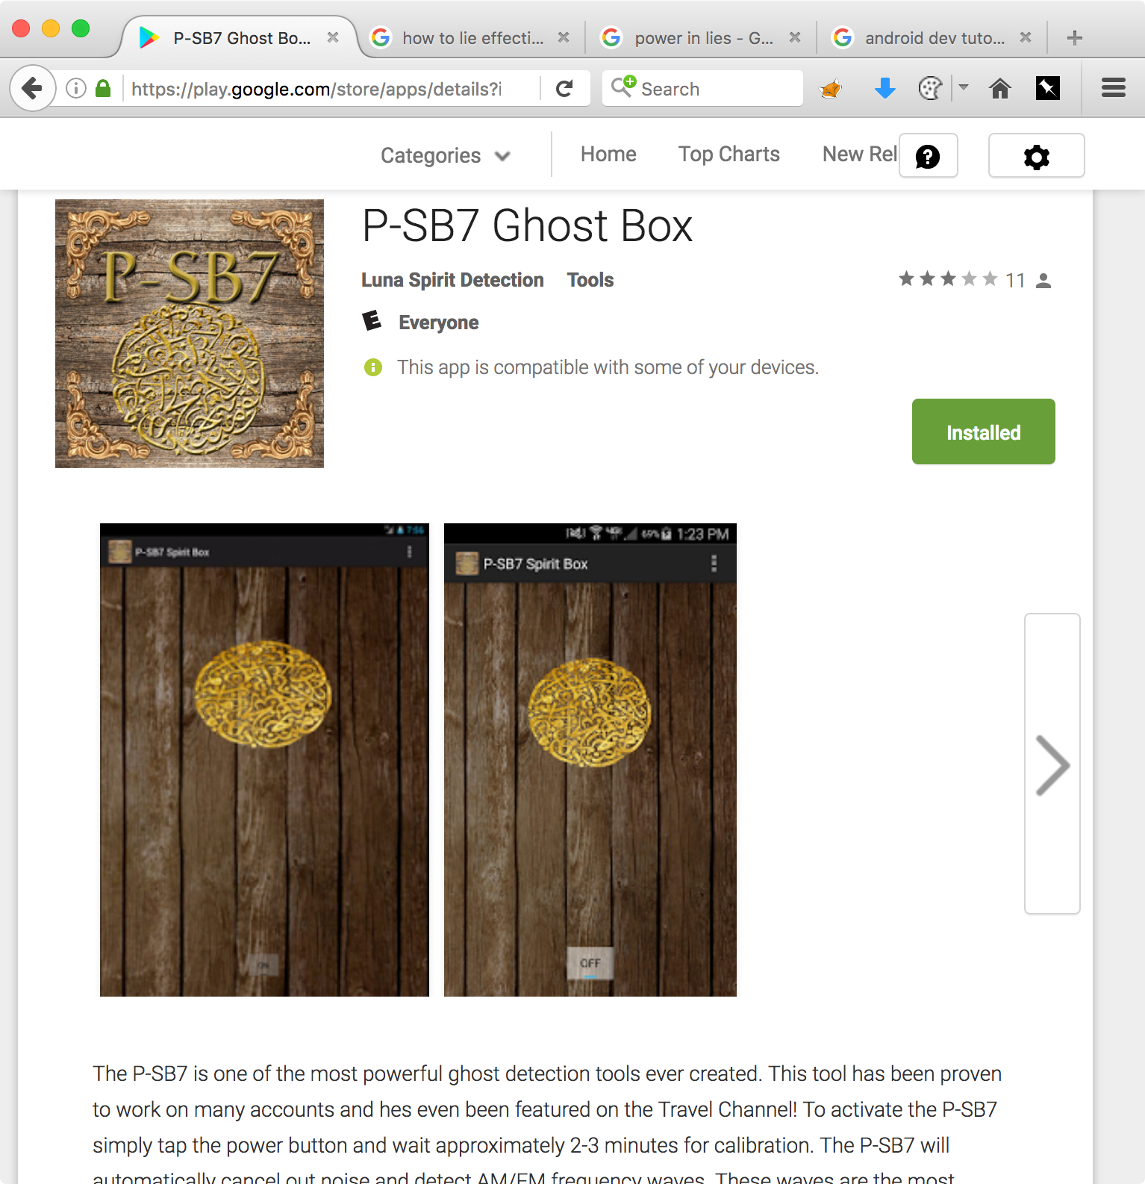
P-SB7 GHOST BOX App
Published by Luna Spirit Detection
$14.99, 2.9 stars, 11 ratings
EVP app, decoding AM/FM radio frequency waves, noise cancellation
"I own a P-SB7 device and I decided to compare this app to it. To my surprise, they picked up nearly exactly the same readings. I highly recommend this app ..."
Billy Allen, 5-star Rating
Notes:
https://play.google.com/store/apps/details?id=com.stevehultay.joesbox1&reviewId=Z3A6QU9xcFRPRTJMdTczYlZNTHBISDZoam1mZkFJMWdfcHZVZXFCSmFzRWZjMGFkbjBWWEg4VGxOS3R6a0szMkFfTzVkczJ0Um9zZHE3Q1FiLWgwYXFnX2ZF

Slide 19
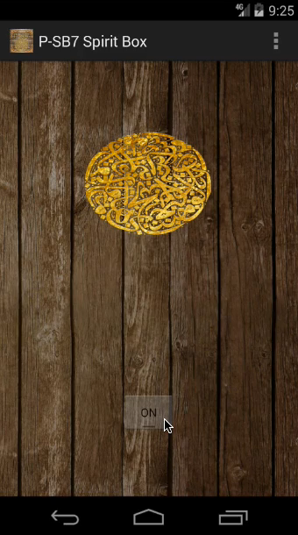
P-SB7
GHOST BOX
Functionality
"Tap the power button and wait 2-3 minutes for calibration"
Click "ON" to hear EVP
Recommends waiting 3 minutes for calibration
Ask questions, listen for answers
"Proven to work on many accounts ... featured on the Travel Channel!"
"The P-SB7
will cancel out noise and detect AM/FM frequency waves"

Slide 20

ANDROID APP DECOMPILATION
Android apps are distributed as bytecode interpreted files
  Like a Java JAR file ─ unlike Windows PE, Linux ELF, macOS Mach-O files (NDK exception)
APK files can be viewed as decompiled Java source
  Not the original Java source, but pretty close
Historically, DEX2JAR, then JD-GUI, Procyon, CFR, Fernflower, etc.
Better: JadX by Skylot
JadX is a superior Android RE tool, eliminating the need for DEX2JAR

Slide 21
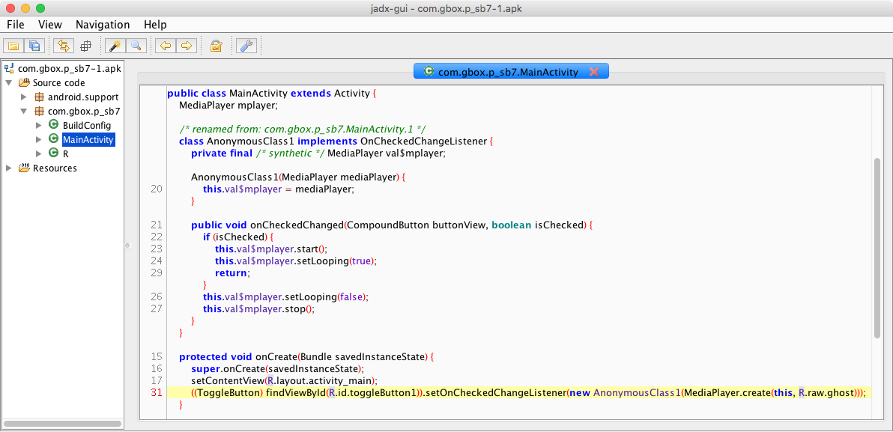
DECOMPILED P-SB7 GHOST BOX App

Slide 22

R.RAW.GHOST
$ ls
com.gbox.p_sb7-1.apk
$ unzip -q com.gbox.p_sb7-1.apk
$ cd res/raw
$ ls -l ghost*
-rw-r--r-- 1 jwright staff 1212537 Mar 22 2015 ghost.ogg
$15!!!

Slide 23
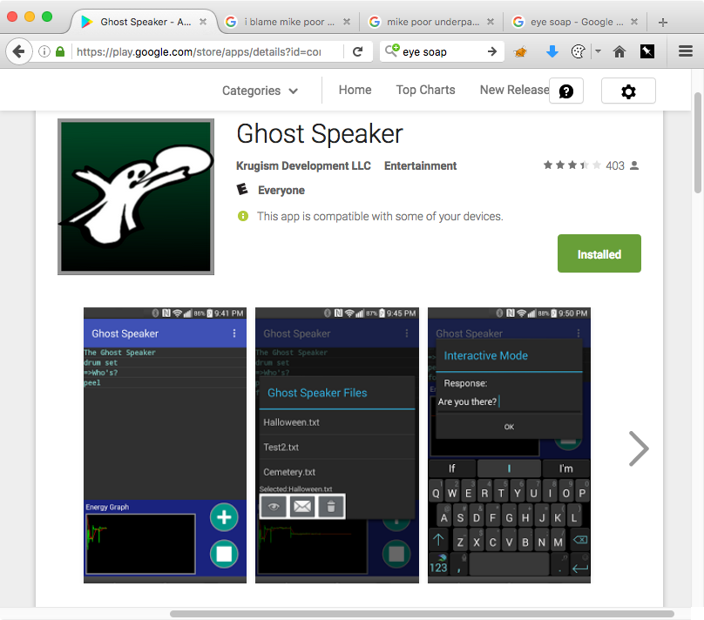
GHOST SPEAKER App
Published by Luna Spirit Detection
$2.99, 3.5 stars, 403 ratings
EVP app, decoding AM/FM radio frequency waves, noise cancellation
"Got names at a Cemetery. George for one, turned around was standing in front of Georges head stone. This app is real and can be manipulated by spirit."
Jojo B., 5-star Rating
Notes:
https://play.google.com/store/apps/details?id=com.stevehultay.joesbox1&reviewId=Z3A6QU9xcFRPRTJMdTczYlZNTHBISDZoam1mZkFJMWdfcHZVZXFCSmFzRWZjMGFkbjBWWEg4VGxOS3R6a0szMkFfTzVkczJ0Um9zZHE3Q1FiLWgwYXFnX2ZF

Slide 24
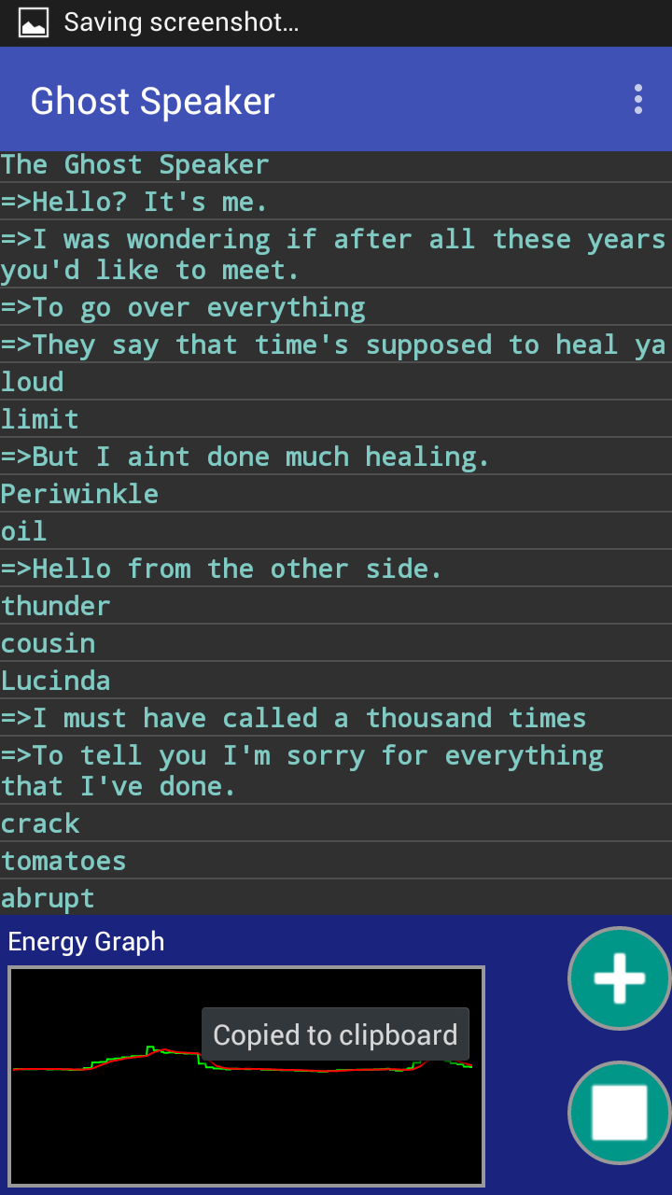
GHOST SPEAKER App
"... values are processed through the speech translation software"
Surveys the environmental electro-magnetic field readings
Accepts input in the form of questions from user
Decodes EMF data, producing speech synthesis output
"... calculates energy values that paranormal entities might be projecting"

Slide 25
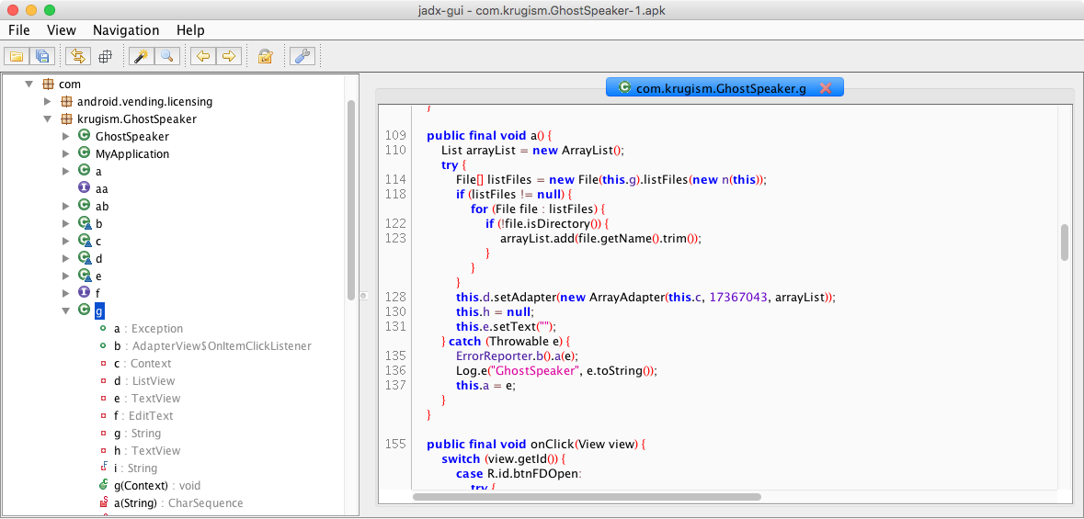
APPLICATION OBFUSCATION ─ PROGUARD
Krugism used application obfuscation to obscure object and variable names

Slide 26
DECODING OBFUSCATED CODE
$ mkdir ghostspeaker
$ jadx -d ghostspeaker com.krugism.GhostSpeaker-1.apk
...
$ ls ghostspeaker/
AndroidManifest.xml android/ com/ org/ res/
Import JadX code into Android Studio for analysis
  Start Android Studio, click Import project (Eclipse ADT, Gradle, etc.)
  Select JadX output directory then click Next | Next | Next | Next | Next | Next | Finish
Start your analysis at the micro-level
  Focus on small-picture items, ignore the big-picture for now
  Try to understand small pieces of code, a little at a time
  Use the Android Developer and Stack Overflow sites to help understand code

Slide 27
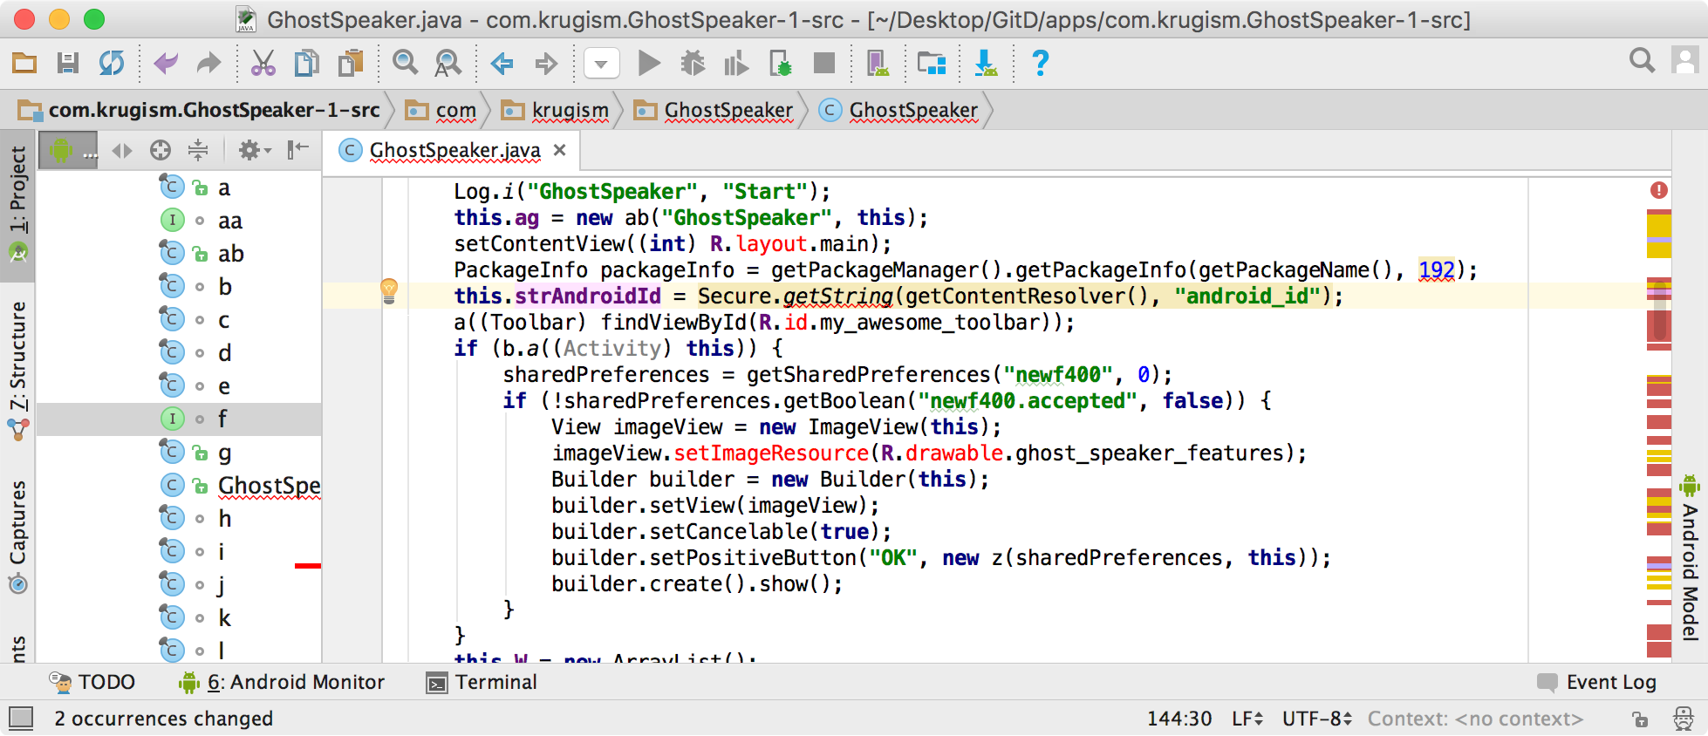
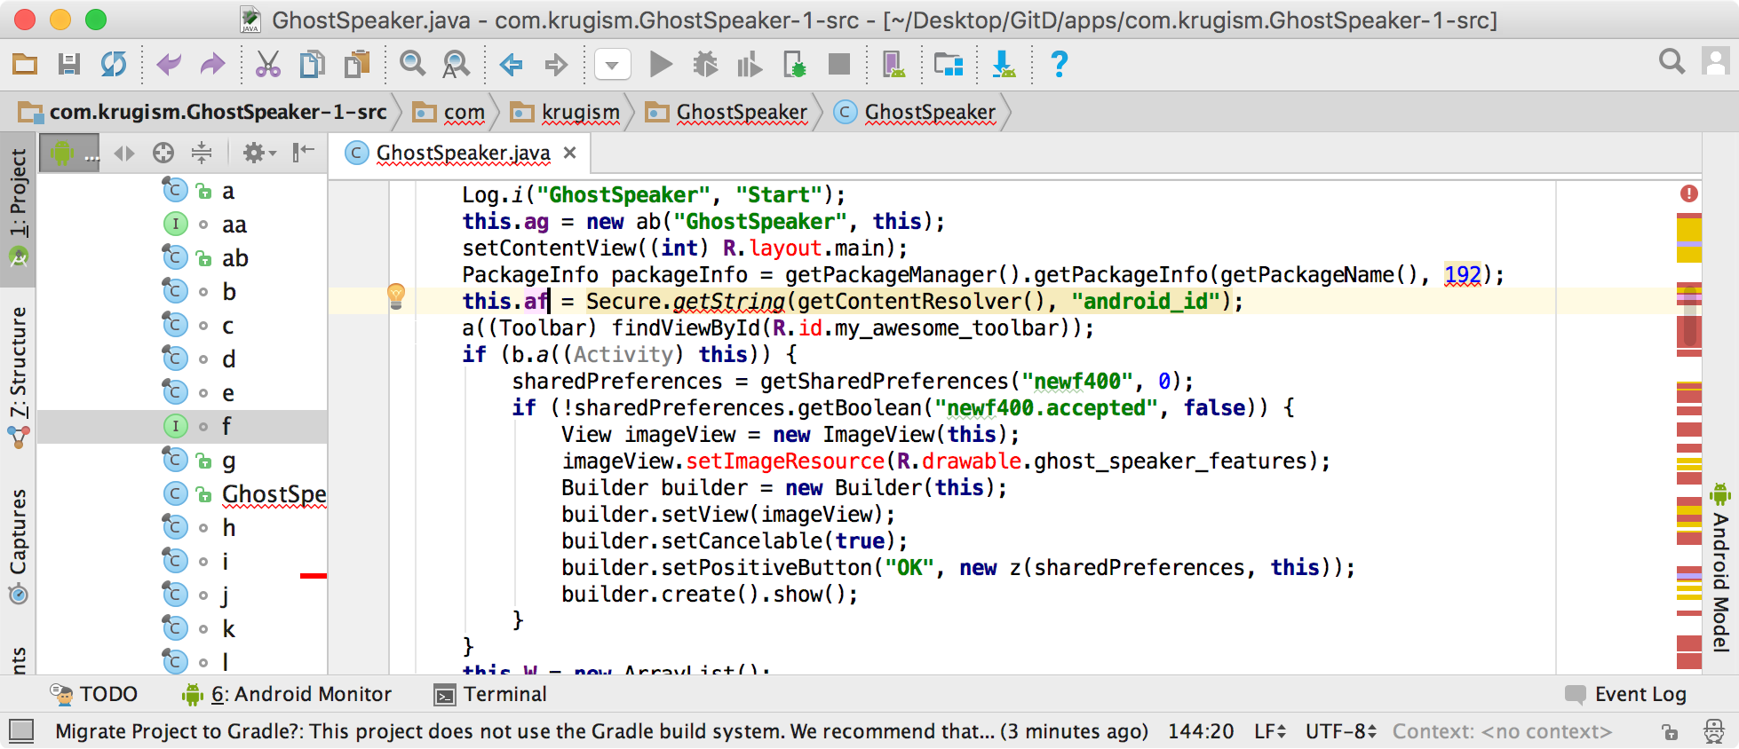
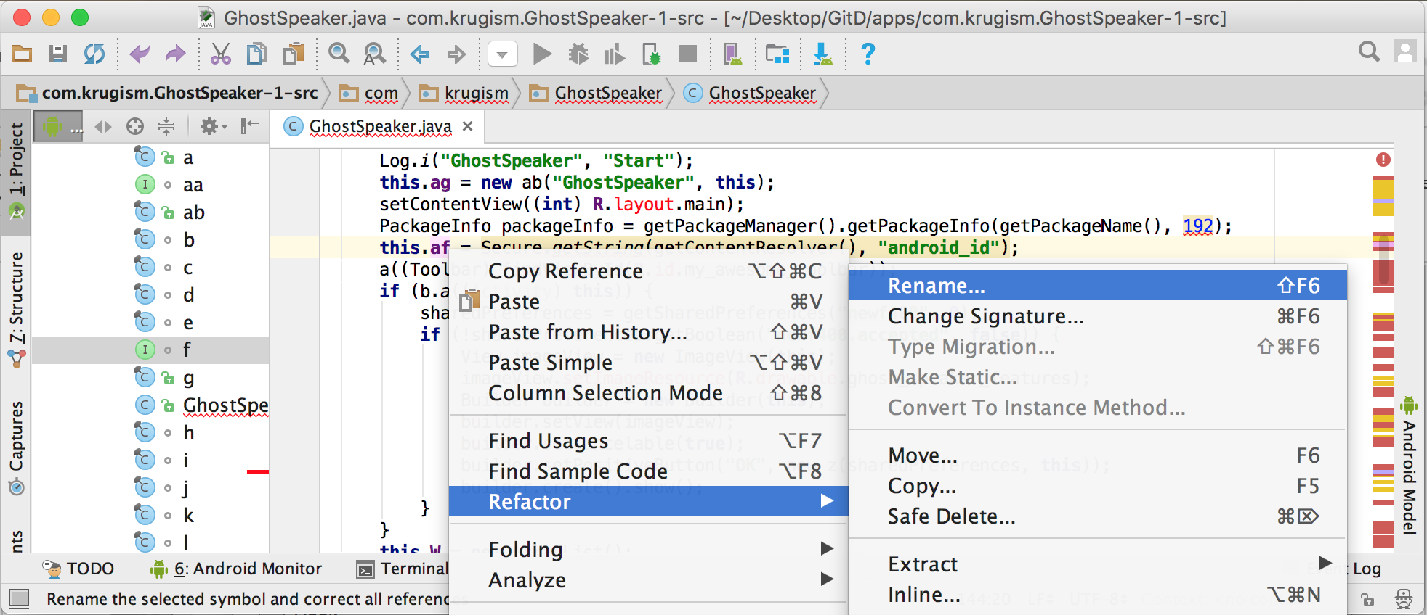
REFACTOR AND RENAME VARIABLES
Identify variables to be renamed using code context
Highlight variable then right-click | Refactor | Rename
(or Shift F6)

Slide 28
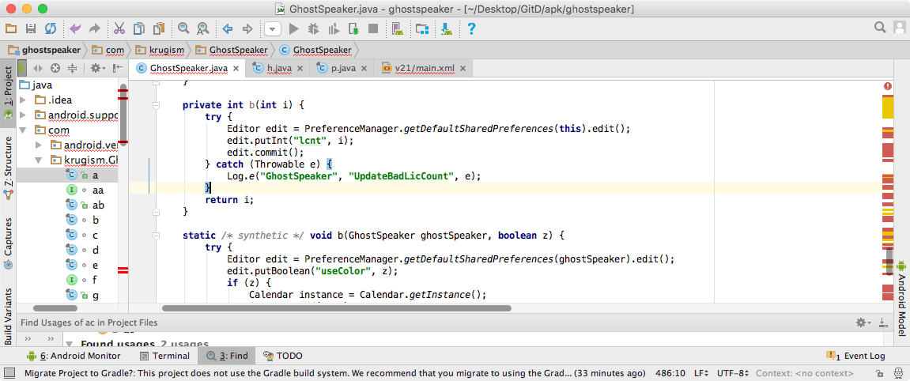
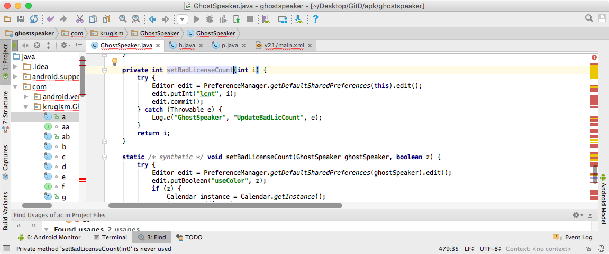
USE LOGGING MESSAGES, EXCEPTIONS
Use string clues in code to rename variables, methods

Slide 29
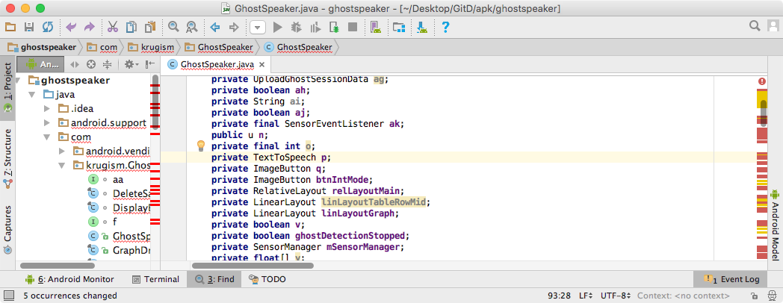
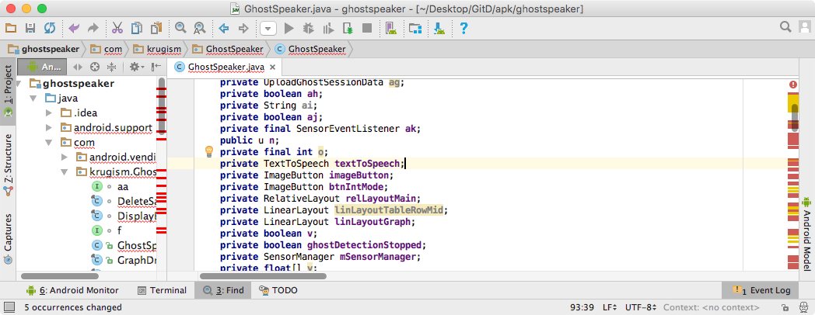
COMPLEX OBJECT TYPES
It's OK to rename variables to complex object type names

Slide 30
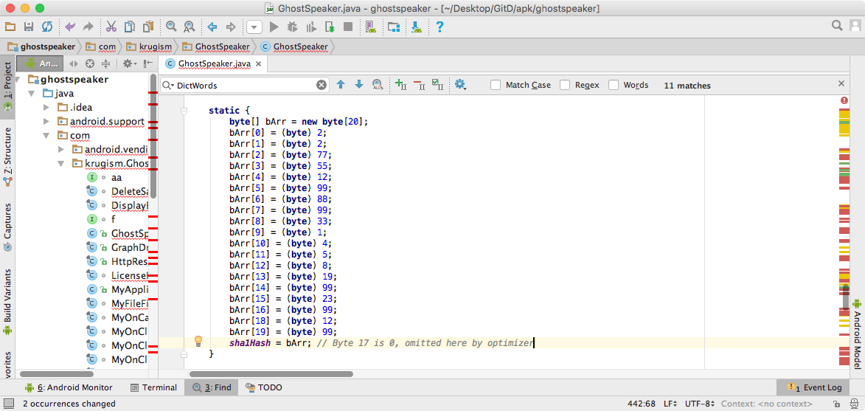
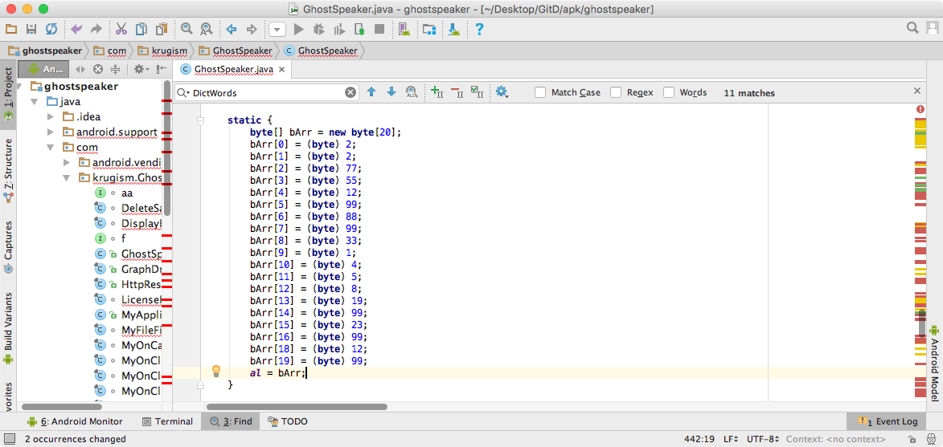
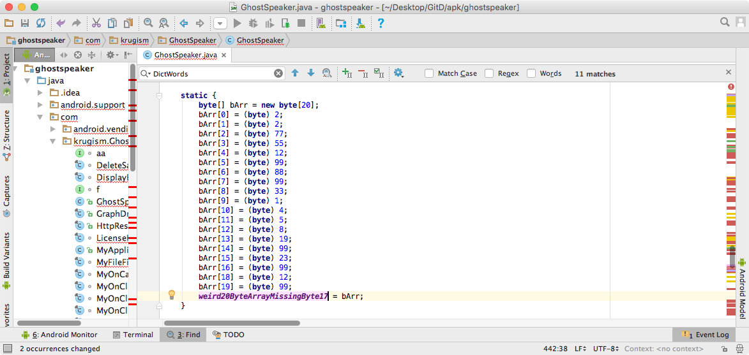
USE TEMPORARY NAMES FOR READABILITY
You can temporarily name variables to help you decode meaning
When you have more context, rename again later, adding comments as needed

Slide 31
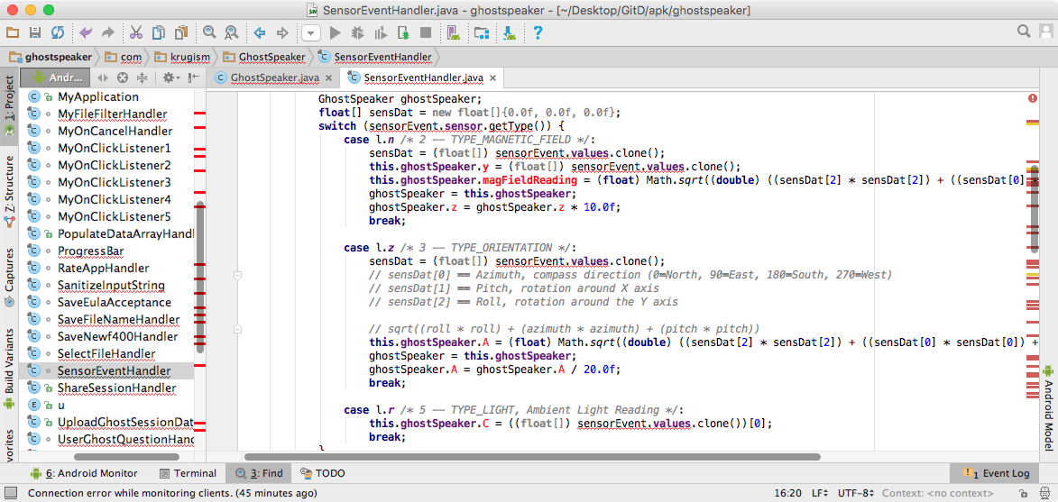
GHOST SPEAKER: readSensorDataMaths

Slide 32
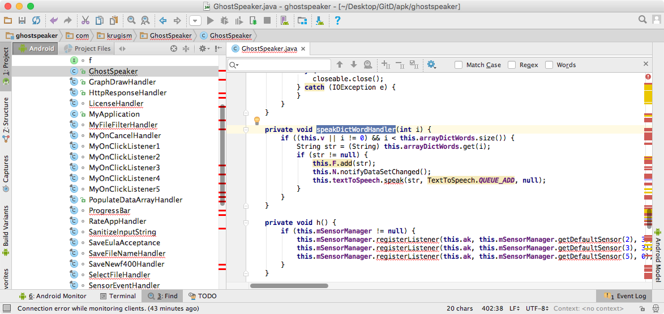
GHOST SPEAKER: speakDictWordHandler

Slide 33
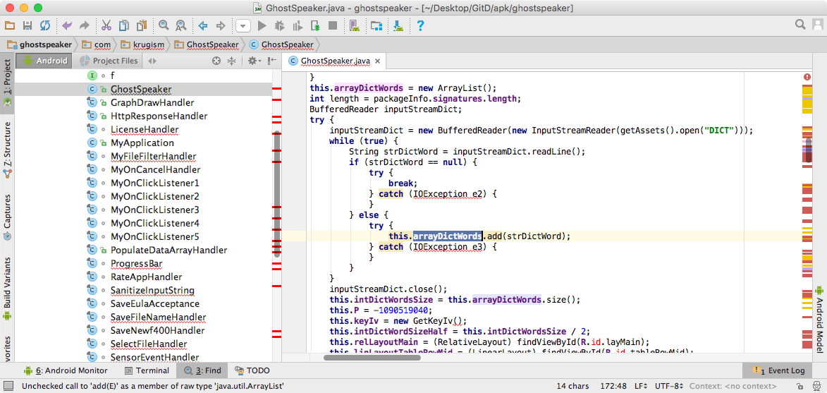
GHOST SPEAKER: readDictWordListIntoArray

Slide 34
FUN WITH SCARY WORDLIST
$ python
>>> import os, random
>>> words = [line.rstrip() for line in open("DICT")]
>>> len(words)
2854
>>> for i in range(0,4): os.system("say -v Bahh -i %s"%random.choice(words))
claim
lighthouse
abscess
poisoned
>>> for i in range(0,4): os.system("say -v Bad -i %s"%random.choice(words))
born
relax
evil
Camille
>>> for i in range(0,4): os.system("say -v Whisper -i %s"%random.choice(words))
angel
musette bag
metal
burn
Notes:
$ cat speakeviltome.py
import os, random
voices = ["Bad", "Bahh", "Cellos", "Boing", "Pipe", "Whisper"]
words = [line.rstrip() for line in open("DICT")]
voice=random.choice(voices)
for i in range(0,4):
os.system("say -v %s -i %s"%(voice, random.choice(words)))

Slide 35
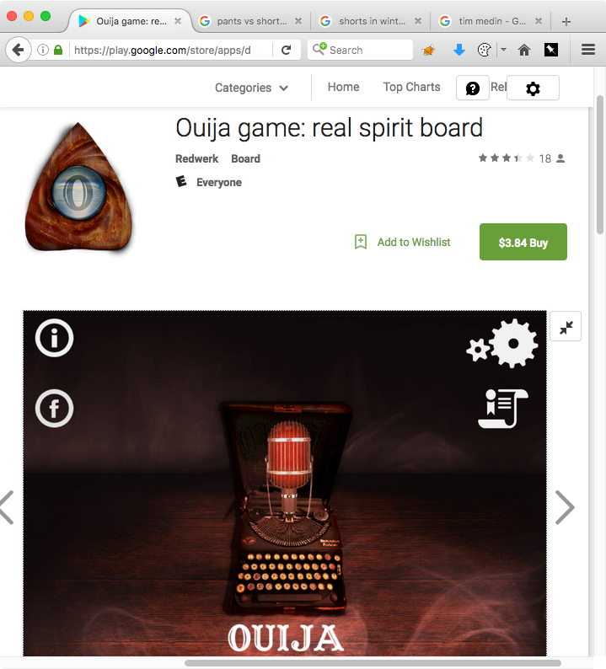
OUIJA App
Published by Redwerk Board
$3.84, 3.4 stars, 18 ratings
"Converse with ghosts and spirits right from your phone"
"Connected with spirit named P. This app should be strictly prohibited to cold hearted users. I couldn't sleep last night. And I feel like I am possessed now."
Mukta Poudel, 4-star Rating

Slide 36
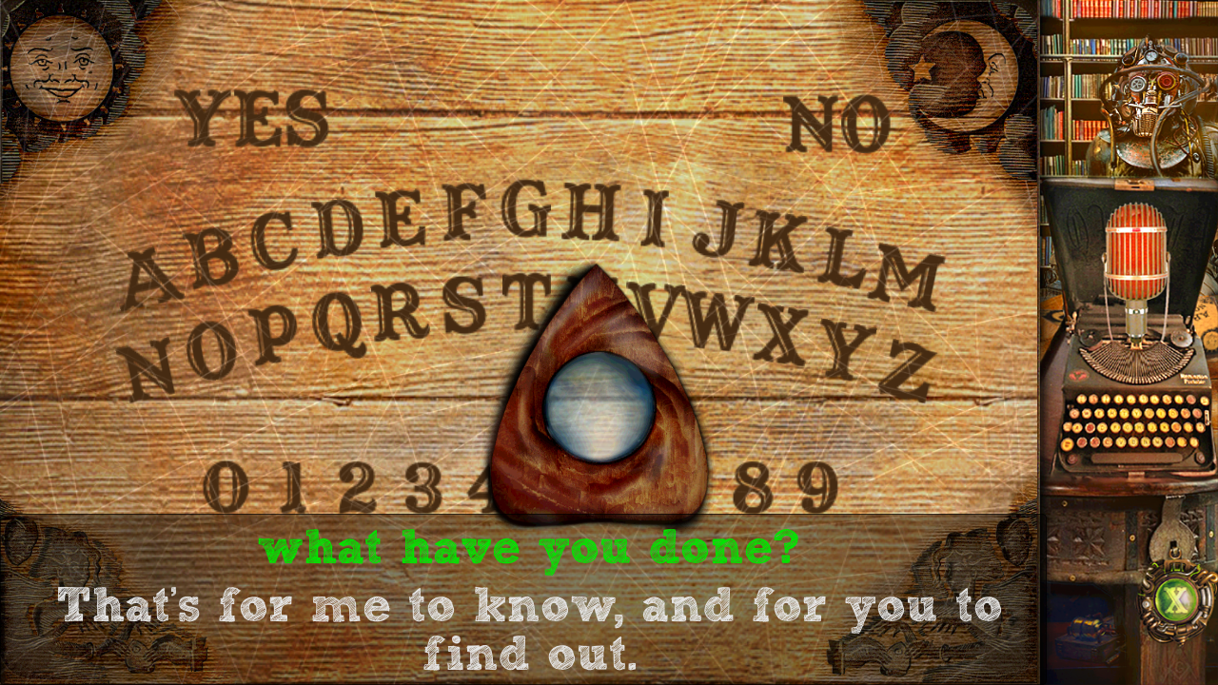
OUIJA App Functionality
"No spirits were hurt during the development of this project"
Type to ask a question
Spirit responds by moving planchette

Slide 37

CROSS-PLATFORM DEV
Unity logo discloses that Ouija is a cross-platform development app
  PhoneGap, Xamarin, 5App, etc.
Behavioral analysis remains the same
Static analysis techniques require platform-specific tools and techniques
Unity offers C#, BOO or JavaScript support with the Unity Engine

Slide 38
EXTRACTED OUIJA APK
File(s) | Description
AndroidManifest.xml | Minimal Android app declarations
classes.dex | Minimal Android app to launch the Unity Engine (for ARM, or x86)
lib/* | Natively compiled libraries for the Unity Engine
assets/bin/Data/* | Shaders, textures, and other Unity objects
assets/bin/Data/Managed/Assembly*.dll | Unity app binaries
Unity code is not compiled; it is stored in CIL format (like a JAR file)
Notes:
Unity code is not compiled, stored in Common Intermediate Language (like a Java JAR file)

Slide 39
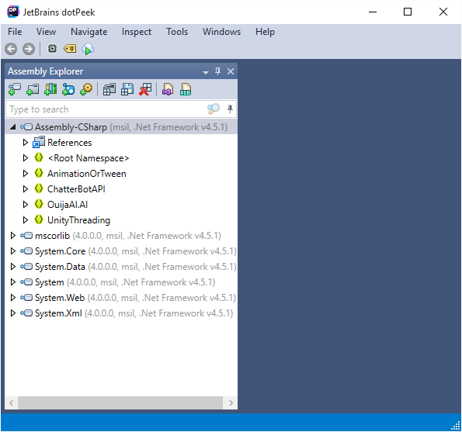
OUIJA APP DECOMPILATION
Ouija has Assembly-CSharp.dll
We can use a C# decompiler to analyze Ouija's code
JetBrains dotPeek decompiles CIL files, revealing approximated C# code
  Free, closed source
  "JadX for C#"

Slide 40
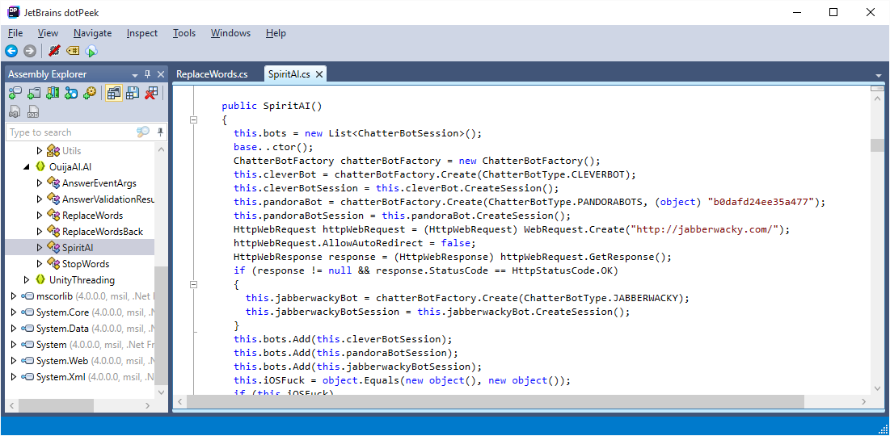
SPIRITAI CLASS

Slide 41
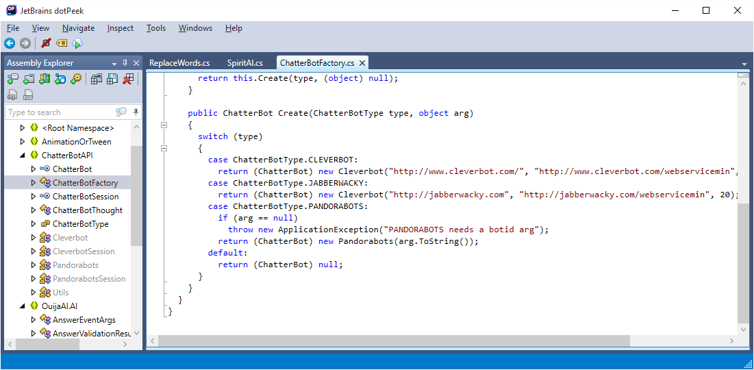
CHATTERBOXFACTORY CLASS

Slide 42
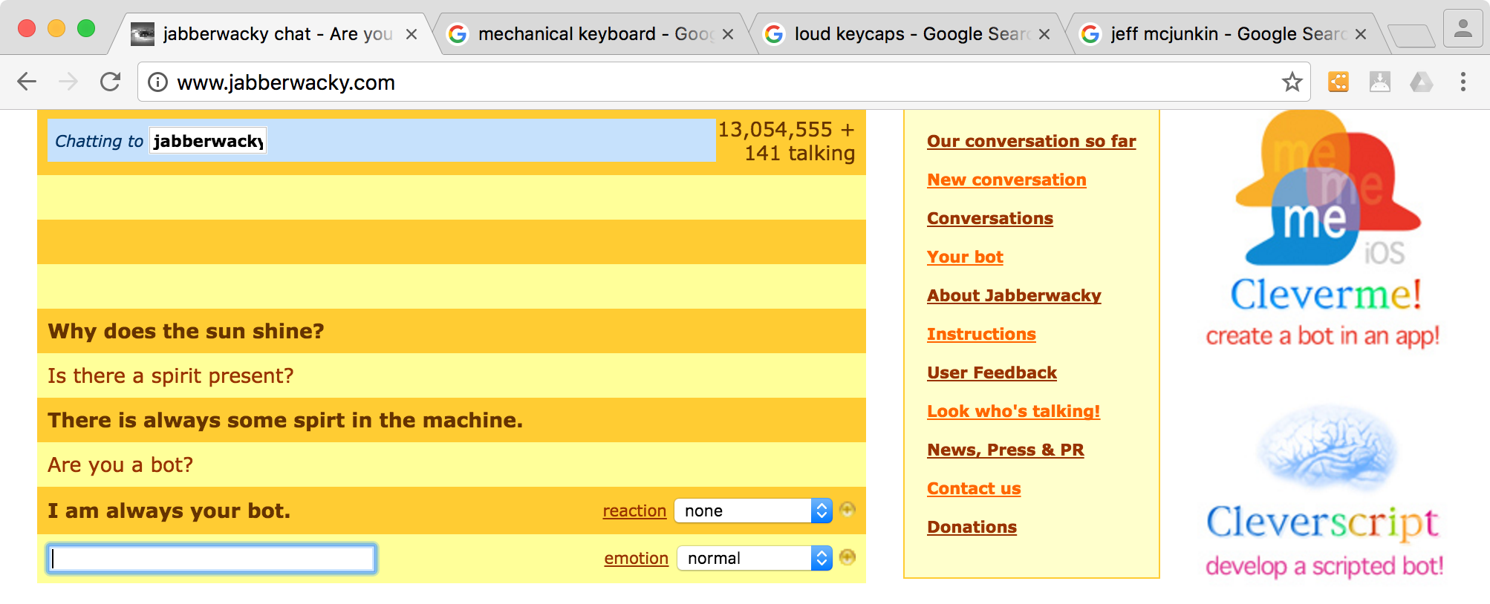
JABBERWACKY

Slide 43
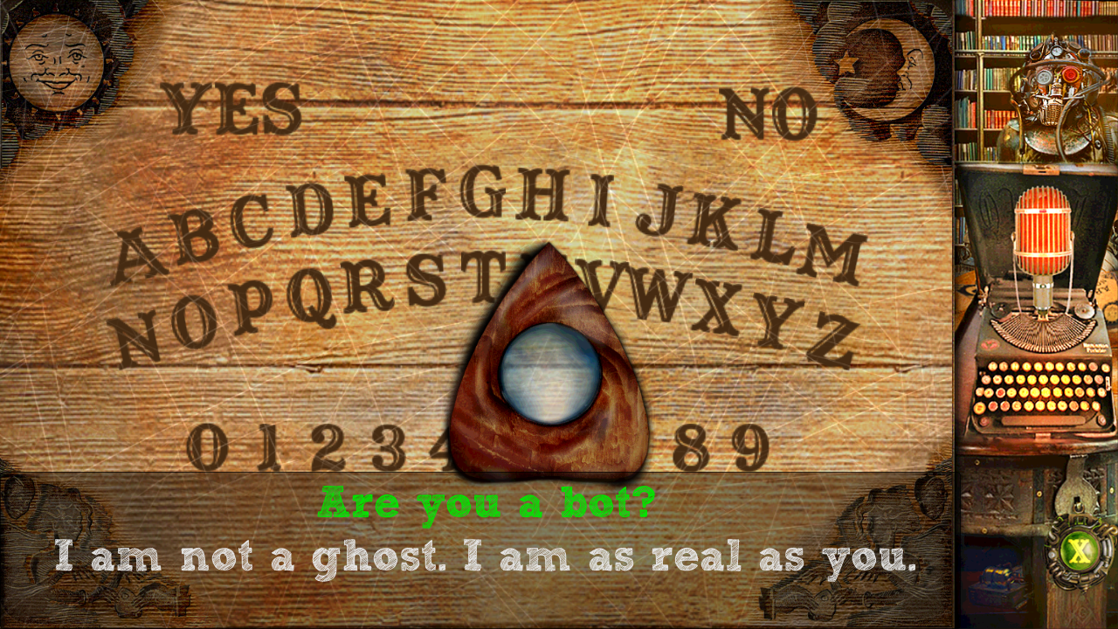
SPIRIT RESPONSE

Slide 44
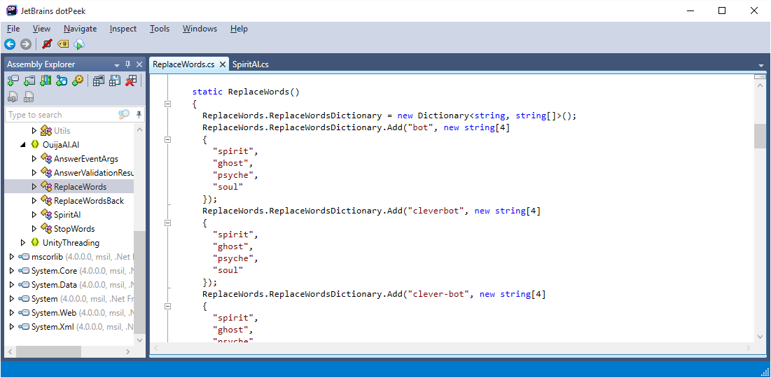
REPLACEWORDS CLASS

Slide 45
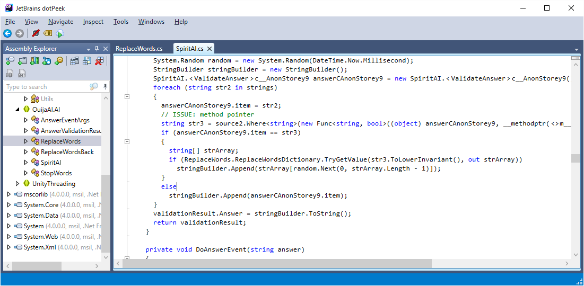
SPIRITAI CLASS, REPLACEWORDS

Slide 46
GHOST BOX APPS
I evaluated 20 Android "Ghost Box" apps for signs of otherworldly existence
Many apps took less than an hour to evaluate
Obfuscated, complex applications took 4+ hours in many cases
Was this a smart use of time?
Busted:
18 apps
Plausible:
2 apps
Confirmed:
0 apps

Slide 47
WHAT I LEARNED
Many apps reveal their secrets with file system data
JadX is a valuable decompiler for Android app RE
  Use jadx-gui to browse decompiled sources
  Use jadx to extract APK sources to a directory, search with grep/findstr/Select-String
Android Studio is essential for obfuscated app analysis
  "Rename All Instances", "Find Usages", "Go To Declaration"
  Start small, understand little bits of code, work your way to broader understanding
Cross-platform Development requires different analysis tools
  Unity, Xamarin susceptible to .NET decompilers, PhoneGap discloses JavaScript code

Slide 48
HOW YOU SHOULD APPLY THIS
Start evaluating your own apps
Write your own Android app
  Something simple, like a decimal to hex converter, or hexadecimal scientific calculator
  Forces you to learn Android APIs, programming idioms; makes you a better RE
Pick a project you will have fun with
  Cheating at video games, exposing advertiser misconduct, hacking JARVIS/home automation, analyze fortune teller apps, etc.
Become a better pen tester by building skills, and put them into action.

Slide 49
CONCLUSION
I spent $200 on Ghost Box apps...and it was well spent
None of the apps conclusively communicate with the dead
  File system objects reveal static audio files, images
  APK reverse engineering reveals Java source and feeble trickery
  Obfuscated apps require more time, but fail with persistent analysis
  Cross-platform apps fail as well, but require different analysis tools
I didn't find any ghosts, but I'm a better analyst now than when I started.

Slide 50


Slide 51
RESOURCES
Destination America's A Haunting - http://www.destinationamerica.com/tv-shows/a-haunting
Ghost Hunter App - http://tinyurl.com/lgvv3tb
Joe's Ghost Box App - http://tinyurl.com/httteu7
P-SB7 Ghost Box App - http://tinyurl.com/jqbupgs
Ghost Speaker App - http://tinyurl.com/9k7ug43
Ouija Game: Real Spirit Board App - http://tinyurl.com/jr3mp4n
JadX - https://github.com/skylot/jadx
ProGuard - https://www.guardsquare.com/proguard
Android Studio - https://developer.android.com/studio
JetBrains dotPeek - https://www.jetbrains.com/decompiler
Jabberwacky - http://www.jabberwacky.com
Joshua Wright
"I never met an Android app I didn't like (to break) "
@joswr1ght
jwright@hasborg.com

